Slide 1


Sociology Bridging Menu
You are about to start an exciting journey into the world of Sociology, where you will begin to understand the wider world and your place within it!
Remember
Choose what modules you do and when, but work through them consistently. Different tasks will take you varying amounts of time, but on average you should aim to do one or two per week
All green tasks are core modules, they are compulsory and must be completed and brought with you to your first lesson.
The red hot chili indicates that the task is more challenging than the others
Numbers eg (1) correspond to how you should evidence the module which can be found in the slides following the menu. They can be saved within this powerpoint or as separate documents clearly labelled with the subject

Slide 2





Sociology Bridging Menu (Green modules are core (compulsory) modules , indicates the most challenging modules )
 | Read | Watch | Listen | Visit (virtually or physically at a later date) | Do
 | Culture and Society A general introduction to the concepts of culture and society that looks the question What is society?, the nature of social organisation and the relationship between culture and instinct (1) | Harrow – a very British education Explore what it is like to attend a private school and consider how this advantages/disadvantages students in their education (1) | The class ceiling: Thinking Allowed (1) | Museum of Childhood (7) | Open Learn: Identity in question Why is identity important and how are identities formed? This free course, Identity in question, looks at the many different ways in which identity can be categorised. By examining the requirements of the state, how a child views gender, and the importance of race or place of birth, you will start to understand how each individual can have more than one identity. (4)
 | Everyday Sexism After experiencing a series of escalating sexist incidents, Laura Bates started the everyday sexism project and has gone on to write 'a pioneering analysis of modern day misogyny‘. (1) | Kids behind bars Exploire the impact of a criminal record on the life chances for young people and the sociological factors that have led to them committing crime (1) | Post-truth: Thinking Allowed (1) | Virtual LSE Open Day (5) | Transition Booklet Complete the activities in the transition booklet (2)
 |  |  |  |  | Choose one of the Sociological Theories listed below– Research and produce a presentation which covers: The key points of the theory The main thinkers and what they say How the theory can be applied to everyday life Any criticisms of your chosen theory Sociological Theories: Marxism Functionalism Feminism New Right Postmodernism (3)
 | The madness of crowds In his devastating new book The Madness of Crowds, Douglas Murray examines the twenty-first century's most divisive issues: sexuality, gender, technology and race. (1)
 |  |  | Identity: Thinking Allowed (1) | The Old Bailey (1)
 | 1984 Hidden away in the Record Department of the sprawling Ministry of Truth, Winston Smith skilfully rewrites the past to suit the needs of the Party. Yet he inwardly rebels against the totalitarian world he lives in, which demands absolute obedience and controls him through the all-seeing telescreens and the watchful eye of Big Brother.(1) | TED Talks (1) Why gender equality is good for everyone – even men The boost students need to overcome obstacles | Gangs and Spirituality: Thinking Allowed (1)
 |  |  |  | LSE Public Lectures (1)
 | Understanding Deviance An indispensable guide to the sociological theories behind crime, it outlines the principal theories of crime and rule-breaking, discussing them chronologically.. (1) | TED Talks (1) Why gender equality is good for everyone – even men The boost students need to overcome obstacles | Surveillance: Thinking Allowed (1) | Explore your options in Sociology on UniFrog (1)
 |  | The men with many wives Some estimate that there are 20,000 polygamous marriages among Muslims in the UK. This documentary explores polygamous life and asks how it can be reconciled with modern British values.) (1)

Slide 3
(1) - Book/Journal/Podcast/Film Review
Would you/would you not recommend it? Why?
Rating:
Review by: ___________________________________________
Title: _______________________________________________________
Author: ____________________________________________________
Review of (please circle)
Book Journal Podcast Film Documentary
What was it about?
What did you find particularly interesting/inspiring/shocking? Has this changed your opinion?
What would you like to learn more about?
How does it link to this subject and why is it important?
Save your answers as part of this PowerPoint & copy the template as many times as you need

Slide 4
Transition Booklet (2)
Complete the activities in the transition booklet and bring a printed copy with you to your first lesson

Slide 5
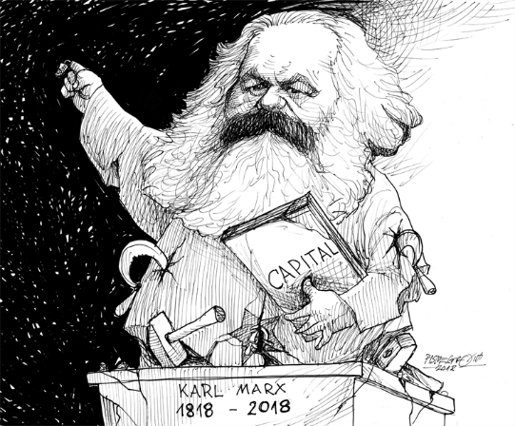
(3) Research presentation: Sociological Theories
Do this as a PowerPoint presentation that covers each of the points below:
    The key points of the theory
    The main thinkers and what they say
    How the theory can be applied to everyday life
    Any criticisms of your chosen theory
Add the notes you would say in the notes section beneath each slide so that each slide just shows the key concise points

Slide 6

OpenLearn: What do we mean by “family”? (4)
To evidence this you can
Save any notes you take
Take and save a screenshot of completed modules or the completed course
Download the course completion certificate.

Slide 7

Virtual LSE Sociology Department Open Day (5)
How many students are in the Sociology Department in total?
How many teaching staff are there?
What are some of the core areas of teaching?
What are the typical entry requirements?
What does the course structure look like?
How are students assessed?
What sort of work do students go on to in the future?

Slide 8

(6) Visit the Museum of Childhood/The Old Bailey
Choose whether you would like to make (to summarise the attraction and/or your visit if possible):
A podcast
An informative flyer
A mini film
A report
A newspaper article

