Slide 1
Sociology A Level Bridging Work
You are about to start an exciting journey into the world of Sociology, where you will begin to understand the wider world and your place within it!
On the first pages is general information about sociology to help you answer the question ‘how does this relate to sociology’.
There is also logistical information about the course and what to expect.
On slide 4, you will find all of your options for pieces of media or places to explore related to sociology.
You must choose at least 5 and write up a report for EACH.
Print this and bring it to your first lesson in September!

Slide 2
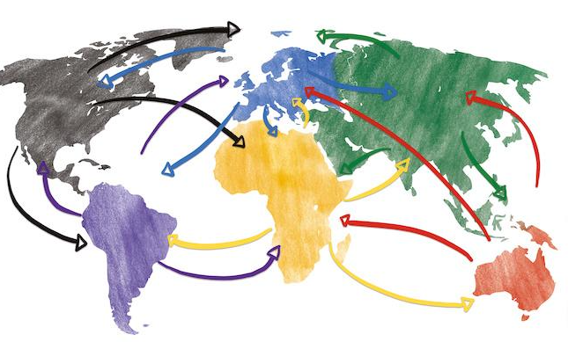
What is sociology?
The study of society, of people and people’s behaviour.
Sociologists conduct research from a perspective (such as feminism), which guides their questions and thinking.
Here are some links to further information about the basics of sociology:
What is sociology?
What do sociologists do?
British Sociological Association
Notes:
https://www.britsoc.co.uk/media/23892/bsa_discover_sociology.pdf
https://www.britsoc.co.uk/what-is-sociology/what-do-sociologists-do/
https://www.thebritishacademy.ac.uk/blog/what-is-sociology/

Slide 3
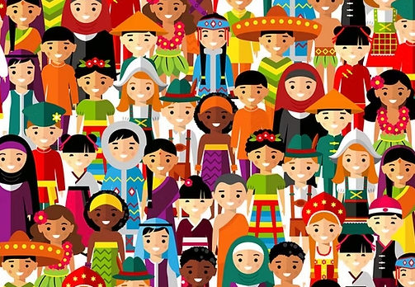
Sociology A Level information
AQA exam board
Compulsory units:
Education
Theory & Methods
Crime & Deviance
Paper 2 options:
Families and Households
Beliefs in Society

Slide 4
Sociology Bridging Menu
 | Read | Watch | Listen | Visit | Do
 | Culture and Society A general introduction to the concepts of culture and society that looks the question What is society?, the nature of social organisation and the relationship between culture and instinct | Harrow – a very British education Explore what it is like to attend a private school and consider how this advantages/disadvantages students in their education | The class ceiling: Thinking Allowed | Museum of Childhood | Open Learn: Identity in question Why is identity important and how are identities formed? This free course, Identity in question, looks at the many different ways in which identity can be categorised. By examining the requirements of the state, how a child views gender, and the importance of race or place of birth, you will start to understand how each individual can have more than one identity.
 | Everyday Sexism After experiencing a series of escalating sexist incidents, Laura Bates started the everyday sexism project and has gone on to write 'a pioneering analysis of modern day misogyny‘. | Kids behind bars Explore the impact of a criminal record on the life chances for young people and the sociological factors that have led to them committing crime | Post-truth: Thinking Allowed | Royal Court of Justice
 | The madness of crowds In his devastating new book The Madness of Crowds, Douglas Murray examines the twenty-first century's most divisive issues: sexuality, gender, technology and race.
 |  |  | Identity: Thinking Allowed ( | The Old Bailey
 | 1984 Hidden away in the Record Department of the sprawling Ministry of Truth, Winston Smith skilfully rewrites the past to suit the needs of the Party. Yet he inwardly rebels against the totalitarian world he lives in, which demands absolute obedience and controls him through the all-seeing telescreens and the watchful eye of Big Brother. | TED Talks Why gender equality is good for everyone – even men The boost students need to overcome obstacles Do schools kill creativity? | Gangs and Spirituality: Thinking Allowed
 |  |  |  | LSE Public Lectures
 | Understanding Deviance An indispensable guide to the sociological theories behind crime, it outlines the principal theories of crime and rule-breaking, discussing them chronologically.. | TED Talks (1) Why gender equality is good for everyone – even men The boost students need to overcome obstacles | Surveillance: Thinking Allowed | Explore your options in Sociology on UniFrog
 |  | The men with many wives Some estimate that there are 20,000 polygamous marriages among Muslims in the UK. This documentary explores polygamous life and asks how it can be reconciled with modern British values.)

Slide 5
Book/Journal/Podcast/Film/Museum/Lecture Review
Would you/would you not recommend it? Why?
Rating:
Review by: ___________________________________________
Title: _______________________________________________________
Author: ____________________________________________________
Review of: Book Journal Podcast Film Documentary Museum Lecture Other
What was it about?
What did you find particularly interesting/inspiring/shocking? Has this changed your opinion?
What would you like to learn more about?
How does it link to sociology and why is it important?

Slide 6
Book/Journal/Podcast/Film Review
Would you/would you not recommend it? Why?
Rating:
Review by: ___________________________________________
Title: _______________________________________________________
Author: ____________________________________________________
Review of (please circle)
Book Journal Podcast Film Documentary
What was it about?
What did you find particularly interesting/inspiring/shocking? Has this changed your opinion?
What would you like to learn more about?
How does it link to sociology and why is it important?

Slide 7
Book/Journal/Podcast/Film Review
Would you/would you not recommend it? Why?
Rating:
Review by: ___________________________________________
Title: _______________________________________________________
Author: ____________________________________________________
Review of (please circle)
Book Journal Podcast Film Documentary
What was it about?
What did you find particularly interesting/inspiring/shocking? Has this changed your opinion?
What would you like to learn more about?
How does it link to sociology and why is it important?

Slide 8
Book/Journal/Podcast/Film Review
Would you/would you not recommend it? Why?
Rating:
Review by: ___________________________________________
Title: _______________________________________________________
Author: ____________________________________________________
Review of (please circle)
Book Journal Podcast Film Documentary
What was it about?
What did you find particularly interesting/inspiring/shocking? Has this changed your opinion?
What would you like to learn more about?
How does it link to sociology and why is it important?

Slide 9
Book/Journal/Podcast/Film Review
Would you/would you not recommend it? Why?
Rating:
Review by: ___________________________________________
Title: _______________________________________________________
Author: ____________________________________________________
Review of (please circle)
Book Journal Podcast Film Documentary
What was it about?
What did you find particularly interesting/inspiring/shocking? Has this changed your opinion?
What would you like to learn more about?
How does it link to sociology and why is it important?

