Slide 1
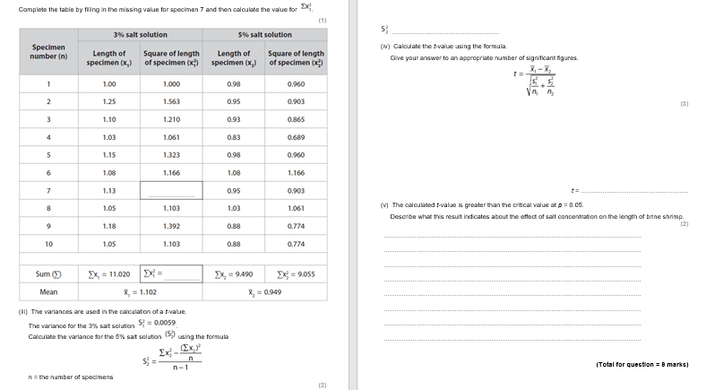
Stats Pt 1
16 May 2023
CP 13: Investigate the effects of temperature on the development of organisms (such as seedling growth rate, brine shrimp hatch rates).
Notes:
Needs printing!

Slide 2
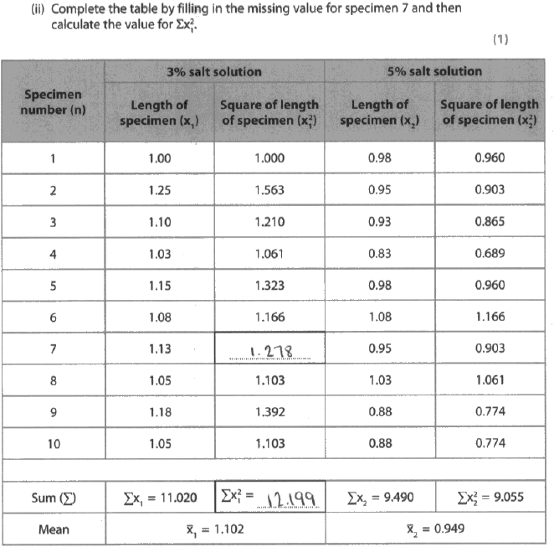
Model Answer
What mistakes did this student make?
Notes:
This one got full marks

Slide 3
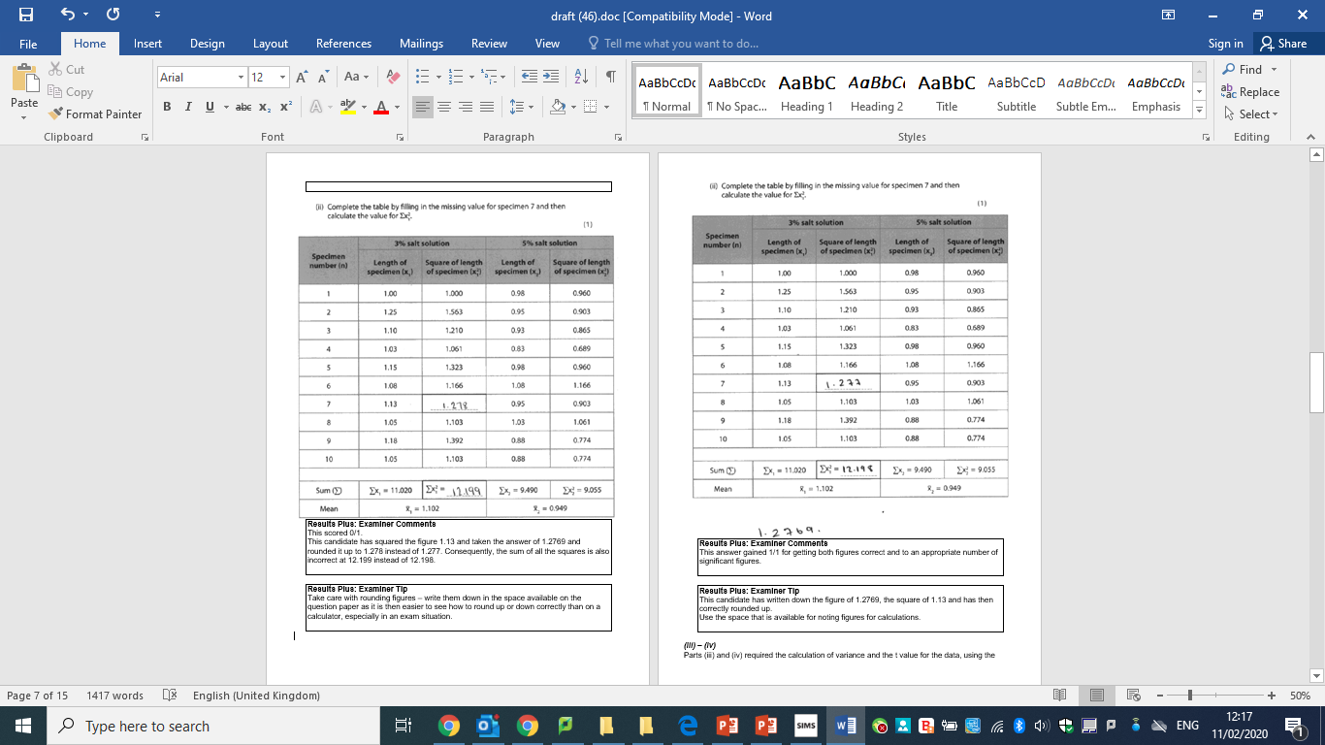

Slide 4
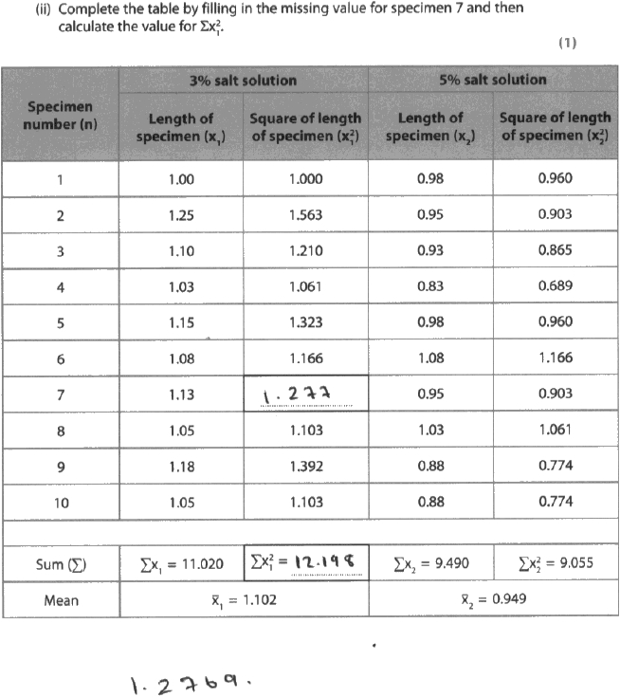
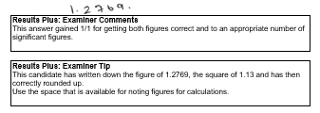
Correct Answer

Slide 5
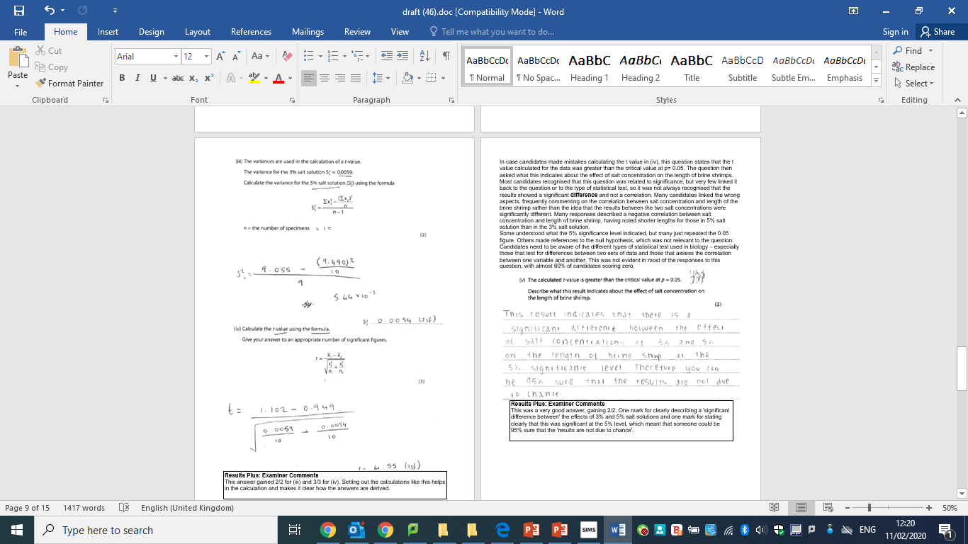
Correct Answer

Slide 6
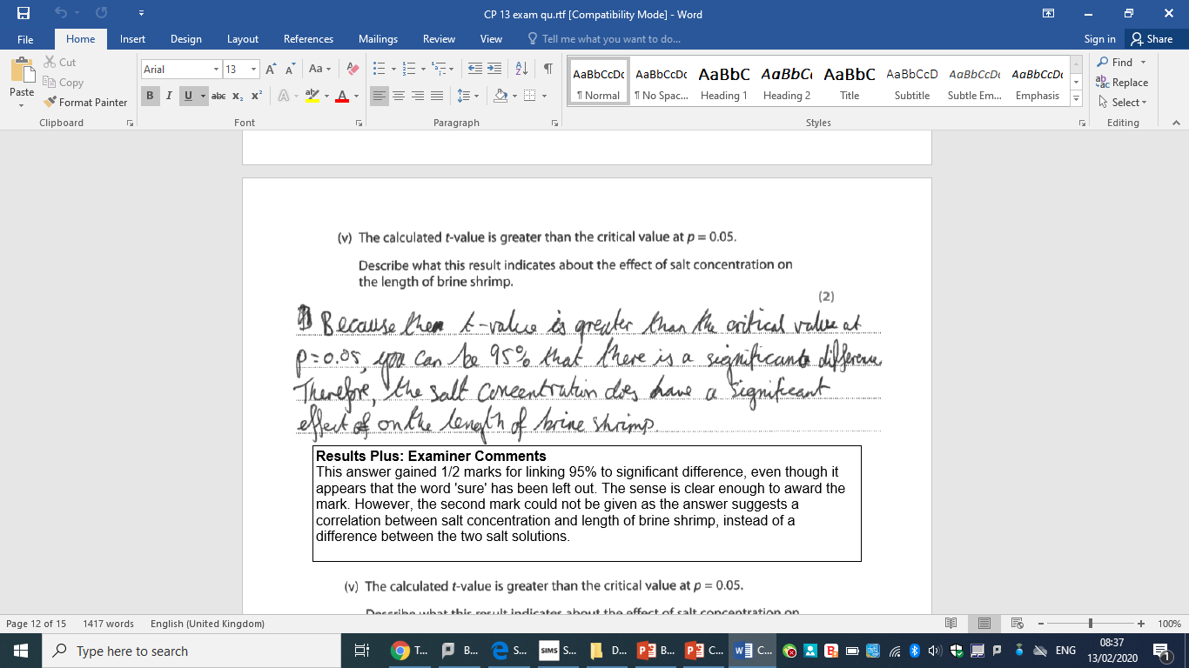
Model Answer
What mistakes did this student make?
Does the t-test test for a correlation?

Slide 7
Correct Answer

Slide 8

Correct Answer

Slide 9
Stats:
-Students T Test -Chi Squared
-Standard Deviation -Spearman’s Rank

Slide 10
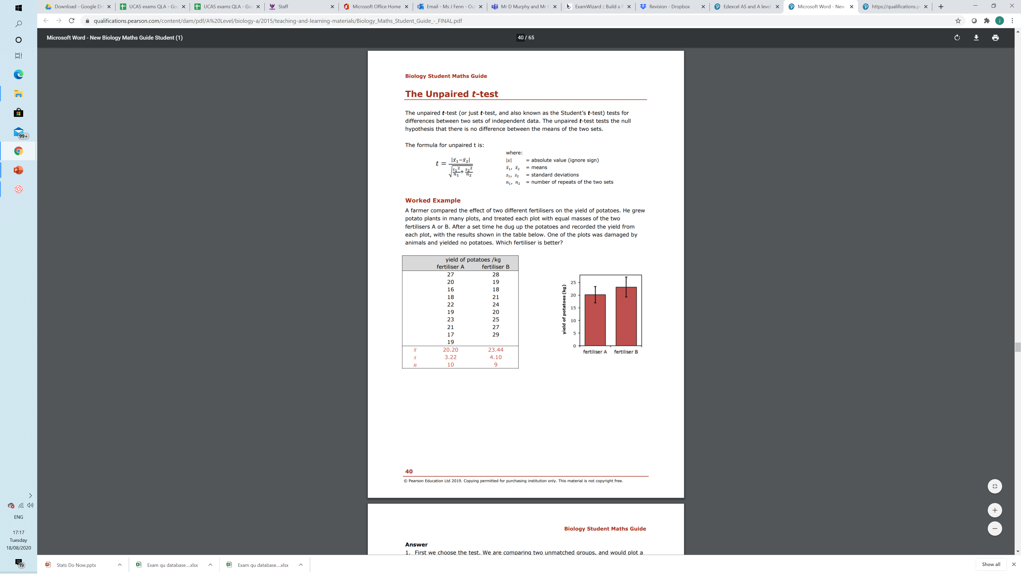
Un-paired T-test Model Answer

Slide 11
First we choose the test. We are comparing two unmatched groups, and would plot a bar chart, so we use the t test.
State the null hypothesis that we are testing: There is no difference in mean yield between the two fertilisers.
Calculate the mean of each set and put it in a new row as shown above.
Calculate the standard deviation (s) of each set, and put it in a new row. It saves time if you use the stats function of a calculator for these two steps.
Count the number of measurements in each set (n), and put it in a new row.

Slide 12
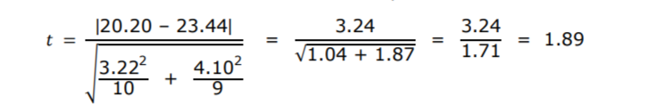
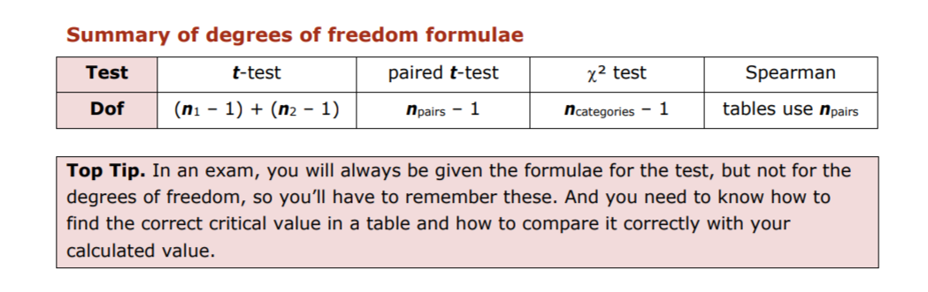
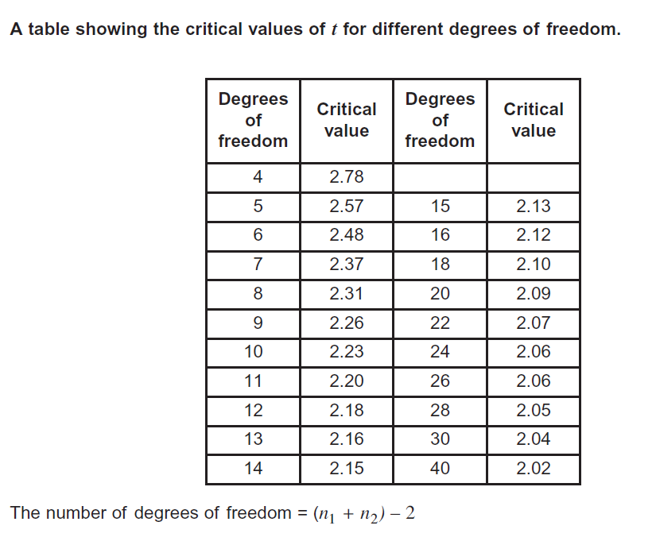
Put all the values into the formula to calculate unpaired t:
Calculate the degrees of freedom:
dof = (n1 – 1) + (n2 – 1) = 9 + 8 = 17
Note that the two samples don’t have to be the same size.
Look up the critical value of t for P = 0.05 and dof = 17
(= 2.11).
Compare this critical value of t (2.11) with our calculated value of t (1.89). T crit (2.11) > t calc (1.89) so P > 0.05
Now that we have our P–value, we can state the conclusion: There is no significant difference between the two fertilisers.
The probability is greater than 0.05 that the observed difference in the means is just due to chance, so we accept the null hypothesis.

Slide 13
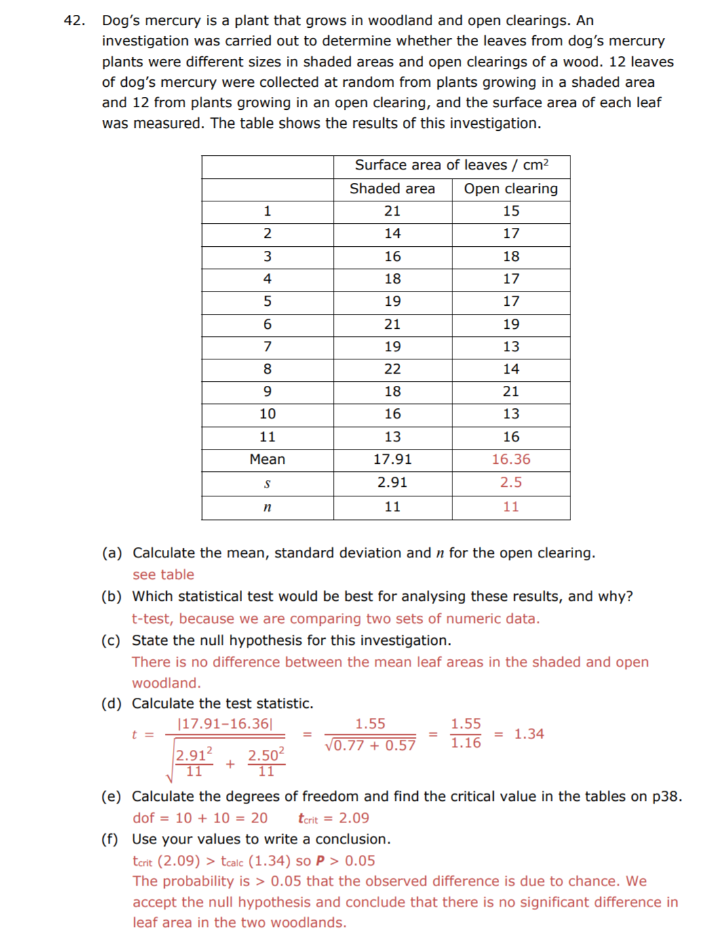

Slide 14
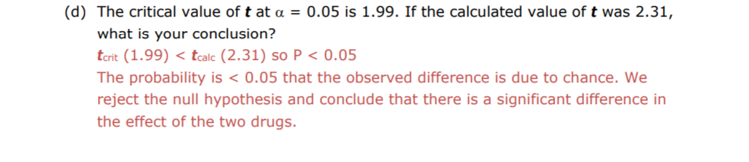
Mini Whiteboards: Make a conclusion

Slide 15
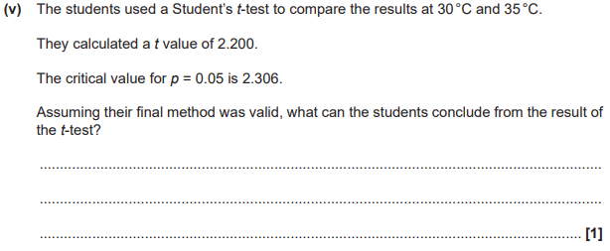
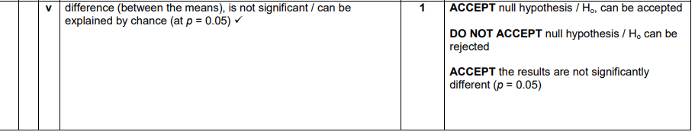

Slide 16
Stats:
-Students T Test -Chi Squared
-Standard Deviation -Spearman’s Rank

Slide 17
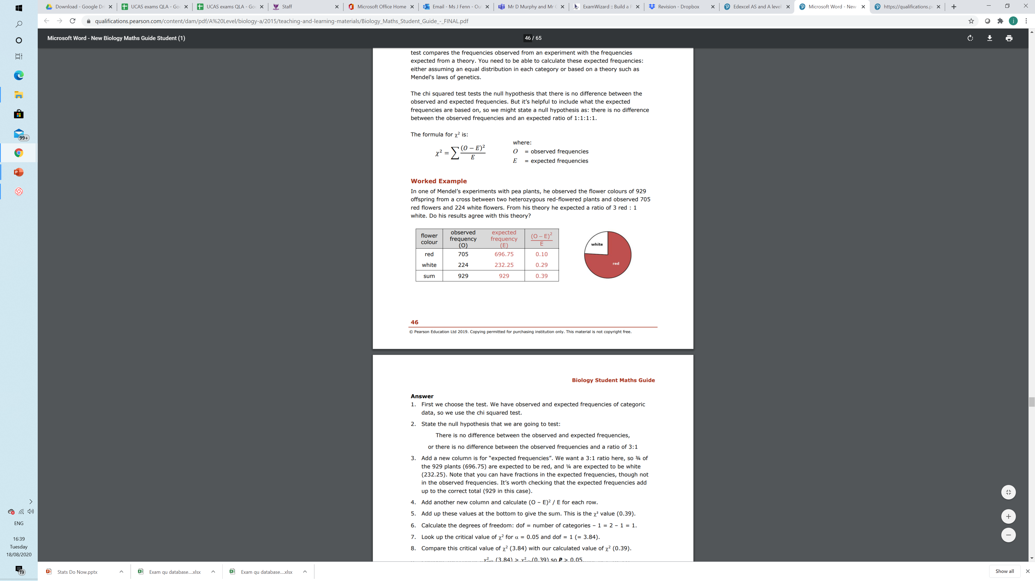
Chi2 Model Answer

Slide 18
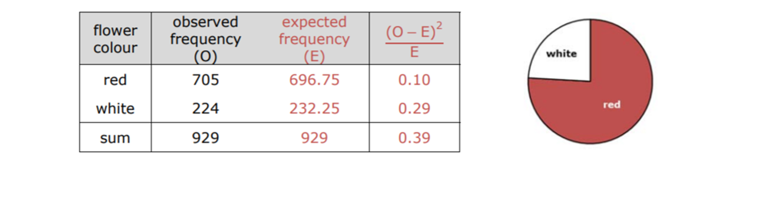
First, we choose the test. We have observed and expected frequencies of categoric data, so we use the chi squared test.
State the null hypothesis that we are going to test: There is no difference between the observed and expected frequencies, or there is no difference between the observed frequencies and a ratio of 3:1
Add a new column is for “expected frequencies”. We want a 3:1 ratio here, so ¾ of the 929 plants (696.75) are expected to be red, and ¼ are expected to be white (232.25). Note that you can have fractions in the expected frequencies, though not in the observed frequencies. It’s worth checking that the expected frequencies add up to the correct total (929 in this case).
Add another new column and calculate (O – E)2 / E for each row.

Slide 19
Add up these values at the bottom to give the sum. This is the X² value (0.39).
Calculate the degrees of freedom: dof = number of categories – 1 = 2 – 1 = 1.
Look up the critical value of X² for α = 0.05 and dof = 1 (= 3.84).
Compare this critical value of X² (3.84) with our calculated value of X² (0.39).
𝜒^{2 critcal} (3.84) > 𝜒^{2 calculated} (0.39) so P > 0.05
Now that we have our P-value, we can state the conclusion:
The probability is greater than 0.05 that the observed difference between the observed frequencies and a ratio of 3:1 is just due to chance, so we accept the null hypothesis. There is no significant difference between the observed frequencies and a ratio of 3:1, i.e. the observed frequencies of flower colours are consistent with the 3:1 ratio predicted by Mendel's law.

Slide 20
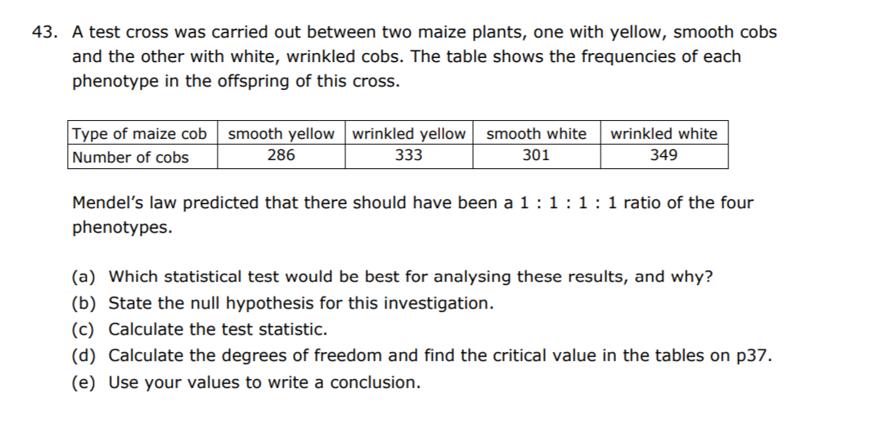
With genetic crosses, agreeing with the predicted ratios (i.e. agreeing with the null hypothesis) is often the desired result (as here), so we may be quite happy with P > 0.05. This is different from most experiments where we’re hoping for interesting results that disagree with the null hypothesis (P < 0.05). But be careful: a high P-value (>0.05) does not provide any support for the null hypothesis, far less prove it; we just haven’t disproved the null hypothesis.
Example Questions on Chi²

Slide 21
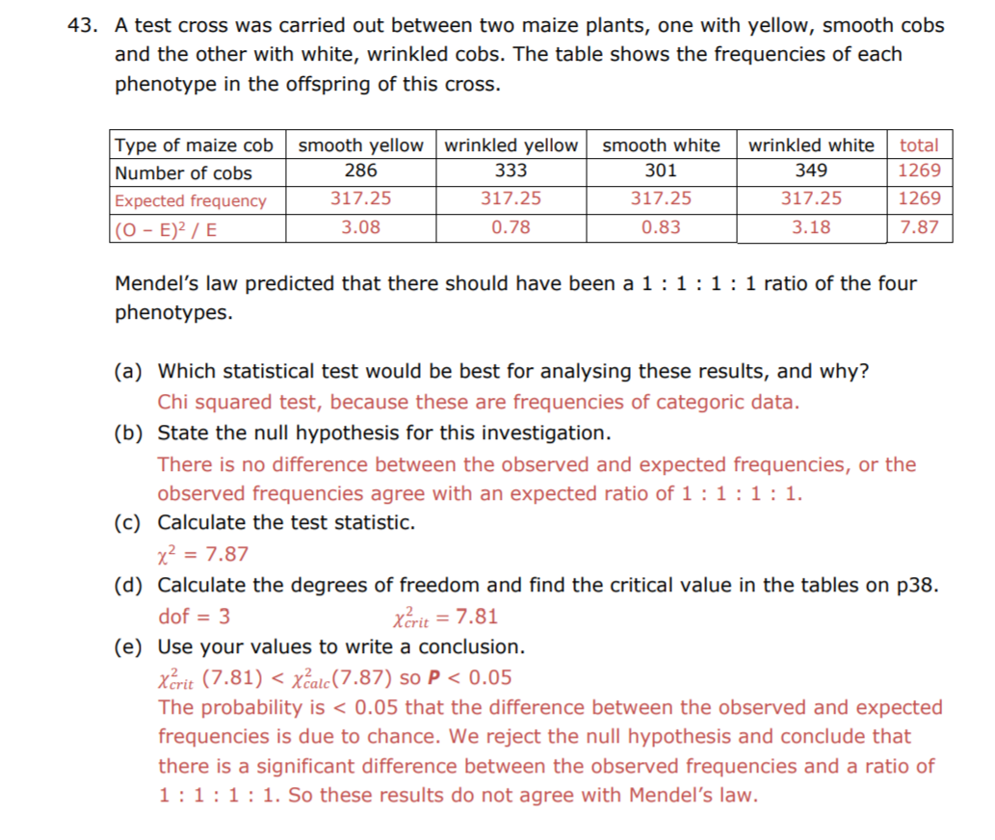
Example Questions on Chi²

Slide 22
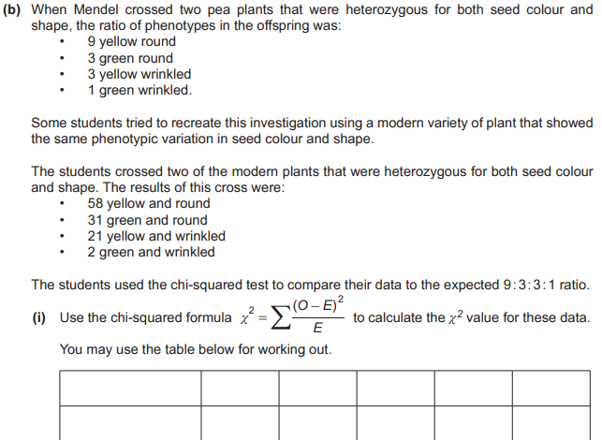
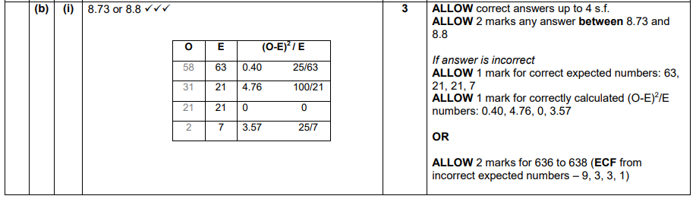

Slide 23
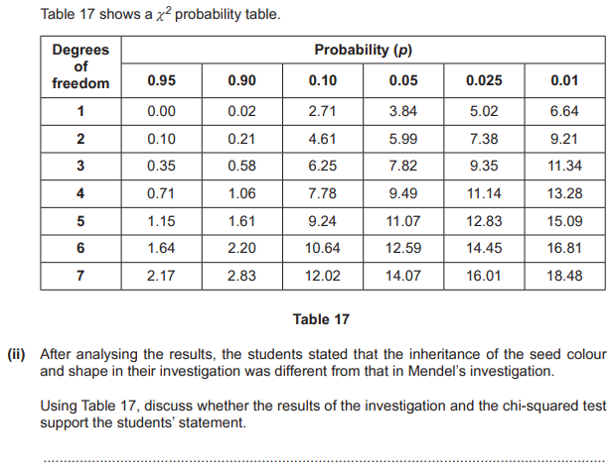
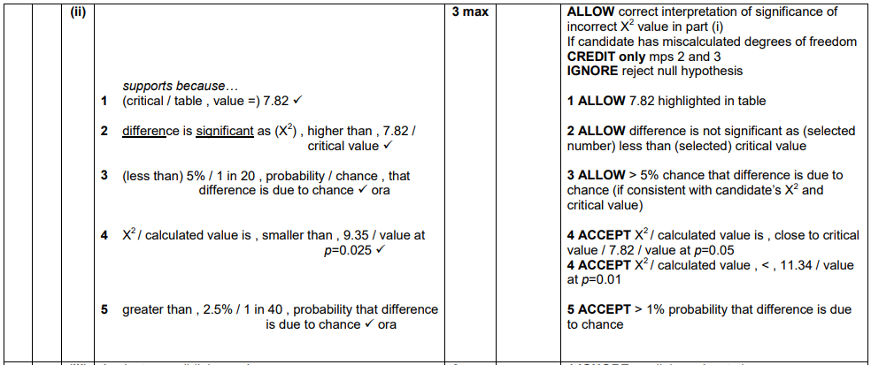

Slide 24
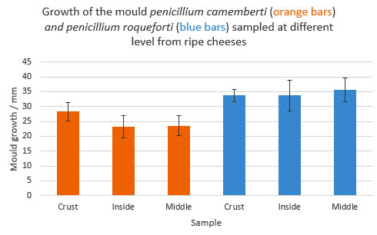
Standard deviation
The standard deviation shows the spread of the data
If the standard deviation is high it shows there is a lot of spread in your data from the mean
A high standard deviation may mean the correlation in your data is not strong. You could then use a statistical test (Chi squared) to check this
We represent the standard deviation as error bars on our charts when comparing groups

Slide 25
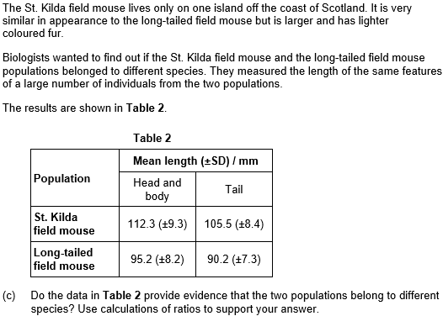
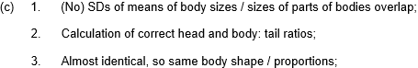
Interpretation

Slide 26
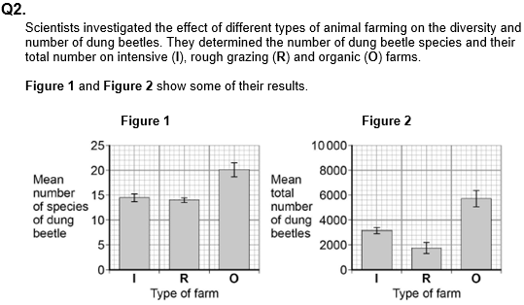
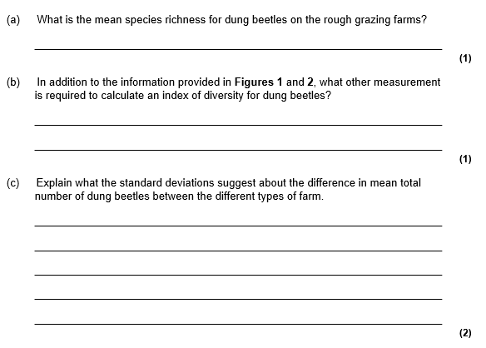
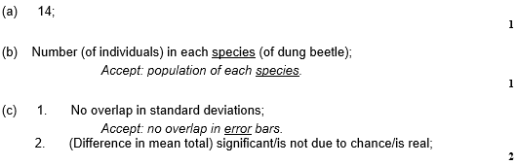
Task – Try this question

Slide 27
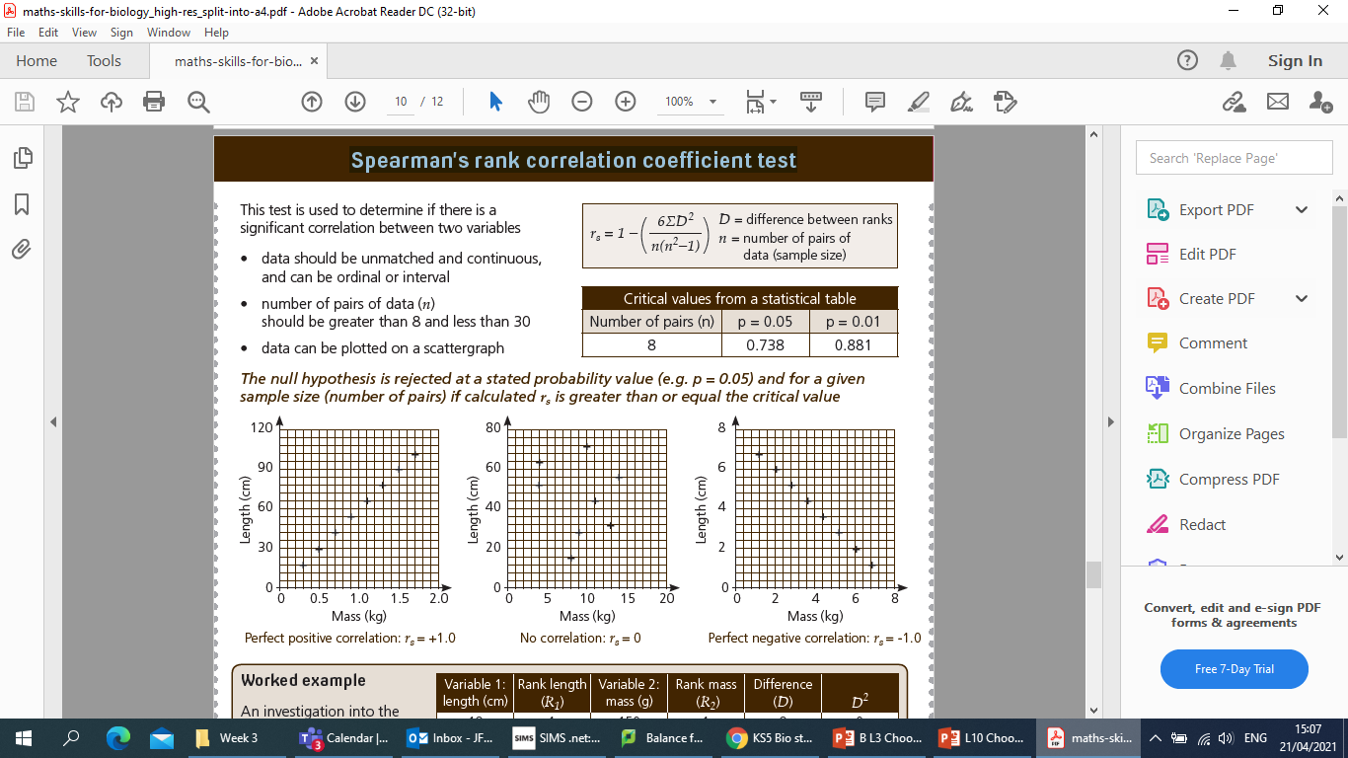
Spearman’s rank correlation coefficient test

Slide 28
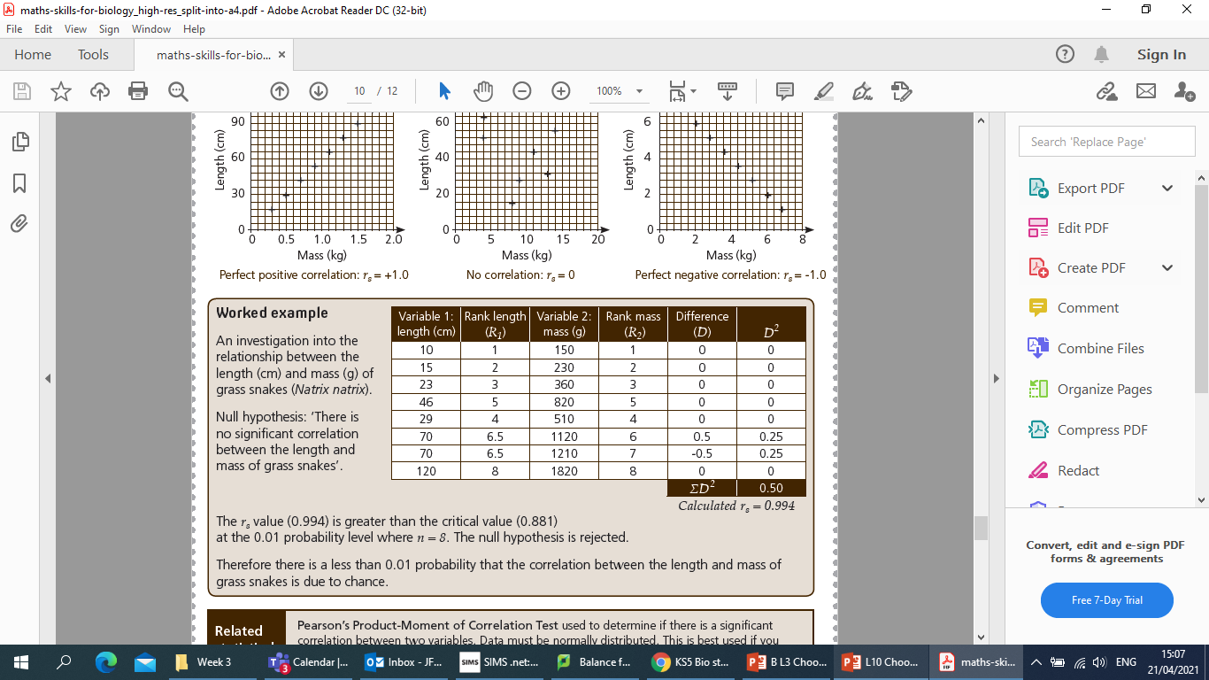
Spearman’s rank correlation coefficient test
(6 x 0.5) ÷ (8 (8² – 1)) = 3 ÷ 504 = 0.0059
1 – 0.0059 = 0.994

Slide 29
Spearman’s rank correlation coefficient test

Slide 30
Rank the height from smallest to largest
Person no. | Height/cm | Height ranking | Weight/ Kg | Weight ranking | D | D²
1 | 175 |  | 73.5
2 | 166 |  | 81.8
3 | 168 |  | 65.5
4 | 183 |  | 81.7
5 | 159 |  | 55.9
6 | 179 |  | 87.5
7 | 195 |  | 107.2
8 | 192 |  | 90.7
9 | 178 |  | 73.5
10 | 181 |  | 69.1
Ʃ

Slide 31
Rank the height from smallest to largest
Person no. | Height/cm | Height ranking | Weight/ Kg | Weight ranking | D | D²
1 | 175 | 4 | 73.5
2 | 166 | 2 | 81.8
3 | 168 | 3 | 65.5
4 | 183 | 8 | 81.7
5 | 159 | 1 | 55.9
6 | 179 | 6 | 87.5
7 | 195 | 10 | 107.2
8 | 192 | 9 | 90.7
9 | 178 | 5 | 73.5
10 | 181 | 7 | 69.1
Ʃ

Slide 32
Rank the weight from smallest to largest
Person no. | Height/cm | Height ranking | Weight/ Kg | Weight ranking | D | D²
1 | 175 | 4 | 73.5
2 | 166 | 2 | 81.8
3 | 168 | 3 | 65.5
4 | 183 | 8 | 81.7
5 | 159 | 1 | 55.9
6 | 179 | 6 | 87.5
7 | 195 | 10 | 107.2
8 | 192 | 9 | 90.7
9 | 178 | 5 | 73.5
10 | 181 | 7 | 69.1
Ʃ

Slide 33
Rank the weight from smallest to largest
Person no. | Height/cm | Height ranking | Weight/ Kg | Weight ranking | D | D²
1 | 175 | 4 | 73.5 | 4.5
2 | 166 | 2 | 81.8 | 7
3 | 168 | 3 | 65.5 | 2
4 | 183 | 8 | 81.7 | 6
5 | 159 | 1 | 55.9 | 1
6 | 179 | 6 | 87.5 | 8
7 | 195 | 10 | 107.2 | 10
8 | 192 | 9 | 90.7 | 9
9 | 178 | 5 | 73.5 | 4.5
10 | 181 | 7 | 69.1 | 3
Ʃ

Slide 34
Calculate the difference of the ranks
Person no. | Height/cm | Height ranking | Weight/ Kg | Weight ranking | D | D²
1 | 175 | 4 | 73.5 | 4.5
2 | 166 | 2 | 81.8 | 7
3 | 168 | 3 | 65.5 | 2
4 | 183 | 8 | 81.7 | 6
5 | 159 | 1 | 55.9 | 1
6 | 179 | 6 | 87.5 | 8
7 | 195 | 10 | 107.2 | 10
8 | 192 | 9 | 90.7 | 9
9 | 178 | 5 | 73.5 | 4.5
10 | 181 | 7 | 69.1 | 3
Ʃ

Slide 35
Calculate the difference of the ranks
Person no. | Height/cm | Height ranking | Weight/ Kg | Weight ranking | D | D²
1 | 175 | 4 | 73.5 | 4.5 | -0.5
2 | 166 | 2 | 81.8 | 7 | -5
3 | 168 | 3 | 65.5 | 2 | 1
4 | 183 | 8 | 81.7 | 6 | 2
5 | 159 | 1 | 55.9 | 1 | 0
6 | 179 | 6 | 87.5 | 8 | -2
7 | 195 | 10 | 107.2 | 10 | 0
8 | 192 | 9 | 90.7 | 9 | 0
9 | 178 | 5 | 73.5 | 4.5 | 0.5
10 | 181 | 7 | 69.1 | 3 | 4
Ʃ

Slide 36
Square the difference for each person
Person no. | Height/cm | Height ranking | Weight/ Kg | Weight ranking | D | D²
1 | 175 | 4 | 73.5 | 4.5 | -0.5
2 | 166 | 2 | 81.8 | 7 | -5
3 | 168 | 3 | 65.5 | 2 | 1
4 | 183 | 8 | 81.7 | 6 | 2
5 | 159 | 1 | 55.9 | 1 | 0
6 | 179 | 6 | 87.5 | 8 | -2
7 | 195 | 10 | 107.2 | 10 | 0
8 | 192 | 9 | 90.7 | 9 | 0
9 | 178 | 5 | 73.5 | 4.5 | 0.5
10 | 181 | 7 | 69.1 | 3 | 4
Ʃ

Slide 37
Square the difference for each person
Person no. | Height/cm | Height ranking | Weight/ Kg | Weight ranking | D | D²
1 | 175 | 4 | 73.5 | 4.5 | -0.5 | 0.25
2 | 166 | 2 | 81.8 | 7 | -5 | 25
3 | 168 | 3 | 65.5 | 2 | 1 | 1
4 | 183 | 8 | 81.7 | 6 | 2 | 4
5 | 159 | 1 | 55.9 | 1 | 0 | 0
6 | 179 | 6 | 87.5 | 8 | -2 | 4
7 | 195 | 10 | 107.2 | 10 | 0 | 0
8 | 192 | 9 | 90.7 | 9 | 0 | 0
9 | 178 | 5 | 73.5 | 4.5 | 0.5 | 0.25
10 | 181 | 7 | 69.1 | 3 | 4 | 16
Ʃ

Slide 38
Add up all of the values for D²
Person no. | Height/cm | Height ranking | Weight/ Kg | Weight ranking | D | D²
1 | 175 | 4 | 73.5 | 4.5 | -0.5 | 0.25
2 | 166 | 2 | 81.8 | 7 | -5 | 25
3 | 168 | 3 | 65.5 | 2 | 1 | 1
4 | 183 | 8 | 81.7 | 6 | 2 | 4
5 | 159 | 1 | 55.9 | 1 | 0 | 0
6 | 179 | 6 | 87.5 | 8 | -2 | 4
7 | 195 | 10 | 107.2 | 10 | 0 | 0
8 | 192 | 9 | 90.7 | 9 | 0 | 0
9 | 178 | 5 | 73.5 | 4.5 | 0.5 | 0.25
10 | 181 | 7 | 69.1 | 3 | 4 | 16
Ʃ

Slide 39
Add up all of the values for D²
Person no. | Height/cm | Height ranking | Weight/ Kg | Weight ranking | D | D²
1 | 175 | 4 | 73.5 | 4.5 | -0.5 | 0.25
2 | 166 | 2 | 81.8 | 7 | -5 | 25
3 | 168 | 3 | 65.5 | 2 | 1 | 1
4 | 183 | 8 | 81.7 | 6 | 2 | 4
5 | 159 | 1 | 55.9 | 1 | 0 | 0
6 | 179 | 6 | 87.5 | 8 | -2 | 4
7 | 195 | 10 | 107.2 | 10 | 0 | 0
8 | 192 | 9 | 90.7 | 9 | 0 | 0
9 | 178 | 5 | 73.5 | 4.5 | 0.5 | 0.25
10 | 181 | 7 | 69.1 | 3 | 4 | 16
Ʃ 50.5

Slide 40
Put your values into the equation
(6 x 50.5) ÷ (10(10² -1)) = 303 ÷ 990
= 0.33333333
1 – 0.3333333 =
0.693 3.s.f

Slide 41
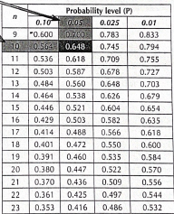
Compare to the critical value
0.694 is positive so we know that there is a positive correlation but not whether it is significant yet.
Find n
Then compare this with the critical value at p =0.05
Is 0.694 larger?

Slide 42
What is your conclusion?
0.694 is greater than 0.648 so the correlation is significant to P=0.05

Slide 43
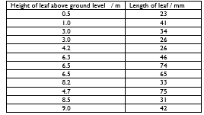
Independent practice
For the following table of results:
(a) State the Null Hypothesis
(b) Calculate the Spearman’s Rank Correlation Coefficient (Rs)
(c) State whether the Null Hypothesis is rejected or accepted and why (use the words ‘95% confident’ and ‘chance’).

Slide 44
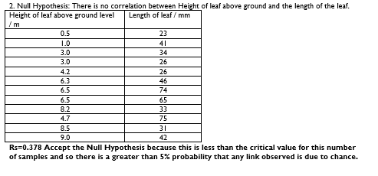
Review

Slide 45
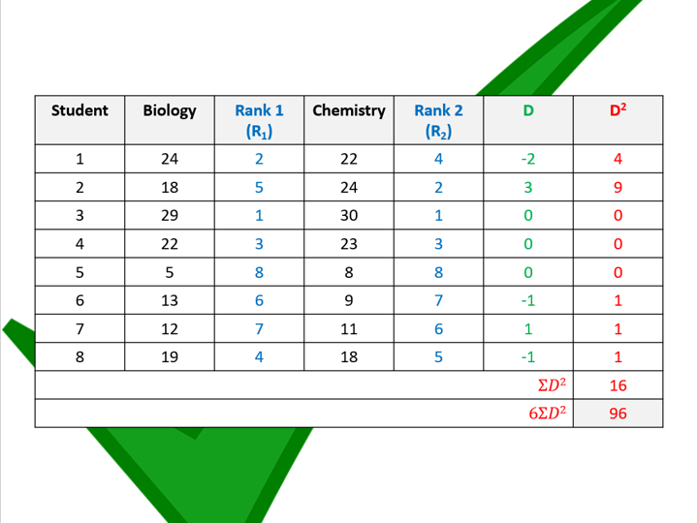
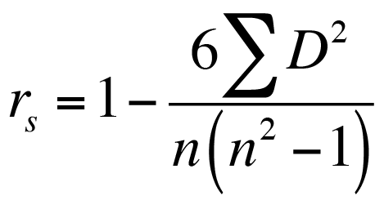
Spearman’s Rank

