Slide 1
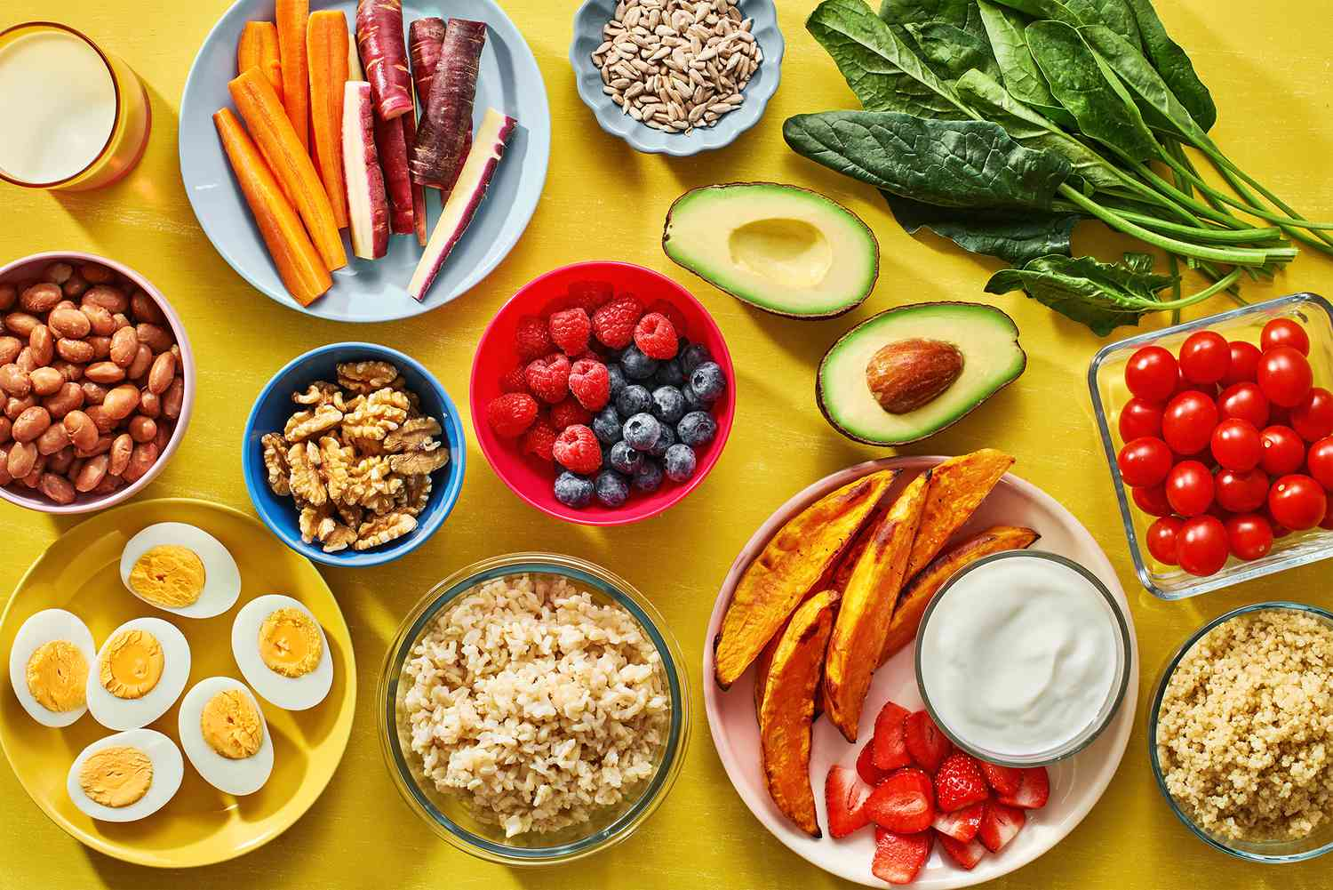
Dear Parent/ Carer, Congratulations! Your child has opted for the amazing 'Food Preparation and Nutrition' GCSE as one of their option choices!
This is a fantastic course which combines a range of food science, in-depth nutrition, food provenance and the practical application of cooking and food preparation skills.

Slide 2
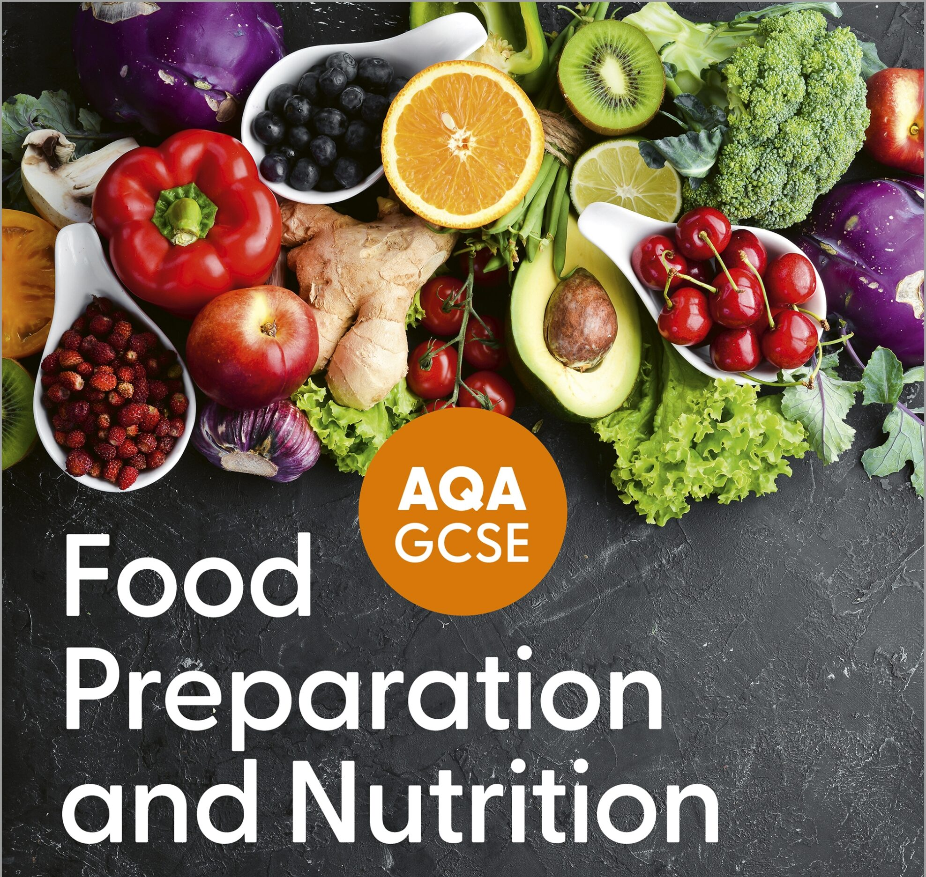
GCSE FOOD PREPARATION AND NUTRITION
The five core topics studied in the theory section of the course:
Food, nutrition and health
Food science
Food safety
Food choice
Food provenance

Slide 3
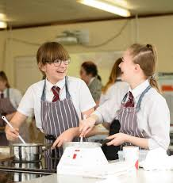
GCSE FOOD PREPARATION AND NUTRITION
As part of the practical element, 12 key skills will be learnt. These will be practiced through practical lessons.
Skill 1: General practical skills (like measuring and weighing)
Skill 2: Knife skills
Skill 3: Preparing fruit and vegetables
Skill 4: Use of the cooker
Skill 5: Use of equipment
Skill 6: Cooking methods
Skill 7: Prepare, combine and shape
Skill 8: Sauce making
Skill 9: Tenderise and marinate
Skill 10: Dough
Skill 11: Raising agents
Skill 12: Setting mixtures

Slide 4
GCSE FOOD PREPARATION AND NUTRITION
Where does your GCSE grade come from
Written exam 1hr 45 minutes in year 11 on the 5 topics shown in slide 1
NEA (non-exam assessment) - Students will prepare, cook and present a final menu of three dishes within a single period of no more than three hours. NEA will include planning in advance for this, a 2000 word written report and photographic evidence of the process and the dishes made.

Slide 5
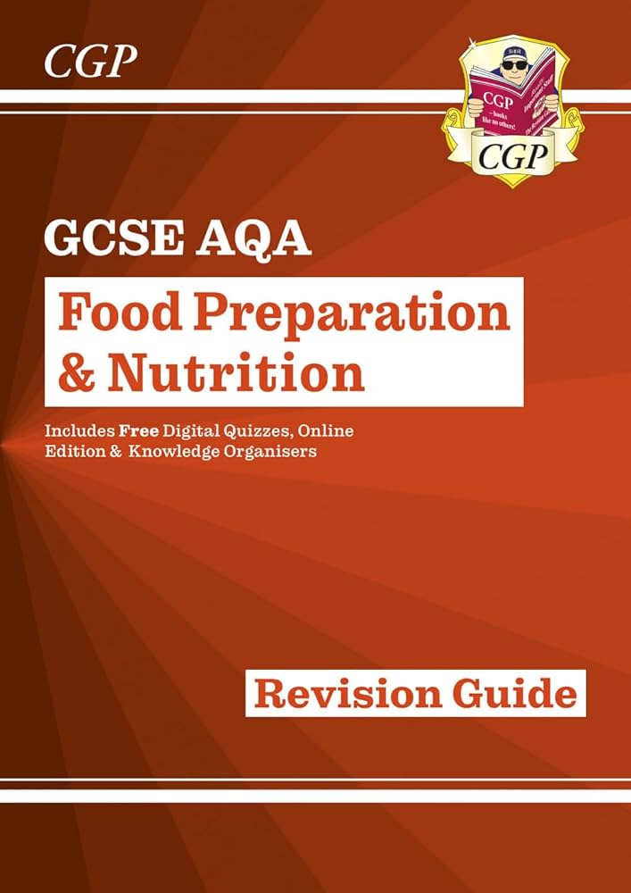
GCSE FOOD PREPARATION AND NUTRITION
HOW TO SUCCEED
Keep all notes organised in your books as per lesson
Read over work learnt in the lesson that night and highlight important information
Engage in the lesson and ask questions if unsure
Purchase a revision booklet and read over the work learnt in class
Go to the AQA website and look up the subject. Here you can print practice exams
Attend intervention lessons if and when required
Speak to staff members about any concerns or to organise time to go over things
Around 5-6£

Slide 6
GCSE FOOD PREPARATION AND NUTRITION
What can I do to support at home
Practice at home - students should be able to practice a range of different dishes, both sweet and savoury and starters, mains and desserts at home. They should also practice the timing of these recipes as their practical coursework assessment in year 11 is only 3 hrs
Recipe Folder - Collect a range of recipes that they are confident with making and store them in a folder
Be realistic - not everything students make will turn out right first time. Practice makes perfect and some dishes that are made need to be modified or developed several times in order to meet the brief, so they may need to cook some dishes multiple times.
Organisation - encourage your child to stay organised and make good use of their planner. Important notices and deadlines.
Practice the presentation skills - take tips from top chefs on really high class presentation of each dish. Create a folder of pictures from magazines or the internet of well-presented foods and use these for inspiration.
Attendance at Intervention is vital - attendance has a proven correlation with success. Encourage and facilitate your child to be able to attend at every opportunity.
Come to extra sessions and revision classes - Extra sessions are put on to support student’s coursework completion or to help them with revision. These are for your child's benefit and they are recommended to attend all sessions or it is possible in year 11
Buy the resources - it is highly recommended you purchase (if you have not already!) the AQA course text book and revision guides for your child to support in-class learning.
Revision it's never too early to start - buy some cue cards and start making brief notes or mini spider diagrams with key facts. Test your child at home to assess their current knowledge and help guide a revision plan.
Keep a positive attitude - Year 10 can be a challenging year where students are required to work hard and they are expected to work to a high standard. Reminding them to stay positive and to continue to keep working and striving to meet deadlines on time is vitally important.

