Slide 1
Topic 3-L4 Cell Cycle and Membranes Revision 30/04/2025
Do Now
Answer the retrieval questions on fertilisation and gametes that you had homework to learn
1 | What is the structure of the cell membranes?
2 | What is a glycoprotein?
3 | Why is the membrane partially permeable?
4 | What is a glycolipid?
5 | Describe the phospholipid bilayer and its interaction with water.
6 | Why doesn't the membrane allow water soluble substances through it?
7 | What role does cholesterol have in a cell membrane?
8 | Evidence for the fluid mosaic model
9 | What happens during Interphase?
10 | What happens in prophase?
11 | What happens in metaphase?
12 | What happens in anaphase?
13 | What happens in telophase?
14 | How does mitosis ensure genetic consistency ?

Slide 2
1 | What is the structure of the cell membranes? | Phospholipid molecules form a continuous bilayer. It contains proteins, cholesterol, glycoproteins and glycolipids. Some proteins are in the inner or outer layer only, some are in both.
2 | What is a glycoprotein? | Proteins with a polysaccharide chain attached
3 | Why is the membrane partially permeable? | Small molecules can move through the gaps between the phospholipids but large molecules and ions can only pass through channel and carrier proteins
4 | What is a glycolipid? | Lipids with a polysaccharide chain attached
5 | Describe the phospholipid bilayer and its interaction with water. | Phosphate head is hydrophilic and the two fatty acid tails are hydrophobic. In the bilayer the hydrophilic heads face out towards the water and the hydrophobic tails are on the inside making the center hydrophobic.
6 | Why doesn't the membrane allow water soluble substances through it? | Because the centre of the membrane is hydrophobic due to the tails
7 | What role does cholesterol have in a cell membrane? | It fits between the phospholipids forming bonds with them. This increases the rigidity of the membrane, making it less fluid
8 | Evidence for the fluid mosaic model | EM images showed a bilayer in cell membranes and new methods for analysing proteins showed that they were randomly distributed in cell membranes. Also did experiments to find out cell is fluid
9 | What happens during Interphase? | Gap phase 1 - cell grows and new organelles and proteins are made. Gap phase 2 - cell keeps growing and proteins needed for cell division are made. ATP content is increased. Synthesis - cell replicates its DNA ready to divide by mitosis
10 | What happens in prophase? | Chromosomes condense, becoming shorter and thicker, each chromosome is visible as 2 strands called chromatids. centrioles start moving to opposite ends of the cell, forming a network of protein fibers called a spindle. nuclear envelope breaks down and the chromosomes lie free in the cytoplasm
11 | What happens in metaphase? | Metaphase ?chromosomes, each with 2 chromatids line up along the middle of the cell and become attached to the spindle fibers at their equator by their centromeres.
12 | What happens in anaphase? | Anaphase ?centromeres divide, separating each pair of sister chromatids. the spindles contract, pulling chromatids to opposite poles of the spindle, centromere first
13 | What happens in telophase? | Telophase ?chromatids reach the opposite poles on the spindle. they uncoil and become long and thin and are called chromosomes again. a nuclear envelope forms around each group of chromosomes so there are 2 nuclei. The cytoplasm divides and there are now 2 genetically identical daughter cells.
14 | How does mitosis ensure genetic consistency ? | DNA replication before mitosis. The arrangement of chromosomes on the spindle and the separation of chromosomes to the pole

Slide 3
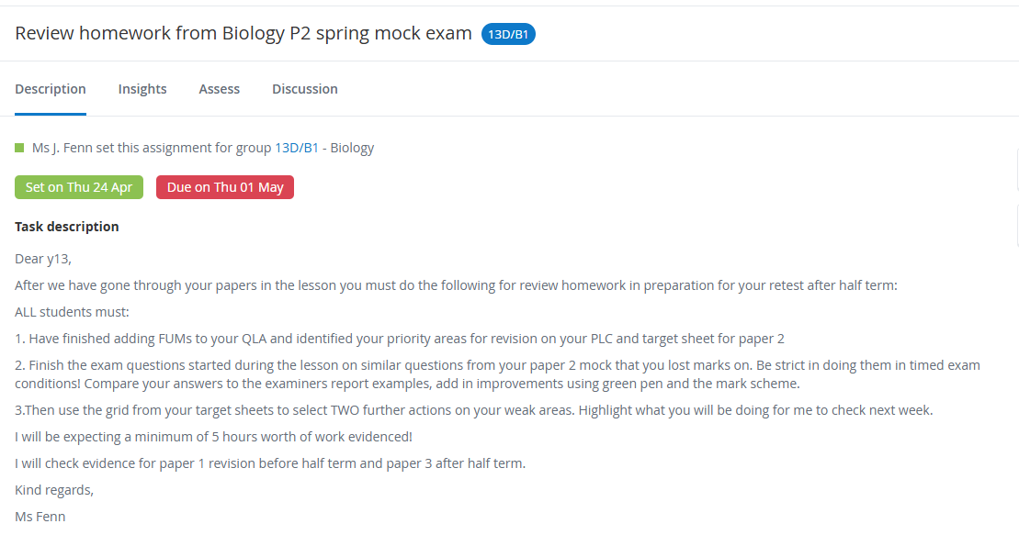
Homework due in
What:
How:
How long:

Slide 4
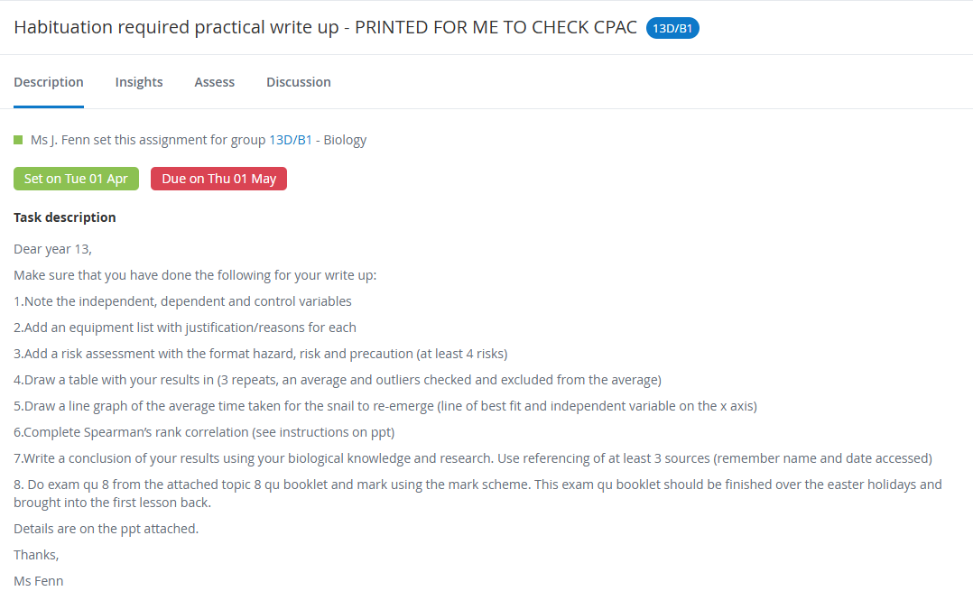

Slide 5
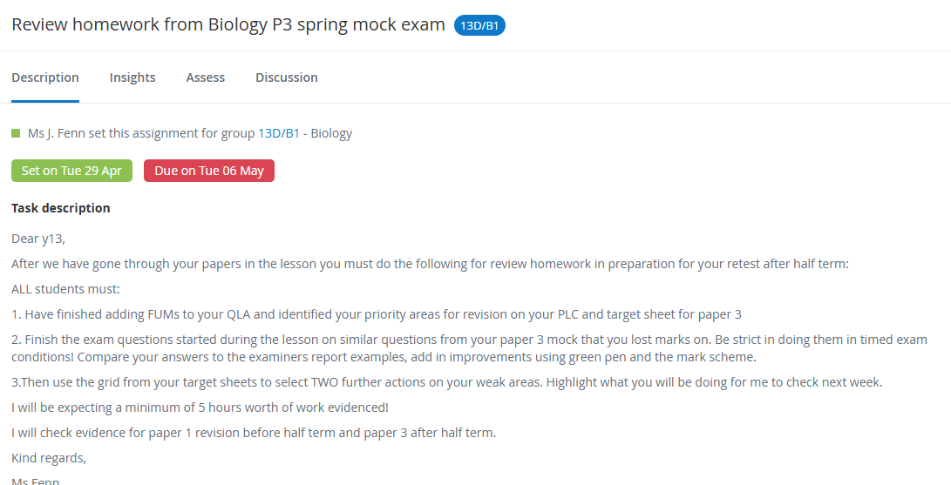

Slide 6
Learning Objectives
To recap specification points {3.8} to {3.9}
To apply your know ledge of these concepts to exam questions

Slide 7
Task
What:
Answer the exam questions
How:
On the sheet provided
Break down using CUBE first
How long:
30 mins
C = Circle the command work
U = Underline the subject specific words
B = Box the tricky words
E = Eliminate the irrelevant words

Slide 8
Answers
What:
I will live mark some of your answers
Add in improvements to your own using a green pen
How:
Then continue using the mark scheme
How long:
10 mins

Slide 9
Exit Ticket – Mini Whiteboards/On PLC
How does today's learning connect to what you know already?​
What connections can you make between today's learning and what we have studied previously?​
*Annotate the above on your Personal Learning Checklist!

Slide 10
Learning Objectives
To recap specification points {x} to {y}
To apply your know ledge of these concepts to exam questions

