Slide 1
Topic 5 Review 25 April 2022
Do Now
Define biotic factors and give some examples
Define niche
Define community
What is a pioneer species?
What is secondary succession?

Slide 2
Review 25 April 2022
Define biotic factors and give some examples
The living features of the ecosystem (e.g. predators, prey, microorganisms)
Define niche
The role of a species in it's environment
Define community
All of the organisms of different species that live in the same habitat and interact with each other
What is a pioneer species?
The first species to colonise an area, tends to be very specialized
What is secondary succession?
Occurs on land that has been cleared of all plants, but where the soil remains

Slide 3

Thumbs Up/Down. How much do you think you know about:
5.1 Understand the terms ecosystem, community, population and habitat. 5.2 Understand that the numbers and distribution of organisms in a habitat are controlled by biotic and abiotic factors. 5.3 Understand how the concept of niche accounts for distribution and abundance of organisms in a habitat. CORE PRACTICAL 10: Carry out a study on the ecology of a habitat, such as using quadrats and transects to determine distribution and abundance of organisms, and measuring abiotic factors appropriate to the habitat. 5.4 Understand the stages of succession from colonisation to a climax community.

Slide 4
Focus Area 1 from Do Now:
5.1 Understand the terms ecosystem, community, population and habitat.
5.2 Understand that the numbers and distribution of organisms in a habitat are controlled by biotic and abiotic factors.
5.3 Understand how the concept of niche accounts for distribution and abundance of organisms in a habitat.

Slide 5
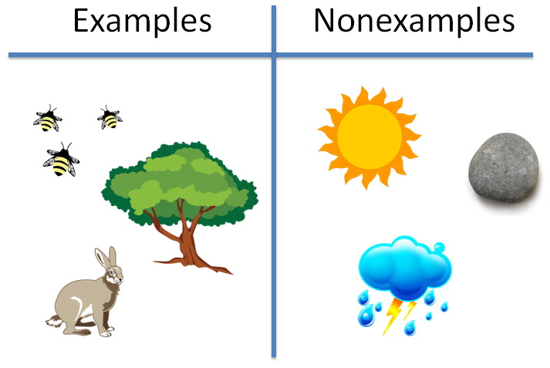
Biotic Factors
What does it mean?
How many can you list?
Now do the same for ABIOTIC FACTORS
Interspecific competition
Grazing
Disease
Predation
Parasitism
Intraspecific competition

Slide 6
Abiotic Factors
What does it mean?
How many can you list?
Carbon dioxide concentration
Soil mineral ion concentration
Solar energy input
Salinity
Soil moisture
Oxygen concentration
Wind exposure
Soil pH
Temperature
Slope & aspect
Altitude

Slide 7
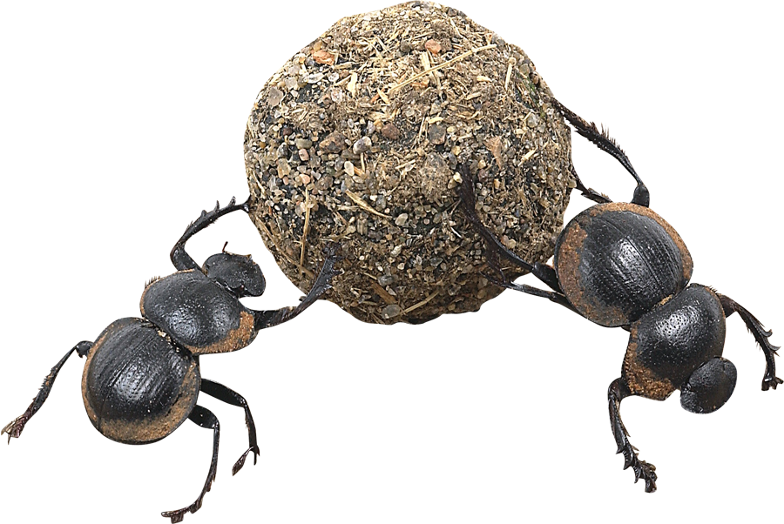

Ecological Niche
The ecological niche describes the functional position of an organism in its environment.
A niche comprises:
  the habitat in which the organism lives.
  the organism’s activity pattern: the periods of time during which it is active.
  the resources it obtains
  from the habitat.
Habitat
Adaptations
Activity patterns
Presence of other organisms
Physical conditions

Slide 8
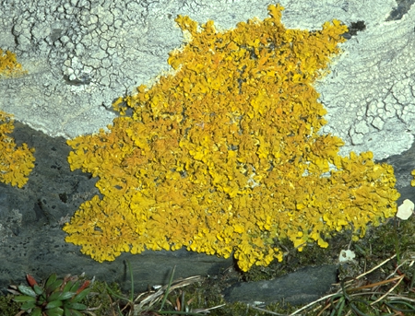
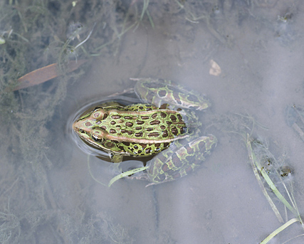
Habitat
An organism’s habitat is the physical place or environment in which it lives.
Organisms show a preference for a particular habitat type, but some are more specific in their requirements than others.
Lichens are found on rocks, trees, and bare ground.
Most frogs, like this leopard frog, live in or near fresh water, but a few can survive in arid habitats.

Slide 9
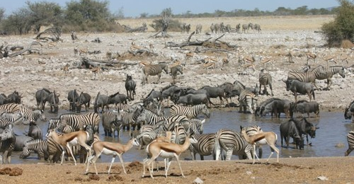
Population vs Community
A POPULATION is a group of individuals of the SAME SPECIES in an area.
A COMMUNITY consists of all the populations that live in a habitat or ecosystem.

Slide 10
WB Task: identify the term from its definition
All the populations of different species
Community

Slide 11
WB Task: identify the term from its definition
Living factors within an ecosystem
Biotic

Slide 12
WB Task: identify the term from its definition
The physical location where an organism lives
Habitat

Slide 13
WB Task: identify the term from its definition
a biological community of interacting organisms and their physical environment
Ecosystem

Slide 14
WB Task: identify the term from its definition
An organism’s functional position within an ecosystem. How it exploits its environment
Niche

Slide 15
WB Task: identify the term from its definition
Non-living factors within an ecosystem
Abiotic factors

Slide 16
WB Task: identify the term from its definition
The number of individuals within a species
Population

Slide 17
Focus Area 2 from Do Now:
CORE PRACTICAL 10:
Carry out a study on the ecology of a habitat, such as using quadrats and transects to determine distribution and abundance of organisms, and measuring abiotic factors appropriate to the habitat.

Slide 18
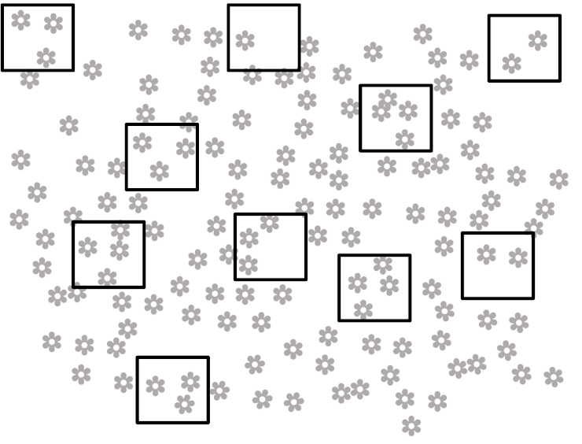
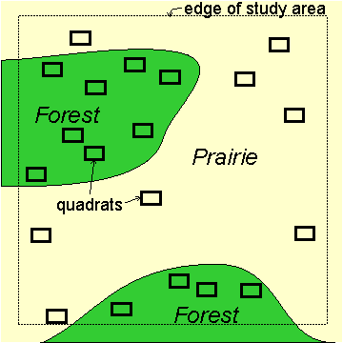
Ways of sampling abundance
Random sampling
Stratified sampling (comparing known areas)

Slide 19
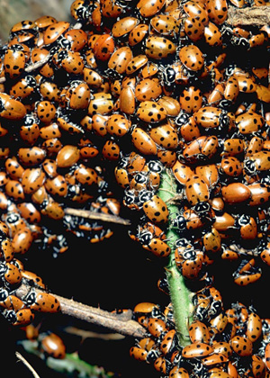
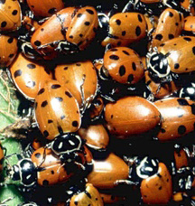
Sample Size
When designing your field study, the size of your sampling unit and the sample size (n) should be major considerations.
The sample size might be the number of individuals or the number of quadrats.
It is usually best to take as many samples as you can, as this helps to account for any natural variability present and will give you greater confidence in your data.
Ladybird population
Sample (n=23)

Slide 20
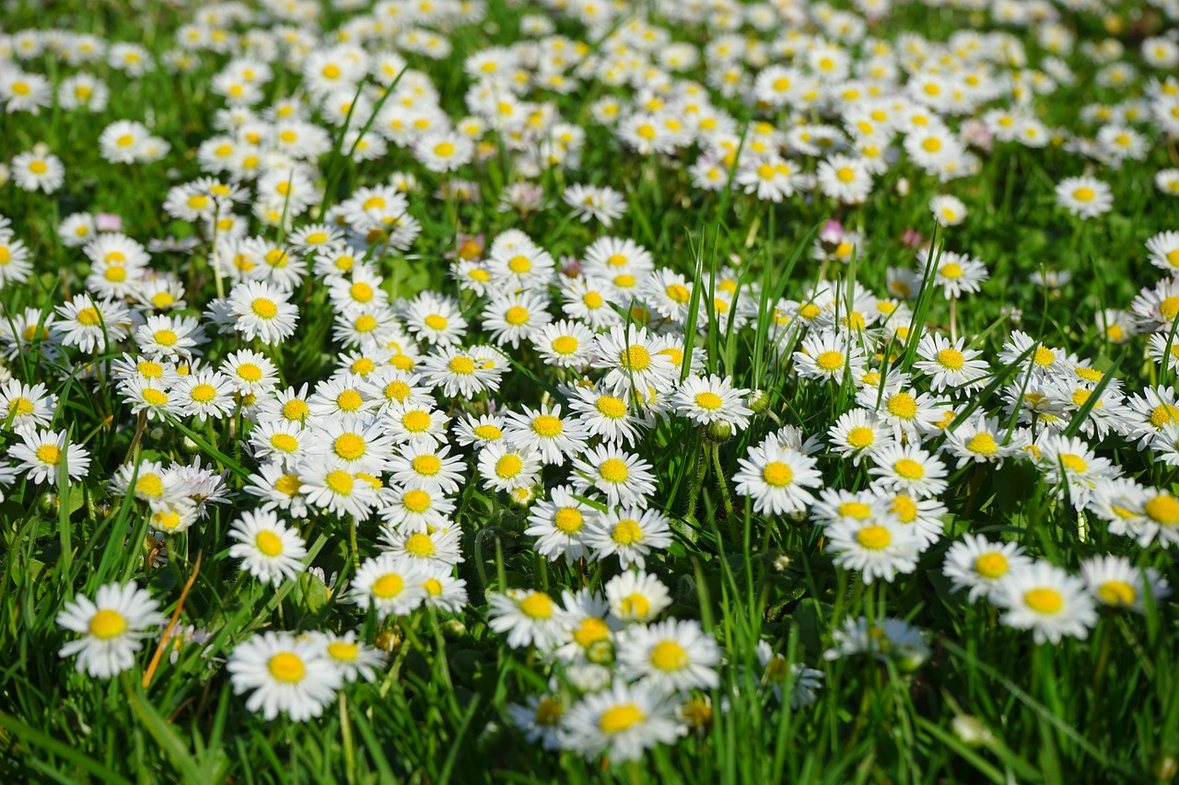
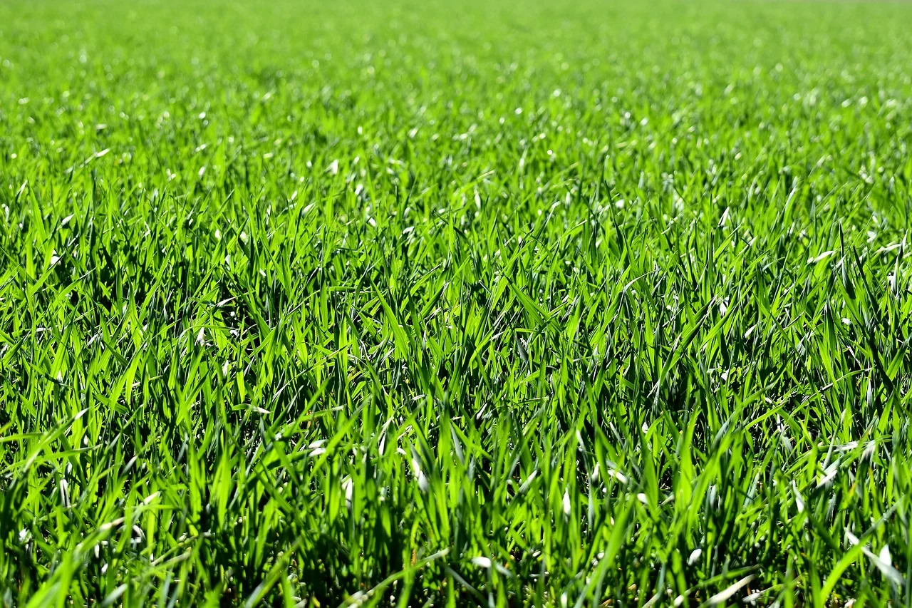
Estimating populations
Source: Pixabay
Source: Pixabay

Slide 21
Percentage cover
A simple way of measuring an organism is to
calculate percentage cover
This is especially useful if it is hard to count all the individual organisms within a quadrat
Quadrats are placed and the number of little squares that are covered by plants are counted
Only count squares more than half covered and estimate the others
Divide by total number of squares and x 100 to give a percentage

Slide 22
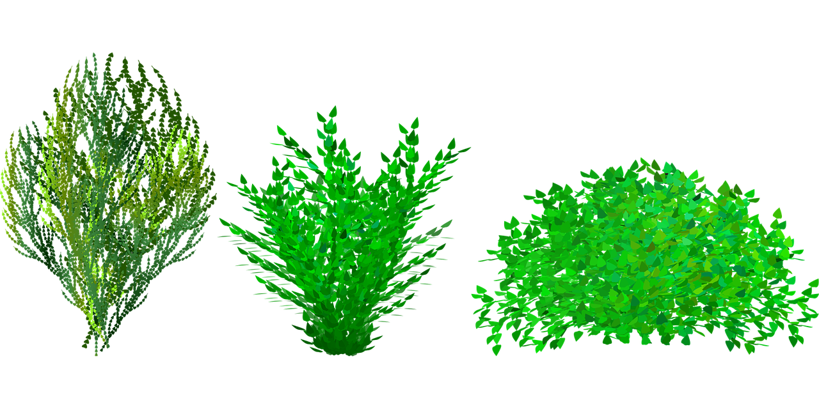
Percentage cover - model
Squares more than half covered = 10
Partial squares together = 2
Total squares = 12
Squares in quadrat = 36
Percentage cover = (12 ÷ 36) x 100
= 33 %
Bush Source: Pixabay

Slide 23
Percentage cover
Squares more than half covered = 8
Partial squares together = 1
Total squares = 9
Squares in quadrat = 36
Percentage cover = (9 ÷ 36) x 100
= 25 %
Bush Source: Pixabay

Slide 24

What is the first step when calculating percentage cover?
Count how many squares are more than half covered

Slide 25
What is the second step when calculating percentage cover?
Add up how many squares are partially covered

Slide 26
What is the third step when calculating percentage cover?
Count how many squares there are in the quadrat

Slide 27
What is the last step when calculating percentage cover?
Divide the number of covered squares by total squares and multiply by 100

Slide 28
Independent practice
Calculate the percentage cover in these quadrats:
a.
b.
Bush Source: Pixabay
Bush Source: Pixabay

Slide 29
Independent practice - answers
a.
More than half covered = 11
Partially covered = 0
Total squares = 11
Squares in quadrat = 36
Percentage coverage = (11÷36) x 100
= 31%
Bush Source: Pixabay

Slide 30
Independent practice - answers
b.
More than half covered = 12
Partially covered = 1
Total squares = 13
Squares in quadrat = 36
Percentage coverage = (13÷36) x 100
= 36%
Bush Source: Pixabay

Slide 31
Testing a hypothesis
Sampling with quadrats – either percentage cover or individual counts like in lesson 5 on the sampling required practical 1
This time you would need to compare two or more places, with changing biotic or abiotic factors.

Slide 32
Testing a hypothesis
Clover plants grow better in neutral soil than
acidic soil.
Independent variable (IV): pH of the soil
Dependent variable (DV): growth of clover plants
Control variables (CV): light intensity, water availability

Slide 33
Testing a hypothesis
Find a field with neutral soil
Use a pH meter to measure the pH of the soil
Measure the size of the field and calculate the area
Randomly choose 10 locations in the field
Use quadrats to count populations at the locations
Calculate a mean
Repeat for a field with acidic soil and compare the results

Slide 34
Independent practice
Bluebells grow better in shady woodland areas than in full sun
What are the independent, dependent and control variables for this hypothesis?
Describe a method to test this hypothesis.
(key words: Quadrat, random, area, multiple, count, woodland, full sun)

Slide 35
Independent practice - answers
Bluebells grow better in shady woodland areas than in full sun
IV = light intensity, DV = bluebell growth, CV = water availability, space

Slide 36
Independent practice - answers
Measure the area of a sample site in woodland
Use a grid and a random number generator to choose 10 random coordinates
Place a quadrat in the coordinates and count the number of bluebells
Calculate a mean and multiply up to estimate the number in the woodland
Repeat the whole procedure using a site that is in full sun – e.g an open field.

Slide 37
Sampling Distribution
Scientists might want to sample the distribution of a species to draw conclusions on what is causing this.
To do this by individually counting the organisms would be very time consuming and in most cases impossible.
Therefore scientists will sample an areas to get an accurate estimate.

Slide 38
Sampling along a transect line
A transect line is used when you are trying to investigate the effect of a changing factor (biotic or abiotic) over a distance.
Quadrat readings are taken along a ‘line’ starting at one point and at various distances from it.
This line is a transect line
Multiple, random readings should be taken at each point to ensure representative data free from bias.

Slide 39

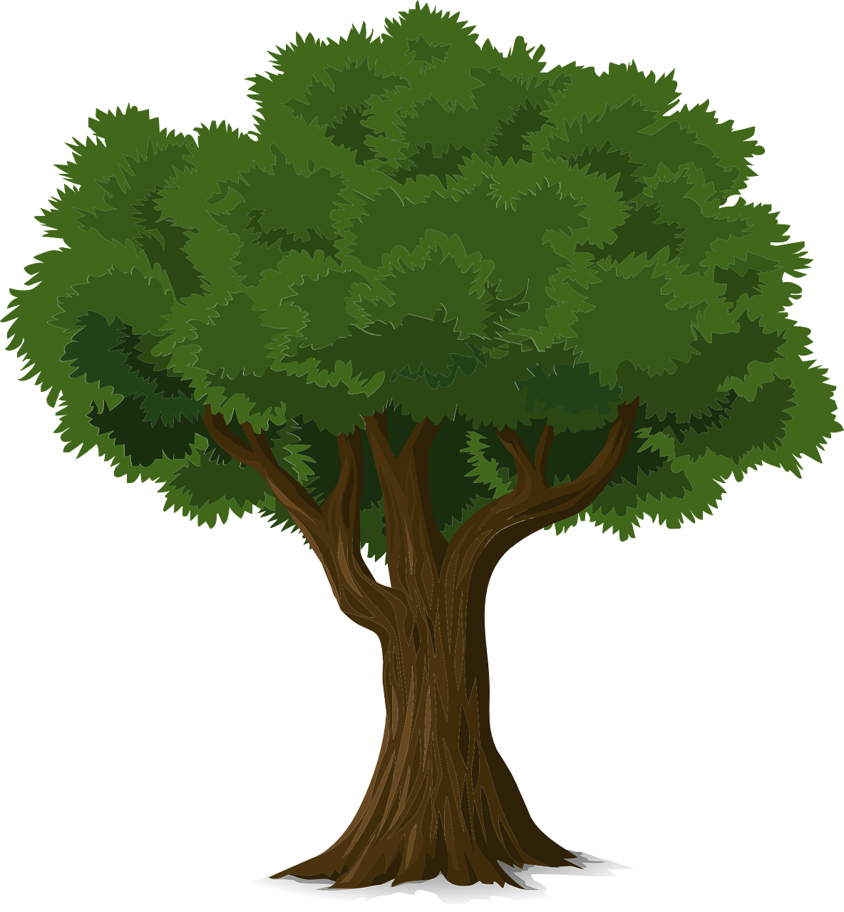
Sampling along a transect line
Road and tree source: Pixabay

Slide 40
Mini whiteboards – which sampling method would you use to …..
compare the abundance of a flowering plant in a grazed field and an adjacent ungrazed field?
Random
Systematic
Stratified

Slide 41
Mini whiteboards – which sampling method would you use to …..
investigate whether there is a link between soil moisture levels and reed height?
Random
Systematic
Stratified

Slide 42
Mini whiteboards – which sampling method would you use to …..
investigate the impact of grazing on grass abundance?
Random
Systematic
Stratified

Slide 43
Mini whiteboards – which sampling method would you use to …..
find out if the percentage cover of species B is different on the tops of dunes than in between the dunes.
Random
Systematic
Stratified

Slide 44
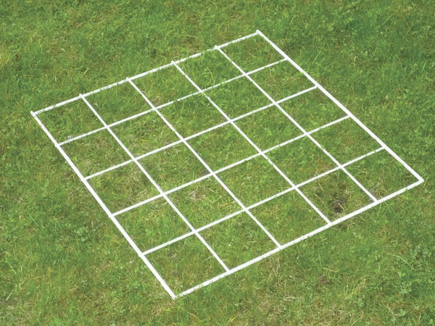
Mini whiteboards – describe how you would use a quadrat to estimate the percentage of organisms in an area
You should count the number of squares that this organism is found in.
Then divide by the total number of squares in the quadrat.
Then multiply by 100

Slide 45
Mini whiteboards – describe how you would use a quadrat to estimate the number of organisms in an area
You should count the number of squares that this organism is found in.
Add the total for all of the quadrats used and divide by the number of quadrats to find the average.
Then multiply by the number of quadrats that would fit into the area sampled.

Slide 46
Mini whiteboards – what is a good number of quadrats to take to get repeatable results?
3
10 or more
1000s
This gives you enough data for a stats test and shouldn’t be too time consuming.

Slide 47
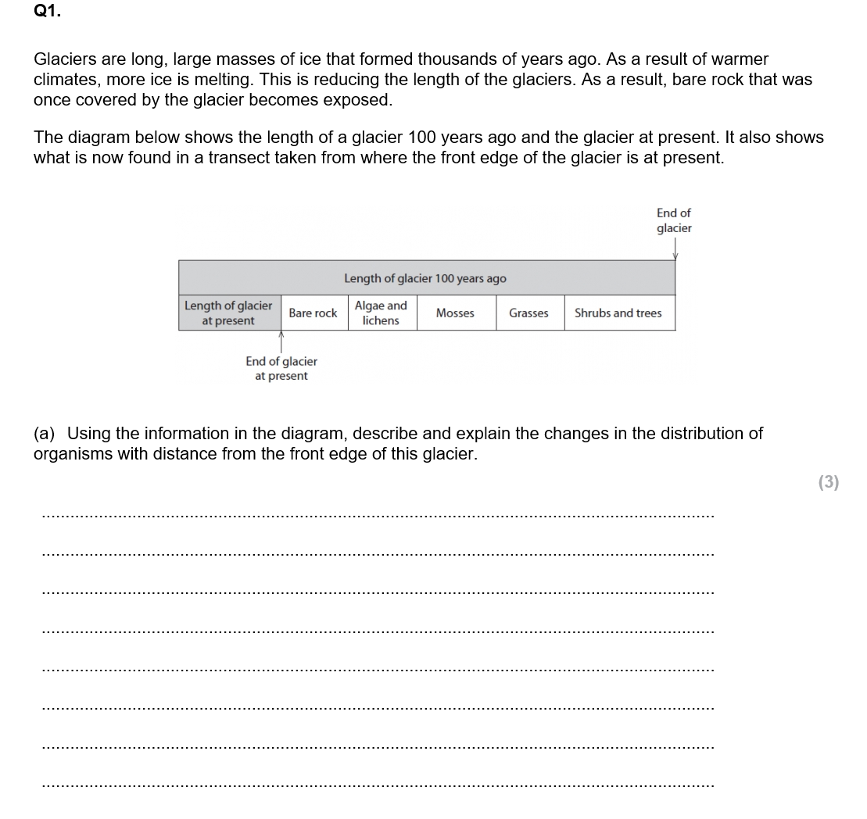

Slide 48
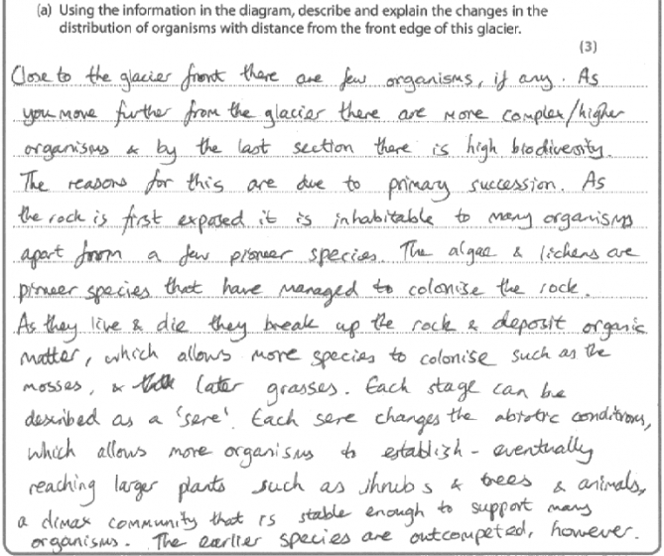
Uses the information given to describe distribution/diversity.
Explains using knowledge of succession.

Slide 49
Focus Area 3 from Do Now:
5.4 Understand the stages of succession from colonisation to a climax community.

Slide 50
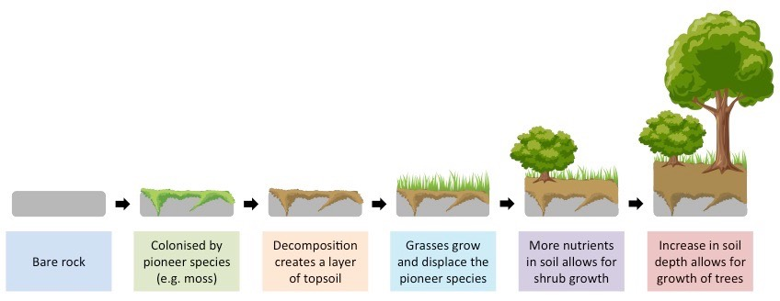
How Does Succession Work?
PRIMARY- Plants grow where NO PLANTS HAVE GROWN BEFORE.
Notes:
50

Slide 51
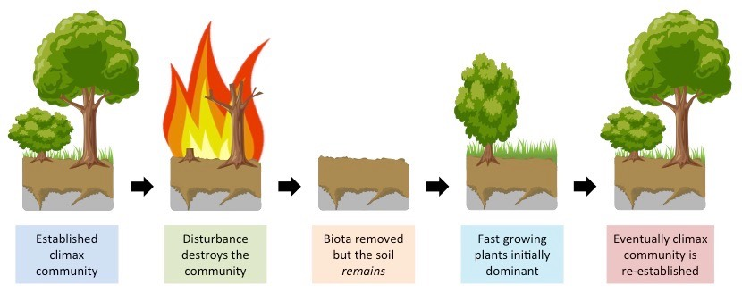
How Does Succession Work?
SECONDARY- Plants grow where there has been a previous population. These will have been destroyed, eg: by fire
Notes:
51

Slide 52
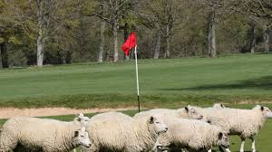
How Does Succession Work?
DEFLECTED- Where a community remains stable only because human activity prevents succession from running its course.
Notes:
52

Slide 53
Think Pair Share
What:
Discuss what the difference is between primary, secondary and deflected session.
How:
In pairs
How long:
1 minute

Slide 54
Questions
What kind of problems would a pioneer species encounter?
Describe the kind of adaptations you might expect to see in a pioneer species in order to overcome these challenges.
How do the pioneer species create an environment for other plants to live in?
What is a climax community?
Explain the difference between primary and secondary succession.
Early stages of ecological succession contain short-lived plants which devote enormous amounts of energy producing seeds. More mature communities do not need to do this. Why?
Describe how ploughing fields each year in farming practices influences the process of succession.

Slide 55
Answers
Exposed to extreme abiotic factors such as wind, light intensity, high desiccation and salinity.
They would have to be able to absorb water quickly and retain it, they would be low on the ground to reduce desiccation, potentially not absorb salt.
When the pioneer species die, as they decay the nutrients from them begins to build a layer of hummus that slowly turns into soil.
This is the last stable community, usually dominated by large plants such as trees like oak.
Primary succession is when the pioneer species lands on virgin soil that has not been colonised before. Secondary succession is when the pioneer species lands on soil that has once had a climax community on that was destroyed through a fire or deforestation for example.
There will be a low success rate of the seeds from the pioneer species surviving, whereas later communities will have soil that is rich in nutrients and conditions that give a higher success rate of seed survival and therefore do not need to produce so many.
Regularly ploughing the fields means that pioneer species will rarely be able to establish themselves to decay and build up a rich soil with nutrients for larger plants to establish themselves on.

Slide 56
Exam Skill Focus:
Complete the exam questions in the booklet provided by your teacher.
The teacher will project some of the questions on the visualiser to help you to answer them.
Then mark using the mark scheme and add in improvements in green pen.
Teacher note: At least 25 minutes of the lesson should be spent doing this

Slide 57
Exit Ticket
Traffic light your PLC for:
5.1 Understand the terms ecosystem, community, population and habitat.
5.2 Understand that the numbers and distribution of organisms in a habitat are controlled by biotic and abiotic factors.
5.3 Understand how the concept of niche accounts for distribution and abundance of organisms in a habitat.
CORE PRACTICAL 10:
Carry out a study on the ecology of a habitat, such as using quadrats and transects to determine distribution and abundance of organisms, and measuring abiotic factors appropriate to the habitat.
5.4 Understand the stages of succession from colonisation to a climax community.

