Slide 1
T5.10 – 5.16 Energy Transfer and Climate Change 3 May 2022
Do Now
What is primary productivity?
Why isn't the transfer of energy from producers to primary consumers very efficient ?
What is the equation for energy efficiency?
How can pollen analysis provide evidence for global warming?
How is dendrochronology used as evidence for climate change ?
What is the role of CO2 and methane in the greenhouse effect ?
What assumptions are made when data is extrapolated?
How do changing rainfall patterns affect the distribution of animals and plants ?
What is the effect of increasing temperature on the rate of enzyme activity?

Slide 2
Review
What is primary productivity?
The rate at which energy is incorporated into organic molecules
Why isn't the transfer of energy from producers to primary consumers very efficient ?
Not all of the available food is eaten (roots, bones twigs),some undigested food remains in faces (cellulose in cell walls), much of the food absorbed by the consumers is used in respiration
What is the equation for energy efficiency?
Energy available after transfer/energy available before transfer) x 100
How can pollen analysis provide evidence for global warming?
Pollen grains have a tough outer layer that is very resistant to decay. each species has a distinctive type of pollen, allowing use to identify the plant species. peat forms in layers, the deeper the layer the older the peat. carbon 14 dating to establish age of peat layer. each plant species has a particular set of ecological conditions in which it flourishes best. if find pollen from a species favouring warmer condition, then the peat was laid down when the climate was warmer
How is dendrochronology used as evidence for climate change ?
The diameter of the new xylem vessels varies according to the season when they are produced. when it is warmer the rings are thicker. a core sample is taken and examined

Slide 3
Review
What is the role of CO2 and methane in the greenhouse effect ?
They absorb infrared radiation and reradiate some of it back to the earth, warming it up
What assumptions are made when data is extrapolated?
There is enough data to establish a trend accurately. the present trends will continue.
How do changing rainfall patterns affect the distribution of animals and plants?
species migrate to other areas where they can survive better because the conditions are more favourable. alien species move to new areas and prey on native species/their food source. diseases may spread
What is the effect of increasing temperature on the rate of enzyme activity?
rate of photosynthesis increases so plants grow faster, but when temperature is too high the rate of growth decreases

Slide 4

Thumbs Up/Down. How much do you think you know about:
5.10 i) Be able to calculate net primary productivity. ii) Understand the relationship between gross primary productivity, net primary productivity and plant respiration. 5.11 Know how to calculate the efficiency of biomass and energy transfers between trophic levels. 5.12 Understand the different types of evidence for climate change and its causes (including records of carbon dioxide levels, temperature records, pollen in peat bogs and dendrochronology), recognising correlations and causal relationships. 5.13 Understand the causes of anthropogenic climate change, including the role of greenhouse gases (carbon dioxide and methane) in the greenhouse effect. 5.14 i) Understand that data can be extrapolated to make predictions and that these are used in models of future climate change. ii) Understand that models for climate change have limitations. 5.15 Understand the effects of climate change (changing rainfall patterns and changes in seasonal cycles) on plants and animals (distribution of species, development and life cycles). 5.16 Understand the effect of temperature on the rate of enzyme activity and its impact on plants, animals and microorganisms.

Slide 5
Focus Area 1 from Do Now:
5.10 i) Be able to calculate net primary productivity.
ii) Understand the relationship between gross primary productivity, net primary productivity and plant respiration.
5.11 Know how to calculate the efficiency of biomass and energy transfers between trophic levels.

Slide 6
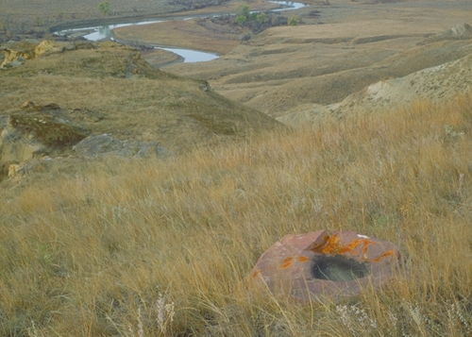
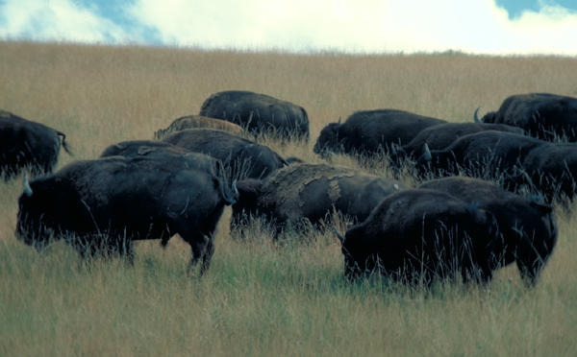

Primary Production
The energy entering ecosystems is fixed by producers in photosynthesis.
Gross primary production (GPP) is the total energy fixed by a plant through photosynthesis.
Net primary production (NPP) is the GPP minus the energy required by the plant for respiration. It represents the amount of stored chemical energy that will be available to consumers in an ecosystem.
Net primary productivity is the biomass produced per unit area per unit time, e.g. g m⁻²y⁻¹
Grassland: high productivity
Grass biomass available to consumers

Slide 7
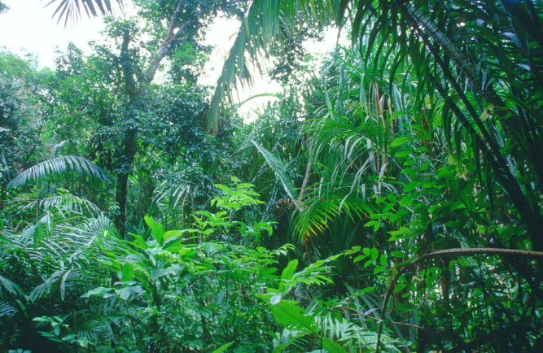
Energy Losses In Producers
Over 90% of the sun’s energy is reflected back into space by clouds and dust or absorbed by the atmosphere.
Not all wavelengths of light can be absorbed and used for photosynthesis
Light may not fall on a chlorophyll molecule
A factor, such as low carbon dioxide levels, may limit the rate of photosynthesis

Slide 8
Energy Losses In Producers (Primary Productivity)
Net primary production (NPP) =
gross primary production (GPP) – respiratory loses (R)

Slide 9
Calculating the efficiency of energy transfers
The amount of energy available is usually measured in kilojoules per square metre per year (kJ m⁻²year⁻¹)
It is useful to calculate the efficiency of the energy transfer between each trophic level.

Slide 10
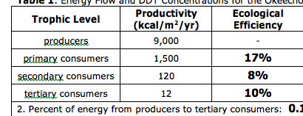
Calculating the efficiency of energy transfers
Energy transfer = energy available after the transfer x 100 energy available before the transfer
For example, the ecological efficiency of primary consumers would be:
1,500 ÷ 9,000 x 100 =
17%

Slide 11
Mini whiteboards: work out the ecological efficiency for secondary consumers
Energy transfer = energy available after the transfer x 100 energy available before the transfer

Slide 12
Mini whiteboards: work out the ecological efficiency for tertiary consumers
Energy transfer = energy available after the transfer x 100 energy available before the transfer
Extra challenge:
Can you explain why the efficiency of secondary and tertiary consumers is low?

Slide 13
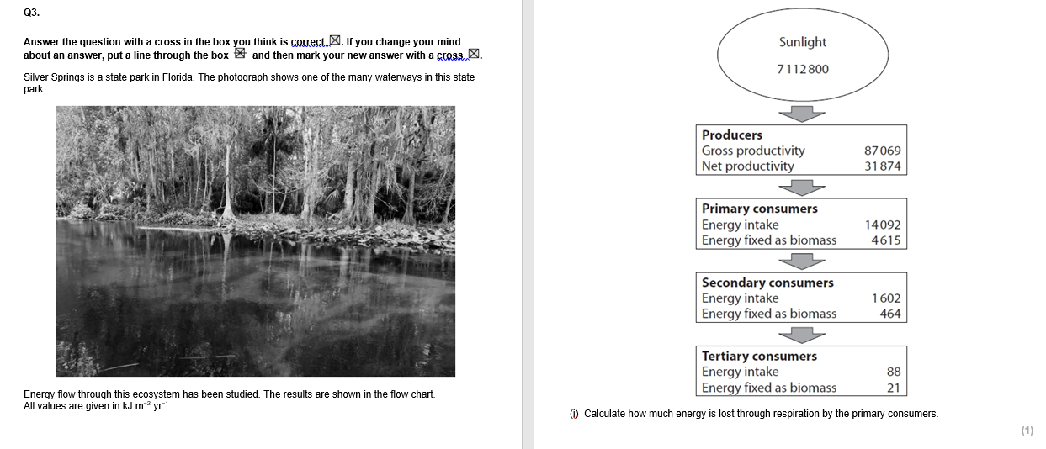
GPP 14092 – NPP 4615 = 9477

Slide 14
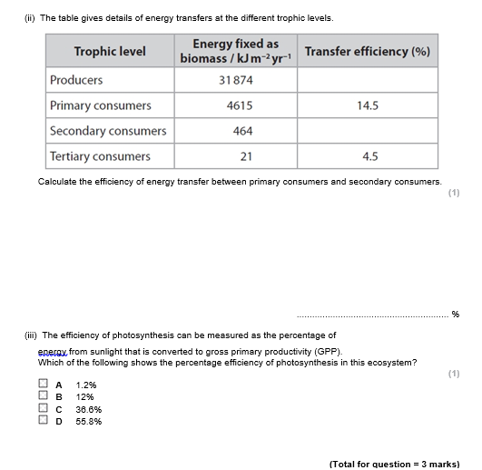
(464 ÷ 4615) x 100 = 10.1
(same number of d.p as in table)

Slide 15
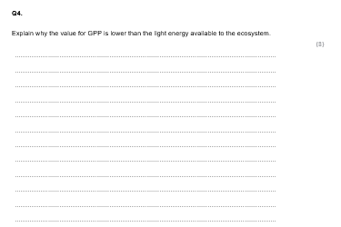
Not all of the light falls on the leaves or producer.
Some of the light is reflected from the surface of the leaf.
Some of the light misses the chloroplasts.
Some of the light is the wrong wavelength to be absorbed by the chloroplast.

Slide 16
Focus Area 2 from Do Now:
5.12 Understand the different types of evidence for climate change and its causes (including records of carbon dioxide levels, temperature records, pollen in peat bogs and dendrochronology), recognising correlations and causal relationships.
5.13 Understand the causes of anthropogenic climate change, including the role of greenhouse gases (carbon dioxide and methane) in the greenhouse effect.
5.14 i) Understand that data can be extrapolated to make predictions and that these are used in models of future climate change.
ii) Understand that models for climate change have limitations.

Slide 17

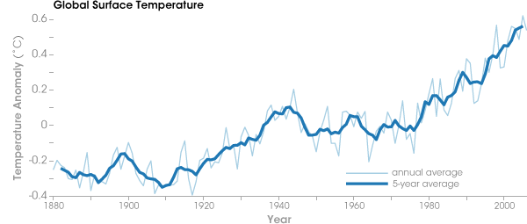
Temperature Records 3-May-22
Q1) What do we call frequent rises and falls in a graph?
Fluctuations
Q2) Extending a line graph using the trend is known as...?
Extrapolating
Q3) Describe this graph (3)
-overall trend described
-steady increase from 1880-1980
-more rapid increase in temperature from 1980-2000
-manipulated data e.g. increase of 0.9°C from 1890-2000

Slide 18
Dating evidence
Temperature records go back to around 1650 in Europe
Tree rings can provide evidence to a maximum of 3000 years ago.
Pollen data and ice cores go back even further!
Pollen- Back about 20,000 years (two ice ages ago)
Ice cores (the proportion of Oxygen 18) gives us data back around 100,000 years.

Slide 19
What is a peat bog core sample?

Slide 20
Pollen Samples
Plants produce pollen in vast amounts.
Pollen grains have a tough outer layer that is very resistant to decay.
Each species of plant has a distinctive type of pollen, allowing us to identify the plant species from which it came.
Peat forms in layers: the deeper the layer, the older the peat. Carbon-14 dating allows the age of a particular peat layer to be established.
Each species of plant has a particular set of ecological conditions in which it flourishes best.
A picture of the conditions present when the pollen was deposited can be deduced from the conditions favoured by the plants present in the community.

Slide 21
True or False?
F
Peat is the accumulation of dead animals.
The deeper the layer of peat the more recent the layer.
Peat bogs are good sources of pollen because low oxygen levels mean that plant material decays very slowly.
Changes in pollen over time indicate changes in species abundance and therefore climate.
Oxygen dating can be used to date the layers of peat.
Ice cores trap nitrogen gas which gives us an indication of the past climate.
F
T
T
F
F
Challenge: correct the false statements.

Slide 22
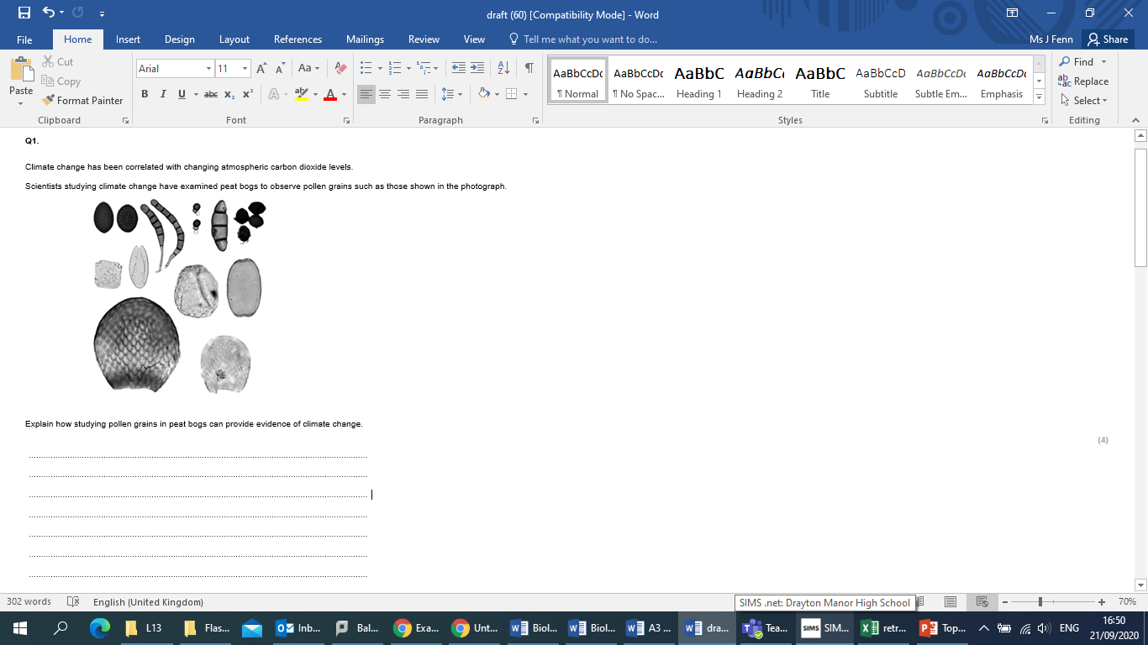
Task: answer the exam question (4 marks)

Slide 23
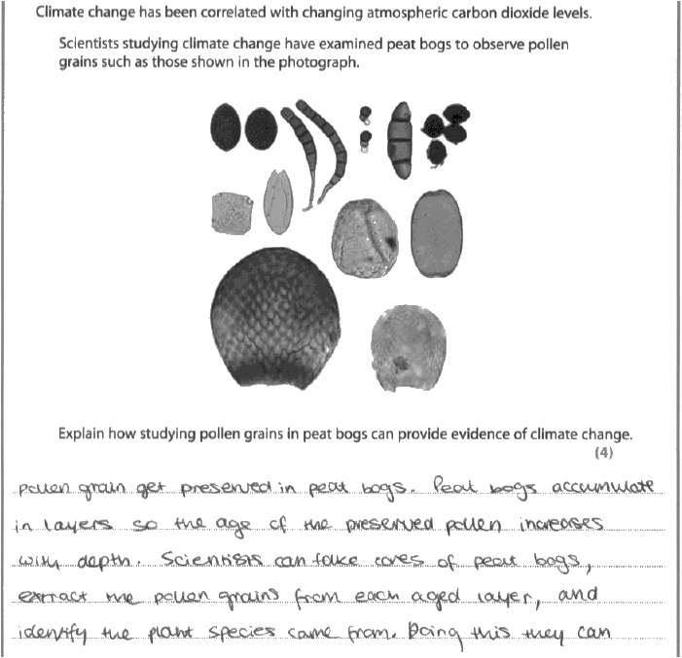
Model Answer

Slide 24
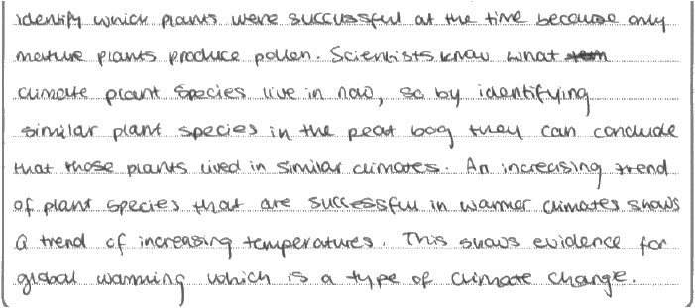
Model Answer

Slide 25
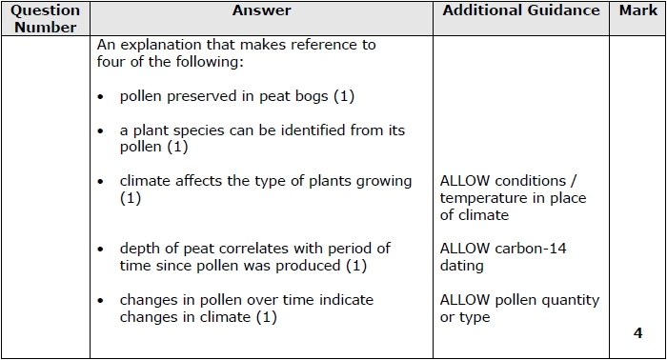

Slide 26
Tree rings
Growth of the Xylem vessels – varies throughout year in our climate
Late Spring/Summer – wide light coloured ring (lots of growth)
Late summer/autumn – narrow darker ring (little growth)
Winter – dormant (no growth)

Slide 27
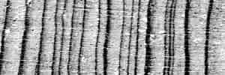
Tree rings
From LTTR, Arizona
X
So one year’s growth is a dark and light ring together = annual growth ring = X

Slide 28
Show me! Tree rings are made up of …..
Xylem vessels
Phloem vessels
Sclerenchyma

Slide 29
Show me! Tree rings are wider when….
It is cold and dry
It is warm and wet
It is warm and dry

Slide 30
Show me! The youngest rings will be
In the middle of the trunk
On the outside of the trunk

Slide 31
Show me! A disadvantage of using tree rings to study climate change is ….
Trees only live for a few decades
Trees only live for a few hundred years
Trees only live for a few 1000 years

Slide 32
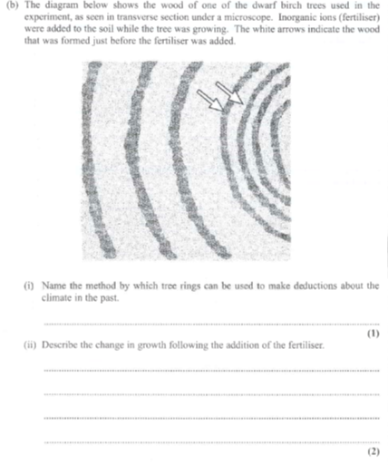
Dendrochronology
After the fertiliser is added the growth increases by approximately double over the next 3 years.

Slide 33
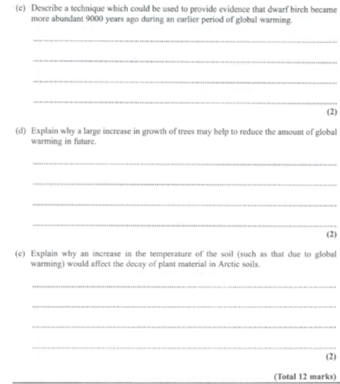
You could use pollen analysis of peat at different depths. The depths could be dated by using a radiocarbon method. You should then look at the species present in the different layers.
More carbon dioxide turned into wood with photosynthesis. Therefore, more carbon dioxide is removed from the atmosphere and so reduces the concentration of greenhouse gases in the atmosphere.
This would increase the rate of decay, due to an increase in microbial activity and enzyme activity.

Slide 34
Focus Area 3 from Do Now:
5.15 Understand the effects of climate change (changing rainfall patterns and changes in seasonal cycles) on plants and animals (distribution of species, development and life cycles).
5.16 Understand the effect of temperature on the rate of enzyme activity and its impact on plants, animals and microorganisms.

Slide 35
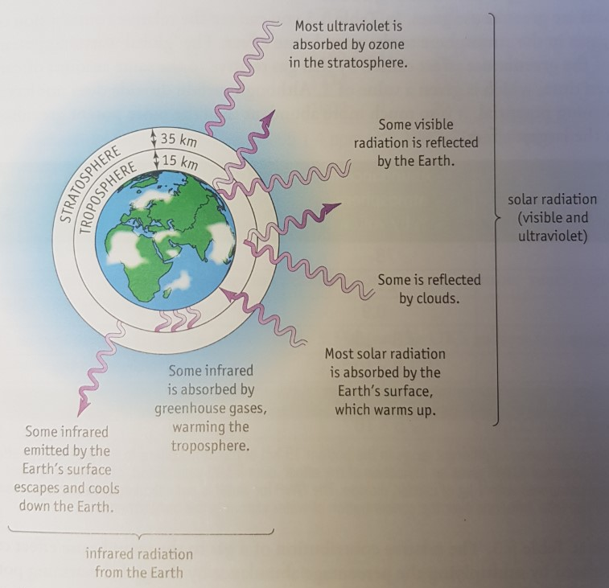
The Greenhouse Effect
In a moment, an image will appear on the board. You have 1 minute to memorise it…

Slide 36
Mini whiteboards: Now scribble down everything you can recall…
How did you do…

Slide 37
Carbon dioxide or methane?
Burning fossil fuels
Carbon dioxide

Slide 38
Carbon dioxide or methane?
Medium global warming potential
Carbon dioxide

Slide 39
Carbon dioxide or methane?
Cattle and rice paddies produce it
Methane

Slide 40
Carbon dioxide or methane?
Higher use of fossil fuels for electricity generation has caused a increase in this gas
Carbon dioxide

Slide 41
Task: answer the exam questions
1. The Intergovernmental Panel on Climate Change (IPCC) has issued the following statement:
"Human influence on the climate system is clear, and recent anthropogenic emissions
of greenhouse gases are the highest in history. Recent climate changes have had
widespread impacts on human and natural systems."
(a) Explain why anthropogenic emissions of greenhouse gases are affecting the climate. (3)

Slide 42
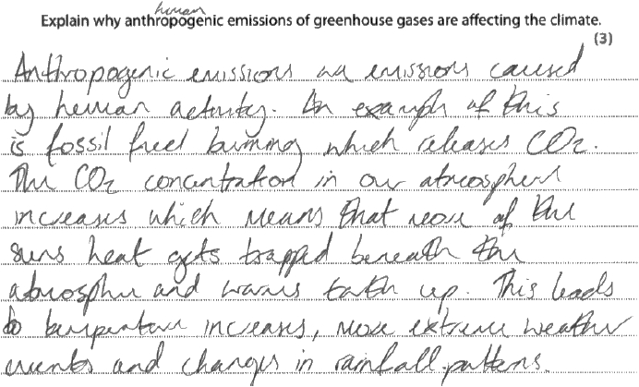
Model Answer

Slide 43
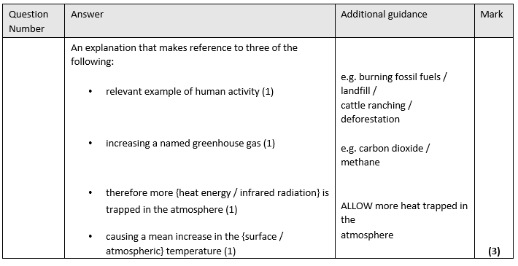

Slide 44
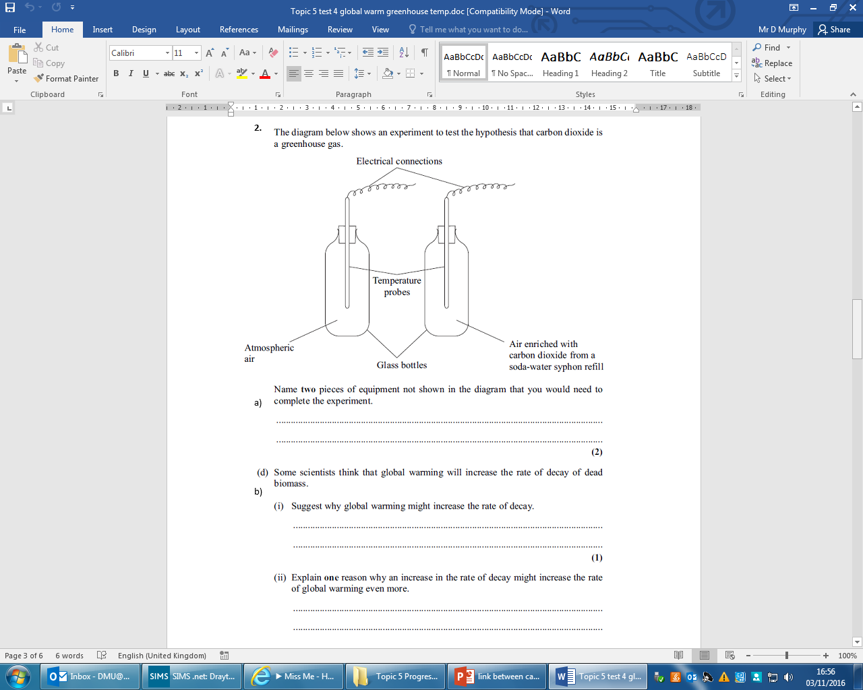
Task: answer the exam questions

Slide 45
A data logger and a heat source

Slide 46
Increased enzyme activity
If the rate of decay increases, then more carbon dioxide is released into the atmosphere. Carbon dioxide is a greenhouse gas, and thus would increase the greenhouse effect.

Slide 47
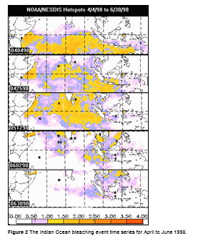
Think Pair Share
Where is the temperature change highest over the months?
What impact does this have on coral?
What impact could this have on the ecosystem?
Notes:
Might be better to do this after the assessed task?

Slide 48
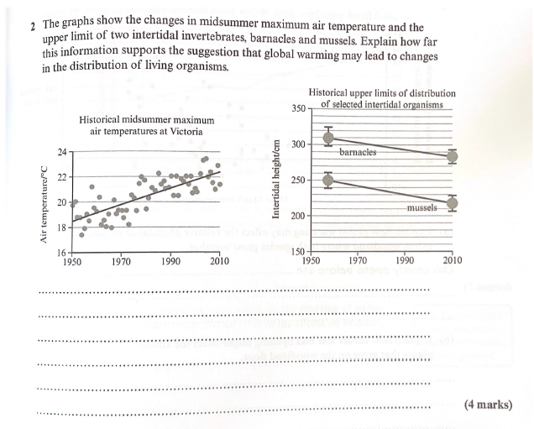
Exam Question
Hint: correlation or cause?

Slide 49
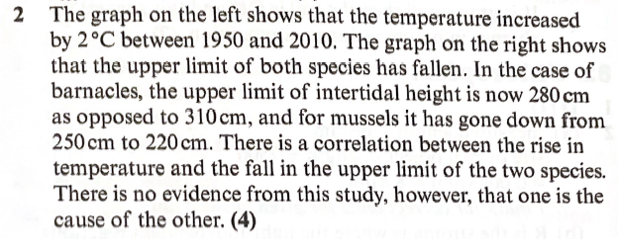
Answers

Slide 50
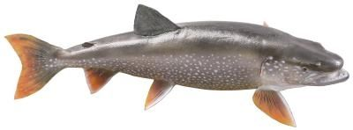
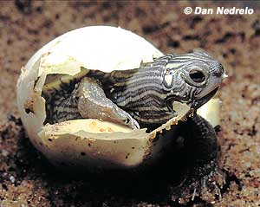
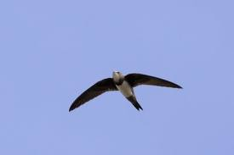
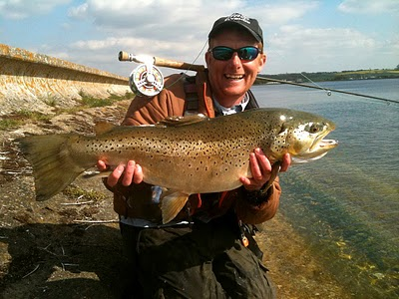
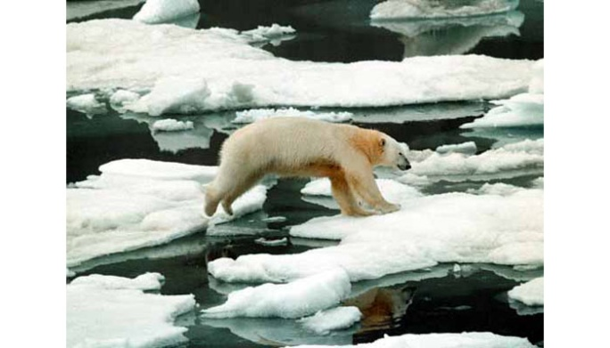
How would a rise in average temperature affect the development of the following?
The temperatures of egg incubation affects the sex of reptiles born
Salmon spawn over winter when temperatures start to drop
Brown trout stop growing in late summer when the temperature warms up
It is taking longer for ice to form around Canada’s Hudson Bay
Swallows migrate back to the UK in spring when the temperature is warmer to allow them to breed
Notes:
Write then share (thinking time)

Slide 51
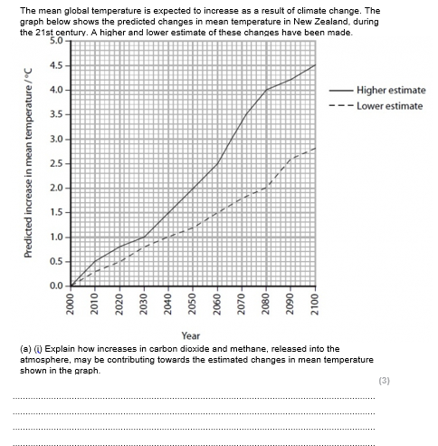

Slide 52
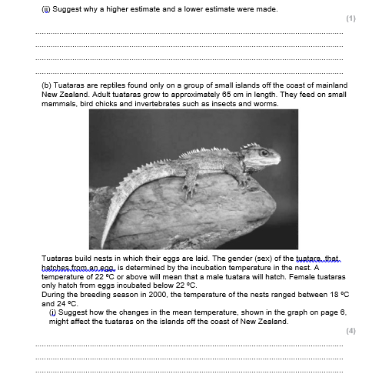

Slide 53
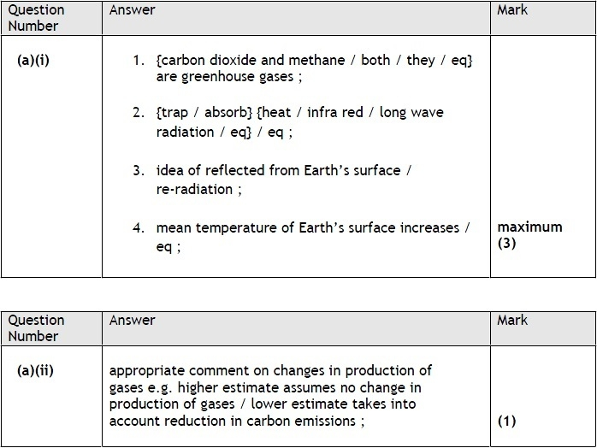

Slide 54
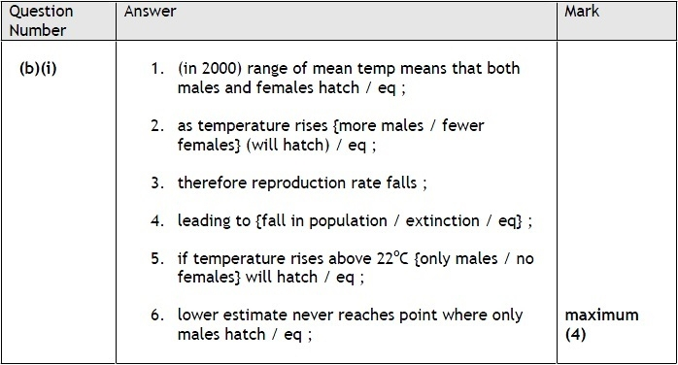

Slide 55
Exam Skill Focus:
Complete the exam questions in the booklet provided by your teacher.
The teacher will project some of the questions on the visualiser to help you to answer them.
Then mark using the mark scheme and add in improvements in green pen.
Teacher note: At least 25 minutes of the lesson should be spent doing this

Slide 56
Exit Ticket
Traffic light your PLC for:
5.10 i) Be able to calculate net primary productivity.
ii) Understand the relationship between gross primary productivity, net primary productivity and plant respiration.
5.11 Know how to calculate the efficiency of biomass and energy transfers between trophic levels.
5.12 Understand the different types of evidence for climate change and its causes (including records of carbon dioxide levels, temperature records, pollen in peat bogs and dendrochronology), recognising correlations and causal relationships.
5.13 Understand the causes of anthropogenic climate change, including the role of greenhouse gases (carbon dioxide and methane) in the greenhouse effect.
5.14 i) Understand that data can be extrapolated to make predictions and that these are used in models of future climate change.
ii) Understand that models for climate change have limitations.
5.15 Understand the effects of climate change (changing rainfall patterns and changes in seasonal cycles) on plants and animals (distribution of species, development and life cycles).
5.16 Understand the effect of temperature on the rate of enzyme activity and its impact on plants, animals and microorganisms.

