Slide 1
Fast and slow twitch muscles revision
22 May, 2025
DO NOW
What does the cardiovascular centre do to increase heart rate?
How does HIV invade T helper cells?
What are two ethical issues raised by the use embryonic stem cells?
Why is water a polar molecule?

Slide 2
Answers
Sends nerve impulses via the sympathetic nerve to cause more frequent depolarisation at the SAN
(gp120) glycoprotein molecules on the virus surface bind to CD4 receptors on the surface of t helper cells. they then combine with a second receptor. this allows the envelope surrounding the virus to fuse with the T helper cell membrane, enabling the viral RNA to enter the cell.
Embryos have the right to life as they are a genetically unique individual, cannot consent. some people have fewer objections to stem cells that have been artificially activated as the cells couldn't survive past a few days anyway.
Oxygen is more electronegative than Hydrogen so there is a slight difference in charge between the atoms.

Slide 3
Types of fibres
Skeletal muscles are made up of two types of muscle fibres – slow twitch and fast twitch.
Different muscles have different proportions of these fibres.

Slide 4
Characteristic | Fast twitch | Slow twitch
Speed
Energy
Colour
Energy source
Type of activity suited to
Found in

Slide 5
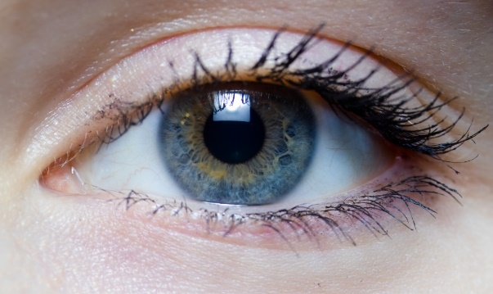
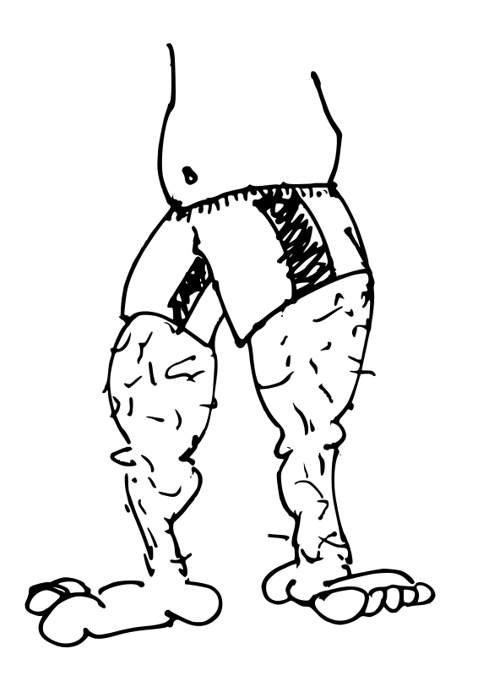
Fast-twitching muscles
Fast twitch muscles contract very quickly, producing rapid, intense contractions.
for fast movement such as in the eyes and legs.
good for short bursts of speed and power e.g. sprinting and weight lifting. They tire quickly
Fast twitch rely on anaerobic respiration using glycogen. There are few mitochondria and blood vessels.
whitish in colour because they don´t have much myoglobin. They respire anaerobically.
High glycogen content and high levels of creatine phosphate, (an organic compound that provides a quick source of energy for muscle fibers to contract).

Slide 6
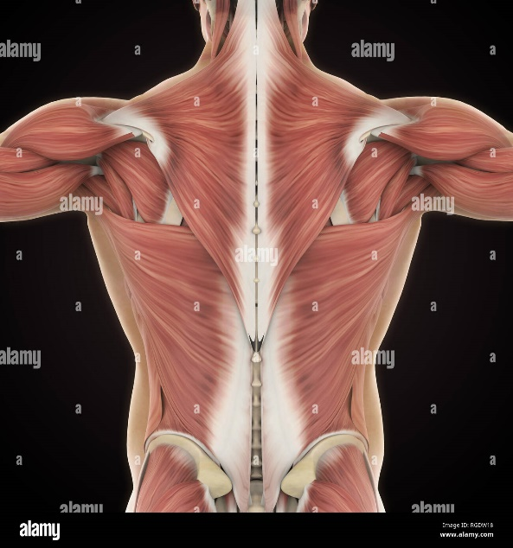
Slow-twitching muscles
Slow twitch muscles are specialised for a slower, sustained contraction.
used for posture e.g. in the back
Good for endurance sports such as running long distances. They are slow to tire.
Energy is released slowly through aerobic respiration in slow twitch. They have many mitochondria and blood vessels supplying oxygen
Slow twitch fibres are reddish in colour because they are rich in myoglobin ( a red coloured protein that stores oxygen).

Slide 7
Exam Question - visualiser

Slide 8
TPS: MWB
What: Improve this KS4 answer to A level standard. ‘How does your body increase heat loss?’ Explain your improvement.
How: independently for 1 min, in pairs for one min
Sweat is released by sweat glands onto the surface of the skin, which cools you down. Another way the body increases heat loss is when the blood vessels near the surface of the skin widen, allowing more blood to flow close to the surface. This helps heat transfer from the blood to the surroundings.
Notes:
Thermoreceptors at the hypothalamus

Slide 9
Answers
Sweat is released by sweat glands onto the surface of the skin. When the sweat evaporates, it takes heat away from the body, which cools you down. Another way the body increases heat loss is through vasodilation. This is when the blood vessels (capillaries) near the surface of the skin widen, allowing more blood to flow close to the surface. This helps heat transfer (radiation) from the blood to the surroundings.
Notes:
Thermoreceptors at the hypothalamus

Slide 10
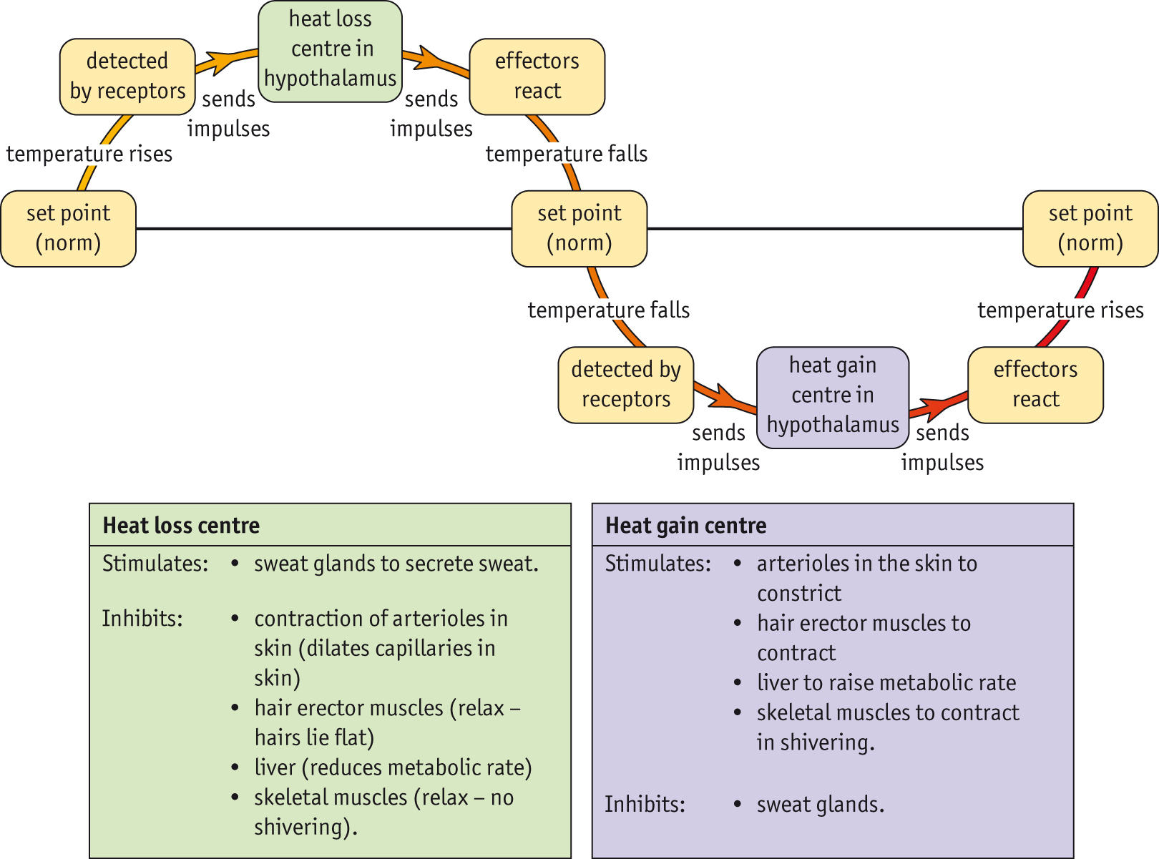

Slide 11
Exam Question - visualiser

Slide 12
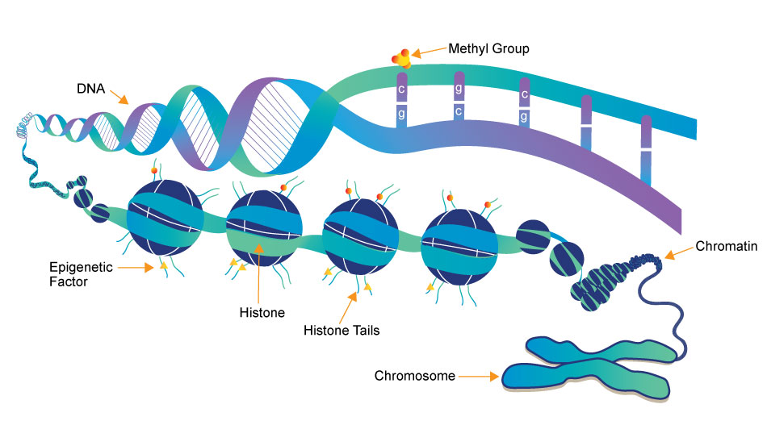
What is the role of the epigenome?
DNA is wrapped around histone proteins which both have chemical markers on them.
These chemical markers make up the epigenome
This influences which genes can be transcribed in a particular cell
The epigenome can be affected by the environment.

Slide 13
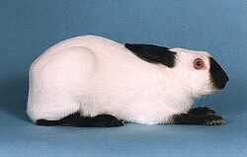
Paired task: Answer the question
Himalayan rabbits have an allele of the tyrosinase gene which produces an enzyme which is inactivated at normal body temperature
Extremities – tips of ears, nose, paws – are much darker than the rest of the animal . How?
In the warmer parts of the body tyrosinase is denatured so no melanin is produced and the hair is white.
The extremities of the body are slightly cooler so the tyrosinase enzyme remains active so melanin is made so the tips are darker.
So coat colour is the result of genotype + environment
Notes:
13

