Slide 1
T8 animals in research, habituation 12 May 2022
Do Now
What is the visual cortex ?
What are ocular dominace columns ?
What happens during the critical period of visual development ?
How are animal experiments used to invesitigate the effects of nature on brain development ?
What are the reasons against animal research?
Why does habituation to a stimulus mean fewer electrical impulses are sent to effectors?

Slide 2
Review
What is the visual cortex ?
An area of the cerebral cortex at the back of the brain. Its role is to receive and process visual information.
What are ocular dominace columns ?
Neurones in the visual cortex that receive information from either the left or right eye. These neurones are grouped together into these columns. The columns are the same size and are arranged in an alternating pattern.
What happens during the critical period of visual development ?
Synapses that receive visual stimulation and pass nerve impulses into the visual cortex are retained. Synapses that don't receive any visual stimulation and do not pass on any nerve impulses to the visual cortex are eliminated.

Slide 3
Review
How are animal experiments used to invesitigate the effects of nature on brain development ?
To study the effects of different genes, scientists genetically engineer mice to lack a particular gene and then raise mice with and without the gene in similar environments. Differences between the brain development of the genetically engineered mice and normal mice are more likely to be due to nature
What are thre reasons against animal research?
Animals are different from humans so drugs may have different effect in humans. pain and distress caused to animals. alternatives exist - computer models. animals have rights to not be experimented on Animals are different from humans so drugs may have different effect in humans. pain and distress caused to animals. alternatives exist - computer models. animals have rights to not be experimented on
Why does habituation to a stimulus mean fewer electrical impulses are sent to effectors?
Repeated exposure to stimulus decreases Ca2+ entering the presynaptic neurone. This decrease in influx of Ca2+ means less neurotransmitter is released from vesicles into the synaptic cleft, so fewer neurotransmitters can bind to receptors in the post synaptic membrane. Fewer Na+ channels on the post synaptic membrane open, so theres a lower chance of AP threshold being reached. Few signals are sent to the effector to carry out response

Slide 4
Lesson objectives
To review A03 skills required for your A-level Biology exams.
The Bigger Picture
A03 questions are roughly 25-27% of your marks
They are usually based on experiment skills
They require you to analyse, interpret and evaluate scientific information, ideas and evidence, including in relation to issues, to:
make judgements and reach conclusions
develop and refine practical design and procedures

Slide 5
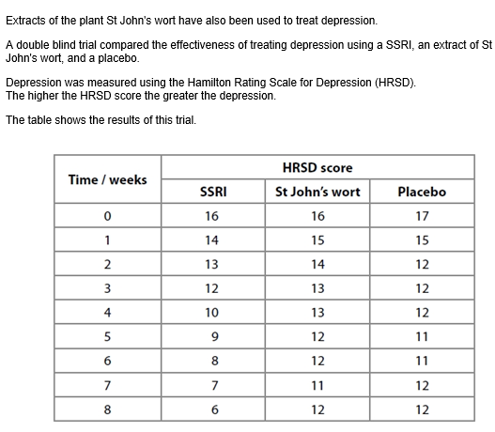
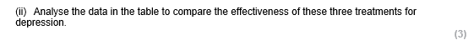
Partner Talk
What does the command word compare mean that you have to do?
Similarities and differences
What are you expecting to see if these treatments are effective?
Low HRSD score
Which treatment is the most effective? How can you tell from the data?
SSRI because its HRSD score reduces the quickest and to the lowest value

Slide 6
Independent task

Slide 7
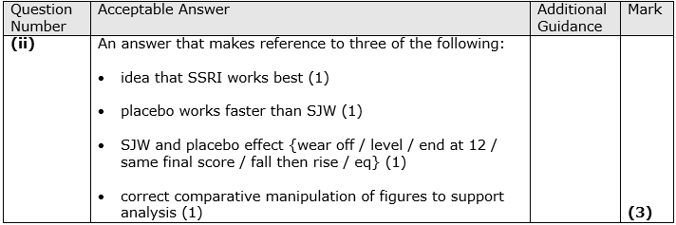
Review

Slide 8
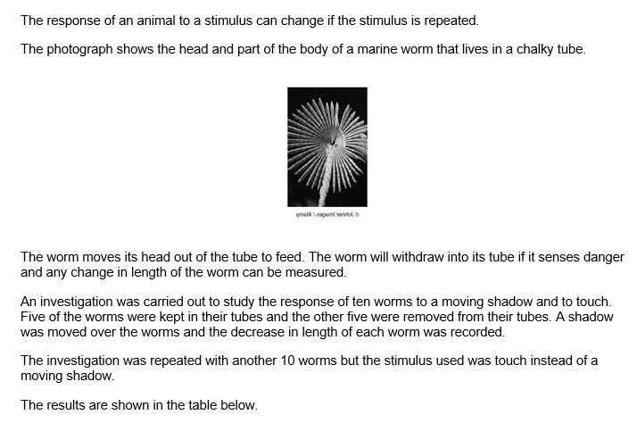

Slide 9
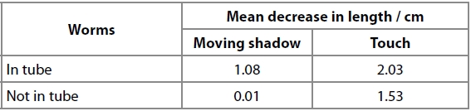
Partner Talk
Discuss a) what the data shows the worm responds to most b) why you think this might be
Analyse the data to explain the difference in the withdrawal response of the worms to the different stimuli (3)
Explain how repeated touch stimulation reduces the withdrawal response (5)

Slide 10
Analyse the data to explain the difference in the withdrawal response of the worms to the different stimuli (3)
Explain how repeated touch stimulation reduces the withdrawal response (5)

Slide 11
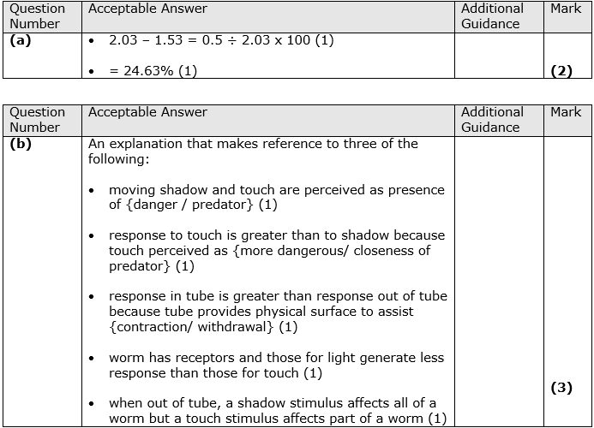

Slide 12
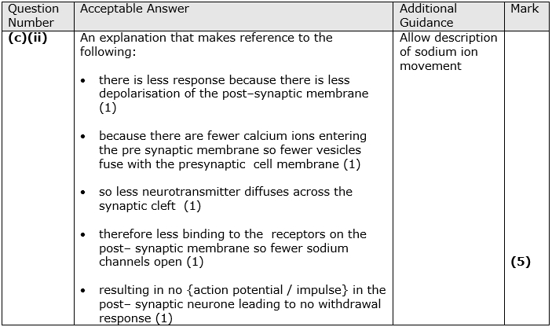

Slide 13
Exam Skill Focus:
Complete the exam questions in the booklet provided by your teacher.
The teacher will project some of the questions on the visualiser to help you to answer them.
Then mark using the mark scheme and add in improvements in green pen.
Teacher note: At least 25 minutes of the lesson should be spent doing this

Slide 14
Exit Ticket
What rules would you give yourself when answering an ‘analyse’ question?
Suggestions:
Check what the command word is after this.
Describe trends in the data that show what is being asked for.
Look out for any SD overlaps
Add in data manipulation to demonstrate the trend being described/asked for.
Identify any biological knowledge that you might need to apply.

