Slide 1
T8 the brain, imaging, Parkinson’s and ecstasy 24 May 2022
Do Now
Which lobe of the cerebral hemisphere processes visual information?
What is the function of the cerebellum?
What can fMRI show us that MRI cannot?
What do we call the technology that uses radioactive isotopes with short half lives?
Name the neurotransmitters that are responsible for Parkinson’s and depression?
Why is L-dopa used as a treatment for Parkinson’s, rather than dopamine itself?
Depression is probably “multifactorial”. What does this mean?
What is an SSRI?

Slide 2
Answers
Do Now
Which lobe of the cerebral hemisphere processes visual information?
Occipital
What is the function of the cerebellum?
Coordinates balance, real time movement (receiving information and deciding on best programmes)
What can fMRI show us that MRI cannot?
Changes in the brain due to activity, rather than just structure alone
What do we call the technology that uses radioactive isotopes with short half lives?
Positron Emissions Tomography (PET)

Slide 3
Answers
Do Now
Name the neurotransmitters that are responsible for Parkinson’s and depression?
Lack of dopamine in Parkinson’s and a lack of serotonin in depression
Why is L-dopa used as a treatment for Parkinson’s, rather than dopamine itself?
L-dopa can cross the blood-brain barrier, whereas dopamine cannot
Depression is probably “multifactorial”. What does this mean?
Depression is probably caused by a combination of several alleles, combined with environmental experiences such as trauma
What is an SSRI?
Selective Serotonin Re-uptake Inhibitor – prevents the reuptake of serotonin into the pre-synaptic membrane, increasing the concentration in the synapse, increasing the level of depolarization in the post-synaptic membrane

Slide 4

Thumbs Up/Down. How much do you think you know about:
8.8 Know the location and functions of the cerebral hemispheres, hypothalamus, cerebellum and medulla oblongata in the human brain.
8.9 Understand how magnetic resonance imaging (MRI), functional magnetic resonance imaging (fMRI), positron emission tomography (PET) and computed tomography (CT) scans are used in medical diagnosis and the investigation of brain structure and function.
8.14 Understand how imbalances in certain, naturally occurring brain chemicals can contribute to ill health, including dopamine in Parkinson’s disease and serotonin in depression, and to the development of new drugs.
8.15 Understand the effects of drugs on synaptic transmissions, including the use of L-Dopa in the treatment of Parkinson’s disease and the action of MDMA in Ecstasy.

Slide 5
Teacher note
only recap one of these areas if the majority of the class highlight it as an area of development
Then go to slide 55 for exam skill focus

Slide 6
Focus Area 1 from Do Now:
8.8 Know the location and functions of the cerebral hemispheres, hypothalamus, cerebellum and medulla oblongata in the human brain.

Slide 7
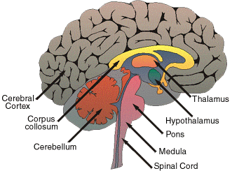
Parts Of The Brain
There are 3 parts to the brain
The hindbrain
Brainstem – Uppermost part of the spine, where the spine joins the brain
Medulla - controls vital ‘housekeeping’ functions, such as heartbeat, blood pressure and peristalsis.
Cerebellum - controls muscle co-ordination & learns motor programmes (e.g. like how to ride a bike, or write).
The midbrain is small and connects the forebrain to the hindbrain
The forebrain
Pituitary gland
Hypothalamus – contains homeostatic centres, which control processes such as body temperature
Cerebral cortex

Slide 8
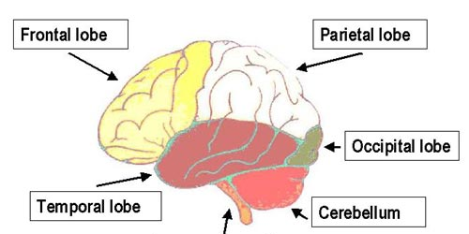
The forebrain (cerebral cortex):study the image and information carefully for 1 minute
sensory cortex processes and interprets information about touch, taste, pressure, pain, heat and cold --> sensation
motor cortex involved in control of concious movement
association area associated with decision making, learning, ‘thinking’. memory, conciousness of emotions, speech
processes & interprets information from the eyes → vision
processes & interprets information from the ears → hearing
processes sound recognition and speech
co-ordination of movement and balance
medulla – control of heartbeat, breathing

Slide 9
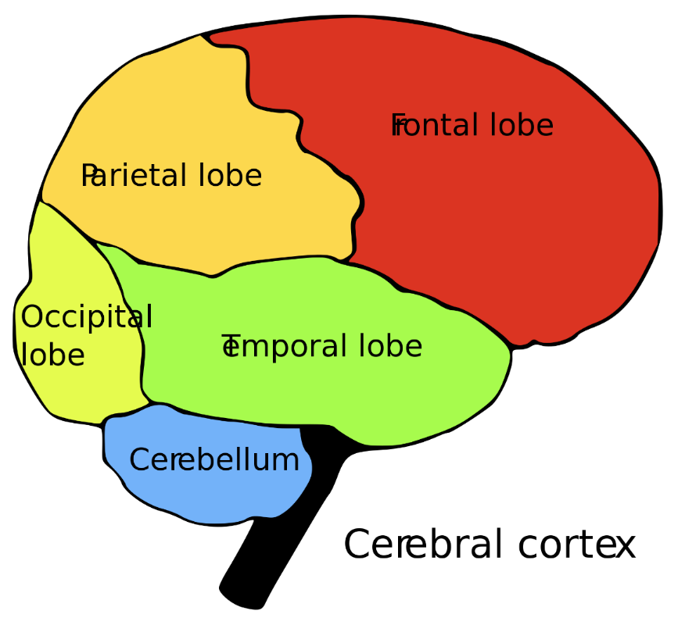
Regions of the Brain: the cerebral cortex
What are the names of each lobe?
1
2
1
2
4
3
4
5
3
5

Slide 10
Regions of the Brain: the cerebral cortex
Which lobe?
Is where you think and make decisions?
Would process pain from touching something sharp?
Where on your head are your ears found?! In music what word describes the pace?
Is involved in storing your memories?
Is involved in your eye sight?
Is involved in processing how good your food tastes?
Frontal lobe
Parietal lobe
Temporal lobe
Frontal lobe
Occipital lobe
Parietal lobe

Slide 11
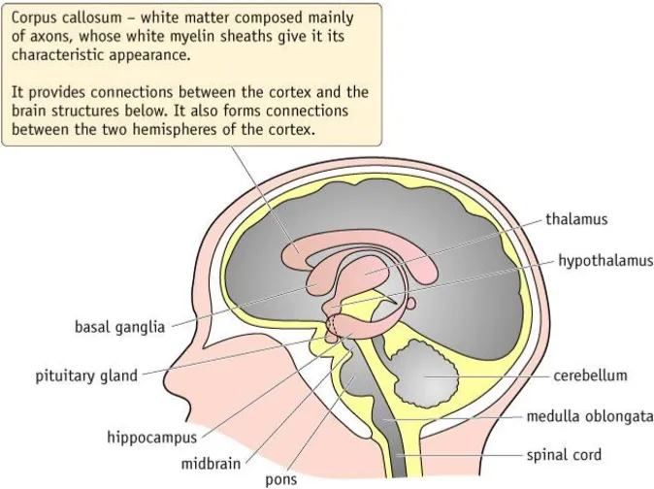
The forebrain continued
There are different regions of the brain that control different behaviours and responses:
Hypothalamus – controls body temperature and secretes hormones such as ADH
Pituitary gland – produces hormones which are involved in the co-ordination and control of body systems

Slide 12
The hind brain
There are different regions of the brain that control different behaviours and responses:
Cerebellum – concerned with coordinating muscular activity and balance.
Medulla oblongata – concerned with unconscious activities such as controlling heartbeat, movements of gut and breathing.

Slide 13
Which part of the brain has been damaged?
A patient has great difficulty moving down stairs.
Cerebral cortex
Hypothalamus
Pituitary
Cerebellum
Medulla

Slide 14
Which part of the brain has been damaged?
A patient is slurring and has broken speech.
Cerebral cortex
Hypothalamus
Pituitary
Cerebellum
Medulla
Can you give the name of the lobe?
Frontal

Slide 15
Which part of the brain has been damaged?
A patient struggles with their short term memory.
Cerebral cortex
Hypothalamus
Pituitary
Cerebellum
Medulla
Can you give the name of the lobe?
Frontal

Slide 16
Which part of the brain has been damaged?
A patient falls frequently.
Cerebral cortex
Hypothalamus
Pituitary
Cerebellum
Medulla

Slide 17
Which part of the brain has been damaged?
A patient has developed arrhythmia (irregular heart beat)
Cerebral cortex
Hypothalamus
Pituitary
Cerebellum
Medulla

Slide 18
Which part of the brain has been damaged?
A patient struggles with their long term memory.
Cerebral cortex
Hypothalamus
Pituitary
Cerebellum
Medulla

Slide 19
Which part of the brain has been damaged?
A patient has struggles to breathe at a steady rate.
Cerebral cortex
Hypothalamus
Pituitary
Cerebellum
Medulla

Slide 20
Focus Area 2 from Do Now:
8.9 Understand how magnetic resonance imaging (MRI), functional magnetic resonance imaging (fMRI), positron emission tomography (PET) and computed tomography (CT) scans are used in medical diagnosis and the investigation of brain structure and function.

Slide 21
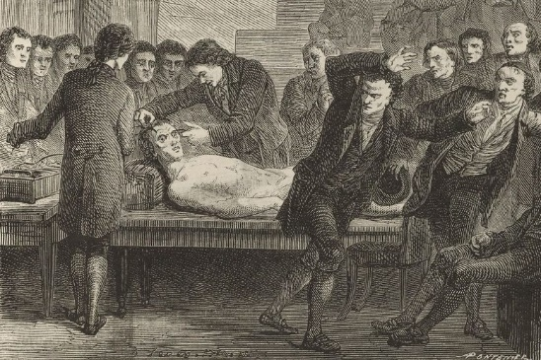
Investigating Brain Structure
Until fairly recently there were main three ways of studying the brain:
1. Anatomical study from dead bodies
A cadaver or corpse is a dead human body that is used by medical students, physicians and other scientists to study anatomy.

Slide 22
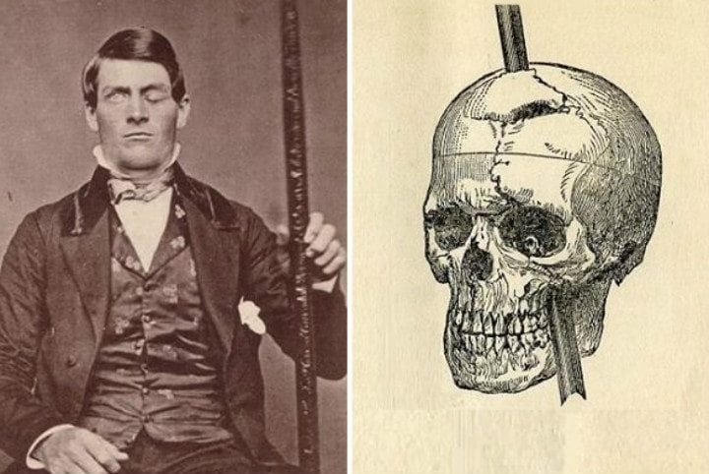
Investigating Brain Structure
2. Studying people with brain damage
By matching damaged areas of the brain to changes in behaviour or memory have helped elucidate the functions of some parts of the brain.
In 1848, Phineas Gage suffered an accident.
He was polite and hardworking, became rude and unreliable.
Today we know an area of his cerebral cortex was damaged which controlled social inhibitions.

Slide 23
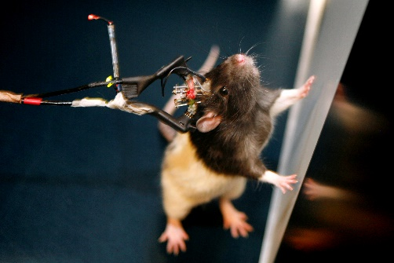
Investigating Brain Structure
3. Studies using animals
Animals are used because it is possible to control the extent of a lesion or area of stimulation under laboratory conditions.

Slide 24
Investigating Brain Structure
The problem with these studies is that the activity of the brain is not measured directly: it is either inferred from behaviour, or by identifying links between tissue damage and brain function.
So how can we measure the activity of the brain directly, without having to operate?

Slide 25
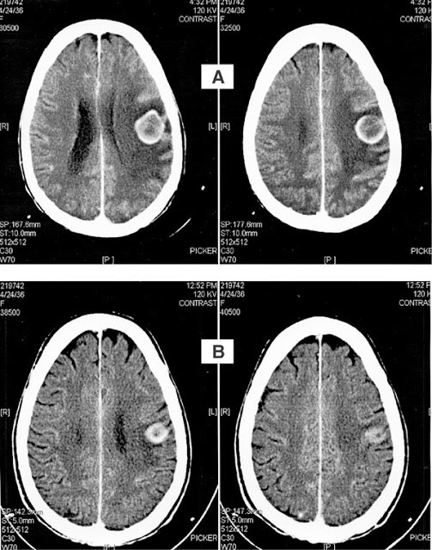
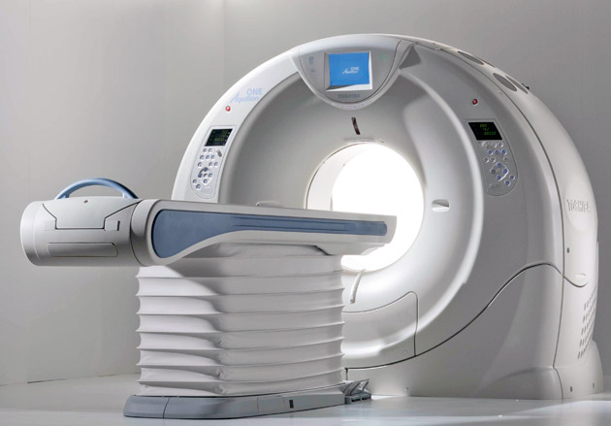
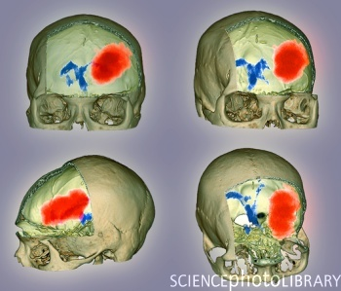
CT/CAT Scan – allows 3D scan of soft tissue using x-rays

Slide 26
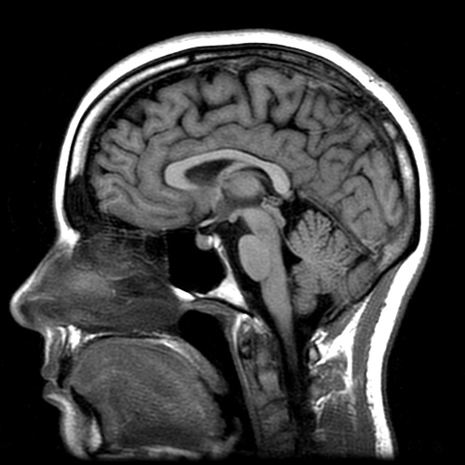
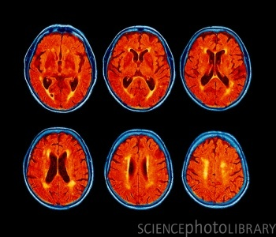
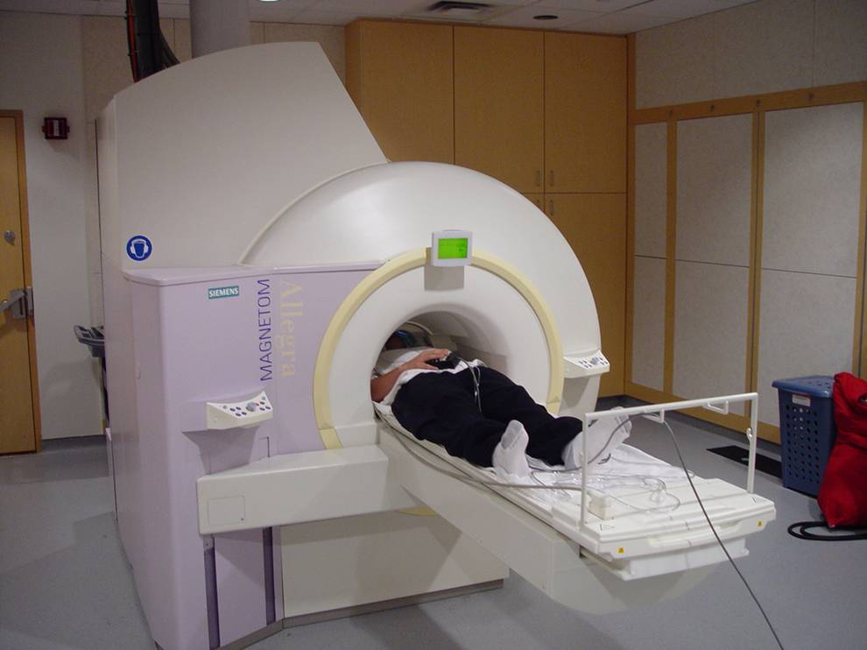
MRI Scan – uses a magnetic field and radiowaves to gain high resolution image of soft tissue
This is an MRI of someone with alzheimers. What do you notice about the images?

Slide 27
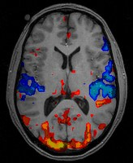
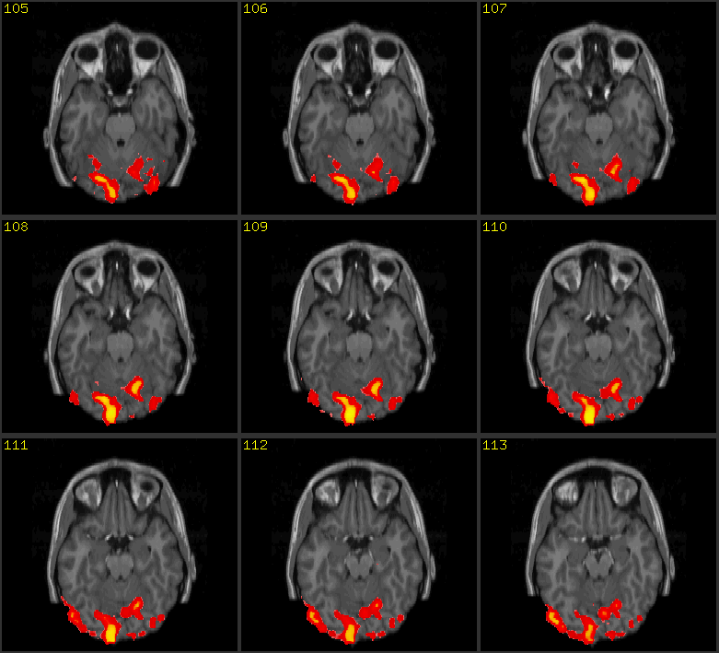
fMRI –looks at oxygen uptake so can see brain activity

Slide 28
Task: copy the table
Use the textbooks, revision guides and following slide to fill this table in:
 | How it works | What it can show? | Pros | Cons
CT scan
MRI scan
fMRI scan
PET scan

Slide 29
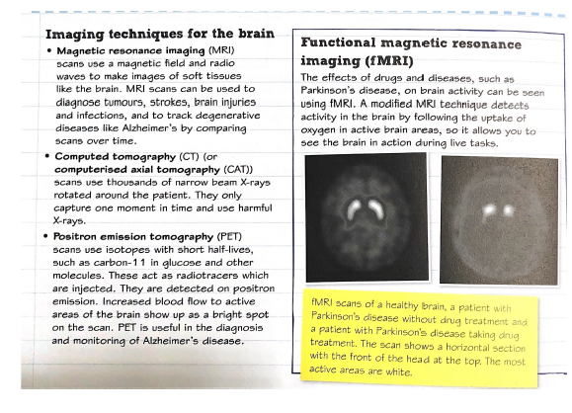

Slide 30
 | How it works | What it can show? | Pros | Cons
CT scan | Narrow beam x-rays are attenuated according to the density of the tissue. | Soft tissues within the brain can be distinguished. | They give detailed structures and can detect brain disease. | Only give a ‘frozen moment’, so look at structures and not brain function. Limited resolution. X-rays can be harmful.
MRI scan | Uses a magnetic field and radiowaves to monitor H nuclei in water in the tissues. Energy from radiowaves is released from the H nuclei when switched off, detected and sent to the computer. | It gives a 3D image to detect tumours, strokes, brain injuries etc by comparing images over time. | The images have a higher resolution than CT scans. | Time it takes and cost.

Slide 31
 | How it works | What it can show? | Pros | Cons
fMRI scan | Radiowaves are absorbed by deoxyheamoglobin, where as oxyheamoglobin does not. This shows where neural activity is happening since neural activity results in an increase demand for oxygen and therefore blood flow. Here there will be an increase in oxyheamoglobin with blood flow and therefore less radio signal is absorbed. | This can show brain action such as memory, emotions, language and consciousness. Can follow a sequence of events over time. | This shows the functioning and activity of the brain. | Can only capture images if the patient is very still, is expensive and has low temporal resolution because of a 5 second time lag.
PET scan | PET uses isotopes with short half lives, such as carbon 11 that are incorporated into compounds such as glucose or water. They use labelled radiotracers which show up with an increased blood flow to an area of neural activity. | Used to produce detailed images that allow the structure and functioning of tissues and organs to be evaluated. Helps to diagnose cancers, heart disease and brain disorders. | They can be used to monitor Alzheimers to look at the accumulation of plaques. PET is good at determining whether lesions in the body are benign or malignant, eliminating the need for surgical biopsies if PET scans are negative. | A PET scan can only be done once or twice a year for safety reasons.

Slide 32
True or False?
fMRI and MRI scans can give you details about brain activity.
fMRI scans use isotopes with short half lives.
CT scans are lower resolution than MRI scans.
MRI uses a magnetic field and radiowaves to monitor H nuclei in water in the tissues.
PET scans can tell you whether a tumour is benign or malignant.
CT scans use radiowaves and a magnetic field.
PET uses isotopes with short half lives, such as oxygen 14 that are incorporated into compounds such as glucose or water. These act as radiotracers.
F
F
T
T
T
F
F
Correct the false statements

Slide 33
True or False?
fMRI and MRI scans can give you details about brain activity and MRI shows you brain image.
fMRI scans use isotopes with short half lives radiowaves that are absorbed by deoxyheamoglobin, where as oxyheamoglobin does not.
CT scans are lower resolution than MRI scans.
MRI uses a magnetic field and radiowaves to monitor H nuclei in water in the tissues.
PET scans can tell you whether a tumour is benign or malignant.
CT scans use radiowaves and a magnetic field narrow beam x-rays are attenuated according to the density of the tissue.
PET uses isotopes with short half lives, such as oxygen 14 carbon 11 that are incorporated into compounds such as glucose or water. These act as radiotracers.
T
T
T
Correct the false statements

Slide 34
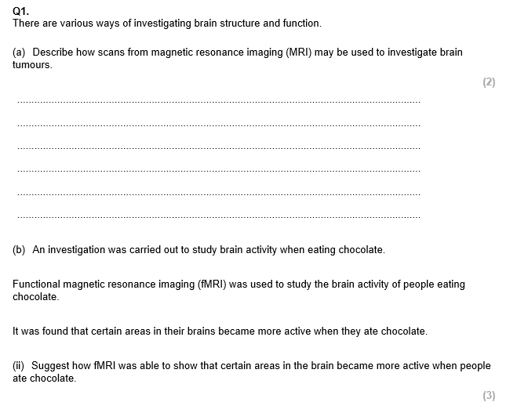
Exam Practice
Notes:
https://forms.office.com/Pages/ShareFormPage.aspx?id=iYn3rziWp0eNI4TyuLlMi8B-BXJHprdNq73bu_EMIc5UQUxPODVCN1pRTVIxMTBSQVU5VEpSM00wOS4u&sharetoken=ToBKkaRXGJ7Qt1VQeZoy

Slide 35
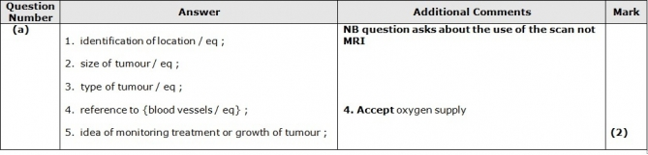
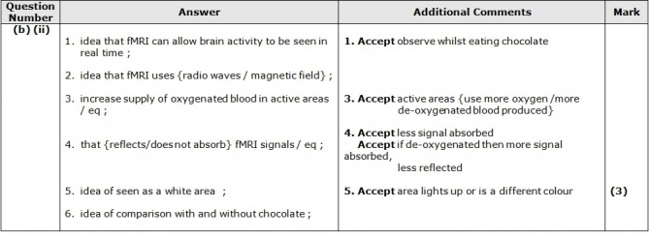

Slide 36
Focus Area 3 from Do Now:
8.14 Understand how imbalances in certain, naturally occurring brain chemicals can contribute to ill health, including dopamine in Parkinson’s disease and serotonin in depression, and to the development of new drugs.

Slide 37
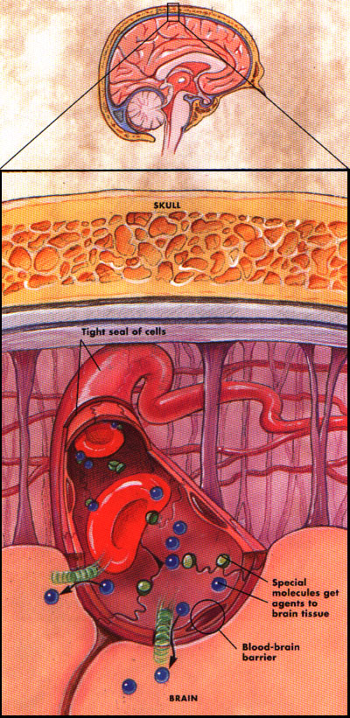
The Blood-Brain Barrier
The blood–brain barrier is the separation of circulating blood and the brain extracellular fluid in the central nervous system (CNS)
Prevents infection of the brain
It does this by having endothelial cells which restrict the diffusion of microscopic objects which are large and hydrophilic
Small hydrophobic molecules, such as oxygen, CO₂ or hormones can diffuse through easily
Unfortunately, because antibodies and antibiotics are too large to cross the blood–brain barrier, infections of the brain that do occur are often very serious and difficult to treat.

Slide 38
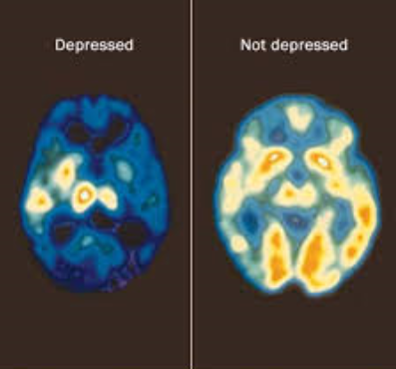
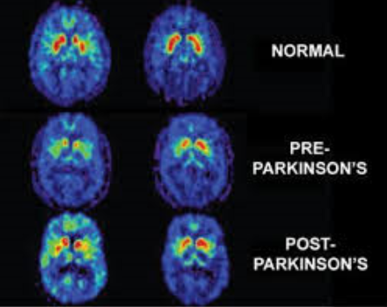
Depression and Parkinson’s disease
Both are caused by chemical imbalances in the brain.
Depression involves the neurotransmitter serotonin.
Parkinson’s involves the neurotransmitter dopamine.
Both can have a genetic link: In Parkinson’s this is often due to mutations in one of several identified genes.
More often the depression and Parkinson’s are multifactorial.

Slide 39
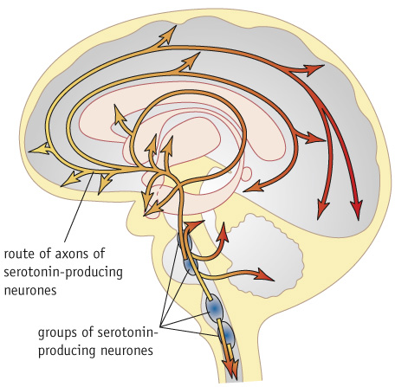
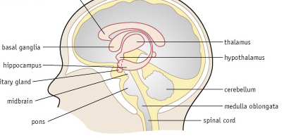
Study Parkinson’s (P248) and Depression (P250) on the subsequent slides. Read and then answer these questions:
How is the neurotransmitter involved (diagram of mechanism)?
What are the symptoms?
What are the treatments (diagram of mechanisms)?
Any other important info

Slide 40
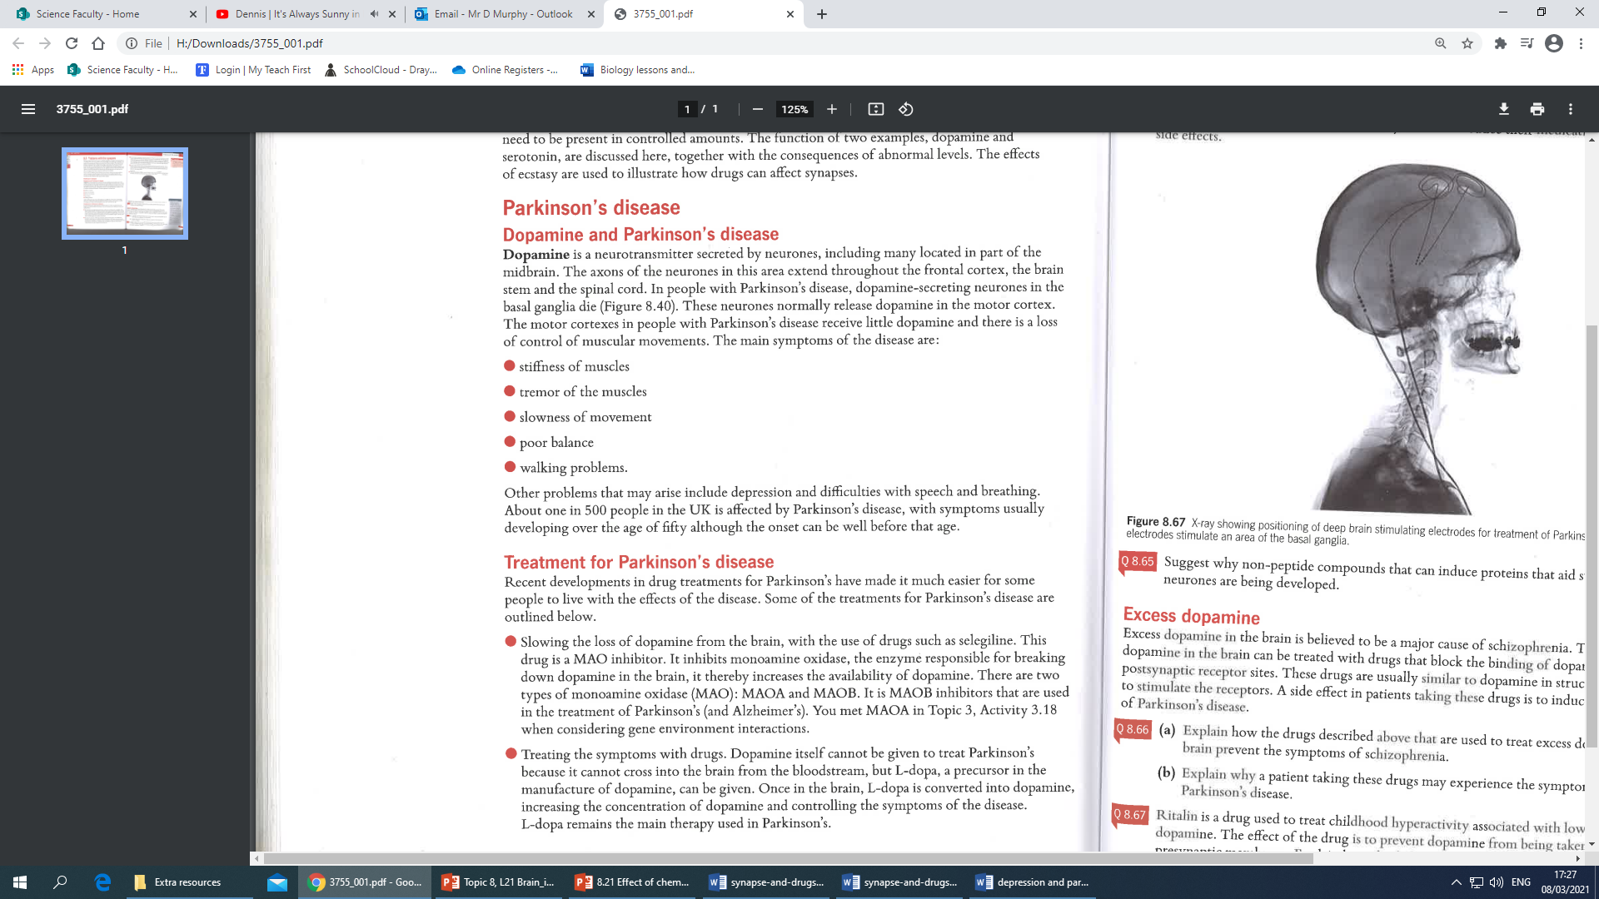

Slide 42
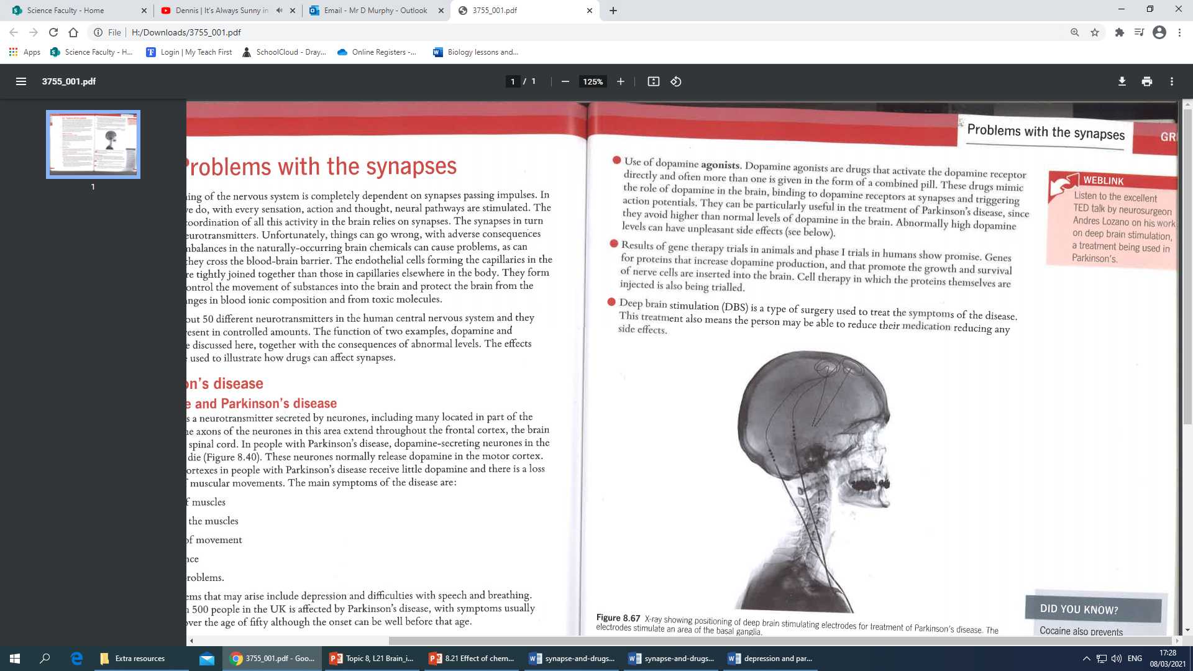

Slide 43
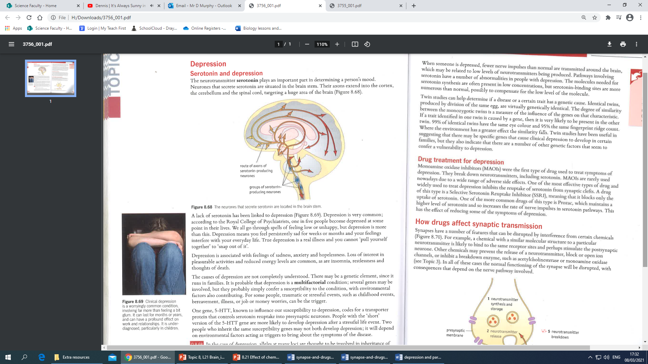

Slide 44
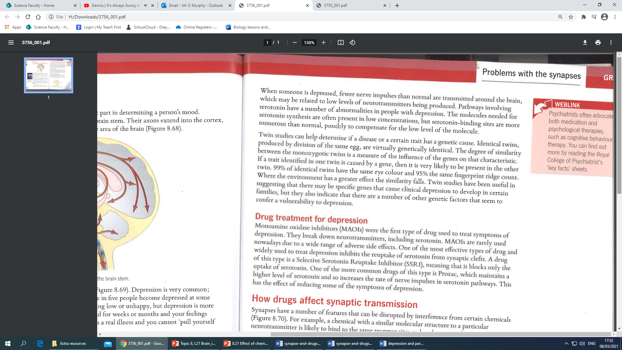

Slide 46
Depression or Parkinsons?
P
Is caused by a lack of dopamine.
A symptom is stiffness of muscles.
Is caused by a lack of serotonin.
It can be treated by using MAOB inhibitors to prevent the enzymes responsible for breaking down dopamine.
The causes are multifactorial, including genes such as the 5-HTT gene and lifestyle factors such as stress.
Selective Serotonin Reuptake Inhibitor (SSRI) drugs that block the re-uptake of serotonin can help with the symptoms.
P
D
P
D
D

Slide 47
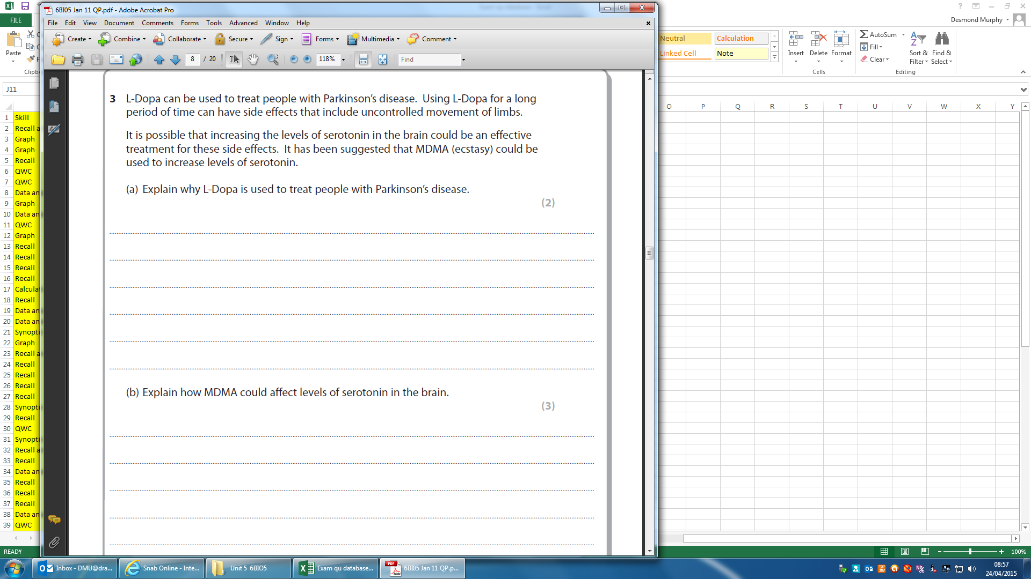
Exam Practice:

Slide 48
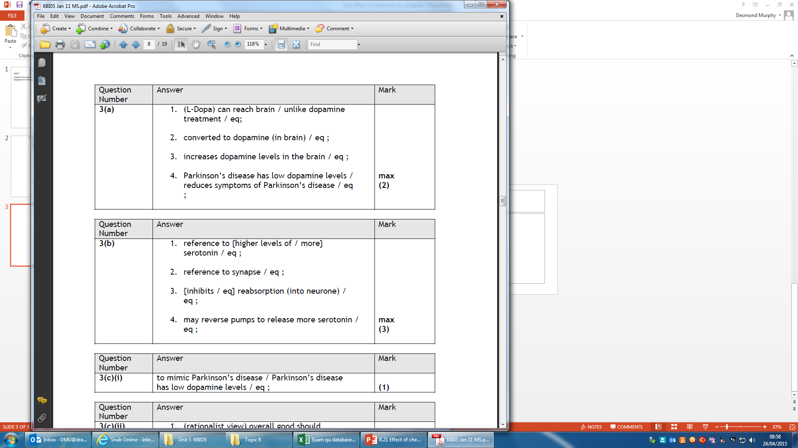
Exam Practice:

Slide 49
Focus Area 4 from Do Now:
8.15 Understand the effects of drugs on synaptic transmissions, including the use of L-Dopa in the treatment of Parkinson’s disease and the action of MDMA in Ecstasy.

Slide 50
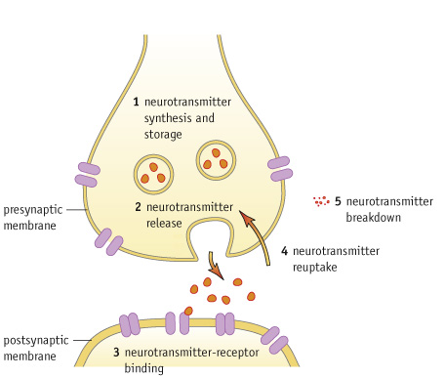
The diagram shows the variety of ways drugs can effect the synapse.
Prozac is an SSRI- which number represents the way that Prozac works?
What effects can Drugs have on Synapses…
Ecstasy works in the same way, increasing the serotonin concentration in the synapse by binding to transporter molecules in the presynaptic membrane that are responsible for transporting serotonin back into the cytoplasm and vesicles.

Slide 51
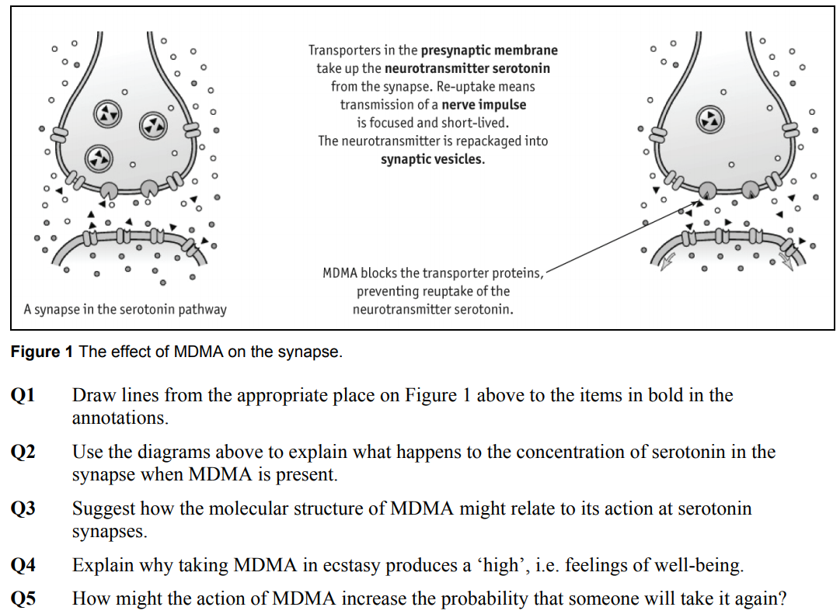

Slide 52
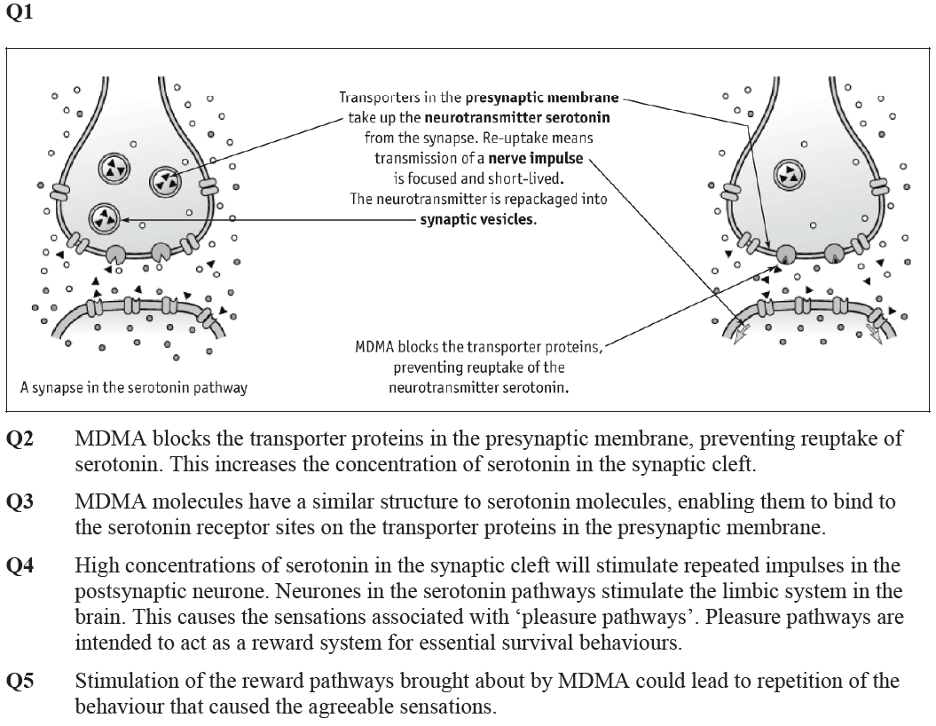

Slide 53
Exam Practice:

Slide 54
Exam Practice:

Slide 55
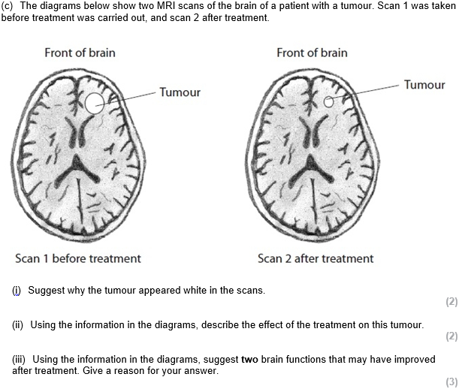
Exam Skill Focus:
A02/3 data analysis questions
Hints-
i) How do tumours compare to normal tissue?
How do MRI scans work?
ii) “using information…” similar to a data question, can you “quote” the image, or “manipulate the data”?
iii) What do you know about location and function?

Slide 56
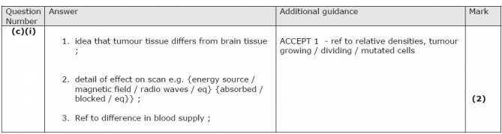
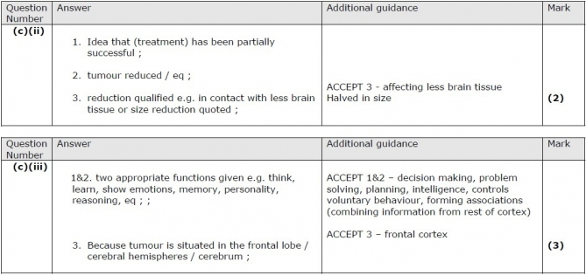
Mark your answers

Slide 57
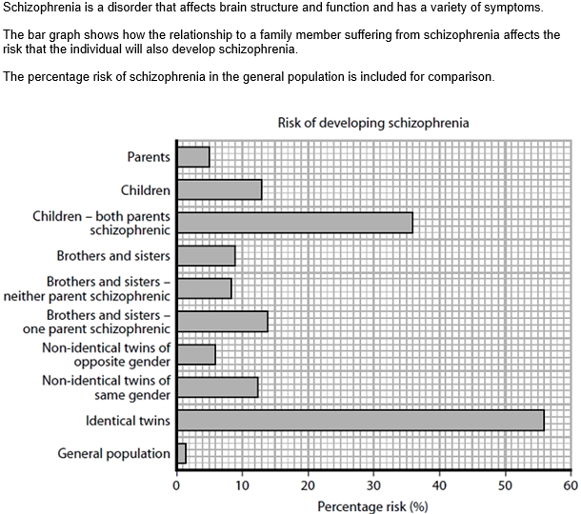
Exam Skill Focus:
(a) Explain the difference between the percentage risks of developing schizophrenia in identical twins and non-identical twins of the same gender. (2)
Hint: notice how it says “the difference” rather than saying “higher” or “lower” – therefore, you can be confident that one mark will be for saying which is higher/lower. Then say why.
(b) Some early studies of schizophrenia included identical twins raised in separate families.
(i) Explain how the design of these studies allows the influence of environmental factors on the development of schizophrenia to be investigated. (2)

Slide 58
Exam Skill Focus:
(ii) The conclusions based on these early studies of identical twins raised in separate families are said to lack validity.
Give two reasons why these studies may lack validity.
(2)
Validity – controlling every other factor apart from the one being investigated. So has it been completely controlled?
(c) Schizophrenia has been linked to abnormally high levels of a neurotransmitter in the brain.
Explain how the action of the drugs used to treat schizophrenia may lead some patients to experience symptoms similar to those of Parkinson's disease.
(5)
“a neurotransmitter” – again, they haven’t mentioned which one, so which is it in Parkinson’s?

Slide 59
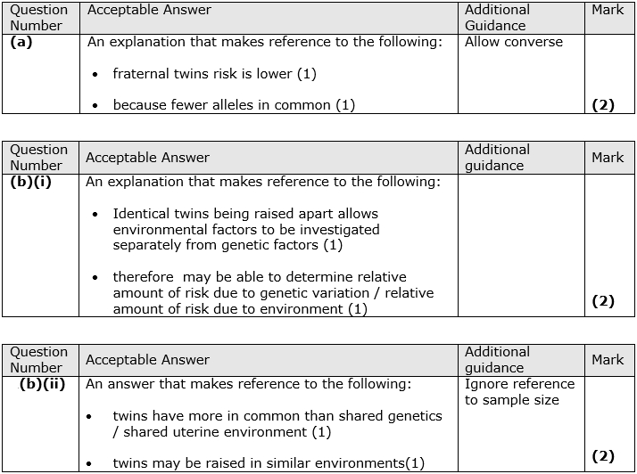
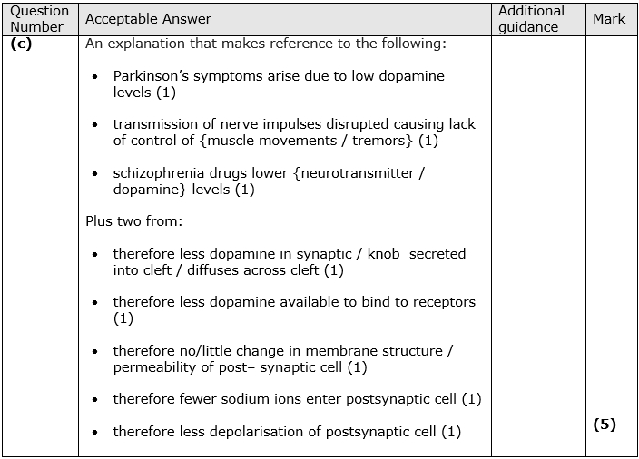
Mark your answers

Slide 60
Exam Question Booklet:
Complete the exam questions in the booklet provided by your teacher now and finish for homework.
The teacher will project some of the questions on the visualiser to help you to answer them.

Slide 61
Key word definitions testing
What: quiz your partner to see which words they can give you the definitions for
How: in pairs using the glossaries
How long: 5 minutes

Slide 62
Exit Ticket
Traffic light your PLC for:
8.8 Know the location and functions of the cerebral hemispheres, hypothalamus, cerebellum and medulla oblongata in the human brain.
8.9 Understand how magnetic resonance imaging (MRI), functional magnetic resonance imaging (fMRI), positron emission tomography (PET) and computed tomography (CT) scans are used in medical diagnosis and the investigation of brain structure and function.
8.14 Understand how imbalances in certain, naturally occurring brain chemicals can contribute to ill health, including dopamine in Parkinson’s disease and serotonin in depression, and to the development of new drugs.
8.15 Understand the effects of drugs on synaptic transmissions, including the use of L-Dopa in the treatment of Parkinson’s disease and the action of MDMA in Ecstasy.

