Slide 1
T8 nerve impulses, rods, synapses and plant responses 19 May 2022
Do Now
What is the role of the Na/K pump and the K+ channel in the resting potential ?
What is the role of depolarisation during an action potential ?
What is the purpose of refractory period ?
How does the calcium influx cause neurotransmitter release (in synapse transmission) ?
What is saltatory conduction?
How do the eyes respond to dim light?
When it is light and your rod cells are stimulated what happens?
Describe how IAA is involved in phototropism
What are short day plants?

Slide 2
Answers
Do Now
What is the role of the Na/K pump and the K+ channel in the resting potential ?
Na/K pumps use AT to move 3 Na+ out of the neurone for every 2 K+ moved in, using ATP. Then K+ channel allows facilitated diffusion of K+ out of the neurone down their conc gradient. This makes the outside of the membrane more positive, creating a pd. Then K+ diffuse back in down their electrical gradient, there is no net movement of K+.
What is the role of depolarisation during an action potential ?
If the potential difference reaches the threshold (-55mV), more Na+ voltage gated channels open. More Na+ diffuse into the neurone. (positive feedback)
What is the purpose of refractory period ?
Acts as a time delay so APs dont overlap but pass along as discrete impulses. It makes sure APs are unidirectional
How does the calcium influx cause neurotransmitter release (in synapse transmission) ?
the influx of Ca 2+ into the synaptic knob causes the synaptic vesicles to move to and fuse with the presynaptic membrane. the vesicles release the neurotransmitter into the synaptic cleft (exocytosis)

Slide 3
Answers
Do Now
What is saltatory conduction?
In a myelinated neurone, depolarisation only happens at the nodes of Ranvier. The neurones cytoplasm conducts enough electrical charge to depolarise the next node, so the impulse jumps from node to node
How do the eyes respond to dim light?
Photoreceptors in the eyes detect lack of light CNS processes the information. Radial muscles in the iris are stimulated by the motor neurones. Radial muscles contract to dilate the pupils and the circular muscles relax
When it is light and your rod cells are stimulated what happens ?
light energy causes rhodopsin to break into retinal and opsin. this is bleaching. the opsin triggers a series of membrane bound reactions, resulting in the Na+ channels closing so Na+ are actively transported out of the cell but cant diffuse back in. Na+ build up outside of cell, making inside much more negative. the cell membrane is hyperpolarised and the release of neurotransmitters is stopped. so bipolar neurone is not inhibited. Bipolar neurone depolarises. If the change in potential difference reaches the threshold an AP is transmitted to the brain via the optic nerve
Describe how IAA is involved in phototropism
IAA moves to the more shaded parts of the shoots and roots, so there's uneven growth. IAA causes cells to elongate and the shoot bends towards the light. IAA inhibits growth in roots so the root bends away from the light

Slide 4
Answers
What are short day plants?
plants that flower when the period of uninterrupted darkness is more than 12 hours, they need long hours of darkness to convert all Pfr to Pr. Pfr inhibits flowering

Slide 5

Thumbs Up/Down. How much do you think you know about:
8.1 Know the structure and function of sensory, relay and motor neurones including the role of Schwann cells and myelination. 8.2 i) Understand how the nervous systems of organisms can cause effectors to respond to a stimulus. ii) Understand how the pupil dilates and contracts. 8.3 Understand how a nerve impulse (action potential) is conducted along an axon including changes in membrane permeability to sodium and potassium ions and the role of the myelination in saltatory conduction. 8.4 Know the structure and function of synapses in nerve impulse transmission, including the role of neurotransmitters, including acetylcholine. 8.5 Understand how the nervous systems of organisms can detect stimuli with reference to rods in the retina of mammals, the roles of rhodopsin, opsin, retinal, sodium ions, cation channels and hyperpolarisation of rod cells in forming action potentials in the optic neurones. 8.6 Understand how phytochrome and IAA bring about responses in plants to environmental cues, including their effects on transcription.

Slide 6
Teacher note
only recap one of these areas if the majority of the class highlight it as an area of development
Then go to slide 87 for exam skill focus

Slide 7
Focus Area 1 from Do Now:
8.1 Know the structure and function of sensory, relay and motor neurones including the role of Schwann cells and myelination.
8.2 i) Understand how the nervous systems of organisms can cause effectors to respond to a stimulus.
ii) Understand how the pupil dilates and contracts.

Slide 8
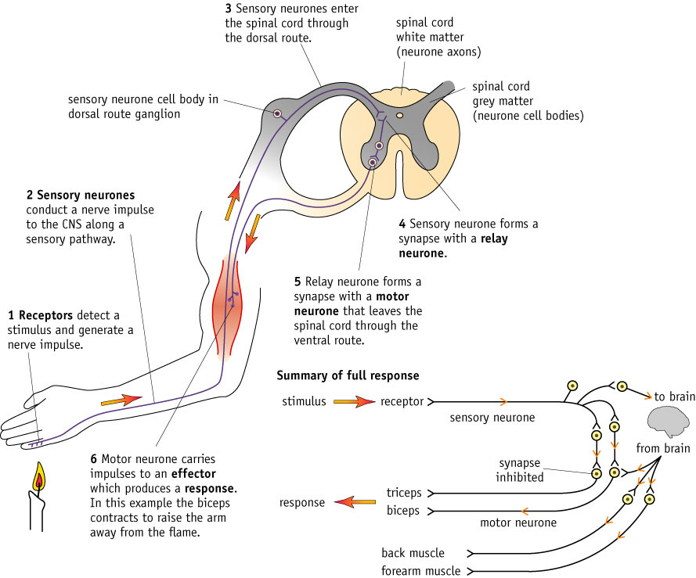
Reflex Arcs

Slide 9
Partner Talk
What: describe what happens in a reflex arc
How: Number 1 describe to number 2 first. Number 2 give feedback
Then number 2 describe to number 1. Number 1 give feedback.
How long:
2 minutes

Slide 10
Mini whiteboards
Write the missing words in order.

Slide 11
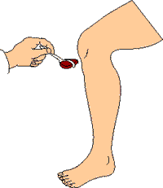
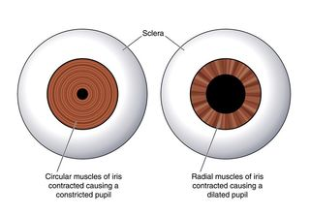
Examples of Reflex Arcs
Knee Jerk Reaction – Involved in keeping standing
Pupil Dilation – Protect eyes from light
Vomit Reflex
Cough Reflex
Sneeze Reflex
Eye tracking Reflex

Slide 12
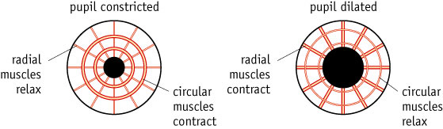
Diagram of Pupil Response

Slide 13
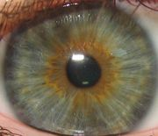
In Bright Light
When light levels are high Circular muscles in the iris contract
This causes the pupil to become smaller
This is controlled by the parasympathetic nervous system

Slide 14
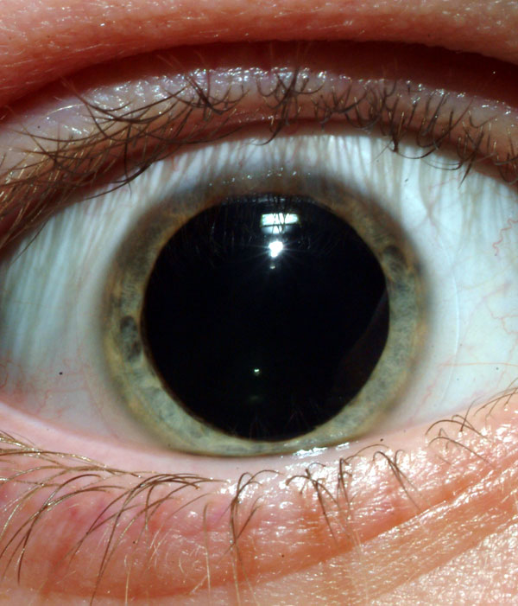
In the Dark
When light levels are low Radial muscles contract
This causes the pupil to increase in size
This is caused by the sympathetic nervous system

Slide 15
Partner Talk
What: Describe what happens in a the light and the dark with a pupil reflect
How: Number 2 describe to number 1 first. Number 1 give feedback
Then number 1 describe to number 2. Number 2 give feedback.
How long:
2 minutes

Slide 16
Mini whiteboards
For each diagram note:
The stimulus
Receptors
Parasympathetic/Sympathetic pathway
What happens to the radial and circular muscles

Slide 17
Answers
Bright light detected by photoreceptors in the retina
Dim light detected by photoreceptors in the retina
Parasympathetic (p for pinhole)
Sympathetic (s for scared)

Slide 18
Control of the Pupil Reflex: high light
Light strikes photoreceptors in the retina
Nervous impulses are sent along the Sensory neuron (Optic Nerve)
This is co-ordinated by relay neurons in the Midbrain
Signals are sent along the parasympathetic nervous system
The motor neurone connects to the effector in the iris
The circular muscles contract

Slide 19
Control of the Pupil Reflex: darkness
Little Light strikes photoreceptors in the retina
Nervous impulses are sent along the Sensory neuron (Optic Nerve)
This is co-ordinated by relay neurons in the Midbrain
Signals are sent along the sympathetic nervous system
The motor neurone connects to the effector in the iris
The radial muscles contract

Slide 20
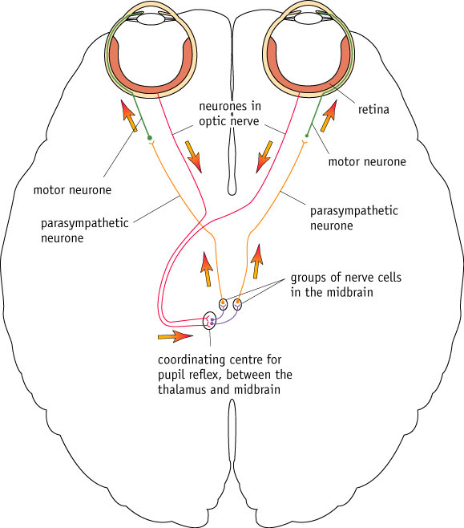
Partner Talk What: Use the diagram to describe the pupil response How: Number 1 do in light. Number 2 do in darkness. The person listening should give feedback. How long: 3 minutes

Slide 21
Eye Reflexes Quick Quiz
What are the receptors in this situation and where are they?
What happens to the radial and circular muscles in the iris to make the pupils dilate?
What happens to the radial and circular muscles in the iris to make the pupils constrict?
Where is the relay neurone in this reflex?
When the pupils dilate which out of the sympathetic or parasympathetic pathway is used?
When the pupils constrict which out of the sympathetic or parasympathetic pathway is used?
photoreceptors in retina
radial contract, circular relax
circular contract, radial relax
midbrain
sympathetic
parasympathetic
Notes:
, 2. radial contract, circular relax 3. circular contract, radial relax 4. midbrain 5. parasympathetic 6. sympathetic

Slide 22
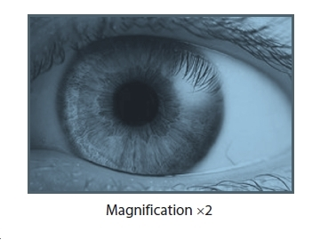
Exam Questions
(a) The picture below shows the human eye with the black pupil in the centre.
The pupil can change size to allow either more or less light into the eye.
Its size is controlled by the iris muscles surrounding it.
(i) Suggest why the pupil appears black. (1)
(ii) There are two sets of iris muscles, the radial muscles and the circular muscles.
They work antagonistically to alter the size of the pupil.
Explain why these two sets of muscles need to be antagonistic. (3)
(iii) The pupil increases in diameter in dim light.
Explain how neurones enable this response to occur. (3)

Slide 23
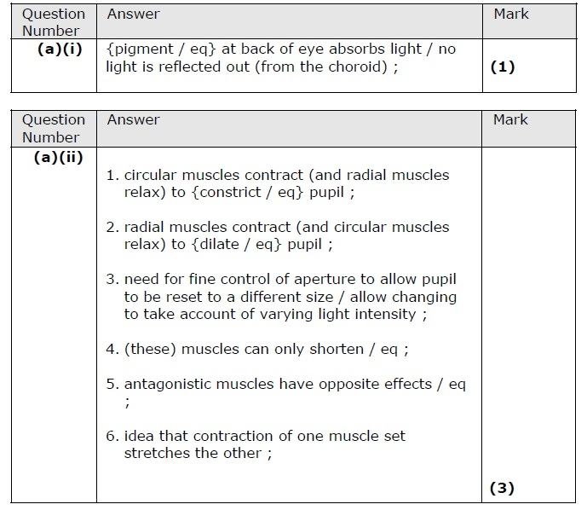
Answers

Slide 24
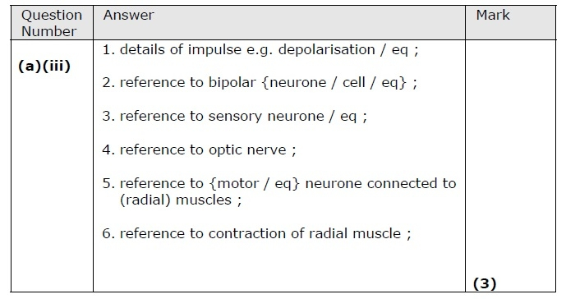
Answers

Slide 25
Focus Area 2 from Do Now:
8.3 Understand how a nerve impulse (action potential) is conducted along an axon including changes in membrane permeability to sodium and potassium ions and the role of the myelination in saltatory conduction.
8.4 Know the structure and function of synapses in nerve impulse transmission, including the role of neurotransmitters, including acetylcholine.

Slide 26
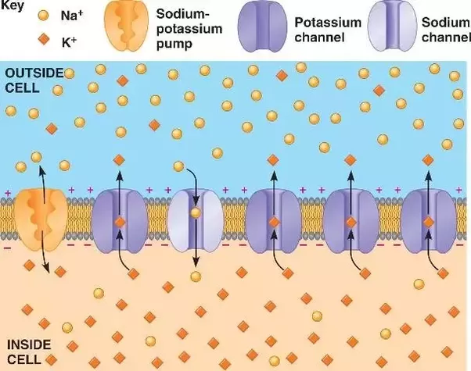
Action potential recap
When a neurone is stimulated, some depolarisation occurs, opening _________ channels.
Sodium flows in down its ______________ gradient into the cell.
If a potential difference ____________ is reached, this will cause more Sodium channels to open.
This causes further depolarisation, triggering more Sodium channels to open- an example of ___________________.
The movement of Sodium ions causes the potential difference to reach ________.
At this point, the Sodium channels close, and the ____________ channels open.
Potassium moves out of the cell down its _______________ and concentration gradients.
The fall in potential difference is known as _______________.
So many Potassium ions move out of the cell that it becomes even more negative than resting potential- the cell has become ________________.
The Potassium channels shut and Potassium _________ back into the cell down its electrochemical gradient.
electrochemical
repolarisation
diffuses
positive feedback
Sodium
concentration
threshold
+40mV
Potassium
hyperpolarised
Notes:
Partner Talk then cold call?

Slide 27
Answers
Sodium
When a neurone is stimulated, some depolarisation occurs, opening _________ channels.
Sodium flows in down its ______________ gradient into the cell.
If a potential difference ____________ is reached, this will cause more Sodium channels to open.
This causes further depolarisation, triggering more Sodium channels to open- an example of ___________________.
The movement of Sodium ions causes the potential difference to reach ________.
At this point, the Sodium channels close, and the ____________ channels open.
Potassium moves out of the cell down its _______________ and concentration gradients.
The fall in potential difference is known as _______________.
So many Potassium ions move out of the cell that it becomes even more negative than resting potential- the cell has become ________________.
The Potassium channels shut and Potassium _________ back into the cell down its electrochemical gradient.
electrochemical
threshold
positive feedback
+40mV
Potassium
concentration
repolarisation
hyperpolarised
diffuses

Slide 28
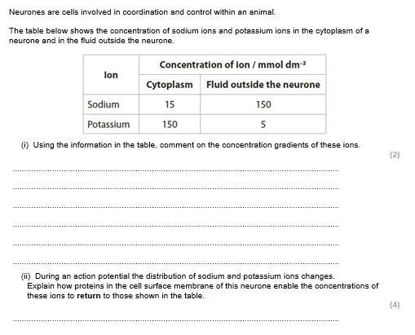
Exam Question
Notes:
13DB1 https://forms.office.com/Pages/ShareFormPage.aspx?id=iYn3rziWp0eNI4TyuLlMi8B-BXJHprdNq73bu_EMIc5UMFIwTkVWQVpLTVVDVFgzMldTM09CWjY2SC4u&sharetoken=AFIeQEQRNJbLGdg7MOJK
13BB1 https://forms.office.com/Pages/ResponsePage.aspx?id=iYn3rziWp0eNI4TyuLlMi8B-BXJHprdNq73bu_EMIc5UMVhNTkhWUkpJVTNXWEE4ODIzU1FTTkZUOC4u

Slide 29
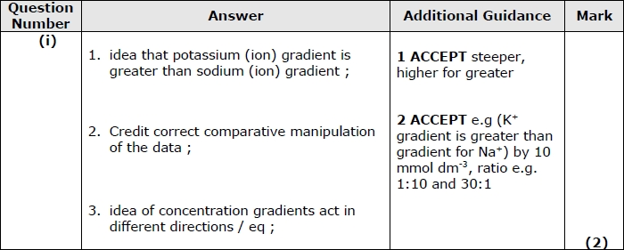

Slide 30
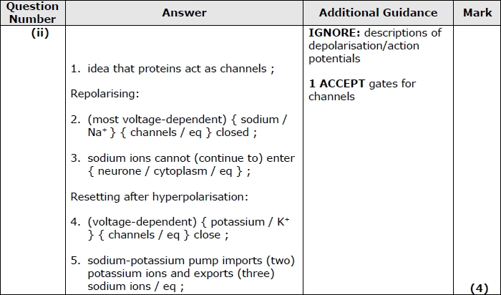

Slide 31
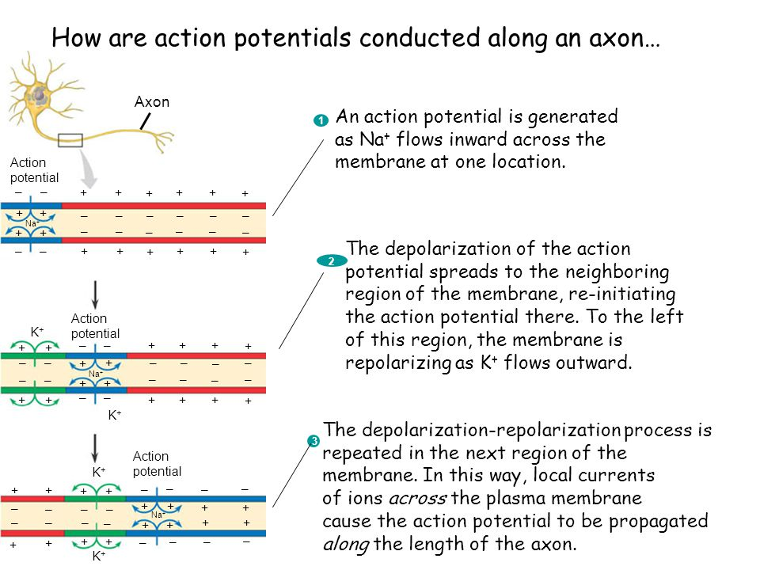
Notes:
Model with plasticine and mini wbs at the same time

Slide 32
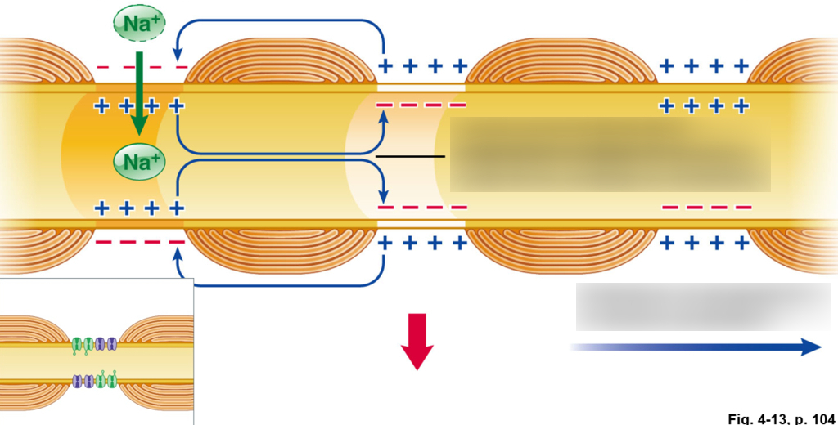
Saltatory Conduction

Slide 33
Partner Talk
What: explain how salutatory conduction speeds up the conduction of an impulse
How: in pairs. Number 2 first should explain and number 1 gives feedback. Then number 1 explains and number 2 gives feedback.
How long: 30 seconds

Slide 34
Mini whiteboards
What causes the initial increase in positive charge inside the axon?
Diffusion of Na+ ions from earlier part of the axon.
Name the insulation around the axon
Myelinated sheath/schwann cell.
Explain why an impulse travels faster in a myelinated axon compared to an unmyelinated axon.
The impulse jumps between the nodes of ranvier.
Name the process by which the impulse jumps from one node to the next.
Salutatory conduction.
Name the gaps between the schwann cells.
Nodes of ranvier.
Describe the purpose of the refractory period.
A new action potential can not be generated in the same section of membrane for about 5 miliseconds. This make the impulse travel in one direction along a nerve fibre.

Slide 35
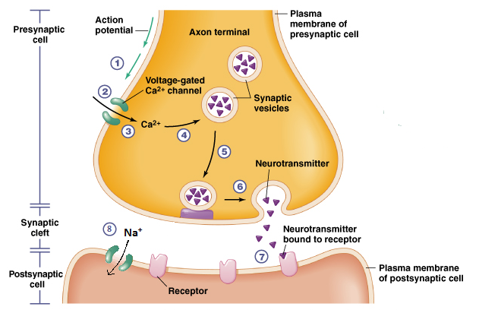
How does the neurotransmitter cause an impulse on the post synaptic membrane?

Slide 36
Partner Talk
What: describe what happens in at a synapse
How: Number 1 describe to number 2 first. Number 2 give feedback
Then number 2 describe to number 1. Number 1 give feedback.
How long: 2 minutes

Slide 37
Inactivation of neurotransmitters
Once a post synaptic cell has been stimulated, it is important that the NT is inactivated.
It could:
Be taken back into the presynaptic cell to be used again.
Diffuse away to be taken up by other cells.
Be broken down by specific enzymes and then stored for reuse.

Slide 38
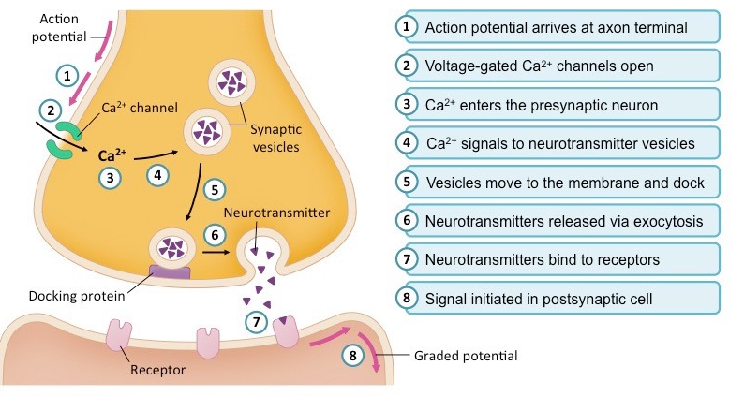
Mini whiteboards What is happening at each step?

Slide 39
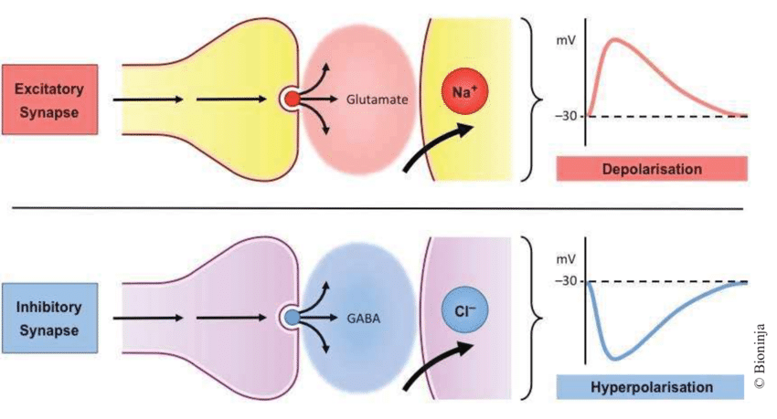
Types of synapses

Slide 40
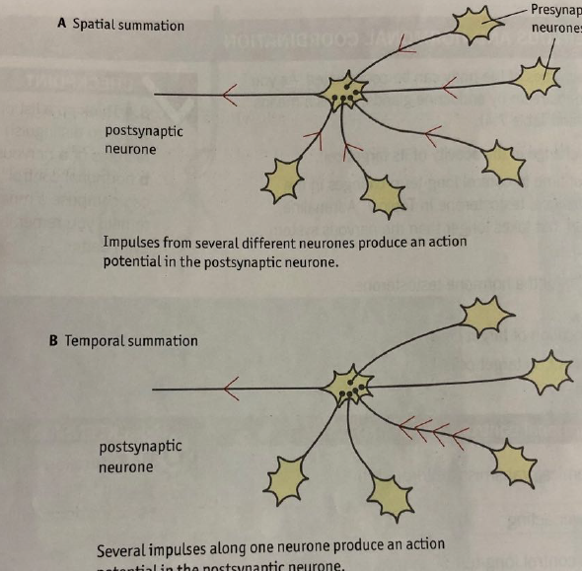
Excitatory synapses
Make it more likely that an action potential will occur in the post synaptic cell
Post synaptic membrane permeability to Na⁺
Each impulse adds to the effect of the others – this process is called SUMMATION.
Spatial and temporal summation – space and time

Slide 41
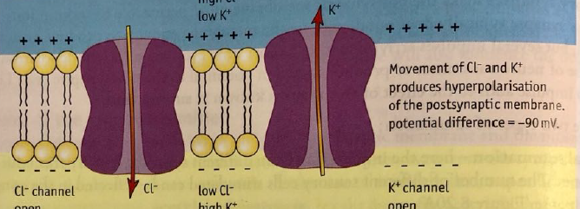
Inhibitory synapses
Make it less likely that an action potential will result in the post synaptic neurone.
Set up a hyperpolarisation by opening K⁺ and Cl⁻ channels in post SN
K⁺ OUT, Cl⁻ IN so inside is more negative than resting level

Slide 42
Partner Talk
What: Describe the process of excitatory and inhibitory synapses
How:
Number 2 describe excitatory synapses to number 1. Number 1 give feedback
Then number 2 describe inhibitory synapses to number 2. Number 2 give feedback.
How long:
2 minutes

Slide 43
Mini whiteboards: Which type of synapse?
Causes depolarisation of the post synaptic membrane.
Excitatory

Slide 44
Mini whiteboards: Which type of synapse?
Impulses from different neurones and synapses joins together initiate depolarisation in the post synaptic neurone.
Spatial summation

Slide 45
Mini whiteboards: Which type of synapse?
Cl-
Inhibitory

Slide 46
Mini whiteboards: Which type of synapse?
Prevents depolarisation of the post synaptic membrane.
Inhibitory

Slide 47
Mini whiteboards: Which type of synapse?
Na+
Excitatory

Slide 48
Mini whiteboards: Which type of synapse?
Several impulses arrive one after the other to initiate depolarisation in the post synaptic neurone.
Temporal summation

Slide 49
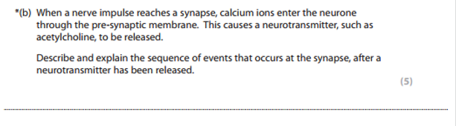
Exam Question

Slide 50
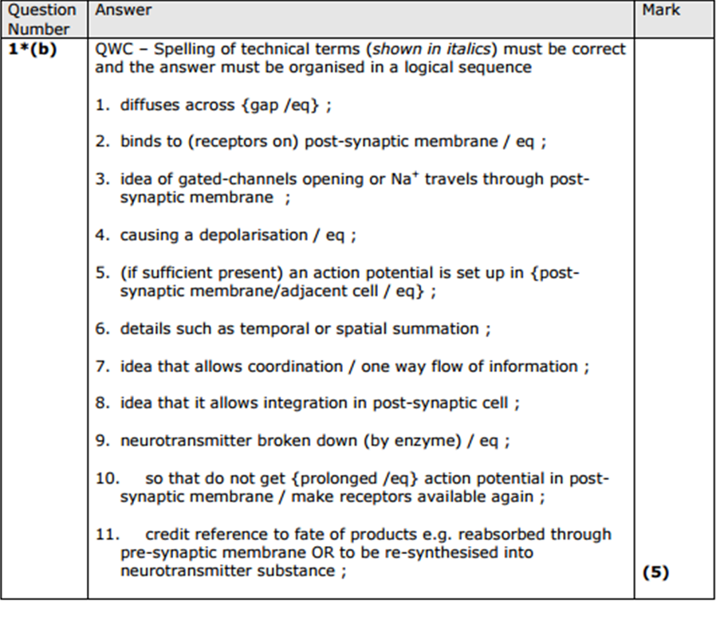

Slide 51
Focus Area 3 from Do Now:
8.5 Understand how the nervous systems of organisms can detect stimuli with reference to rods in the retina of mammals, the roles of rhodopsin, opsin, retinal, sodium ions, cation channels and hyperpolarisation of rod cells in forming action potentials in the optic neurones.

Slide 52
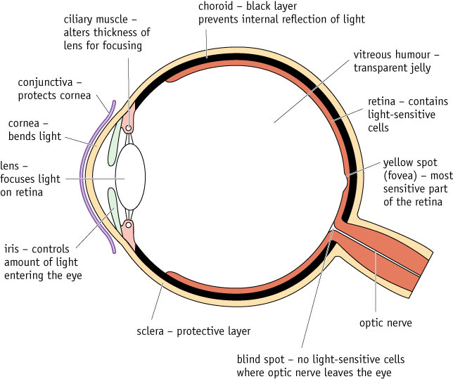
The Structure Of The Retina

Slide 53
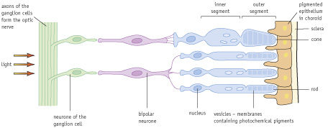
The Structure Of The Retina
Direction of impulse
Direction of light

Slide 54
The Structure Of The Retina

Slide 55
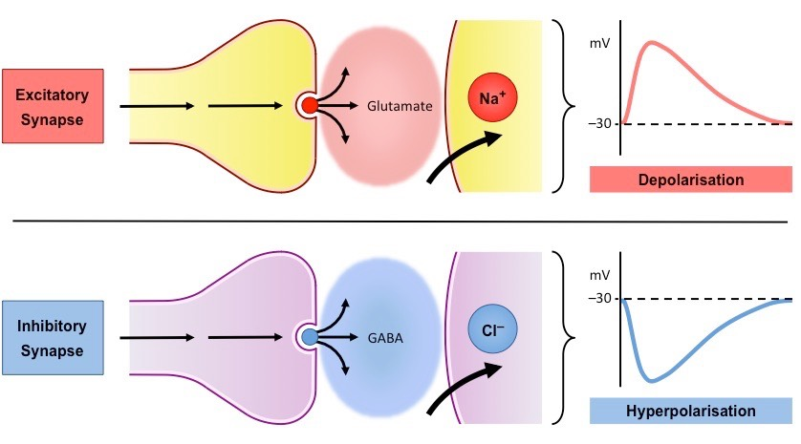
Recall Inhibitory Synapses

Slide 56
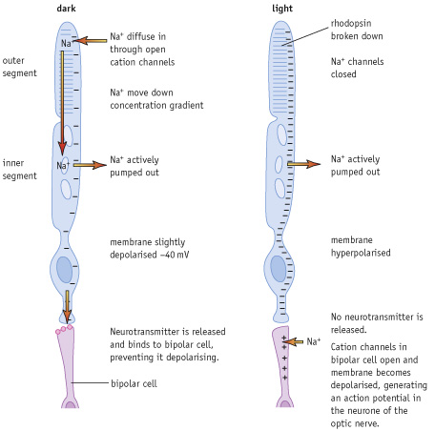
Partner Talk
What: describe what happens in the rod cells in the light and the dark
How: in pairs. Number 1 describe the process in the dark and number 2 gives feedback. Then number 2 describes the process in the light and number 1 gives feedback.
How long: 2 minutes

Slide 57
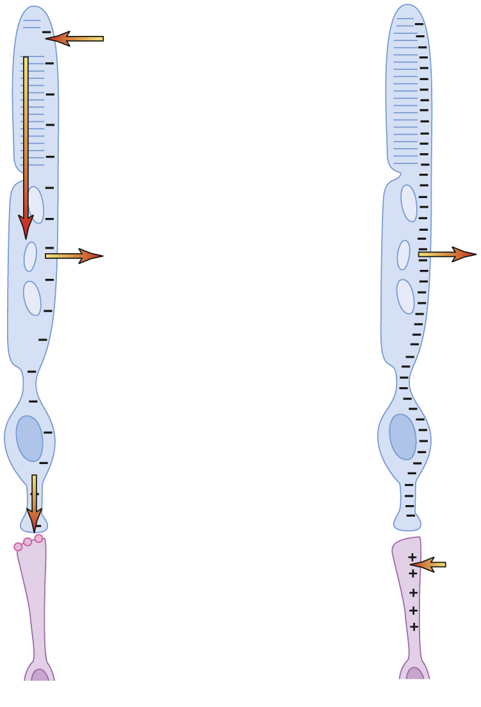
Mini whiteboards: match up the process with correct labels
Na+ actively pumped out causing the membrane to be slightly depolarised -40mv
No Na+ can enter
No inhibition so cation channels in bipolar cell open and membrane becomes depolarised, generating an action potential which is transmitted to the optic never.
Rhopodsin absorbs light and breaks down into retinal and opsin
Na+ diffuse in through cation channels
No neurotransmitter is released
Na+ move down the concentration gradient
Na+ pumped out causing the membrane to be hyperpolarised
Opsin activates closing of non-specific cation channels
Inhibitory synapse neurotransmitter released binds to bipolar cell, preventing it depolarising
dark
light
e
a
5
4
9
b
7
f
g
2
c
h
1
8
d
10
6
i
j
3

Slide 58
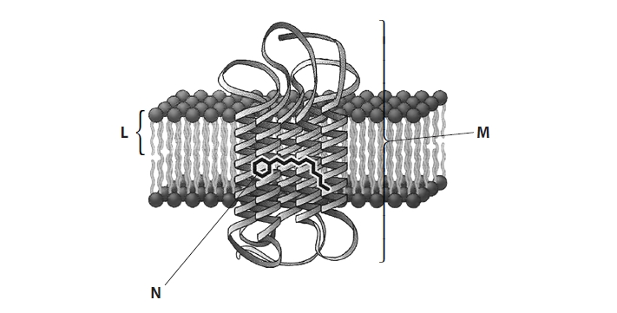
Exam Questions
The effect of being shown a cheeseburger on saliva production in a child was studied.
When the child was shown the cheeseburger, information would have been sent from the eye to the brain.
Describe the role of sodium ions in the functioning of a mammalian rod cell. (3)
The diagram shows part of the membrane of the outer segment of a rod cell.
(b) (i) Give the name of the visual pigment labelled M.(1)
(ii) Give the name of the light-absorbing part of the visual pigment labelled N.(1)
(c) Describe how the absorption of light by the part labelled N results in an action potential in the optic nerve.(3)

Slide 59
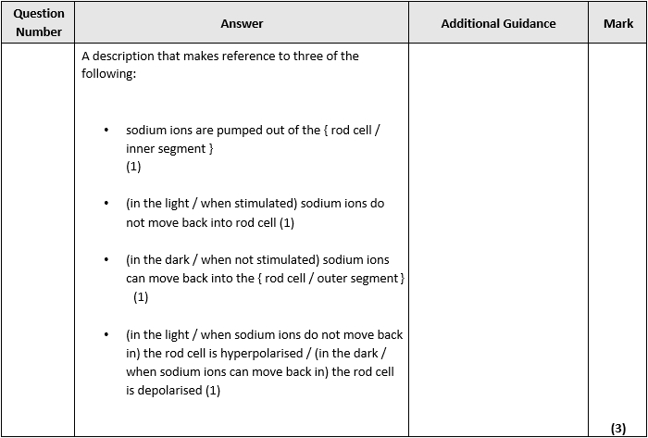
Answers

Slide 60
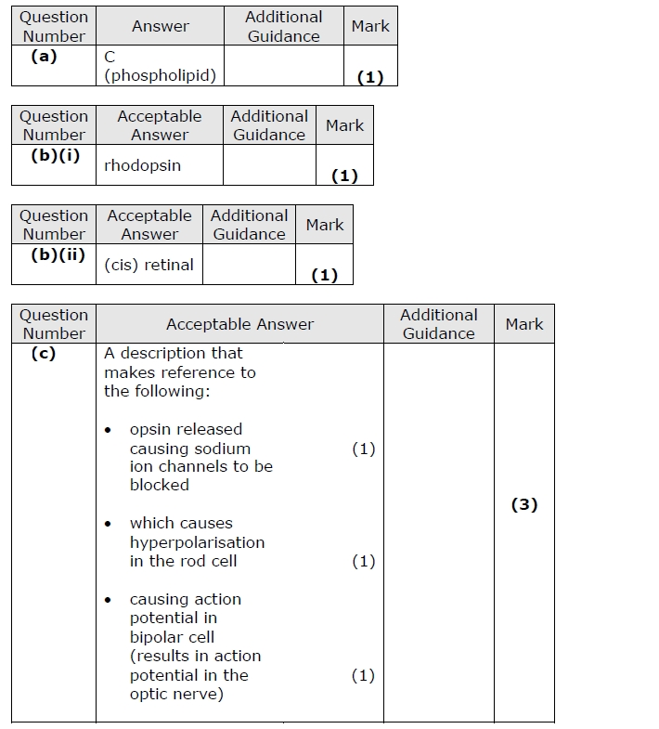

Slide 61
Focus Area 4 from Do Now:
8.6 Understand how phytochrome and IAA bring about responses in plants to environmental cues, including their effects on transcription.

Slide 62
Plant photoreceptors: phytochromes
Phytochrome molecules consist of a protein component bonded to a non-protein light absorbing pigment molecule.
This is similar to rhodopsin, where retinal is the non-protein component and opsin is the protein component.

Slide 63
Phytochrome has 2 forms:
Red-absorbing phytochrome
Far red absorbing phytochrome
Interconverted
Two forms of the same compound
Total amount same
P_{r}
P_{fr}
P_{r}
P_{fr}

Slide 64
In red light
P_{fr}
P_{r}
P_{fr}
P_{r} absorbs red light, changes to P_{fr} form.
P_{fr} doesn’t absorb red light, stays the same.

Slide 65
In far red light
P_{r}
P_{fr}
P_{r}
P_{r} doesn’t absorb far red light, stays the same.
P_{fr} absorbs far red light, changes to P_{r} form.

Slide 66
In pure light
P_{fr}
P_{r}
In pure red light, all the phytochrome ends up in the P_{fr} form.
In pure far red light, all the phytochrome ends up in the P_{r} form.

Slide 67
Sunlight
Mostly red
A little far red

Slide 68
In sunlight
P_{r}
P_{fr}
P_{fr}
P_{fr}
P_{r}
P_{r}
P_{fr}
P_{fr}
P_{r}
P_{fr}
P_{fr}
P_{r}
P_{fr}
P_{fr}
P_{fr}
P_{r}
P_{fr}
P_{fr}
P_{r}
P_{r}
P_{fr}
P_{fr}
P_{r}
P_{fr}
P_{r}
P_{fr}
P_{r}
P_{fr}
P_{fr}
P_{fr}
In sunlight most P gets converted to P_{fr} form.

Slide 69
Start of night
Most P in P_{fr} form.
P_{r}
P_{fr}
P_{fr}
P_{fr}
P_{r}
P_{r}
P_{fr}
P_{fr}
P_{r}
P_{fr}
P_{fr}
P_{r}
P_{fr}
P_{fr}
P_{fr}
P_{r}
P_{fr}
P_{fr}
P_{r}
P_{r}
P_{fr}
P_{fr}
P_{r}
P_{fr}
P_{r}
P_{fr}
P_{r}
P_{fr}
P_{fr}
P_{fr}

Slide 70
In the dark
P_{fr} form changes gradually to P_{r} form.
P_{r}
P_{fr}
P_{fr}
P_{fr}
P_{r}
P_{fr}
P_{r}
P_{fr}
P_{r}
P_{fr}
P_{fr}
P_{r}
P_{fr}
P_{r}
P_{fr}
P_{fr}
P_{r}
P_{r}
P_{fr}
P_{fr}
P_{r}
P_{r}
P_{fr}
P_{fr}
P_{r}
P_{fr}
P_{r}
P_{fr}
P_{r}
P_{fr}
P_{fr}
P_{fr}
P_{r}

Slide 71
After a short night
P_{fr} still left.
P_{r}
P_{fr}
P_{fr}
P_{fr}
P_{r}
P_{fr}
P_{r}
P_{fr}
P_{r}
P_{fr}
P_{fr}
P_{r}
P_{fr}
P_{r}
P_{fr}
P_{fr}
P_{r}
P_{r}
P_{fr}
P_{fr}
P_{r}
P_{r}
P_{fr}
P_{fr}
P_{r}
P_{fr}
P_{r}
P_{fr}
P_{r}
P_{fr}
P_{fr}
P_{fr}
P_{r}

Slide 72
Partner Talk
What: discuss what happens to the phytochrome after a short night vs a long night
How: in pairs
How long: 30 seconds

Slide 73
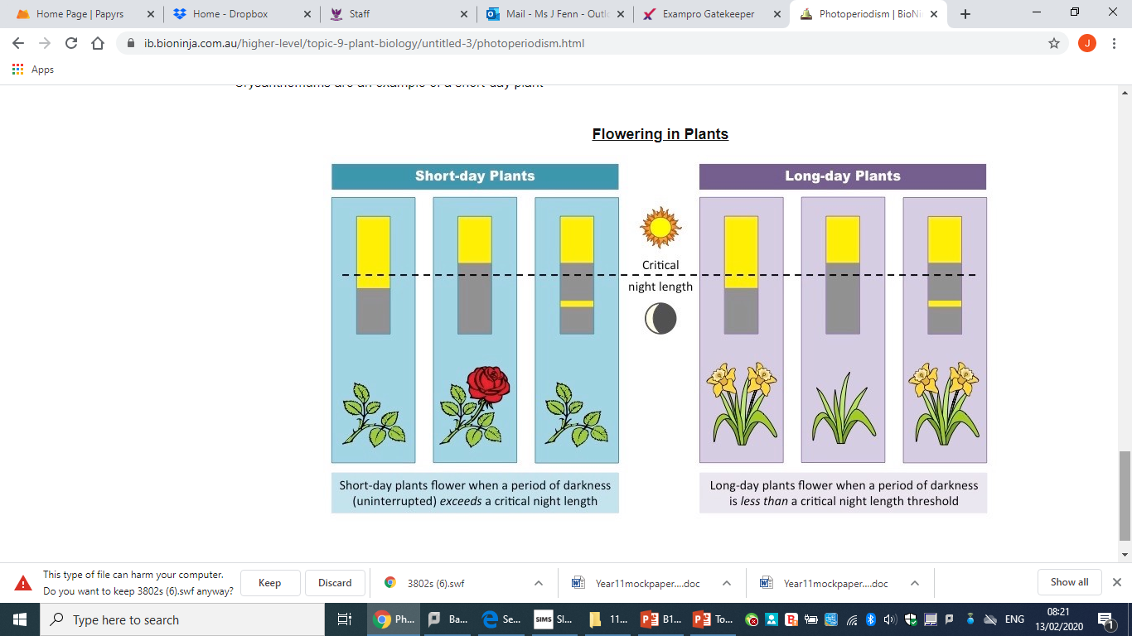
Short Day Plant = Long Night Plant
Needs long night
Needs P_{fr} gone at end of night
P_{fr} inhibits flowering for SDPs

Slide 74
Long Day Plant = Short Night Plant
Needs short night
Needs P_{r} gone at end of night
P_{r} inhibits flowering for LDPs

Slide 75
Day Neutral Plants
Flower when mature enough
Maybe other environmental signals (temp?)
Day length (dark length) doesn’t matter

Slide 76
Partner Talk
What: discuss what short day and long day plants need to flower
How: in pairs
How long: 30 seconds

Slide 77
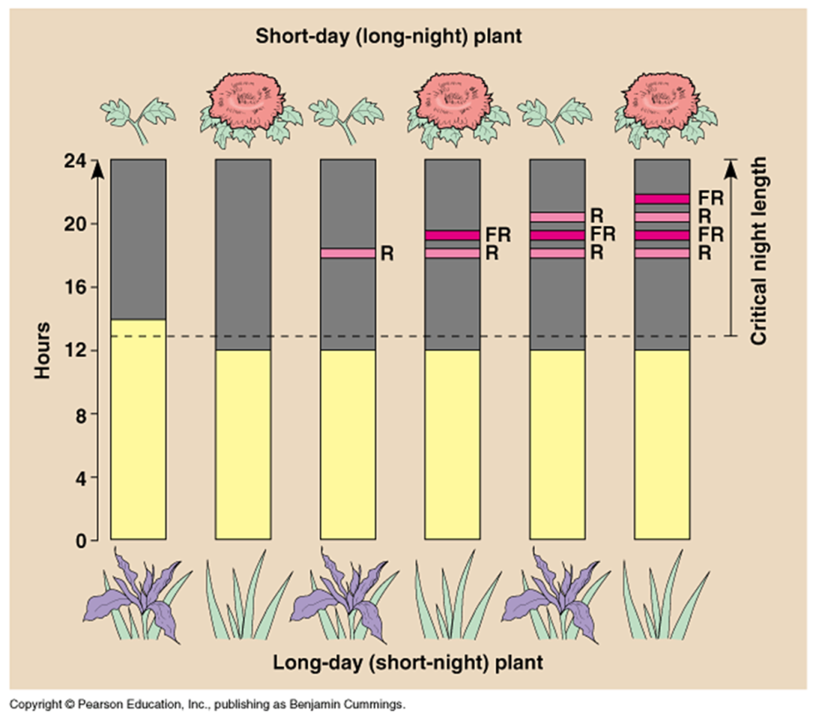
Think Pair Share
Describe how phytochrome P_{r} and P_{fr} control flowering in plants.
Use the diagram below to explain what is happening when Red and Far Red light is applied to the SDP and LDP.

Slide 78
Task
Describe how phytochrome P_{r} and P_{fr} control flowering in plants.
Use the diagram below to explain what is happening when Red and Far Red light is applied to the Short Day Plant and Long Day Plant.

Slide 79
Review
Short day plants need a long night of uninterrupted darkness. They need Pfr to be gone at end of night. You can see this from the figure as any extra red light in darkness reduces the period of darkness to less than the critical period, converting Pr to PFr and inhibits flowering by the presence of Pfr.
Long day plants need a short night/period of darkness. They need need Pr gone at end of night. You can see this from the figure as any extra red light added in the night converts Pr to Pfr, making the darkness less than the critical period and stimulates the plants to flower.

Slide 80
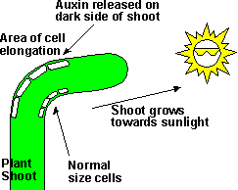
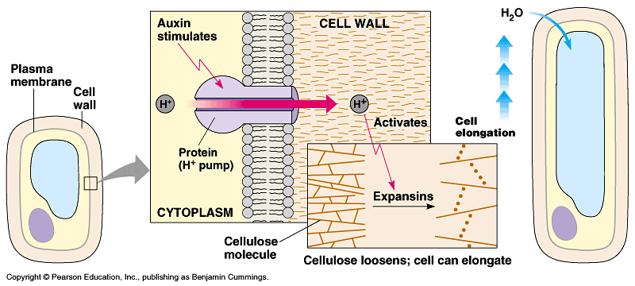
1. Released by meristem at tip
6. Increased potential difference in cell (remember we’ve got rid of H+, so even more negative inside) draws in ions. This causes water uptake via osmosis
4. Transcription factors made to code for enzymes and proton pumps etc
5. Proton pumps H out of cell. Low pH activates enzyme expansins that cause bonds between cellulose microfibrils to break and cell expansion
2. Transported to where they need to be in the phloem and protein carriers between cells
-Check P214 and add to our notes
3. Auxins bind to protein receptors on target cells

Slide 81
Mini Whiteboards Put the following into the correct order:
Proton pumps H out of cell. Low pH activates enzyme expansins that cause bonds between cellulose microfibrils to break and cell expansion.
Transported to where they need to be in the phloem and protein carriers between cells.
Increased potential difference in cell (remember we’ve got rid of H+, so even more negative inside) draws in ions. This causes water uptake via osmosis.
Auxins are released by meristem at tip.
Transcription factors made to code for enzymes and proton pumps etc.
Auxins bind to protein receptors on target cells.
Notes:
13 DB1 https://forms.office.com/Pages/ResponsePage.aspx?id=iYn3rziWp0eNI4TyuLlMi8B-BXJHprdNq73bu_EMIc5URFczNVhYVUQ3NDg5MlRRV04xMktFMFpHRy4u
13BB1 https://forms.office.com/Pages/ResponsePage.aspx?id=iYn3rziWp0eNI4TyuLlMi8B-BXJHprdNq73bu_EMIc5UMERIRUVZTjlMQlQ0WlpSUzZCQVVXWjNSUi4u

Slide 82
Answers
Auxins are released by meristem at tip.
Transported to where they need to be in the phloem and protein carriers between cells.
Auxins bind to protein receptors on target cells.
Transcription factors made to code for enzymes and proton pumps etc.
Proton pumps H out of cell. Low pH activates enzyme expansins that cause bonds between cellulose microfibrils to break and cell expansion.
Increased potential difference in cell (remember we’ve got rid of H+, so even more negative inside) draws in ions. This causes water uptake via osmosis.

Slide 83
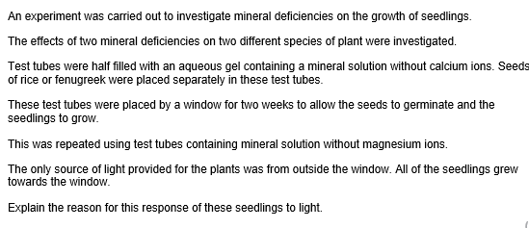
Exam Question

Slide 84
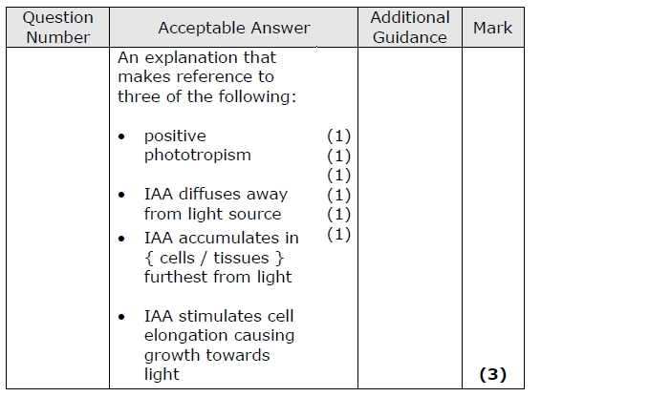
Review

Slide 85
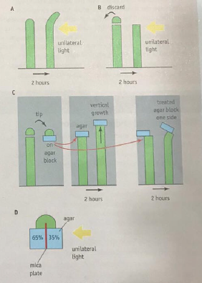
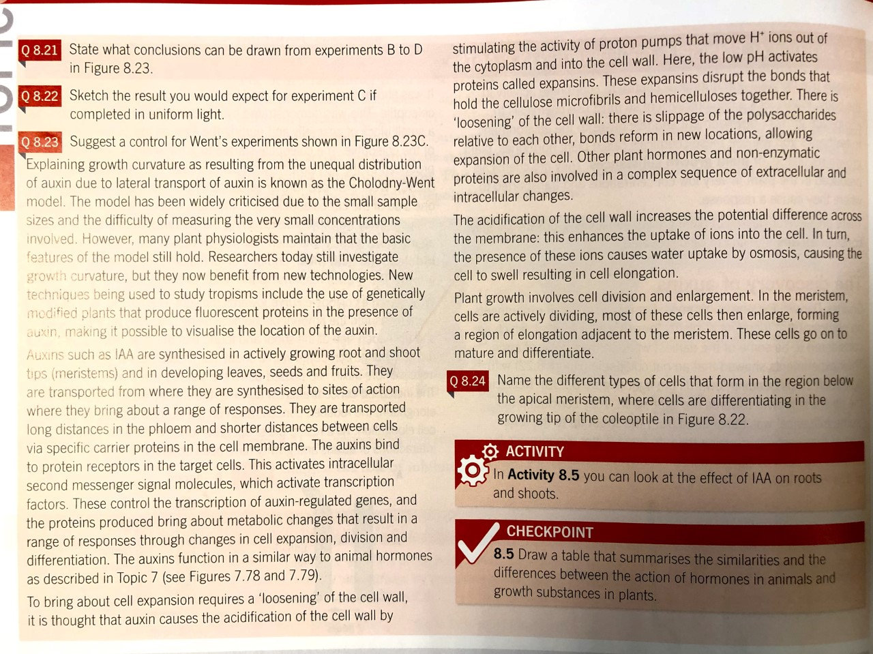
Task: Answer the questions

Slide 86
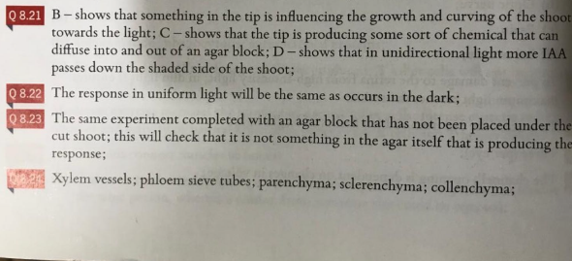
Answers

Slide 87
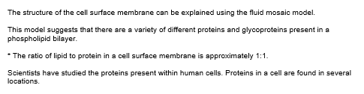
Exam Skill Focus:
A02/3 data analysis questions

Slide 88
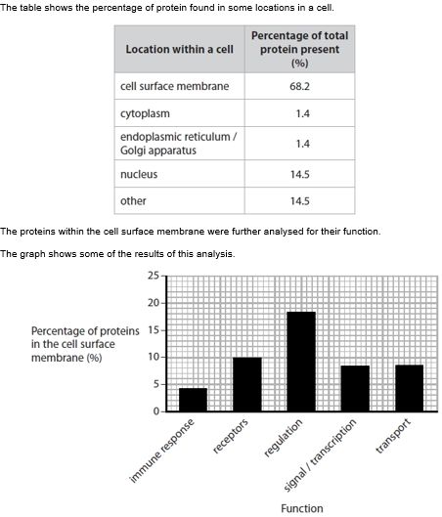
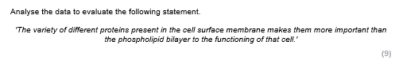
Partner Talk Protein vs phospholipids What: brainstorm all of the different uses of proteins and phospholipids in a cell. Give specific examples from different topics. How: In pairs on mini whiteboards How long: 2 minutes
For/against and judgement
e.g.
Proteins = immune response, cell receptors, hormones, transcription/translation, transport and nerve impulses
Phospholipids = fluidity of membrane, allowing polar substances in and out, diffusion, myelinated sheath
(give specific examples of the above in your answer)

Slide 89
Partner Talk – use data What: what do the initial text, table and graph show you about the uses of proteins and phospholipids? Which has more? How: In pairs on mini whiteboards How long: 2 minutes
For/against and judgement
Quantities of proteins and phospholipids in cell membrane are the same but proteins seem to have more functions.

Slide 90
Task: now answer the question
For/against and judgement
(5 minutes)

Slide 91
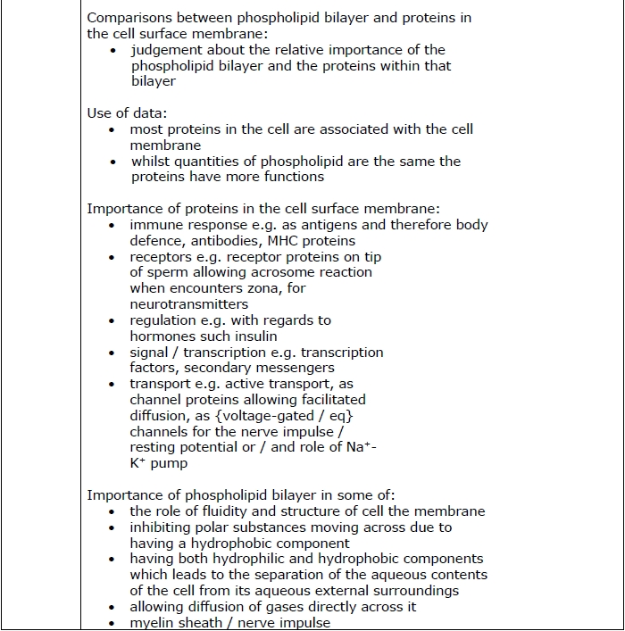
Mark your answers

Slide 92
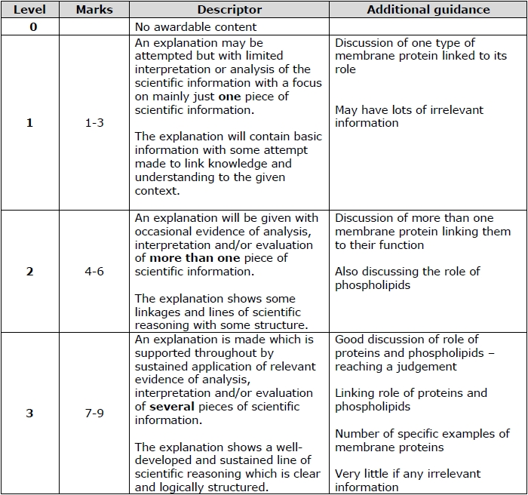

Slide 93
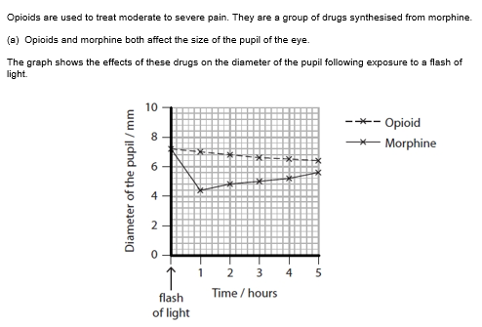
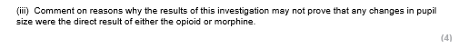
Partner Talk What: for results to be accepted they need to be valid. What information are you missing that would be needed for the scientific community to accept these results? How: In pairs How long: 1 minute
e.g. sample size, controls such as gender of people ….

Slide 94
Task: now answer the question
(3 minutes)

Slide 95
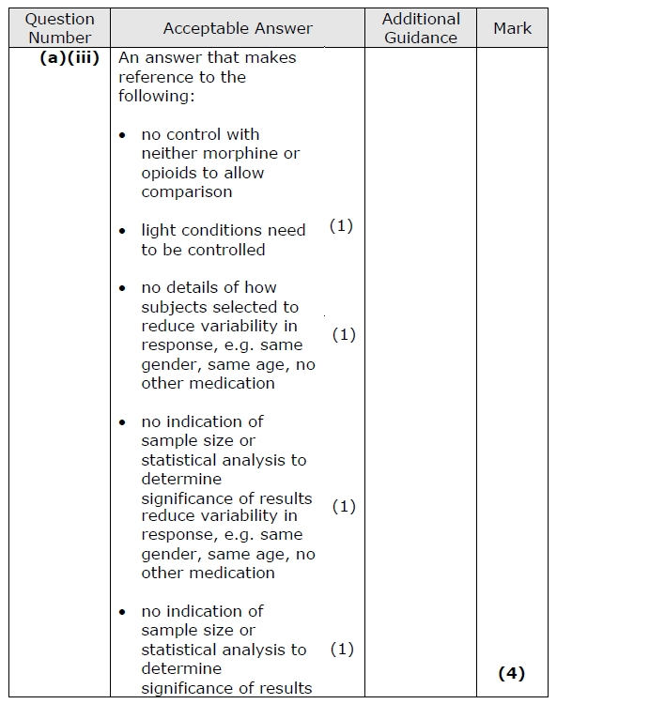
Mark your answers

Slide 96
Exam Question Booklet:
Complete the exam questions in the booklet provided by your teacher now and finish for homework.
The teacher will project some of the questions on the visualiser to help you to answer them.

Slide 97
Key word definitions testing
What: quiz your partner to see which words they can give you the definitions for
How: in pairs using the glossaries
How long: 5 minutes

Slide 98
Exit Ticket
Traffic light your PLC for:
8.1 Know the structure and function of sensory, relay and motor neurones including the role of Schwann cells and myelination.
8.2 i) Understand how the nervous systems of organisms can cause effectors to respond to a stimulus.
ii) Understand how the pupil dilates and contracts.
8.3 Understand how a nerve impulse (action potential) is conducted along an axon including changes in membrane permeability to sodium and potassium ions and the role of the myelination in saltatory conduction.
8.4 Know the structure and function of synapses in nerve impulse transmission, including the role of neurotransmitters, including acetylcholine.
8.5 Understand how the nervous systems of organisms can detect stimuli with reference to rods in the retina of mammals, the roles of rhodopsin, opsin, retinal, sodium ions, cation channels and hyperpolarisation of rod cells in forming action potentials in the optic neurones.
8.6 Understand how phytochrome and IAA bring about responses in plants to environmental cues, including their effects on transcription.

