Slide 1
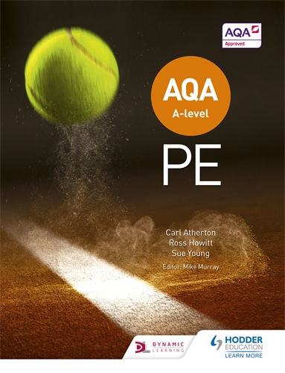
Welcome to your A-Level PE
Taster Lesson
Mr Black (JBL)

Slide 2
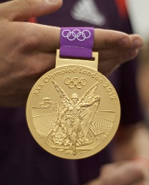
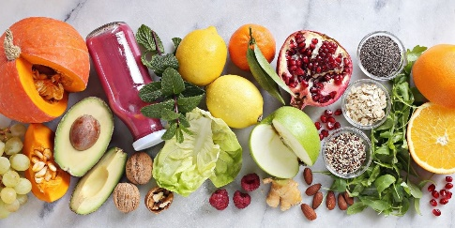
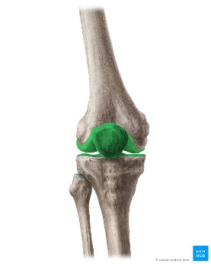
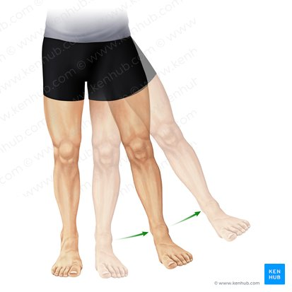
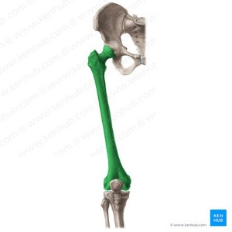
Quick Fire Do Now
Name 1 ​Olympic Gold Medalist
Name 2 Classes of food
List 3 Joints​ of the body
List 4 Movements/actions possible at a joint​
List 5 Bones​ of the skeleton
List 6 muscles of the body

Slide 3
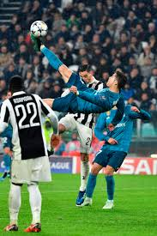
Watch the video clip and answer this question: Why was he able to score that goal?
Typical Task
Consider:
Types of training
Elite coaching
Muscle fibres
Practice
Biomechanics
Think.Pair.Share
Hint – Use the different sections of the A Level Course to help you.
There are many potential answers to this question.
Ronaldo goal

Slide 4
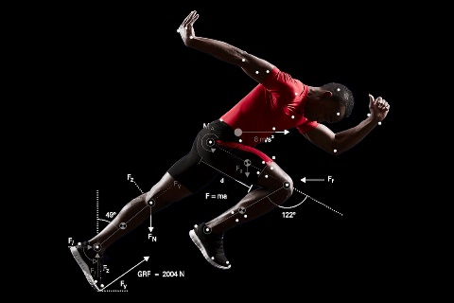
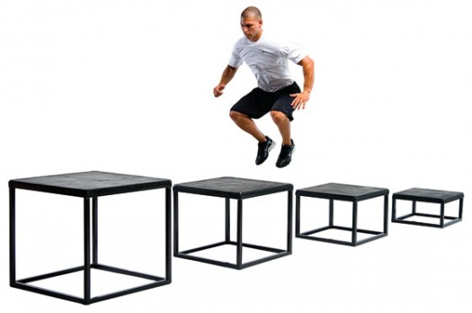
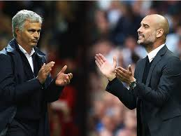
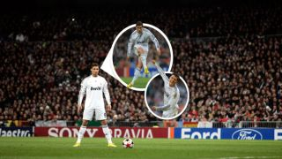
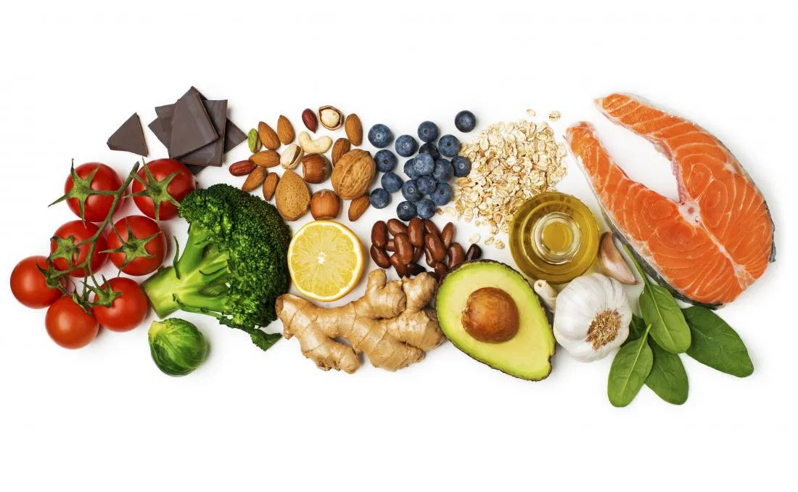
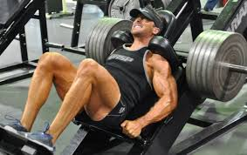
Why he was able to score that goal…
Plyometric training
Elite equipment and coaches
Training – Mass and varied practice (repeating skill)
Visualisation (mental imagery)
Psychology – NACH/confidence/self efficacy
Muscle strength and power – training…….
Fast twitch muscle fibres – genetics & training
Biomechanical advantage (Levers/Impulse)
Diet and nutrition
Sports supplements e.g. creatine

Slide 5
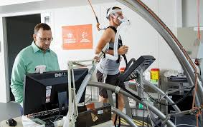
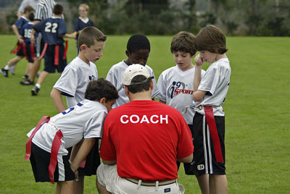
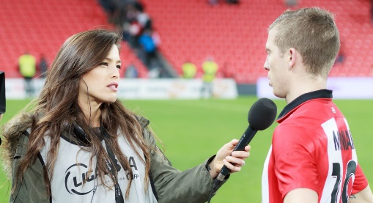
Why study A-level PE?
Career paths:
Physiotherapist
Sports nutritionist
Fitness and leisure industry work
Early years education
Personal Trainer
Sports Administration/Health/Fitness
Sports Scientist
Business (H&F Sector)
Professional Sportsperson
Sports Coach
Journalist
Sports data Analyst
Events Manager
Sports Management
PE Teacher!
Many more…

Slide 6
Course Details
1. Applied anatomy and physiology (JBL, PBO)
2. Skill acquisition (DWI)
3. Sport and society (SGD)
4. Exercise physiology (PBO)
5. Biomechanical movement (PBO)
6. Sport psychology (DWI/PBO)
7. Sport and society and the role of technology in physical activity and sport (SGD, JBL)

Slide 7
How will you be assessed?
End of Year 12 – UCAS exam
End of Year 13 - Paper 1 = 2 hour exam (35%)
Paper 2 = 2 hour exam (35%)
Practical assessment and Coursework (30%)
(Analysis of Performance)

Slide 8
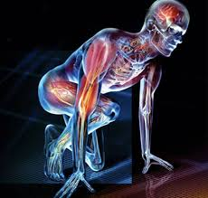
Paper 1: Factors affecting participation in physical activity and sport
What's assessed:
Section A: Applied anatomy and physiology
Section B: Skill acquisition
Section C: Sport and society
How it's assessed
• Written exam: 2 hours
• 105 marks
• 35% of A-level
Questions
• Section A: multiple choice, short answer and extended writing (35 marks)
• Section B: multiple choice, short answer and extended writing (35 marks)
• Section C: multiple choice, short answer and extended writing (35 marks)

Slide 9
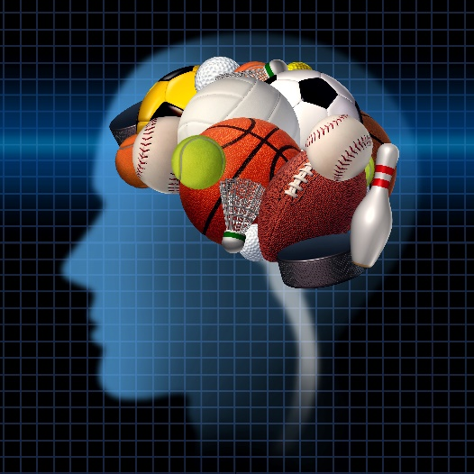
Paper 2: Factors affecting optimal performance in physical activity and sport
What's assessed:
Section A: Exercise physiology and biomechanics
Section B: Sport psychology
Section C: Sport and society and technology in sport
How it's assessed
• Written exam: 2 hours
• 105 marks
• 35% of A-level
Questions
• Section A: multiple choice, short answer and extended writing (35 marks)
• Section B: multiple choice, short answer and extended writing (35 marks)
• Section C: multiple choice, short answer and extended writing (35 marks)

Slide 10
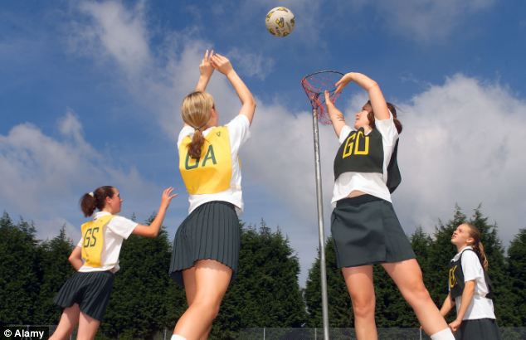
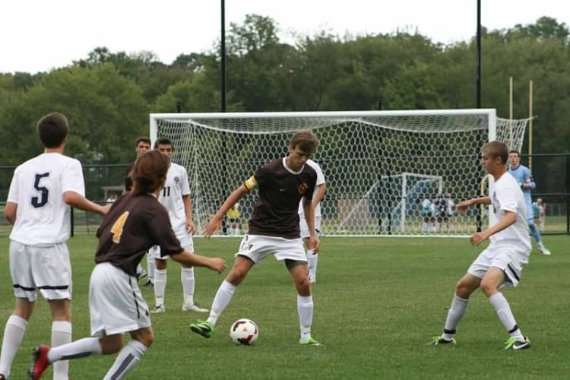
Non-exam assessment: Practical performance in physical activity and sport
What's assessed:
1) Students assessed as a performer or coach in the full sided version of one activity.
Plus:
2) written/verbal analysis of performance (coursework)
How it's assessed
• Internal assessment, external moderation
• 90 marks
• 30% of A-level

Slide 11
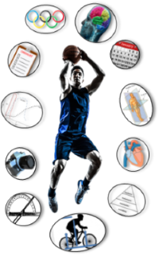
Expectations…
Respect and honesty from you
Turn up to all lessons
All homework to be completed on time
A different attitude from GCSE
To be able to treat you like young adults
Run school clubs and assist with school teams/ officiate fixtures
Lead practical sessions
Perform your chosen sport independently out of school
Enrichment – Wednesday afternoon sport

Slide 12
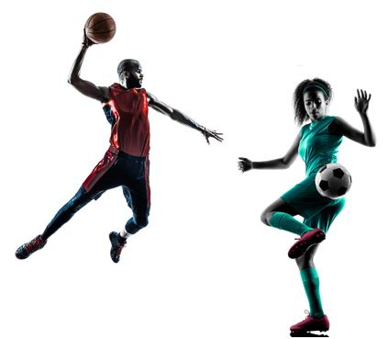
In exchange we will provide…
High quality teaching
Experience
Differentiated and engaging Lessons
Commitment
Honesty regarding your progress
One to one support if necessary

Slide 13
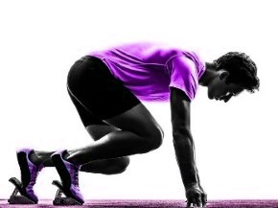
What not to expect
Free lessons - none
An easy ride
Getting by without hard work
An exam as easy as GCSE – 3 sections in each A-level Paper. At the end of each section - 8 marker & 15 marker!
Us to help you if you don’t help yourselves (coursework)

Slide 14
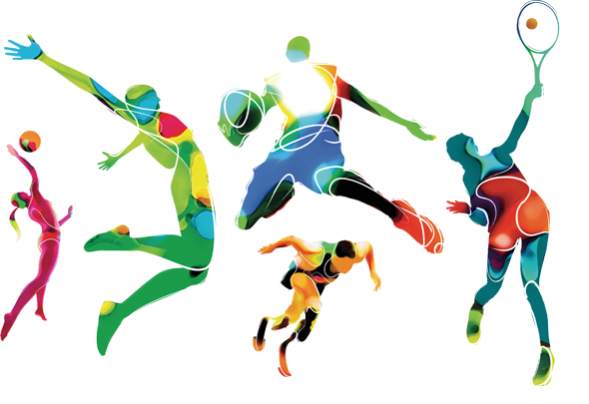
How to help each other…
Support in lessons
Group chat/forums – work missed etc…
Use each others strengths in topic areas e.g. biology students

Slide 15
A-level PE Taster

Slide 16
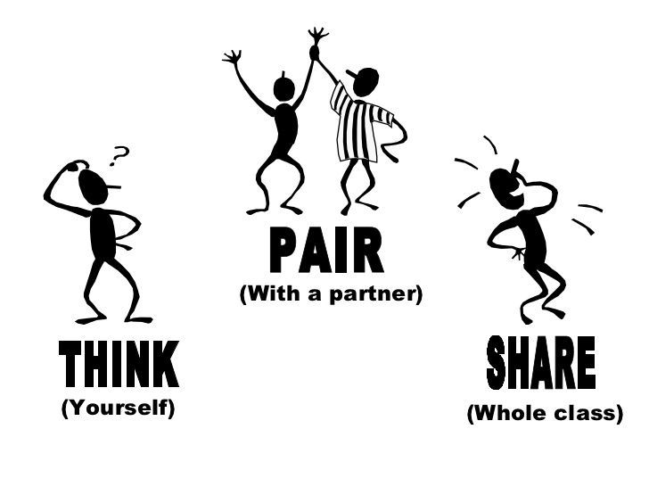
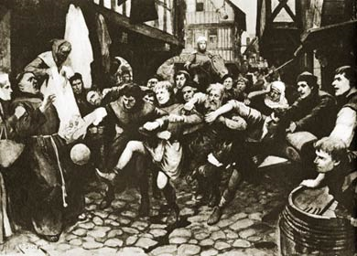
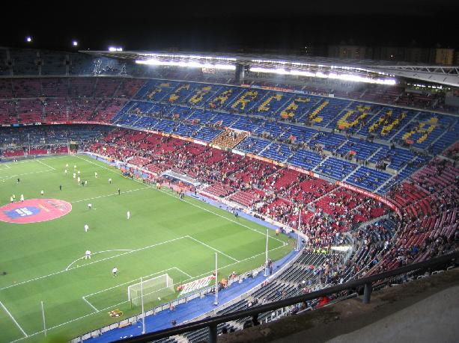
How did we get from this.......to this?
History of Sport
Popular recreation (mob games)
Global modern day sport
1800’s

Slide 17
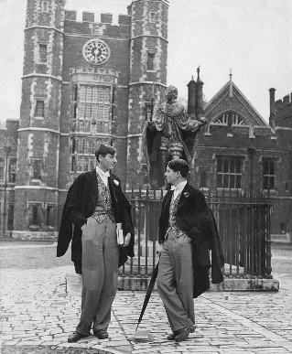
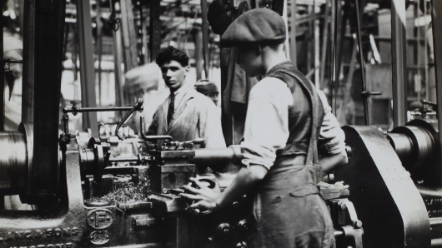
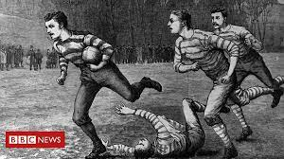
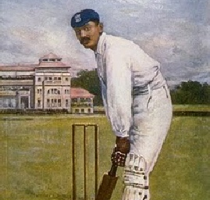
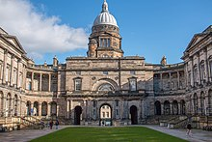
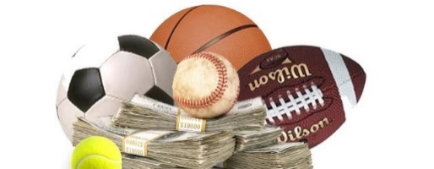
Disorganised mob games (Popular recreation)
Developed in public schools (MC, ATH)
Industrial revolution (Rational recreation)
Taken to University, rules formalised
Sport spread back to schools, standards improved
Sport spread to British empire via church/army
NGBs set up
SPORT APPROACHING MODERN FORM
Impact of media on sport (Commercialisation)

Slide 18
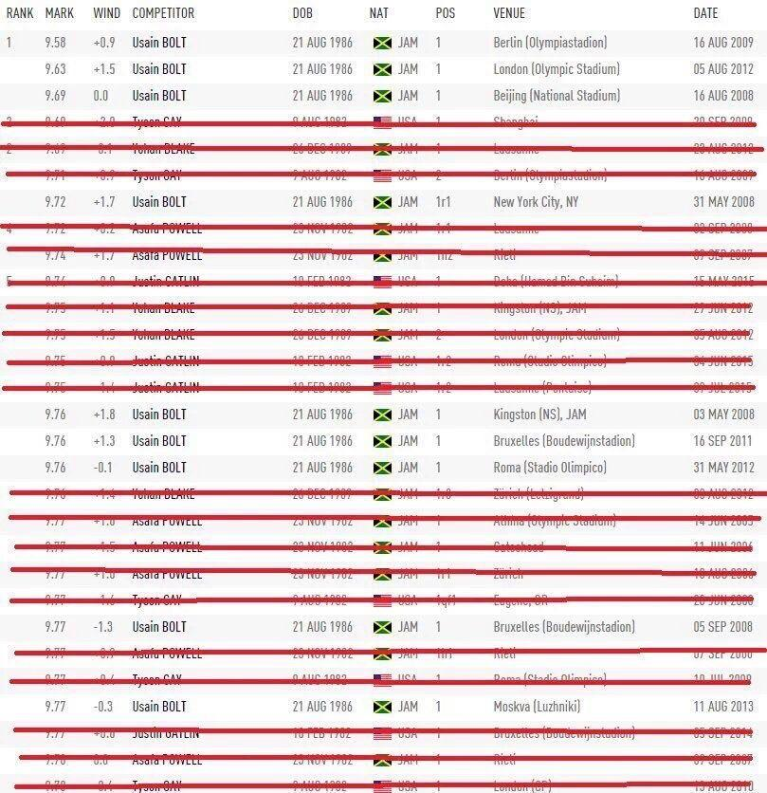
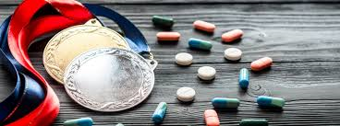
Drugs in Sport
A list of the fastest ever 100metre times.
The names crossed out in red have been caught taking performance enhancing drugs
Drugs are clearly a major issue in twenty-first century sport.
Can you think of reasons FOR and AGAINST the use of drugs in sport?

Slide 19
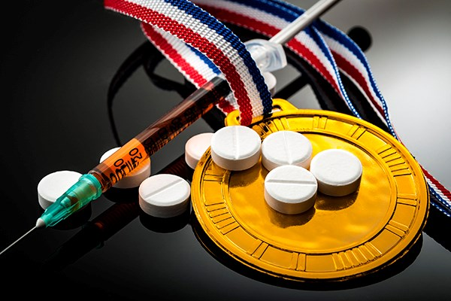
What are the arguments FOR and AGAINST legalising currently banned drugs in Sport?
FOR AGAINST
The battle against drugs is very expensive. Money could be spent in grassroots sport
If everyone takes drugs it will be an even playing field
Some athletes are taking them anyway so its not fair on the others
It is a performers personal choice to take them
If drug taking is allowed it can be regulated and will be much safer
Athletes do not ask to be role models. They should be allowed to put what they want into their bodies to help them train harder and recover quicker.
Taking drugs is cheating
Drug taking is illegal
Many health risks and dangerous side effects
Creates negative role models for young people
Creates a negative image for the sport
Success in sport should be about hard work and talent
Taking drugs gives an unfair advantage and are unethical and against the ethics of sport e.g. fairplay

Slide 20
What to do between now and September…
Complete your Bridging Work and submit it on time.
Participate in your chosen sport (Video?)
Take any opportunities to help out coaching and officiating
Watch and follow sport with a critical eye (punditry/analysis)
Learn some rules; Learn some names of athletes (tennis players/rugby players/footballers/athletics/tennis)
Think carefully about why you want to study and if it is the right subject for you….

Slide 21
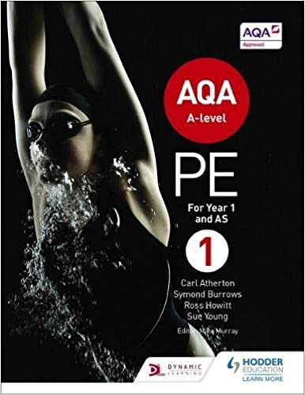
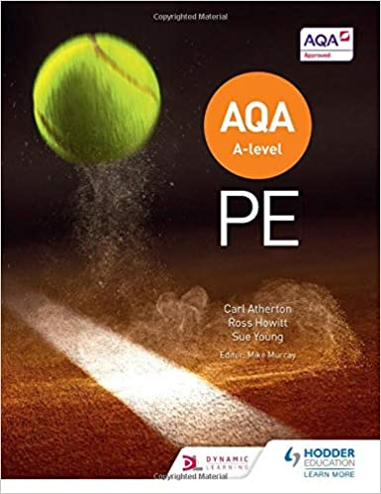

Slide 22
…….and finally..
ENJOY YOUR SUMMER!
Get off Tik-Tok and get active!
HAPPY HOLIDAYS

