Slide 1

Rules for answering questions on graphs 15 September, 2020
Do Now
On your mini whiteboards list the rules that you can remember to:
describe a graph with one line
describe a graph with two lines

Slide 2
Describing a Graph: One Line
Overall trend: Gradual increase/ decrease between...; Steep increase/ decrease between....
Highest/lowest values
Manipulate the data – how much does it increase or decrease by; how many times bigger is it at it’s highest point than lowest point; where is the biggest difference between and how much by
If graph goes up and down - does it return to the original y value at the end?
Use x and y values or ranges of values in descriptions

Slide 3
Two or more Lines/Graphs
Overall trends for each
Compare their increasing and decreasing regions - calculate differences between these
Compare their highest and lowest values – calculate differences between these
State where they cross/are the same value
Compare the steepness of their increases/ decreases
State if one line is higher for most/all of the time
If there are 2 separate graphs, describe them separately first before making any comparisons
If you have 2 graphs – describe each one separately and then compare them.

Slide 4
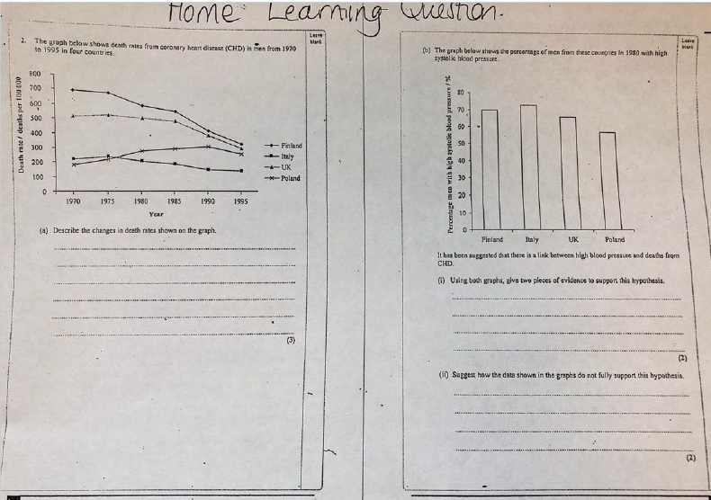
Reviewing Your Homework

Slide 5
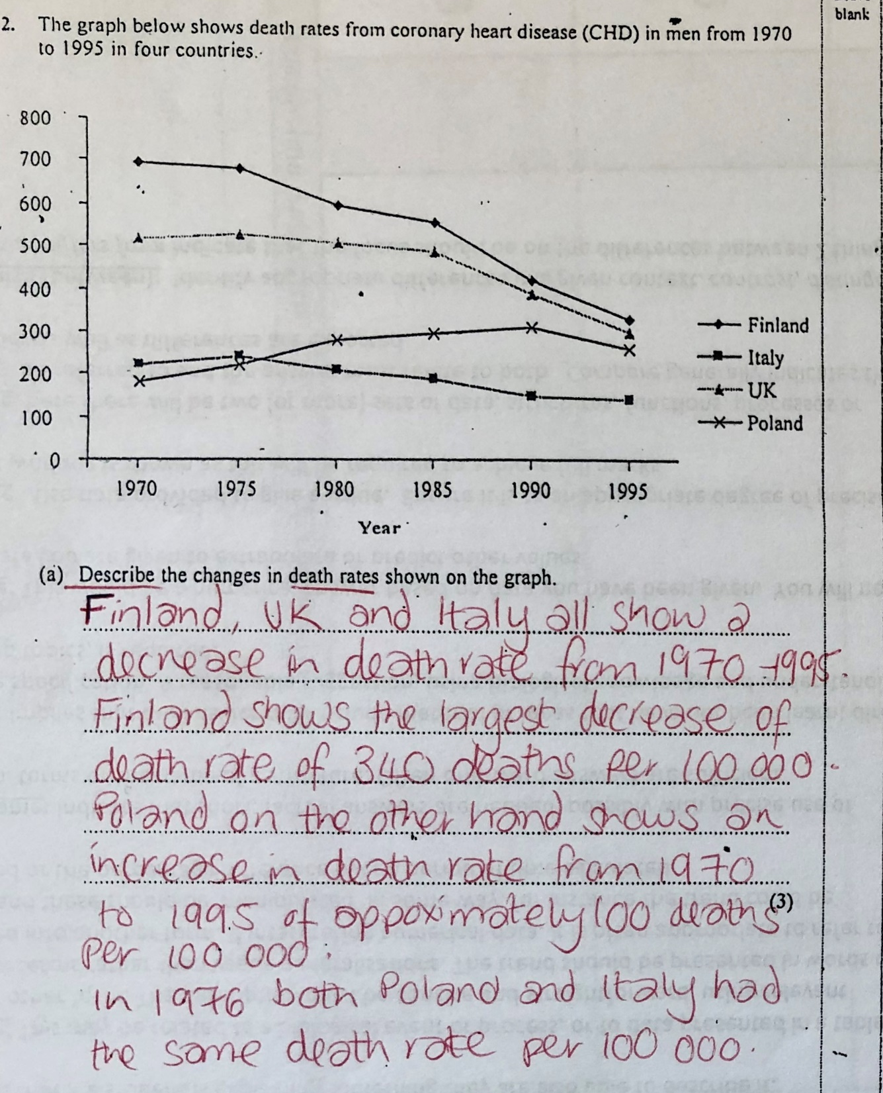

Slide 6



Slide 7
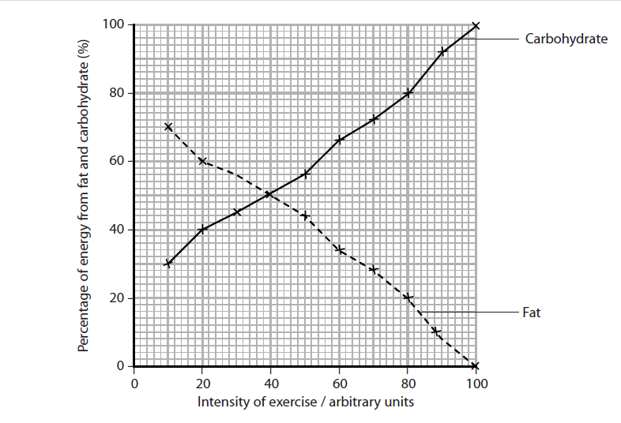
On your mini whiteboard describe this graph…..
Model answer:
As intensity of exercise increases the percentage of energy from carbohydrate increases at a consistent rate. With an increase in intensity of 60 au (from 10 to 100) the percentage of energy from carbohydrate increases by 70%).
As intensity of exercise increases the percentage of energy from fat decreases at a consistent rate. With an increase in intensity of 60 au (from 10 to 100) the percentage of energy from fat decreases by 70%).
At 40 au intensity of exercise both carbohydrate and fat have 50% of energy.
Notes:
Get students to do this in pairs on mini WBs

Slide 8
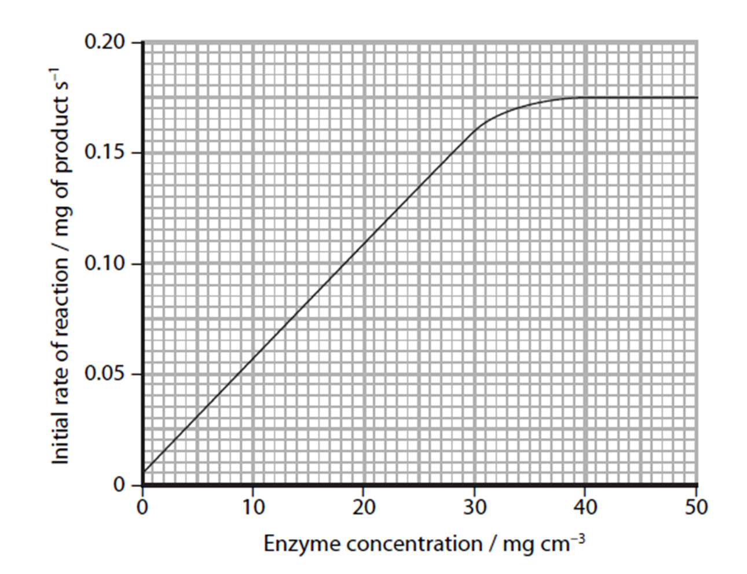
On your mini whiteboard explain this graph…
Model answer:
As enzyme concentration increases from 0 to 30 mg cm⁻³ the initial rate of reaction increases. This is because there will be an increase in the number of collisions between the enzyme and the substrate creating enzyme-substrate complexes.
From 30 mg cm⁻³ enzyme concentration onwards the initial rate of reaction begins to slow, this is because the substrate is the limiting factor and an increase in enzyme concentration will have no effect since there will be limited substrate to break down. Therefore, the initial rate of reaction then levels off and remains at 0.175 mgs⁻¹.
Notes:
MWB opportunity again. Students need to apply their knowledge of enzymes to explain the shape of this graph. It should go along the lines of as enzyme concentration increase so does initial rate of reaction until 30mgcm-3 because there are more successful collisions and so more enzyme-substrate complexes formed. Beyond 30mgcm-3 the initial rate of reaction plateaus at 17.5mg because the substrate is the limiting factor and all active sites are already filled.
Students need their subject knowledge of key words and concepts to be able to explain the graph. They also need to be able to pick out any changes in the graph and to explain them.

Slide 9
Now answer questions 35 – 39 in your booklet

Slide 10
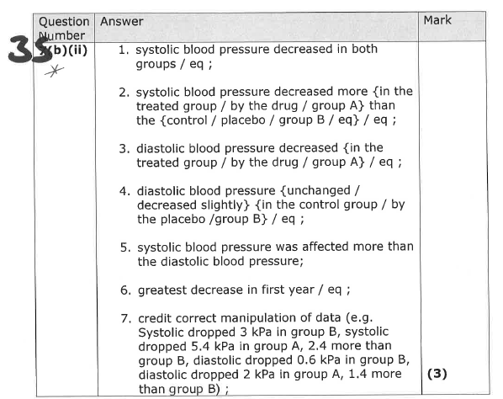
Answers

Slide 11
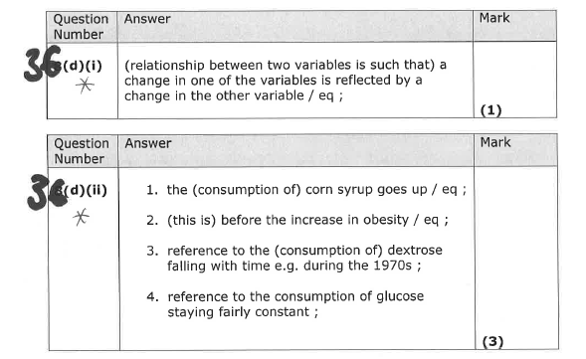

Slide 12

37

Slide 13
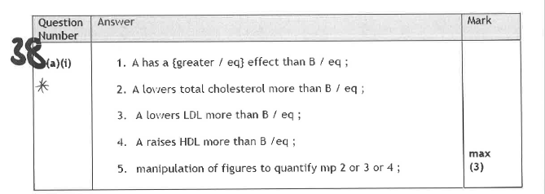

Slide 14
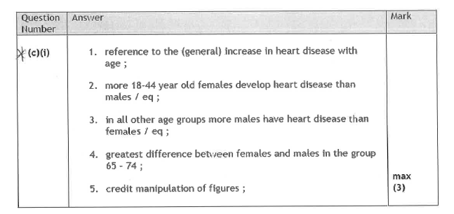

Slide 15
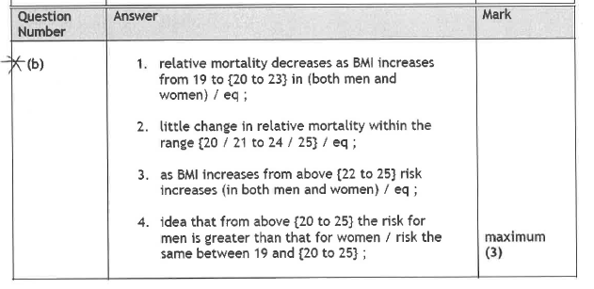
39

Slide 16
Which concepts do you think you might need to be able to explain from a graph?
Pressure changes in the cardiac cycle
Risks and CVD
SA:Vol ratio and oxygen diffusion
Enzyme rate of reaction
Homework:
Find and complete an exam question with a graph where you have to explain one of these concepts.
OR
Make your own graph exam question with a mark scheme on one of these concepts.
Notes:
You could find an exam question for them here but I think that the more independent they are and the more familiar they are with the exam qu database and the Edexcel examboard pastpaper page the better!

