Slide 1
Line Graphs Monday, 21 September 2020
DO NOW Copy the equation below and note what you know about it. What does each part represent?
The equation of a straight line takes the form:
y = mx + c
Where: x and y are different variables
m is the gradient
c is the y-intercept

Slide 2
Line Graphs Monday, 21 September 2020
Learning Objectives
Understand that y = mx + c represents a linear relationship
Determine the intercept of a Graph
Calculate rate of change from a graph showing a linear relationship
Draw and use the slope of a tangent to a curve as a measure of rate of change

Slide 3
Line Graphs
A variable is a value that can change depending on other factors – e.g. temperature, cost, height, test results
The gradient is the steepness of a line
The y-intercept is the point at which a line crosses the y-axis

Slide 4
Line Graphs
To plot a line graph, you need a table of values that contains at least three pairs of co-ordinates
Example: y = 3x + 1
x | 0 | 1 | 2
y
x | 0 | 1 | 2
y | 1 | 4 | 7

Slide 5

y
x | 0 | 1 | 2
y | 1 | 4 | 7
14
13
12
11
y = 3x + 1
10
9
8
7
6
5
4
3
2
1
x
-9
-8
-6
-5
1
2
3
4
5
6
7
8
9
-7
-4
-3
-2
-1
-1
-2
-3
-4
-5
-6
-7
-8

Slide 6
y
The blue line is the line y = 3x + 1
What can you tell about the gradient and y-intercept of the other three lines in comparison to the blue line?
Extension: can you predict what the equations of the other three lines might be?
14
13
y = 3x + 1
12
11
10
Line 3
9
8
7
6
5
4
Line 1
3
2
1
x
-9
-8
-6
-5
1
2
3
4
5
6
7
8
9
-7
-4
-3
-2
-1
-1
-2
-3
-4
-5
Line 2
-6
-7
-8

Slide 7
Line Graphs
Using the example linear graphs calculate their gradients and equations.

Slide 8
Linear Graphs Answers
Calculate the gradient of each line
2. Write the equation of each line in the form y =mx + c
(a)
9/1.8 = 5
Y = 5x + 11
(b)
9/4.4 = 2.05
Y = 2.05x + 1
(c)
-2/8 = -0.25
Y = -0.25x + -3
-8/8 = -1
Y = -1x + 8
(f)
(e)
-20/6.8 = -2.9
Y = -2.9x + 18
-24/6 = -4
Y = -4x + 20
(d)

Slide 9
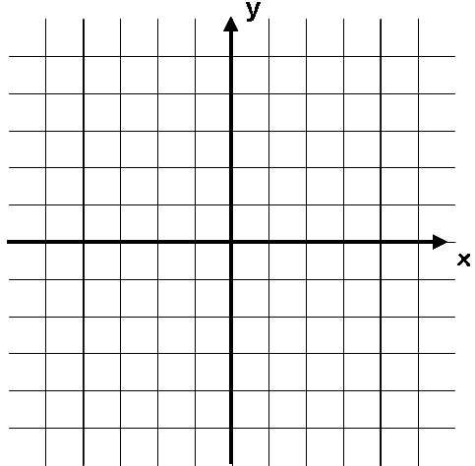
Gradients on a curved graph
You have already seen how to calculate the gradient of a linear graph by dividing the change in y by the change in x
Also known as ‘rise over run’
What if you were asked to calculate the gradient of this line?
The problem on a curved line is that the gradient is different depending on where on the line you are…
On the left side, the gradient will be negative
On the right side, the gradient will be positive
However, we can use a technique to estimate the gradient, using what you already know…
Line is downward sloping so the gradient is negative
Line is upward sloping so the gradient is positive

Slide 10



Gradients on a curved graph
Draw a straight line that just touches the curve where x = 2
This line is known as a tangent to the curve
You can calculate the gradient of it like on a straight line graph
The value will be an estimate of the gradient of the curve at the given point
Estimate the gradient of this line where x = 2
5
2.2
x = 2
2
-5
5
$$Gradient=\frac{rise}{run}$$
$$Gradient=\frac{2.2}{2}$$
-5
$$Gradient=1.1$$

Slide 11
Line graphs
Now plot the graphs on the ‘gradient on a graph’ sheet
Use this information to plot tangents to the curve at the values of x given on the sheet

Slide 12
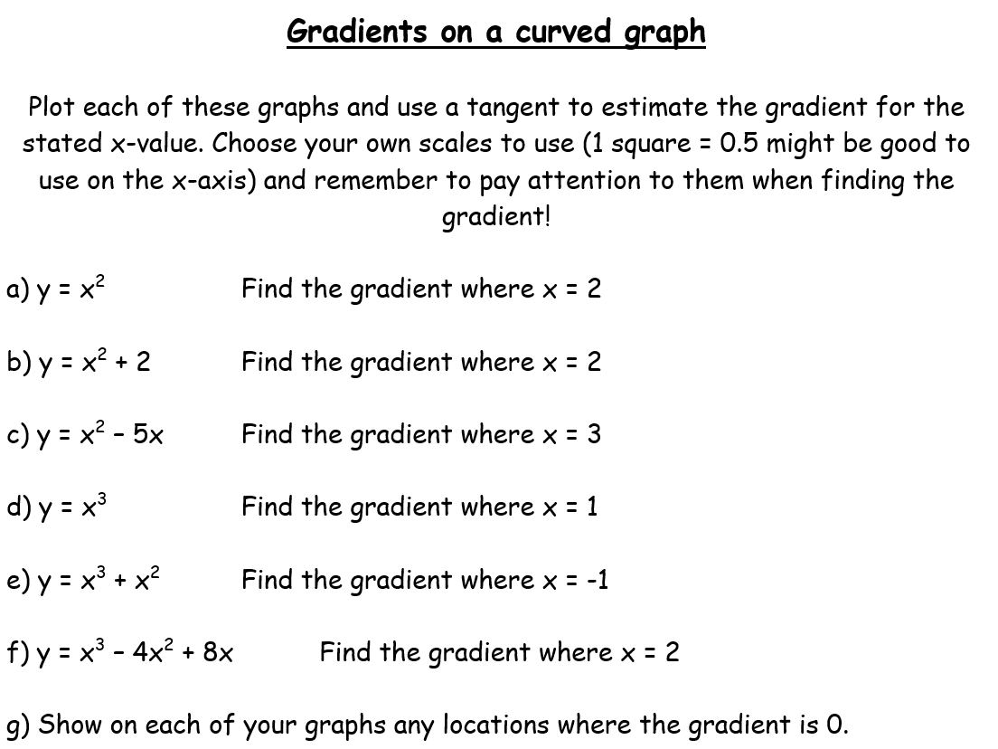
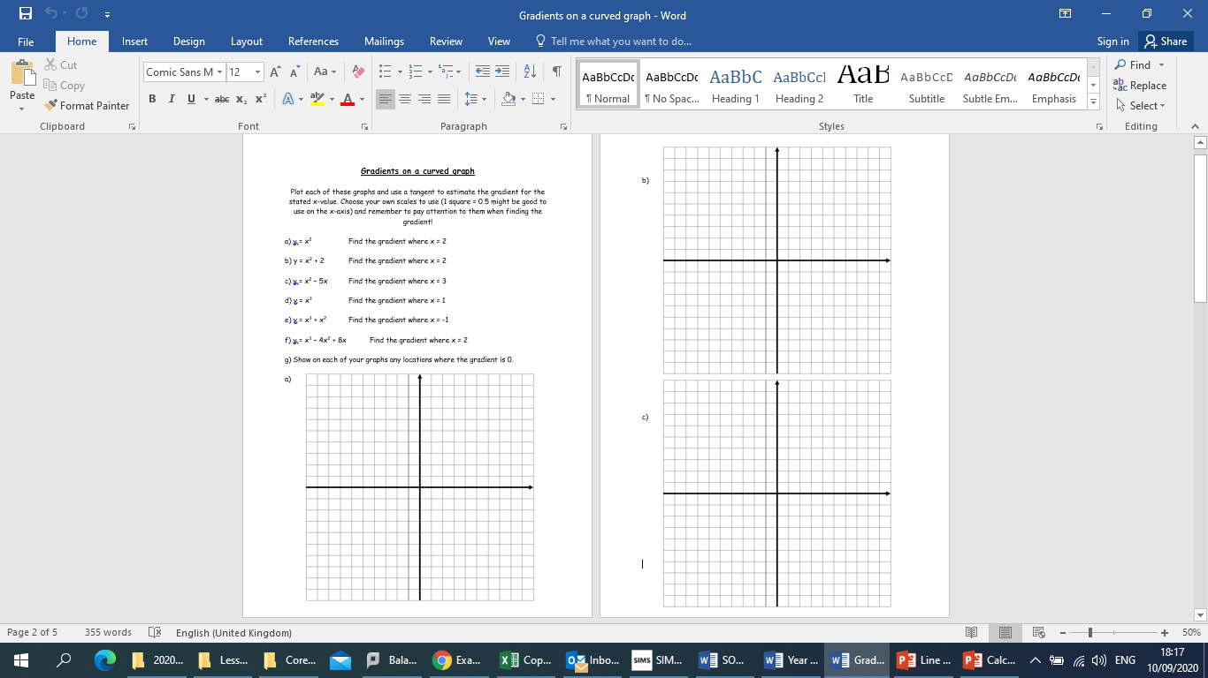

Slide 13
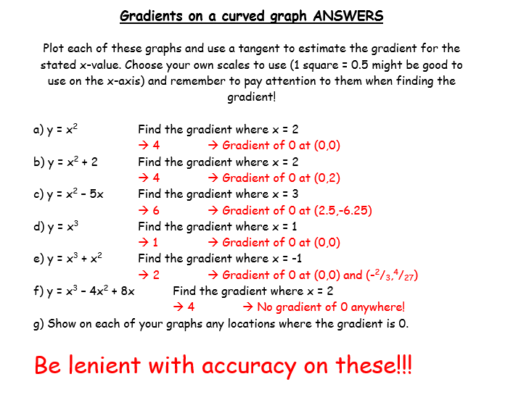

Slide 14
Exit Ticket
What do the different part of y = mx + c equation represent?
Can you describe how to determine the intercept of a graph?
Can you describe how to calculate the gradient of a linear relationship?
Can you describe how to draw a tangent to a curve as a measure of rate of change?

