Slide 1
The Related Study
What the Related Study is and how to go about writing it.

Slide 2
What is it?
The Related Study is the written element of your A-level art and photography course.
It needs to be minimum 1500 words, maximum 3000 words
It can be about any topic of art and photography but must be linked to your creative practice
It is a research-based exploration of a topic, not an artist link
It is 20% of you coursework, which counts for 60% of you’re A-level. It is therefore 12.5% of your whole A-level. This is the difference between a whole grade!

Slide 3
What Does the Related Study Look Like?
A formal piece of writing
Includes image
Has a contents page, main body, and reference list.
Begin using recording your sources immediately, this will be a life saver further down the line
Let’s take a look…

Slide 4
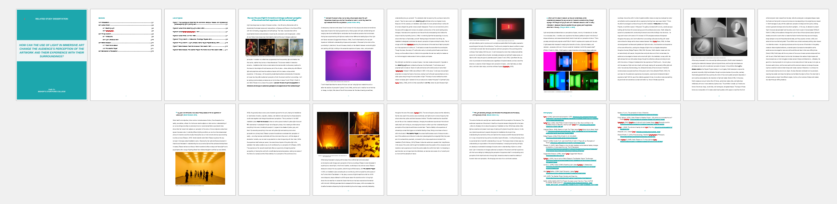

Slide 5
Think of it as a conversation
When thinking of a title for your Related Study, think of a question or discussion that has multiple angles or perspectives. That way, you can research numerous perspectives, before reaching a conclusion at the end.
You may not even reach a conclusion – you may end with a provocation!
The Related Study is a great opportunity to explore the history, concepts and ideas behind art and why it is made. If you are interested in Art History, you will love this part of the course.
DON’T PANIC. It is quite tricky, but we will help and support you along the way!

Slide 6
Who or what would you like to explore in your Related Study?
What threads have appeared in your project that you can use to weave through and with your writing?

Slide 7
Task 1 – List your knowledge!
Activate your memory banks and write a list of EVERY artist, art movement, culture, building or architect you have written an artist link on in the past two years (so Yr 111 and Yr12)
You’ll be amazed at how many you have looked at!

Slide 8
Task 2 - Expand the list
Add the following details to each of the bits of knowledge you listed:
Date/time of existence
Material used
Scale
Art movement he/she/they/it belongs to (eg Cubism, Surrealism etc..)
Form – 2D, 3D, fashion, video, photography etc…
Place/location
Concept/theme/message

Slide 9
Task 3 – Make connections
Using the information you have now listed, try to identify connections and links between what you know.
For example…. You may have looked at Chillida, Deacon and Moore in the past…What do they have in common?
They are all male
They all produce sculpture
They are all from the 20th century
They are all European
Try to join the dots for a number of your previous artist links.

Slide 10
Consider this….
You are having a dinner party to discuss your Related Study topic. Who would you invite?
Who would be sat around the table to discuss your topic?
Who would you include, and who would you exclude?

Slide 11
Task 4 – Have a go at creating questions!
Using your connected knowledge, try to come up with some potential areas for discussion
Don’t panic! This is just an exercise. Nothing set in stone yet!
Don’t worry if you think it may be a statement rather than a discussion, brainstorm ideas for now and we can then tweak them

