Slide 1


Slide 2
Year 1 practicals: topics 1 Thursday, 17 October 2019
Do Now
Investigate the effect of caffeine on heart rate of Daphnia
Investigating vitamin C content of food and drink
For the above practicals note the:
independent variable (including its range and equipment required)
dependent variables (including how this is measured)
controlled variables (including how they are controlled)
how the investigations could be made repeatable
Any ethical issues

Slide 3
I Investigate the effect of caffeine on heart rate of Daphnia
Independent variable = concentration of caffeine, this was made by mixing water with a pro plus tablet. You should have 5 different concentrations e.g. water, 0.5%, 1%, 1.5%, 2% caffeine.
Dependent variable = the heart rate of the Daphnia per minute. This was counted per 15 seconds using dots on a piece of paper or counter. Then multiply by 4.
Controlled variables = volume of solution Daphnia was in using a pipette, length of time the Daphnia was left on the microscope, age and type of Daphnia.
Repeatable = doing the experiment 3 times with different daphnia to calculate a repeatable average and check for outliers. Why do they need to be different?
Ethical considerations = Although they are simple organisms that may not 'suffer' in the same way as higher animals, they still deserve respect. Animals should be returned promptly to the holding tank after being examined.

Slide 4
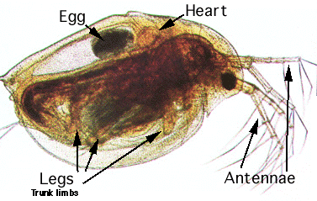
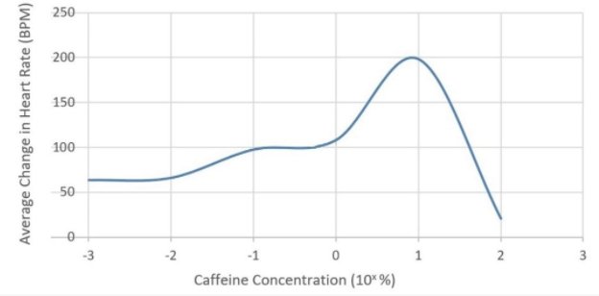
Recapping investigation on the effect of caffeine on heart rate of Daphnia
https://www.youtube.com/watch?v=FPX8hO8y6cQ&t=257s
If you got lots of the questions wrong/blank this is a nice recap.
Then write your answers to the original questions again without looking at your answers.

Slide 5
I Investigating vitamin C content of food and drink
Independent variable = the type of fruit juice or food investigated. There should be at least 5 different types.
Dependent variable = the volume of juice required to turn the DCPIP colourless (or the same colour as the original solution). You should put approximately 1cm3 of DCPIP into each testtube before pipetting in each juice a drop at a time.
Controlled variables = the volume of DCPIP in each test tube, concentration of DCPIP at 1%, the temperature of the solutions using a waterbath, number of shakes of test tube each time .
Repeatable = doing the experiment 3 times to calculate a repeatable average and check for outliers.

Slide 6
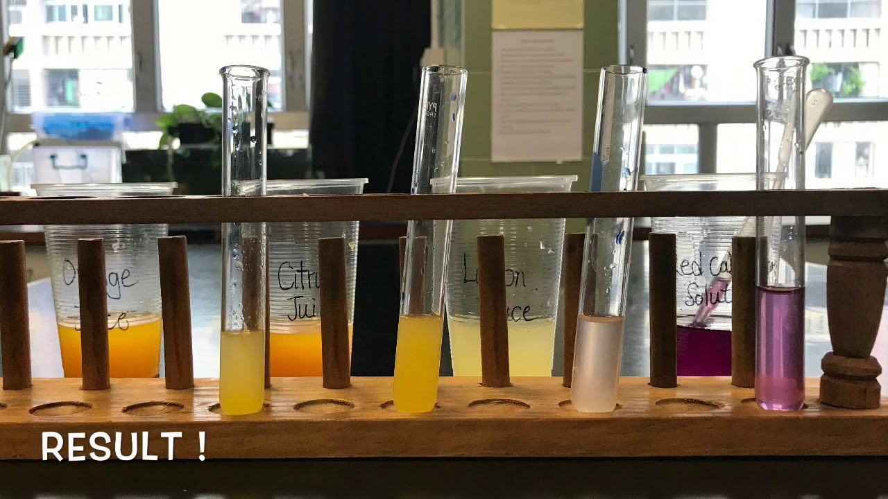
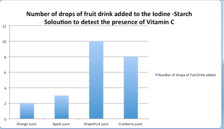
Investigating vitamin C content of food and drink
https://www.youtube.com/watch?v=oI33svVr82U
If you got lots of the questions wrong/blank this is a nice recap.
Then write your answers to the original questions again without looking at your answers.

Slide 7
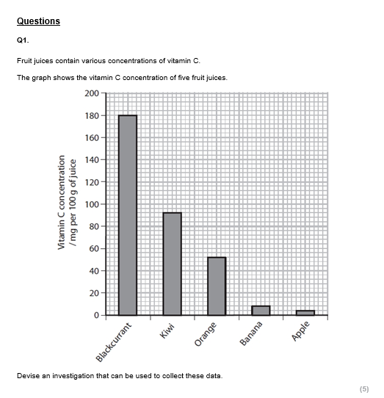
Example question
Discuss in pairs the key things that you think that you will need to include in your answer?
What information will you need to use from the graph and scenario that they give you?

Slide 8
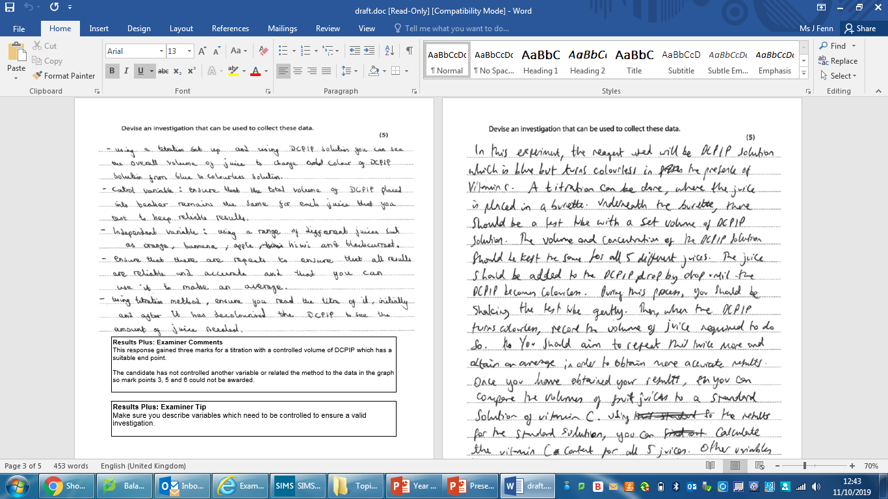
Has this student left anything out?

Slide 10
Now draft your own answer on mini whiteboards in pairs

Slide 11
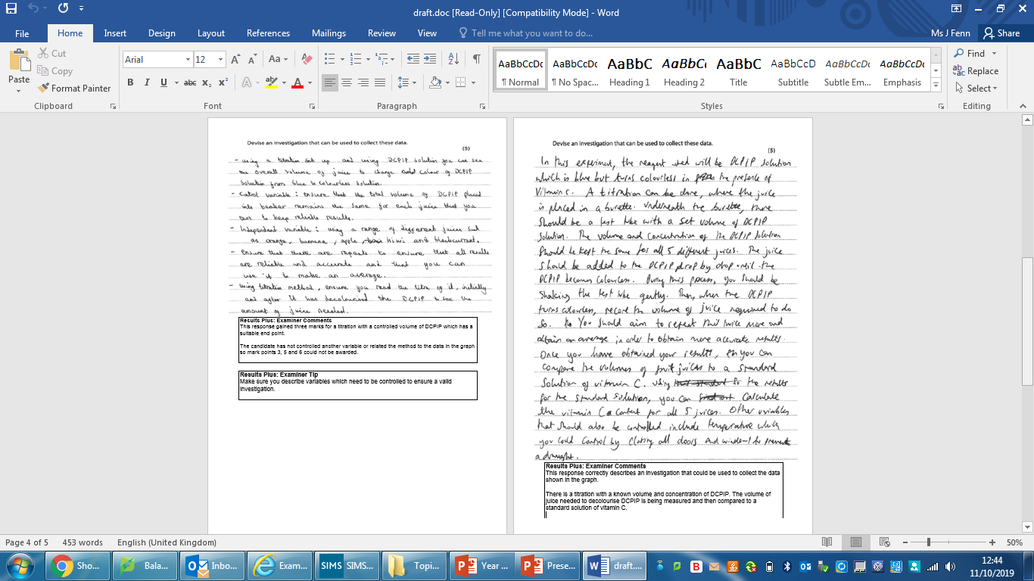
Full marks
Compare yours to this one. Have you left anything out? If so what?

Slide 12
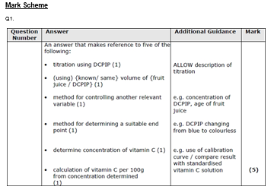

Slide 13
Independent practice
Now try the exam questions on the topic 1 core practicals on your own

