Slide 1
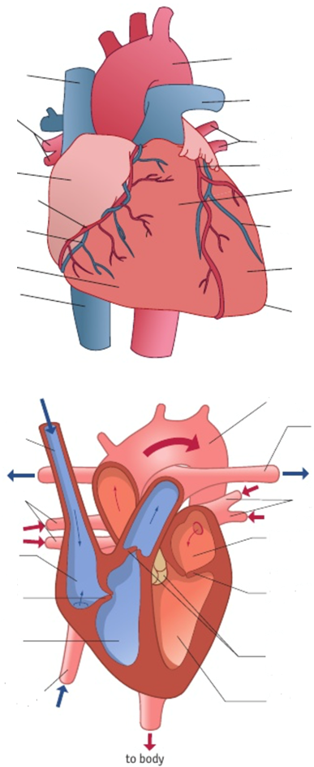
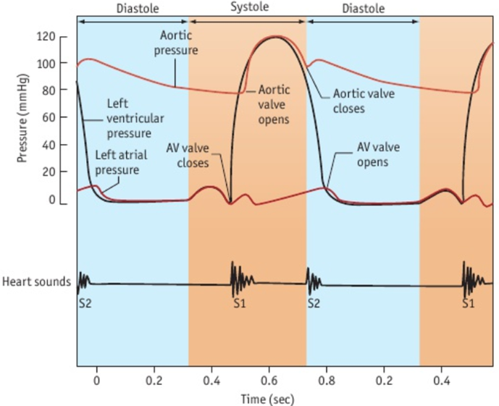
Topic 1 – Heart and Circulation
Draw and describe the structure of the blood vessels:
Artery: Vein: Capillaries:
Describe the 3 phases of the cardiac cycle.
Describe the changes in pressure during each cardiac cycle.

Slide 2
Topic 1 – Heart Disease
What is atherosclerosis?
Describe the course of events that leads to atherosclerosis.
Describe the process that causes the blood to clot
What is the difference between:
Correlation
Causation
How do the following affect the chances of having CVD?
Age
Smoking
Lack of Exercise
Diet
Genetics
What is blood pressure?
What is the range for ‘normal’ blood pressure?

Slide 3
Topic 1 – Water
What is the basic structure and properties of a water molecule?
Describe these properties of water:
Solvent properties
Thermal properties
Density and Freezing
What is the definitions of:
Cohesion
Adhesion
Surface tension
Draw and label hydrogen bonding between 5 molecules of water
Add labels to show
adhesion and cohesion

Slide 4
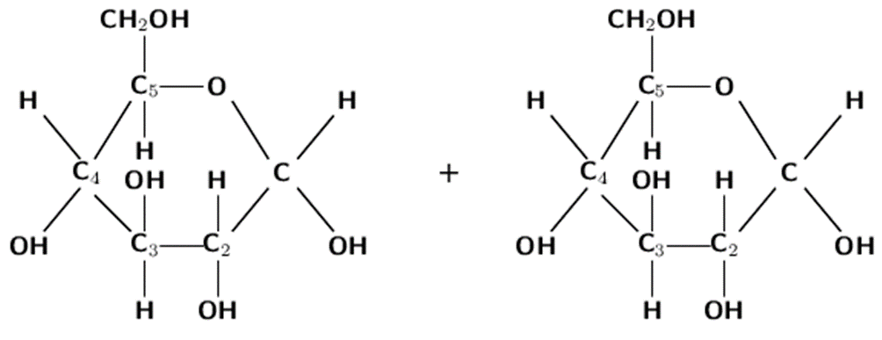
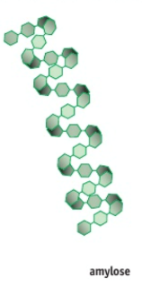
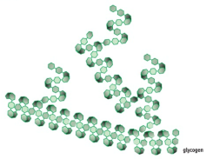

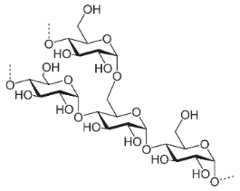
Topic 1 – Carbohydrates
What are carbohydrates?
Monosaccharide | Disaccharide | Polysaccharide
 | Glycogen | Amylose | Amylopectin | Starch
Animal or plant
Made of…
Soluble or insoluble?
Straight or branched?
Type of bond
Structural Diagram
Show the condensation reaction of these two monosaccharides.

Slide 5
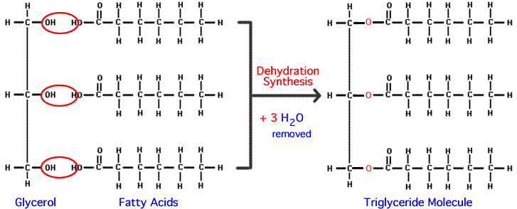
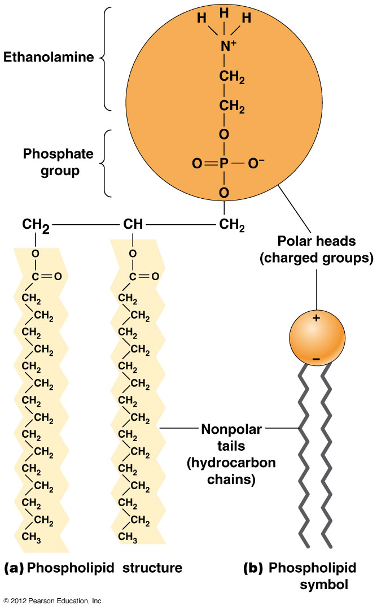
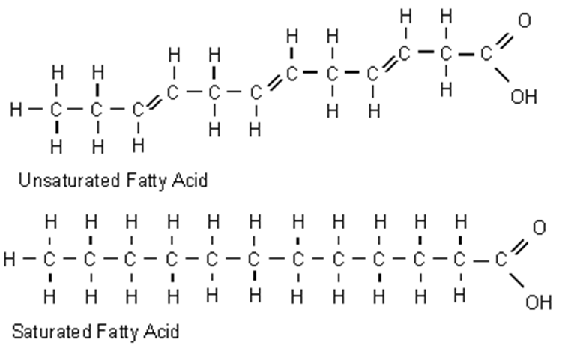
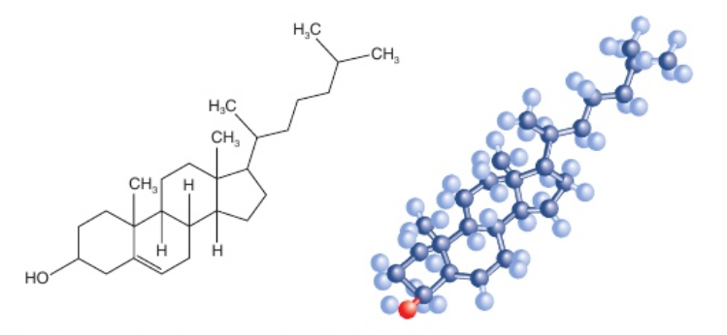
Topic 1 – Lipids
Why are lipids ‘non-polar’?
What are lipids made of?
What is the bond?
What is the difference between a saturated and an unsaturated hydrocarbon?
What is cholesterol?
Why is it important?
What is a lipoprotein?
What is the function of Low-Density Lipoproteins?
What is a phospholipid?
Why is it important?
What is the function of High-Density Lipoproteins?

Slide 6
Topic 1 – Core Practicals
Core Practical: Effect of Caffeine on the Heart Rate of Daphnia
Independent Variable
Dependent variable
Control variables
Outcome
Evaluation
Core Practical: Investigate the vitamin C content of food and drink
Independent Variable
Dependent variable
Control variables
Method
Outcome
Evaluation

