Slide 1


Slide 2
Year 1 practicals: topic 2 Monday, 28 October 2019
Do Now
Investigate membrane structure, including the effect of alcohol concentration or temperature on membrane permeability
Investigate the effect of enzyme and substrate concentrations on the initial rates of reactions
For the above practicals note the:
independent variable (including its range and equipment required)
dependent variables (including how this is measured)
controlled variables (including how they are controlled)
how the investigations could be made repeatable
Extension: can you explain how you would present and analyse the data from these experiments?

Slide 3
Year 1 practicals: topic 2 Monday, 28 October 2019
Bigger Picture
From looking at your UCAS papers and your last test on topics 1 -4 we need to work on your recall of year 1 required practicals and how to answer exam questions on them.
Nationally last year, students underperformed on paper 3 and on questions related to practicals in different contexts.
Learning objectives
Can you recall the steps, equipment and variables involved in each of the core practicals in topic 2?
Can you apply this information to answer exam questions with a different context?
Can you understand and use scientific terminology such as repeatability and validity?

Slide 4
Investigate membrane structure, including the effect of alcohol concentration or temperature on membrane permeability
Independent variable = alcohol concentration or temperature e.g. 0%, 10%, 20%, 30%, 40%, 50% alcohol or 10 20 30 40 50 oC in the waterbath.
Dependent variable = the absorbance of the beetroot solution in a colorimeter.
Controlled variables = volume of the alcohol/water solution, mass of the beetroot using top pan balance, length of time left for, temperature, pH.
Repeatable = doing the experiment 3 times to calculate a repeatable average and check for outliers.

Slide 5
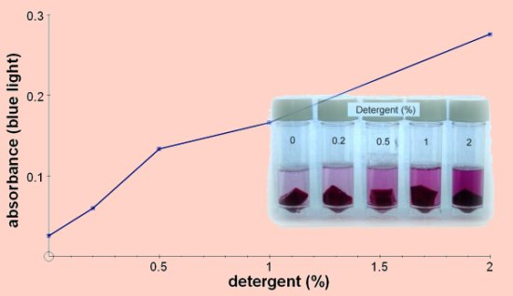
Investigate membrane structure, including the effect of alcohol concentration or temperature on membrane permeability
https://www.youtube.com/watch?v=UzwOfFvLtJ0
If you got lots of the questions wrong/blank this is a nice recap.
Then write your answers to the original questions again without looking at your answers.

Slide 6
Investigate the effect of enzyme and substrate concentrations on the initial rates of reactions
Independent variable = mass of potato using top pan balance e.g. 0.5g, 1.0g, 1.5g, 2.0g, 2.5g or concentration of the hydrogen peroxide e.g. 0m, 0.5m, 1m, 1.5m, 2m.
Dependent variable = the volume of oxygen produce over a time period, collected in a syringe or upside down measuring cylinder. This was then plotted onto a graph of time and volume of oxygen and a tangent was drawn to the curve at the steepest part within the first 60 seconds. This was used to calculate the initial rate (volume/time) and then plotted on a second graph with mass/concentration vs initial rate of reaction.
Controlled variables = mass of the potato/concentration of hydrogen peroxide, type and age of potato, temperature using waterbath, pH with pH buffer.
Repeatable = doing the experiment 3 times to calculate a repeatable average and check for outliers.

Slide 7
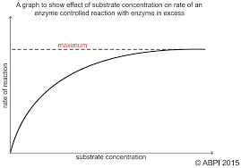
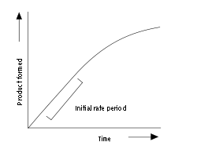
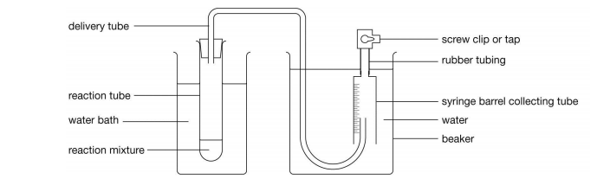
Investigate the effect of enzyme and substrate concentrations on the initial rates of reactions
https://www.youtube.com/watch?v=rABpkD42Ap4
If you got lots of the questions wrong/blank this is a nice recap.
Then write your answers to the original questions again without looking at your answers.

Slide 8
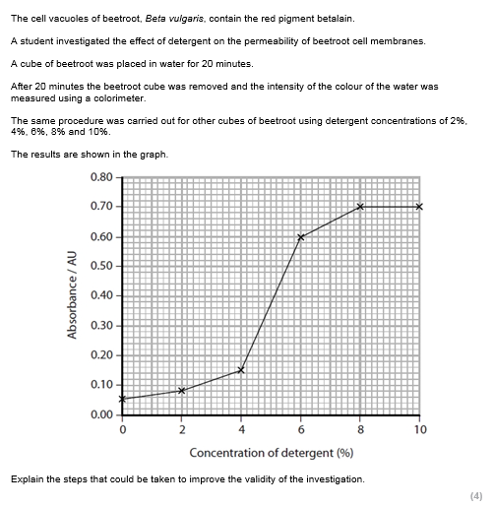
Example question
Discuss in pairs the key things that you think that you will need to include in your answer?
What are the key words in the question and what do they mean?
What does validity mean?
A valid experiment is one where all the necessary variables in an investigation are controlled to make sure that only the independent variable affects the dependent variable.
Notes:
print

Slide 9
Example answer to improve
You could control the temperature. The beetroot should be of the same source and the same mass using a top pan balance. You could also do some repeats to get an average.

Slide 10
What did you add to the answer?
You could control the temperature. The beetroot should be of the same source and the same mass using a top pan balance. You could also do some repeats to get an average.

Slide 11
My model answer
You need to control the temperature using a waterbath because this would affect the rate of diffusion of the betalain pigment across the membrane. The beetroot should be of the same source and the volume of solution kept the same so that the betalain pigment is the same concentration in each sample. The beetroot should be cut with a cork borer and measured with a ruler to make sure that the surface area is always the same, so that surface area to volume ratio does not affect the diffusion. You should do at least three repeats at each concentration to check for outliers and to calculate a reliable average.

Slide 12
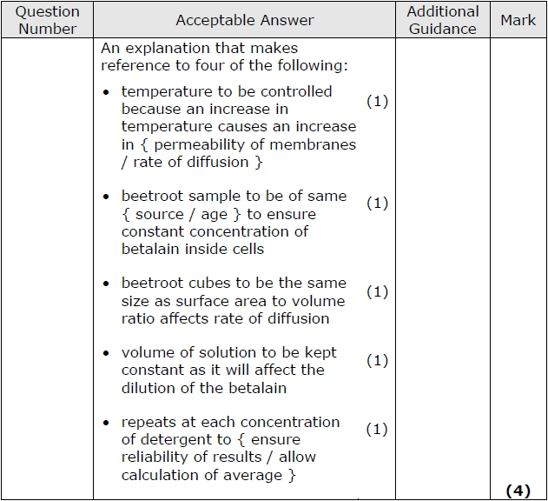
Swap with another pair and mark your answers

Slide 13
How would you change your answer if the command word was:
Warm
Hot
Scorching
Describe?
Devise?
Assess?

Slide 14
How would you change your answer if the command word was:
Describe: “say what you would do step by step, no reasons given”.
Devise: “say what you would do step by step, potentially giving reasons”.
Assess: “say all the things that you would do and why, and identify which are the most important and why”.
Now each group will be given one of the command words to change your answer to address.

Slide 15
Independent practice
Now try the exam questions on the topic 2 core practicals on your own
Finish for homework

