Slide 1
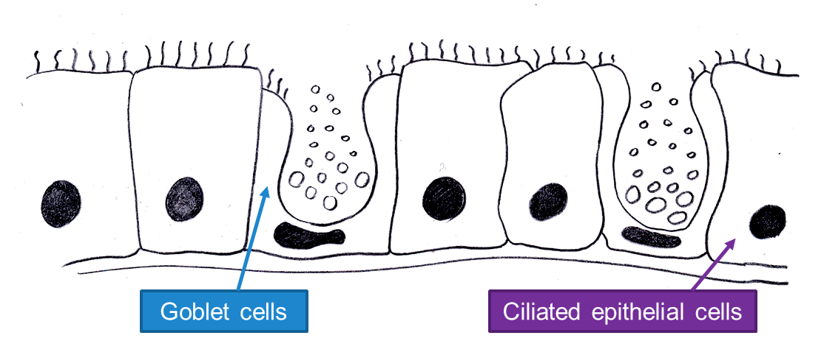
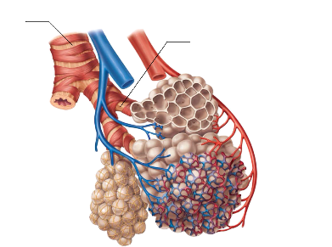

Topic 2 – Gas Exchange and Diffusion
Describe the function of these cells in the trachea
How are the alveoli adapted for quick and efficient gas exchange?
Define Fick’s Law
How does this relate to the rate of diffusion?
How does surface area to volume ratio affect diffusion?
$$Surface area:Vol= \frac{surface area}{volume}$$
Complete the table
How does having cystic fibrosis effect gas exchange?
Length of side (cm) | Surface Area (cm²) | Volume (cm³) | Surface Area: Volume
1 | 6 | 1
2 | 24 | 8
3 | 54 | 27
4 | 96 | 64

Slide 2
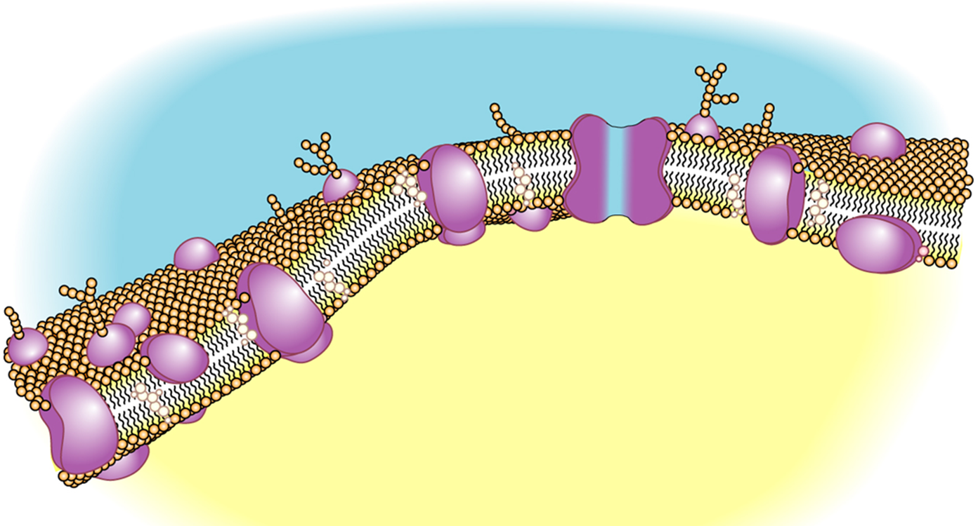
Topic 2 – Membrane Structure
What the role of the cell surface membrane?
How do the properties of the phospholipid allow it to form a bilayer?
Explain why it is known as the “Fluid Mosaic Model”
Draw and label a phospholipid
Draw and label a phospholipid

Slide 3
Topic 2 – Transport Across a Membrane
 | Diffusion | Facilitated Diffusion | Osmosis | Active Transport | Exocytosis | Endocytosis
Concentration gradient…
Molecules involved…
Moves through…
Energy…
Core Practical: Beetroot
Independent variable
Dependent variable
Control variables
Method
Expected results

Slide 4
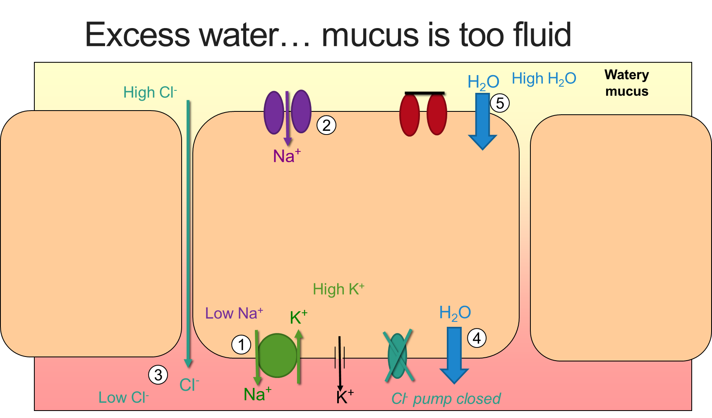
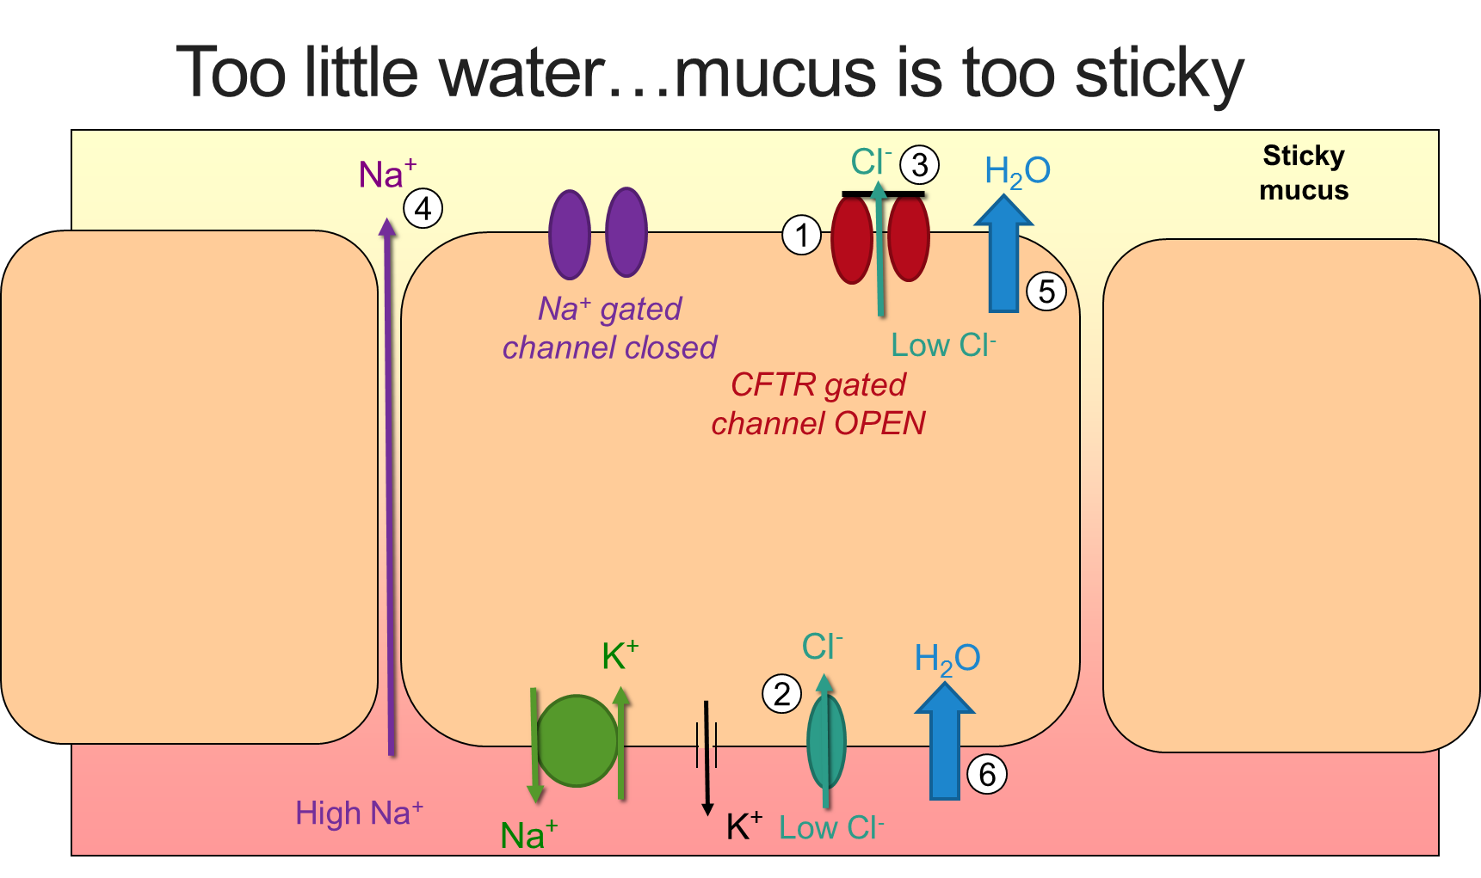
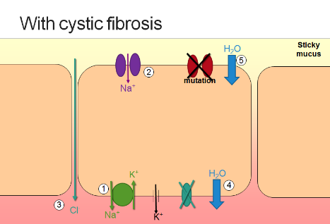
Topic 2 – Cystic Fibrosis
What causes Cystic Fibrosis?
Describe the movement of ions between the cells and the mucus in these scenarios
Excess Water in Mucus | Too Little Water in Mucus | With Cystic Fibrosis
How does having cystic fibrosis affect the lungs?
How does having cystic fibrosis affect the digestive system?

Slide 5
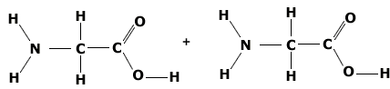
Topic 2 – Protein Structure
List some functions of proteins
Draw and label the basic structure of an amino acid
Draw the dipeptide formed in this reaction
What reaction joins amino acids together?
What bond holds two amino acids together?
What reaction breaks apart amino acids?
Compare the structures of:
Globular Proteins – give an example
Fibrous Proteins – give an example
Structures of a Protein
Primary
Secondary
Tertiary
Quaternary
How is the tertiary structure affected by an increase in temperature?
What determines a conjugated protein?

Slide 6
Topic 2 – Enzymes
Define these terms:
Catalyst
Enzyme
Activation Energy
Describe the lock and key theory. You could draw a diagram
How does temperature affect the rate of an enzyme controlled reaction? Draw a graph
How does pH affect the rate of an enzyme controlled reaction? Draw a graph
How does enzyme concentration affect the rate of an enzyme controlled reaction? Draw a graph
How does substrate concentration affect the rate of an enzyme controlled reaction? Draw a graph
Core Practical: Enzymes
Independent variable
Dependent variable
Control variables
Method
Expected results
How do enzymes reduce the activation energy?
What is the difference between intracellular and extracellular enzymes?
Give an example of each
Describe the induced fit theory. You could draw a diagram

Slide 7
Topic 2 – Nucleic Acids
Draw and label a nucleotide
Draw and label a DNA nucleic acid
Draw and label an RNA nucleic acid
What bond is formed between the back-bone of DNA
 | DNA | RNA
Name of sugar
Double or single stranded?
Nitrogenous bases present

Slide 8
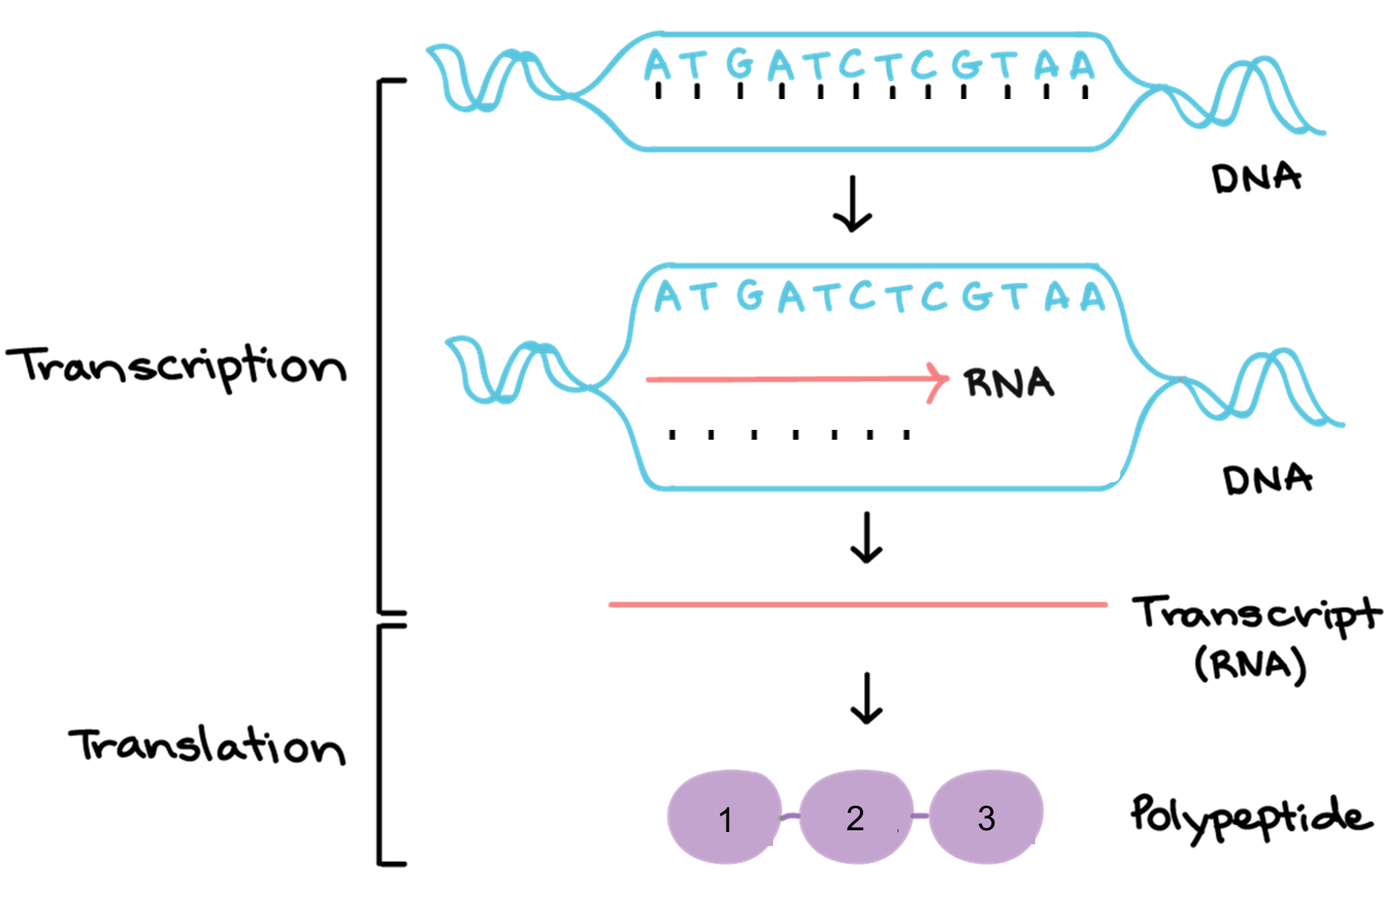
Topic 2 – Protein Synthesis
What is meant by these terms:
Genetic Code
Near-universal
Degenerate
Non-overlapping
 | Transcription | Translation
Location
Molecules Involved
5 Step Summary
Complete the diagram
Fill in the template strand of DNA
Write in the complimentary mRNA molecule
Draw in the correct anticodons on the tRNA molecule

Slide 9
Topic 2 – DNA Replication
Draw and label a nucleotide
Draw and label a DNA nucleic acid
Draw and label an RNA nucleic acid
What bond is formed between the back-bone of DNA
 | DNA | RNA
Name of sugar
Double or single stranded?
Nitrogenous bases present

Slide 10
Topic 2 – Monohybrid Crosses
What are homologous chromosomes?
How did the work of Gregor Mendel influence our current knowledge of genetics?
Draw out a Punnet square to predict what % of offspring will have cystic fibrosis from the following parents.
Homozygous recessive mother, homozygous dominant father
Heterozygous father, homozygous recessive mother
Both parents heterozygous
Keyword | Definition
Gene
Allele
Dominant
Recessive
Monohybrid inheritance
Genotype
Phenotype
Heterozygous
Homozygous

Slide 11
Topic 2 – Genetic Screening
Amniocentesis
When
Method
Risks
Chorionic Villus Sampling (CVS)
When
Method
Risks
Non-invasive prenatal diagnosis (NIPD)
When
Method
Risks
Pre-Implantation Genetic Diagnosis (NIPD)
When
Method
Risks
How are samples tested?
What are the ethics and social implications of genetic testing

