Slide 1


Slide 2
Year 1 practicals: topic 3 (and 4) Thursday, 28 November 2019
Do Now
5. Prepare and stain a root tip squash to observe the stages of mitosis
6. Identify sclerenchyma fibres, phloem sieve tubes and xylem vessels and their location within stems through a light microscope
For the above practicals note the:
independent variable (including its range and equipment required)
dependent variables (including how this is measured)
controlled variables (including how they are controlled)
how the investigations could be made repeatable
Extension: can you explain how you would present and analyse the data from these experiments?

Slide 3
Year 1 practicals: topic 3 (and 4) Thursday, 28 November 2019
Bigger Picture
From looking at your UCAS papers and your last test on topics 1 -4 we need to work on your recall of year 1 required practicals and how to answer exam questions on them.
Nationally last year, students underperformed on paper 3 and on questions related to practicals in different contexts.
Learning objectives
Can you recall the steps, equipment and variables involved in each of the core practicals in topic 3 (and 4)?
Can you apply this information to answer exam questions with a different context?
Can you understand and use scientific terminology such as repeatability and validity?

Slide 4
Prepare and stain a root tip squash to observe the stages of mitosis
Independent variable = N/A.
Dependent variable = the number of cells in mitosis using the mitotic index (count number with visible chromosomes in each phase and divide by total).
Controlled variables = volume and concentration of hydrochloric acid, pressure to macerate/squash root tip to see single layers, volume and concentration of toluidine blue or orcein stain.
Repeatable = doing the experiment 3 times to calculate a repeatable average and check for outliers.

Slide 5
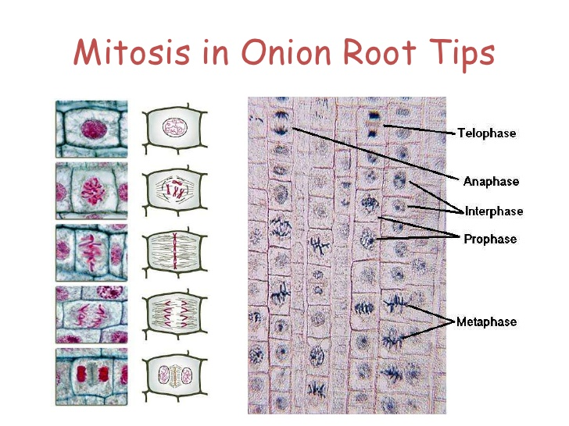
Core Practical 5: Prepare and stain a root tip squash to observe the stages of mitosis
https://www.youtube.com/watch?v=K2_FZRdjQH4

Slide 6
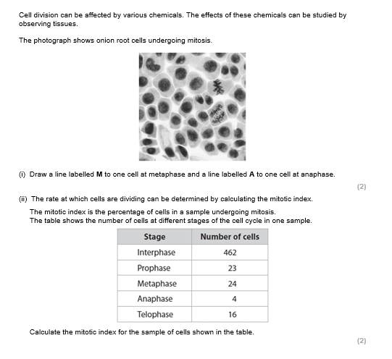
Example exam question
In pairs attempt on your mini whiteboard

Slide 7
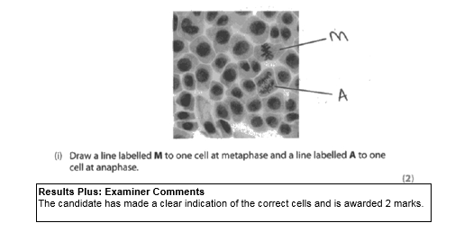

Slide 8
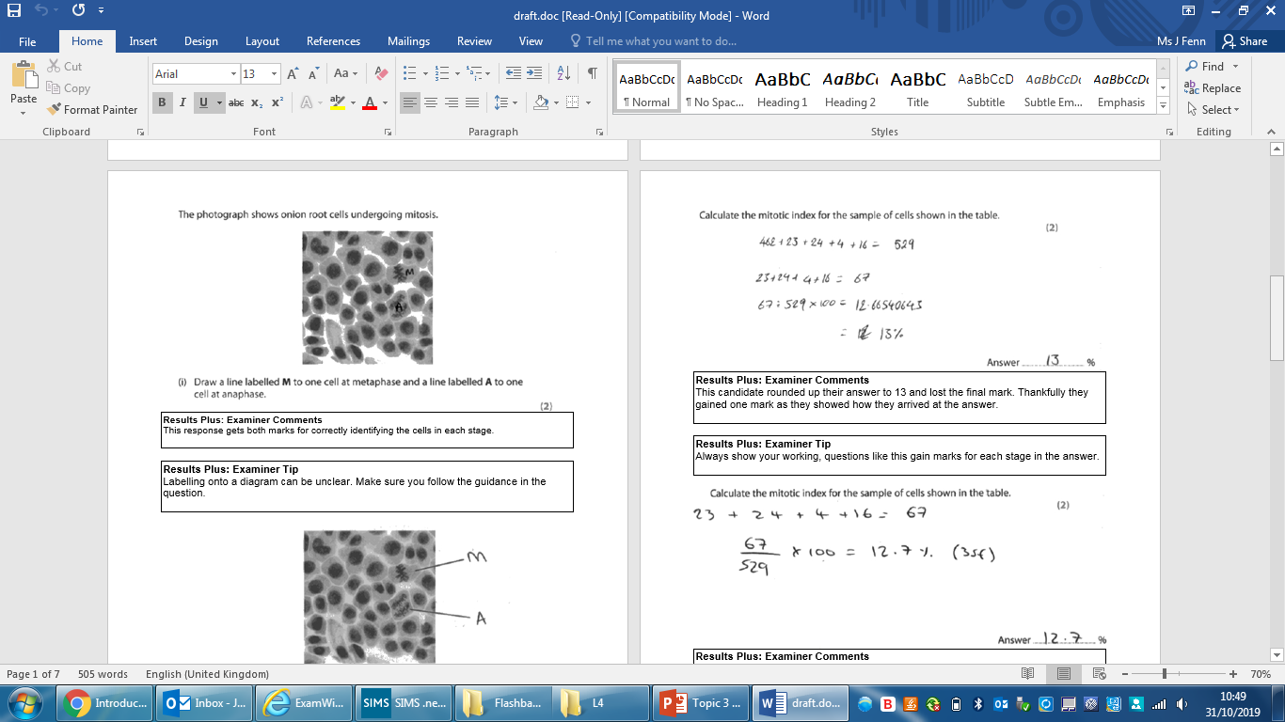
What did they do wrong here?

Slide 9
What did they do wrong here?

Slide 10
Identify sclerenchyma fibres, phloem sieve tubes and xylem vessels and their location within stems through a light microscope
Independent variable = N/A
Dependent variable = identification of the locations of the vessels and vascular bundles.
Controlled variables = type and age of rhubard, volume/mass of rhubard, volume and concentration of methylene blue dye and time left for, pressure on cover slip, magnification
Repeatable = doing the experiment 3 times to calculate a repeatable average and check for outliers.

Slide 11
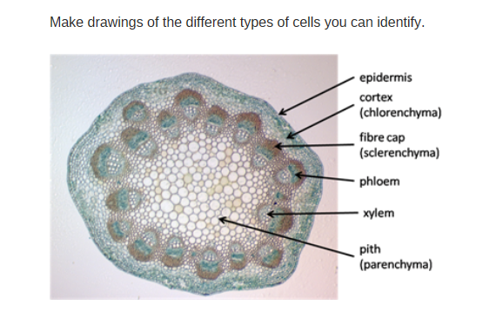

Slide 12
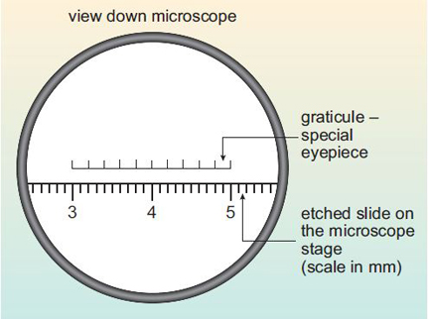
Core Practical 6: use of graticules
https://www.open.edu/openlearn/science-maths-technology/biology/introduction-microscopy/content-section-2.3
(includes an example)

Slide 13
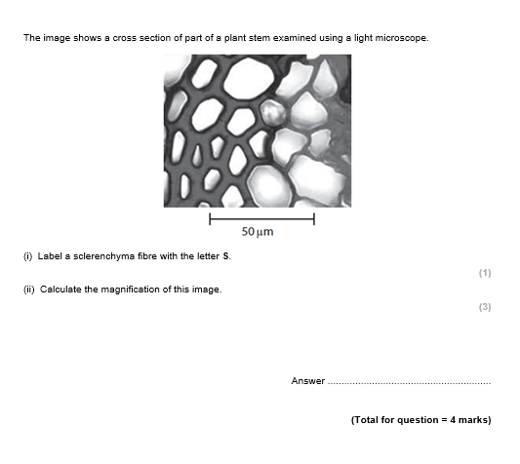
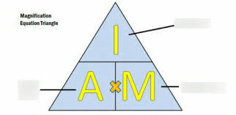
Example exam question
In pairs attempt on your mini whiteboard
Notes:
Print question

Slide 14
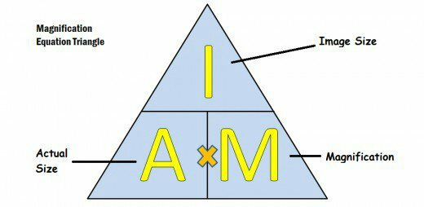

Slide 15
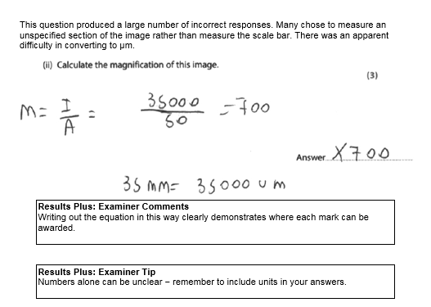

Slide 16
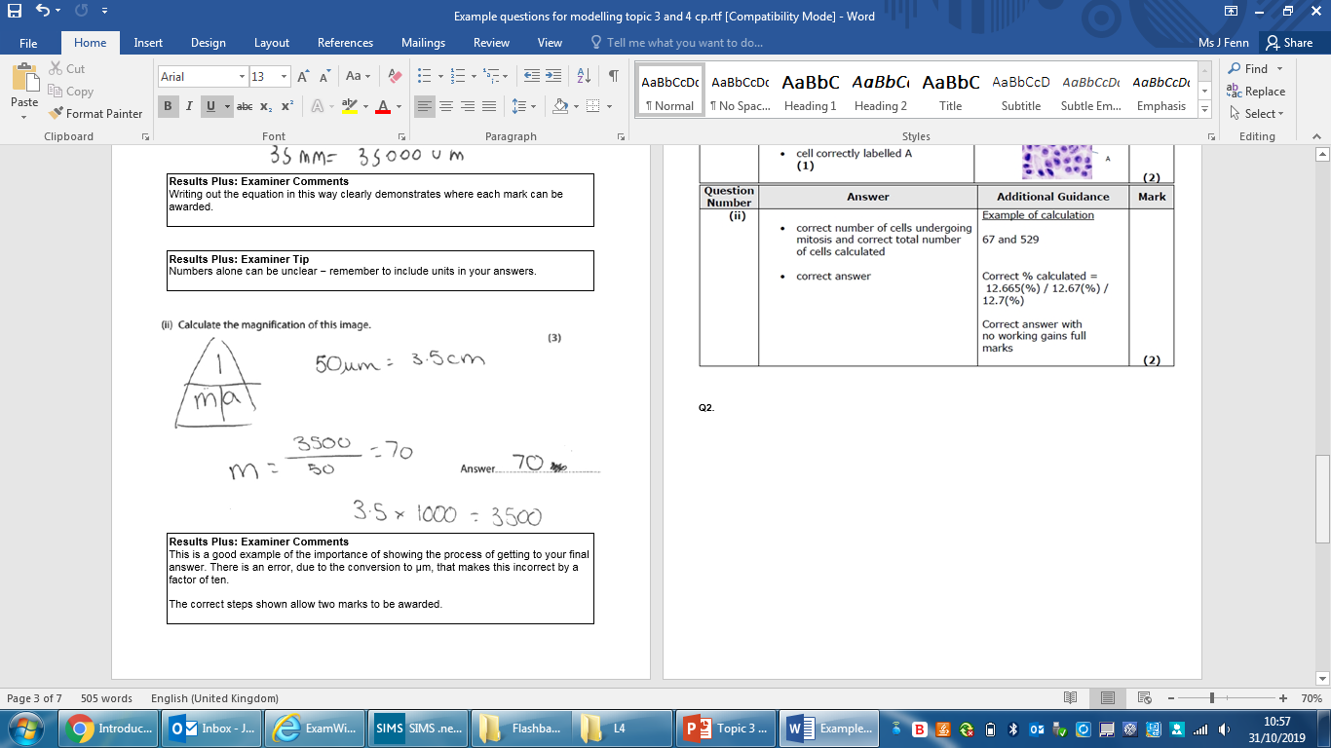
Where is the error in this answer?

Slide 17
Where is the error in this answer?

Slide 18
Independent practice
Now try the exam questions on the topic 3 (and 4) core practicals on your own
Finish for homework

