Slide 1
Protein synthesis revision 12/05/2025
Do Now
Define fertilisation.
What are the adaptations of a sperm cell?
What is the acrosome reaction and what does it trigger?
What happens when the sperm moves through to the cell membrane?
Describe the structure of a globular protein.
Why are animal fats solid at room temperature?

Slide 2
Answers
Do now
Define fertilisation.
when the nuclei of the egg and sperm cells fuse to form a zygote
What are the adaptations of a sperm cell?
Lots of mitochondria to provide energy for tail movement. Acrosome which contains digestive enzymes used to break down the zona pellucida of the egg so sperm can penetrate. flagellum allows sperm to swim towards the egg cell
What is the acrosome reaction and triggers it?
When the sperm reaches the egg and makes contact with the zona pellucida. Chemicals are released from the follicle cells. The acrosome swells and fuses with the sperm cell membrane. Digestive enzymes are released and they digest the follicle cells and zona pellucida.

Slide 3
Answers
Do now
What happens when the sperm moves through to the cell membrane?
the sperm head fuses with the egg cell membrane and this triggers the cortical reaction. The egg cell releases enzymes from cortical granules into the space between the cell membrane and zona pellucida.
Describe the structure of a globular protein.
Round, compact proteins made from multiple polypeptide chains. The chains are coiled up so hydrophilic parts are on the outside and hydrophobic on the inside. Soluble and easily transported in fluids. Important for metabolic reactions, complex tertiary structure causes very specific shapes.
Why are animal fats solid at room temperature?
The straight, saturated hydrocarbon chains pack closely together so there are strong intermolecular bonds between them. They therefore have a higher melting point.

Slide 4
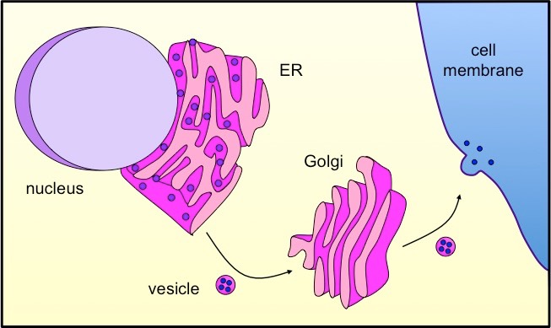
Paired talk
What: Describe the stages in protein synthesis in cells
How: in pairs
How long: 2 mins

Slide 5
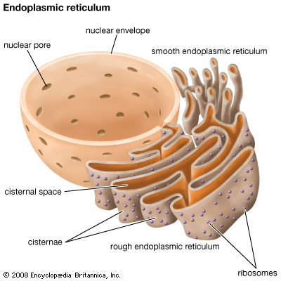
Stages of protein synthesis
1. Proteins made by ribosomes enter and travel through the RER
Notes:
Ribosome in the nucleus

Slide 6
Ribosomes involved in translation in the cytoplasm are found in the rER
aa1
aa2
tRNA
tRNA
Ribosome
UAC
GGG
AUG CCC GGG CGC ACA CGU UUC UGA

Slide 7
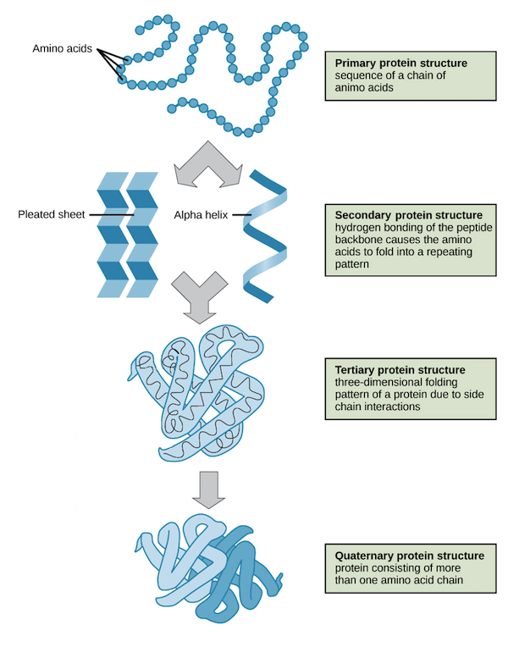
Functions of Endoplasmic Reticulum (rER)
Folding of proteins into secondary, tertiary and/or quaternary structures

Slide 8
2. Vesicles carry the protein from the rER to the Golgi apparatus

Slide 9
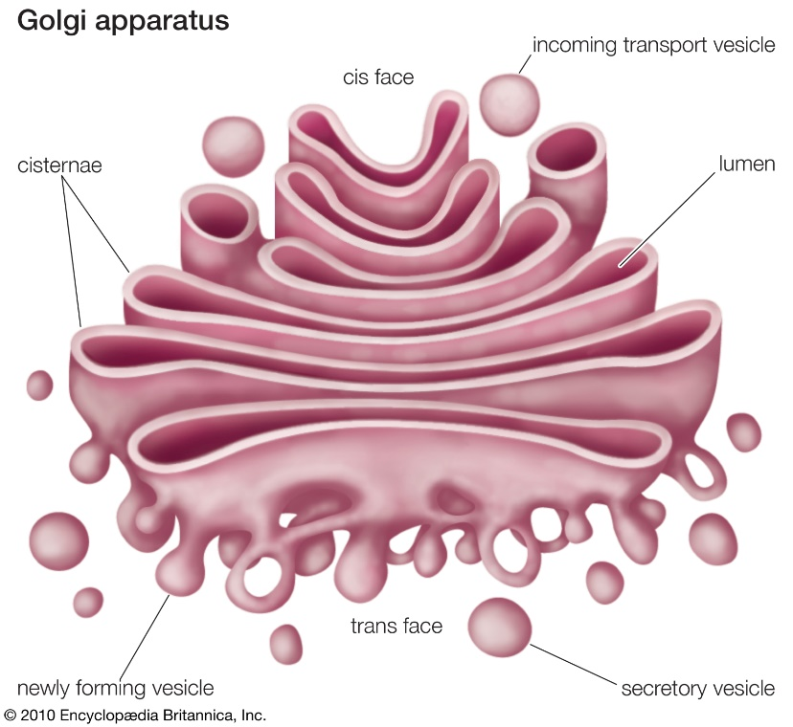
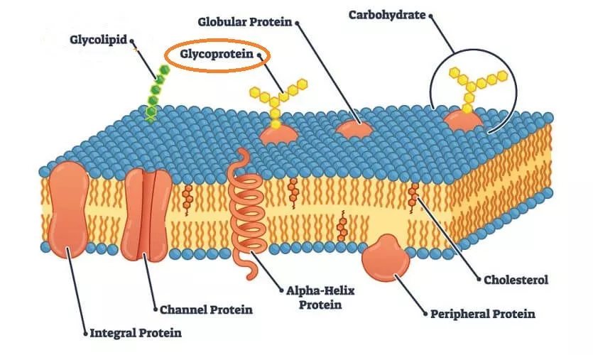
3. Proteins are modified in the Golgi apparatus
The Golgi Apparatus modifies proteins by adding molecules onto them for example; glucose to make glycoproteins.
These proteins are then re-packaged into Golgi vesicles for transport to other organelles.

Slide 10
4. Extracellular proteins are transported in vesicles to the cell membrane for exocytosis to go to other cells

Slide 11
Mini whiteboards
What is the role of the rER in protein synthesis?
To allow proteins to fold into structures and to transport the protein

Slide 12
Mini whiteboards
How do proteins get from the rER to the Golgi apparatus?
In a vesicle

Slide 13
Mini whiteboards
What is the function of the Golgi apparatus?
To modify the protein

Slide 14
Mini whiteboards
Where does the protein go after the Golgi apparatus and how?
To cell membrane via vesicle and released by exocytosis

Slide 15
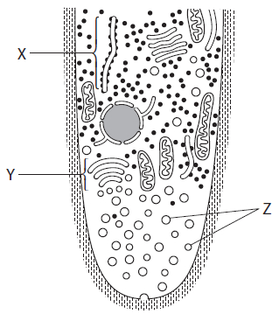
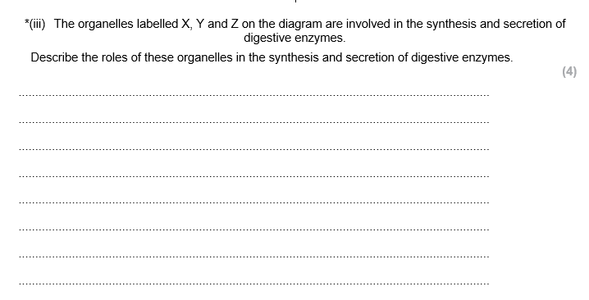
Paired talk

Slide 16
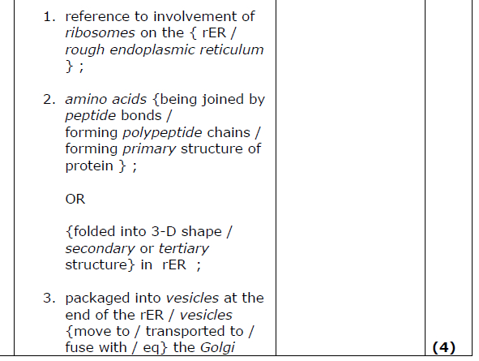

Slide 17
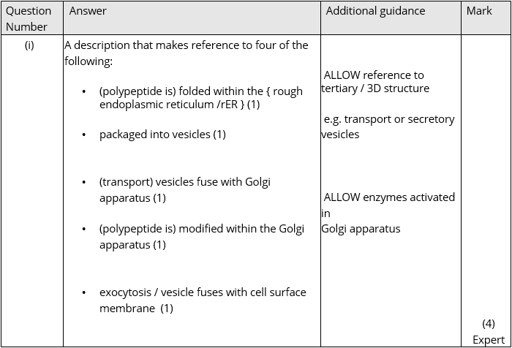
Q1

