Slide 1


Slide 2
Year 1 practicals: topic 4 Thursday, 14 November 2019
Do Now
7. Investigating plant mineral deficiencies
8. The strength of plant fibres
9. Investigate the antimicrobial properties of plants, including the aseptic techniques for the safe handling of bacteria
For the above practicals note the:
independent variable (including its range and equipment required)
dependent variables (including how this is measured)
controlled variables (including how they are controlled)
how the investigations could be made repeatable
Extension: can you explain how you would present and analyse the data from these experiments?

Slide 3
Year 1 practicals: topic 4 Thursday, 14 November 2019
Bigger Picture
From looking at your UCAS papers and your last test on topics 1 -4 we need to work on your recall of year 1 required practicals and how to answer exam questions on them.
Nationally last year, students underperformed on paper 3 and on questions related to practicals in different contexts.
Learning objectives
Can you recall the steps, equipment and variables involved in each of the core practicals in topic 4?
Can you apply this information to answer exam questions with a different context?
Can you understand and use scientific terminology such as repeatability and validity?

Slide 4
7. Investigating plant mineral deficiencies
Independent variable = Minerals that the plants were put in e.g. solutions of water with all bar N-, all bar –Mg, all bar –Ca, one with all, one with none.
Dependent variable = Observations of the colours of the leaves, height of plant
Controlled variables = Volume of solutions, concentrations of minerals, age and type of plant, number of plantlets growing, temperature, time left for.
Repeatable = doing the experiment 3 times to calculate a repeatable average and check for outliers.

Slide 5
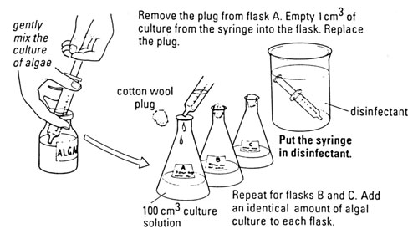
Core Practical 7: Investigating plant mineral deficiencies
https://www.youtube.com/watch?v=wepm47NXQUs&list=PLDM1f5SYgr96GbZM_PlRIvsVEvZxfU2_f&index=7

Slide 6
8: The strength of plant fibres
Independent variable = type of material of fibre, length of fibre or thickness of fibre. E.g. 5 materials, 5 example lengths/thicknesses.
Dependent variable = Mass at which the fibre breaks which can be used to calculate tensile strength e.g. by recording force divided by cross sectional area.
Controlled variables = Any of the independent variable options above not done, temperature, age of fibre etc.
Repeatable = doing the experiment 3 times to calculate a repeatable average and check for outliers.

Slide 7
Core practical 8: The strength of plant fibres
https://www.youtube.com/watch?v=bCc2WAsYSZ4&list=PLDM1f5SYgr96GbZM_PlRIvsVEvZxfU2_f&index=7&t=0s

Slide 8
9. Investigate the antimicrobial properties of plants, including the aseptic techniques for the safe handling of bacteria
Independent variable = plant used e.g. garlic and mint
Dependent variable = Diameter or area of the clear zone around the discs.
Controlled variables = Volume of solution disc is soaked in, time left for, temperature, type of bacteria used.
Also use a control of a disc soaked in water to compare to.
Repeatable = doing the experiment 3 times to calculate a repeatable average and check for outliers.

Slide 9
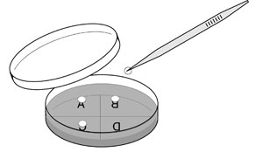
Core practical 9: Investigate the antimicrobial properties of plants, including the aseptic techniques for the safe handling of bacteria
https://www.youtube.com/watch?v=lGtWG28sKUg&list=PLDM1f5SYgr96GbZM_PlRIvsVEvZxfU2_f&index=13

Slide 10
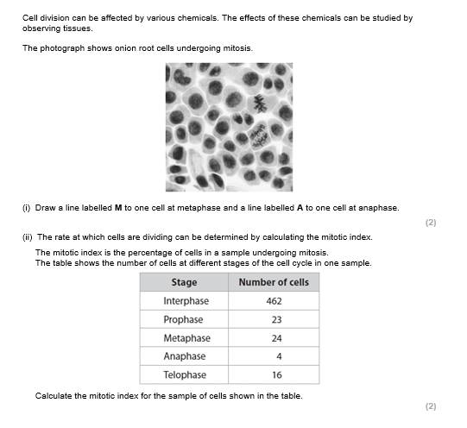
Example exam question
In pairs attempt on your mini whiteboard

Slide 11
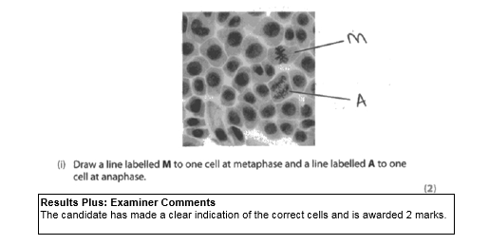

Slide 12
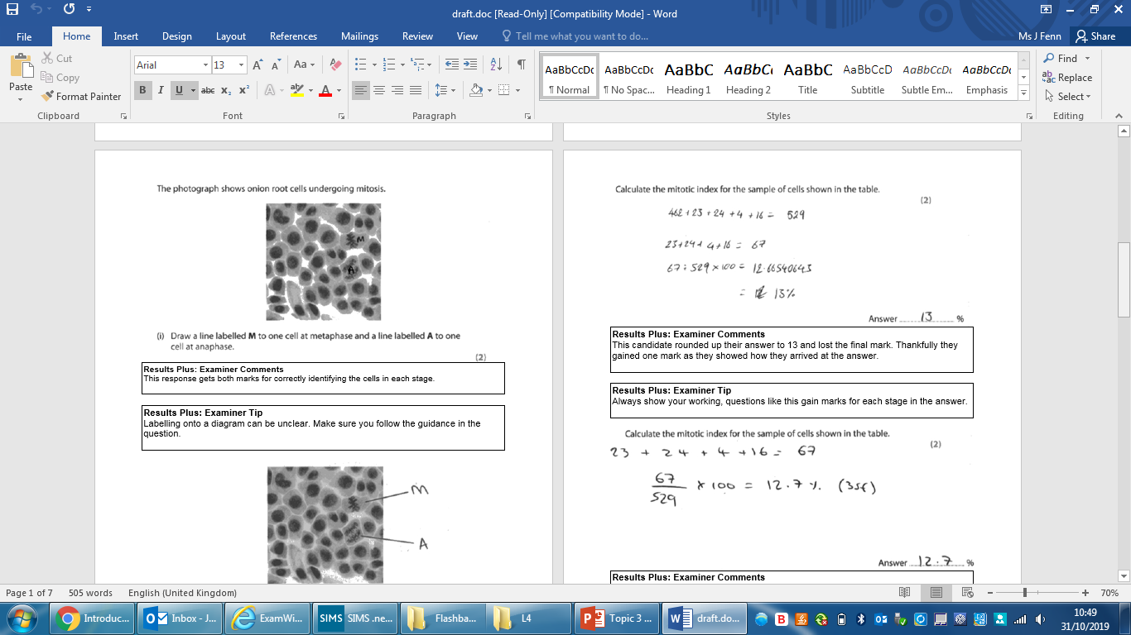
What did they do wrong here?

Slide 13
What did they do wrong here?

Slide 14
Identify sclerenchyma fibres, phloem sieve tubes and xylem vessels and their location within stems through a light microscope
Independent variable = N/A
Dependent variable = identification of the locations of the vessels and vascular bundles.
Controlled variables = type and age of rhubard, volume/mass of rhubard, volume and concentration of methylene blue dye and time left for, pressure on cover slip, magnification
Repeatable = doing the experiment 3 times to calculate a repeatable average and check for outliers.

Slide 15
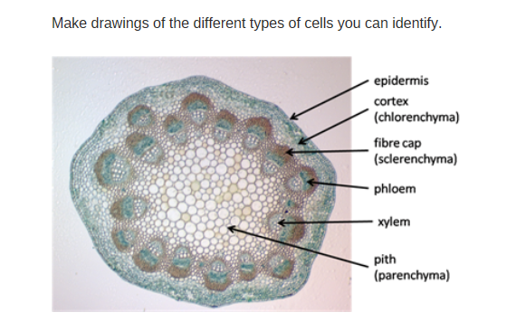

Slide 16
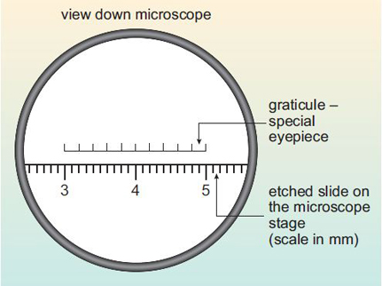
Core Practical 6: use of graticules
https://www.open.edu/openlearn/science-maths-technology/biology/introduction-microscopy/content-section-2.3
(includes an example)

Slide 17
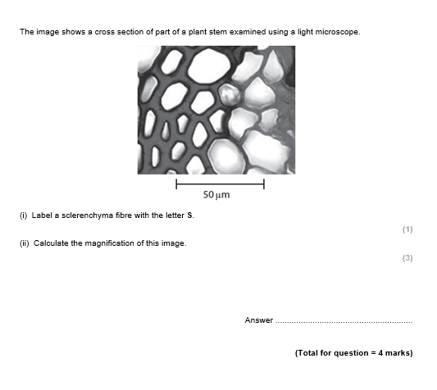
Example exam question
In pairs attempt on your mini whiteboard

Slide 18
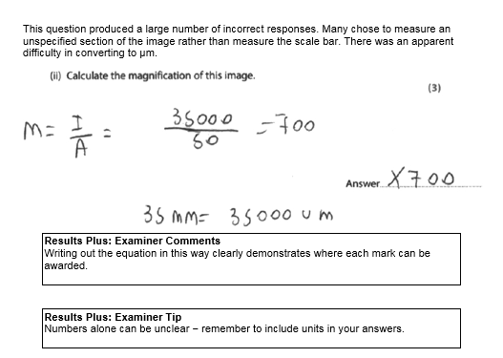

Slide 19
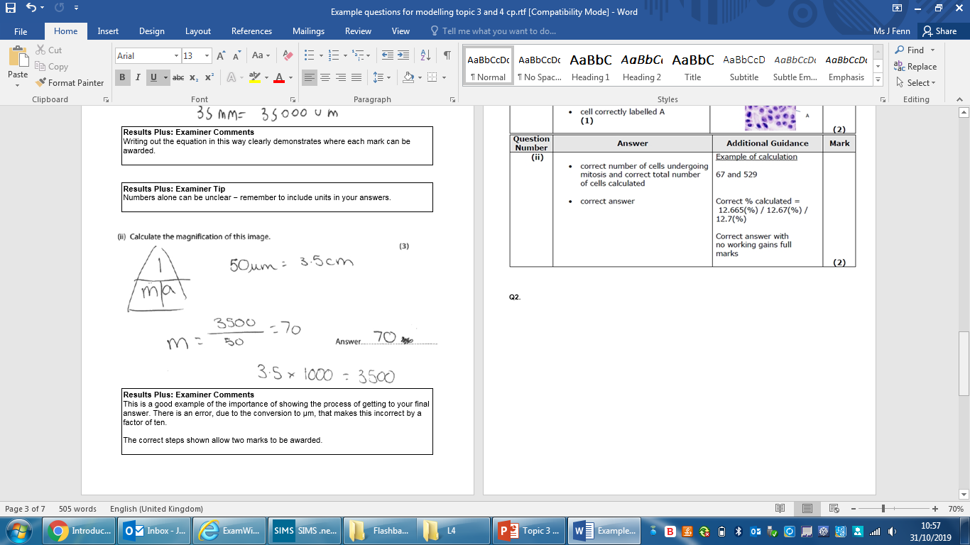
Where is the error in this answer?

Slide 20
Where is the error in this answer?

Slide 21
Independent practice
Now try the exam questions on the topic 3 (and 4) core practicals on your own
Finish for homework

