Slide 1


Slide 2
Year 1 practicals: topic 4
Wednesday, 02 December 2020
Do Now
7. Investigating plant mineral deficiencies
8. The strength of plant fibres
9. Investigate the antimicrobial properties of plants, including the aseptic techniques for the safe handling of bacteria
For the above practicals note the:
independent variable (including its range and equipment required)
dependent variables (including how this is measured)
controlled variables (including how they are controlled)
how the investigations could be made repeatable
Extension: can you explain how you would present and analyse the data from these experiments?

Slide 3
Year 1 practicals: topic 4
Wednesday, 02 December 2020
Bigger Picture
From looking at your UCAS papers and your last test on topics 1 -4 we need to work on your recall of year 1 required practicals and how to answer exam questions on them.
Nationally last year, students underperformed on paper 3 and on questions related to practicals in different contexts.
Learning objectives
Can you recall the steps, equipment and variables involved in each of the core practicals in topic 4?
Can you apply this information to answer exam questions with a different context?
Can you understand and use scientific terminology such as repeatability and validity?

Slide 4
7. Investigating plant mineral deficiencies
Independent variable = Minerals that the plants were put in e.g. solutions of water with all bar N-, all bar –Mg, all bar –Ca, one with all, one with none.
Dependent variable = Observations of the colours of the leaves, height of plant
Controlled variables = Volume of solutions, concentrations of minerals, age and type of plant, number of plantlets growing, temperature, time left for.
Repeatable = doing the experiment 3 times to calculate a repeatable average and check for outliers.

Slide 5
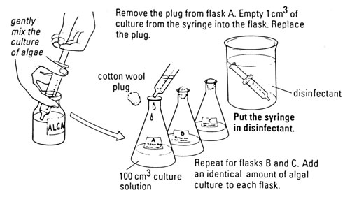
Core Practical 7: Investigating plant mineral deficiencies
https://www.youtube.com/watch?v=wepm47NXQUs&list=PLDM1f5SYgr96GbZM_PlRIvsVEvZxfU2_f&index=7

Slide 6
8: The strength of plant fibres
Independent variable = type of material of fibre, length of fibre or thickness of fibre. E.g. 5 materials, 5 example lengths/thicknesses.
Dependent variable = Mass at which the fibre breaks which can be used to calculate tensile strength e.g. by recording force divided by cross sectional area.
Controlled variables = Any of the independent variable options above not done, temperature, age of fibre etc.
Repeatable = doing the experiment 3 times to calculate a repeatable average and check for outliers.

Slide 7
Core practical 8: The strength of plant fibres
https://www.youtube.com/watch?v=bCc2WAsYSZ4&list=PLDM1f5SYgr96GbZM_PlRIvsVEvZxfU2_f&index=7&t=0s

Slide 8
9. Investigate the antimicrobial properties of plants, including the aseptic techniques for the safe handling of bacteria
Independent variable = plant used e.g. garlic and mint
Dependent variable = Diameter or area of the clear zone around the discs.
Controlled variables = Volume of solution disc is soaked in, time left for, temperature, type of bacteria used.
Also use a control of a disc soaked in water to compare to.
Repeatable = doing the experiment 3 times to calculate a repeatable average and check for outliers.

Slide 9
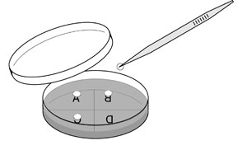
Core practical 9: Investigate the antimicrobial properties of plants, including the aseptic techniques for the safe handling of bacteria
https://www.youtube.com/watch?v=lGtWG28sKUg&list=PLDM1f5SYgr96GbZM_PlRIvsVEvZxfU2_f&index=13

Slide 10
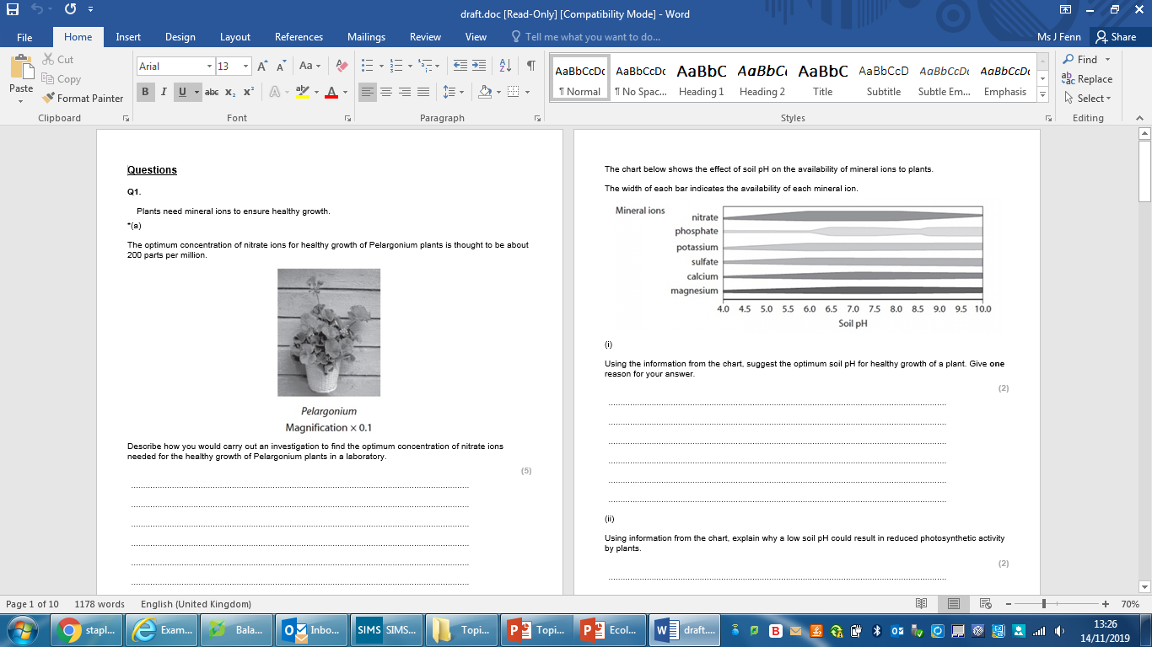
Example exam question
In pairs attempt qu i) on your mini whiteboard
Hint: what are you looking for on the chart?
7 – 7.5

Slide 11
You have been given data in the question so use it!
What minerals do you not see when you look at low pHs on the chart?
What are these ions needed for in relation to photosynthesis?

Slide 12
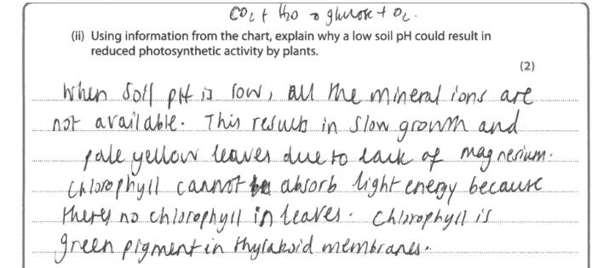
What is incorrect with this answer?
What have they incorrectly read and what link to magnesium have they not clearly made in their answer?

Slide 13
Now write your own answer to ii)

Slide 14
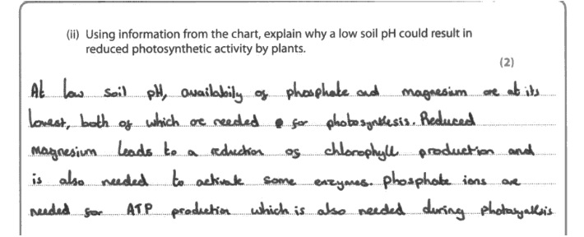
This answer gets full marks. Compare yours to it.

Slide 15
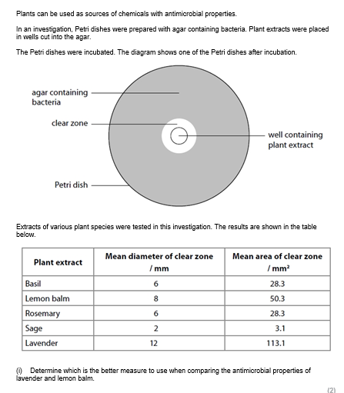
Diameter or Area?
Which would you use and why?
Look at both trends.
Which shows a more dramatic trend?
How would you use the data to demonstrate this in your answer?
Think Pair Share

Slide 16
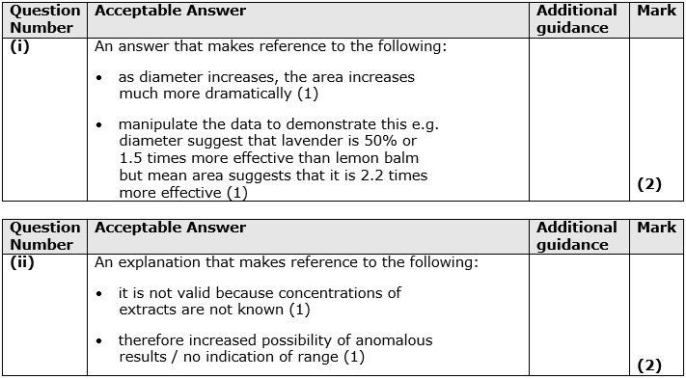

Slide 17
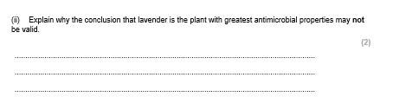
What is the command word asking you to do?
What does the term valid mean?
Explain means give a reason why.
Valid means that all (abiotic and biotic) factors are controlled, meaning that only the independent affects the dependent variable.
So what don’t we know about in this question that could have not been controlled?

Slide 19
Independent practice
Now try the exam questions on the topic 4 core practicals on your own
Finish for homework

