Slide 1
Topic 5 - Ecosystems
Define the terms:
Ecosystem
Community
Population
Habitat
What is meant by the term niche?
What are the three different types of niche?
1.
2.
3.
 | Biotic Factor | Abiotic Factor
Definition
Examples
Anthropogenic
Key principles of using a frame quadrat
Key principles of using a transect
Core Practical: Sampling within an Ecosystem
Variables:
Risk Assessment:
Method:
Conclusion:
Describe the process of ecological succession

Slide 2
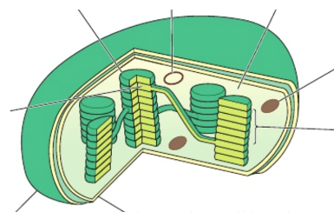
Topic 5 - Photosynthesis
Label the structure of a chloroplast
Light Dependent Reaction
Location:
Requirements:
Products:
Describe the main stages:
Light Independent Reaction
Location:
Requirements:
Products:
Describe the main stages:
Describe the products of photosynthesis and what they are used for
Polysaccharides
Lipids
Proteins
Nucleic acids
Core Practical: Hill Reaction
Variables:
Risk Assessment:
Method:
Conclusion:
Define the term limiting factor
What factors limit photosynthesis

Slide 3
Topic 5 – Energy and the Carbon Cycle
Define:
NPP
GPP
Write the equation that links NPP, GPP and Respiration
How is energy lost between each trophic level?
Draw a diagram of the carbon cycle
How do the following factors affect GPP?
Sunlight
Water
Temperature
What is the role of microorganisms in the carbon cycle?
What factors contribute to the amount of CO₂ in the atmosphere?
How is reforestation important in restoring the balanced of CO₂ in the atmosphere?
What are biofuels?
Why are biofuels important in restoring the balanced of CO₂ in the atmosphere?

Slide 4
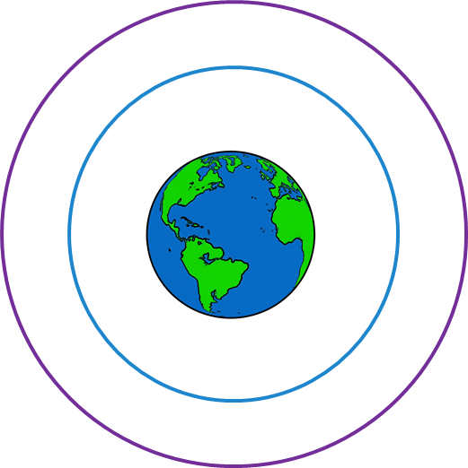
Topic 5 – Climate Change and Global Warming
Define the term climate change
Define the term global warming
Describe how analysis of TEMPERATURE data can be used as evidence for global warming:
Describe the effect of increasing temperatures on:
Distribution of plants
Development and life cycles (Brine Shrimp)
Migration patterns
Describe how analysis of PEAT BOG data can be used as evidence for global warming:
What causes global warming?
Core Practical: Describe the effect of increasing temperatures on enzyme activity
Variables:
Risk Assessment:
Method:
Conclusion:
Annotate the diagram to show the Greenhouse Effect
Describe how analysis of DENDROCHRONOLOGY data can be used as evidence for global warming:

Slide 5
Topic 5 – Evolution
Define the term species
How are organisms adapted to their environment?
Method of Isolation | Description
 | Species occupy different parts of the habitat
 | Species exist in the same area, but reproduce at different times
 | Species exist in the same area, but do not respond to each others’ courtship behaviour
 | Species have become isolated due to: mountain range, river, stretch of ocean
 | Species co-exist but there are physical reasons that prevent them from copulating
 | In some species, hybrids are produced, but they do not survive long enough to breed
 | Hybrids survive to reproductive age, but cannot reproduce
Describe the process of Natural Selection
Describe the process of speciation
Hardy-Weinberg Equation
In a population of 100 people: 87 have straight thumbs, 13 have curved thumbs (tt)
Use the H-W equation to calculate the frequency of alleles

