Slide 1
Topic 6 – DNA Profiling
Why is DNA fingerprinting/DNA profiling or Genetic Fingerprinting able to identify people?
Describe the process for creating a DNA profile
Obtain DNA
Replicate
Create fragments
Separate fragments
Visualise fragments
Use DNA profile
Describe the process of DNA replication
What is the difference between INTRONS and EXONS?
What are STRs?
How do STRs aid DNA fingerprinting?
Describe the process of PCR
What are the repeating units that make up nucleic acids?
Draw and label one

Slide 2
Topic 6 - Forensics
How can the body temperature be used to determine time of death?
What factors can affect the cooling of a dead body?
What is rigor mortis?
Describe how rigor mortis occurs in muscles
How can decomposition be used to determine time of death?
Why are decomposers important in the process of decomposition?
How does Forensic Entomology and succession help to determine time of death?
How would temperature affect forensic entomology?
Draw a diagram of the carbon cycle
Compare plant and corpse succession

Slide 3
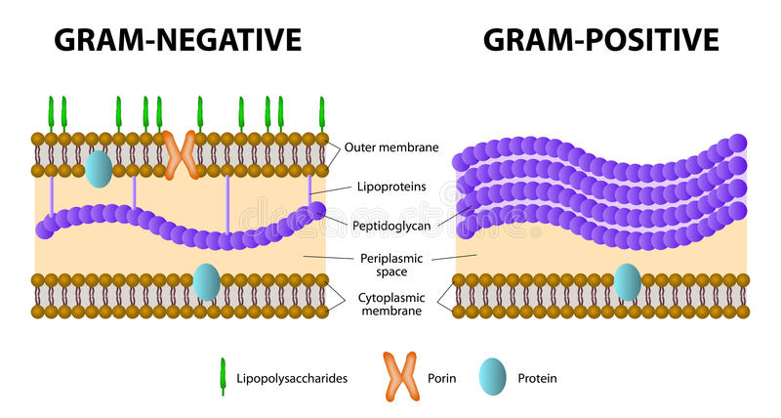
Topic 6 – Pathogens and Disease
Method of transmission | Example Disease | How is it spread?
Air | Flu Tuberculosis Measles
Direct Contact | Athlete’s foot
 | Chlamydia Syphilis HIV
 | HIV Hepatitis Tetanus
 | Malaria Rabies
By water or food | Salmonella Cholera
Draw and label a bacterial cell
What is the difference between gram positive and gram negative bacteria?

Slide 4
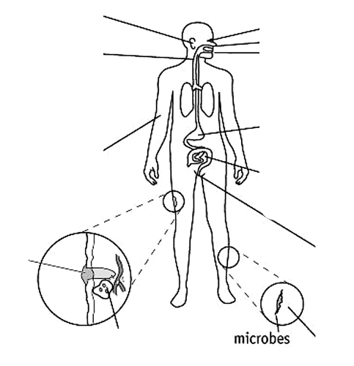
Topic 6 – Pathogens and Disease
How is the body adapted to minimise the entry of pathogens?
Draw and label a virus
How do viruses reproduce?
What is meant by term “latency”?

Slide 5
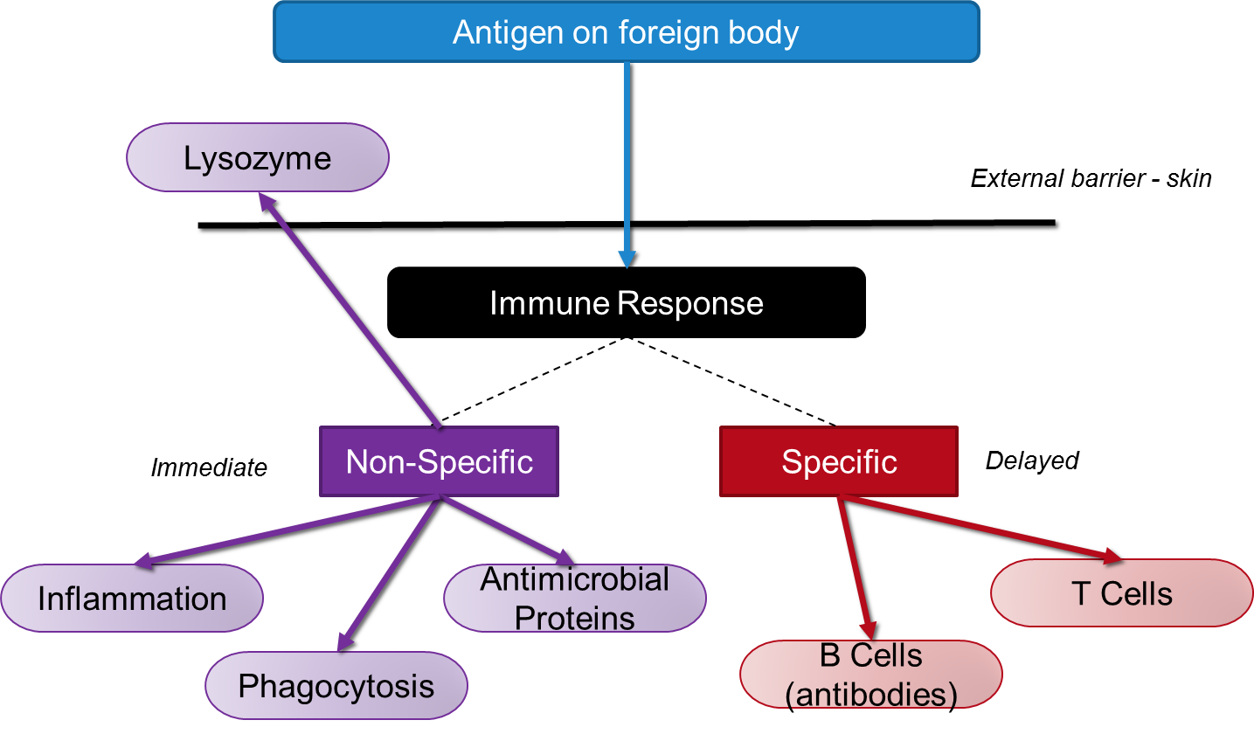
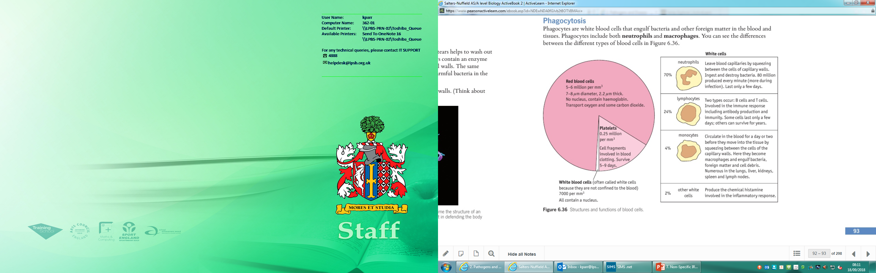
Topic 6 – Non-Specific Immune Response
What are lysozymes and where are they found?
What is their role in the non-specific immune response?
What are the roles of these types of white blood cell:
Neutrophils
Monocytes
Lymphocytes
Describe the inflammatory response
What are antimicrobial proteins?
What is their role in the non-specific immune response?
Describe how blood clots are formed
What role does the lymphatic system play in the immune response?

Slide 6
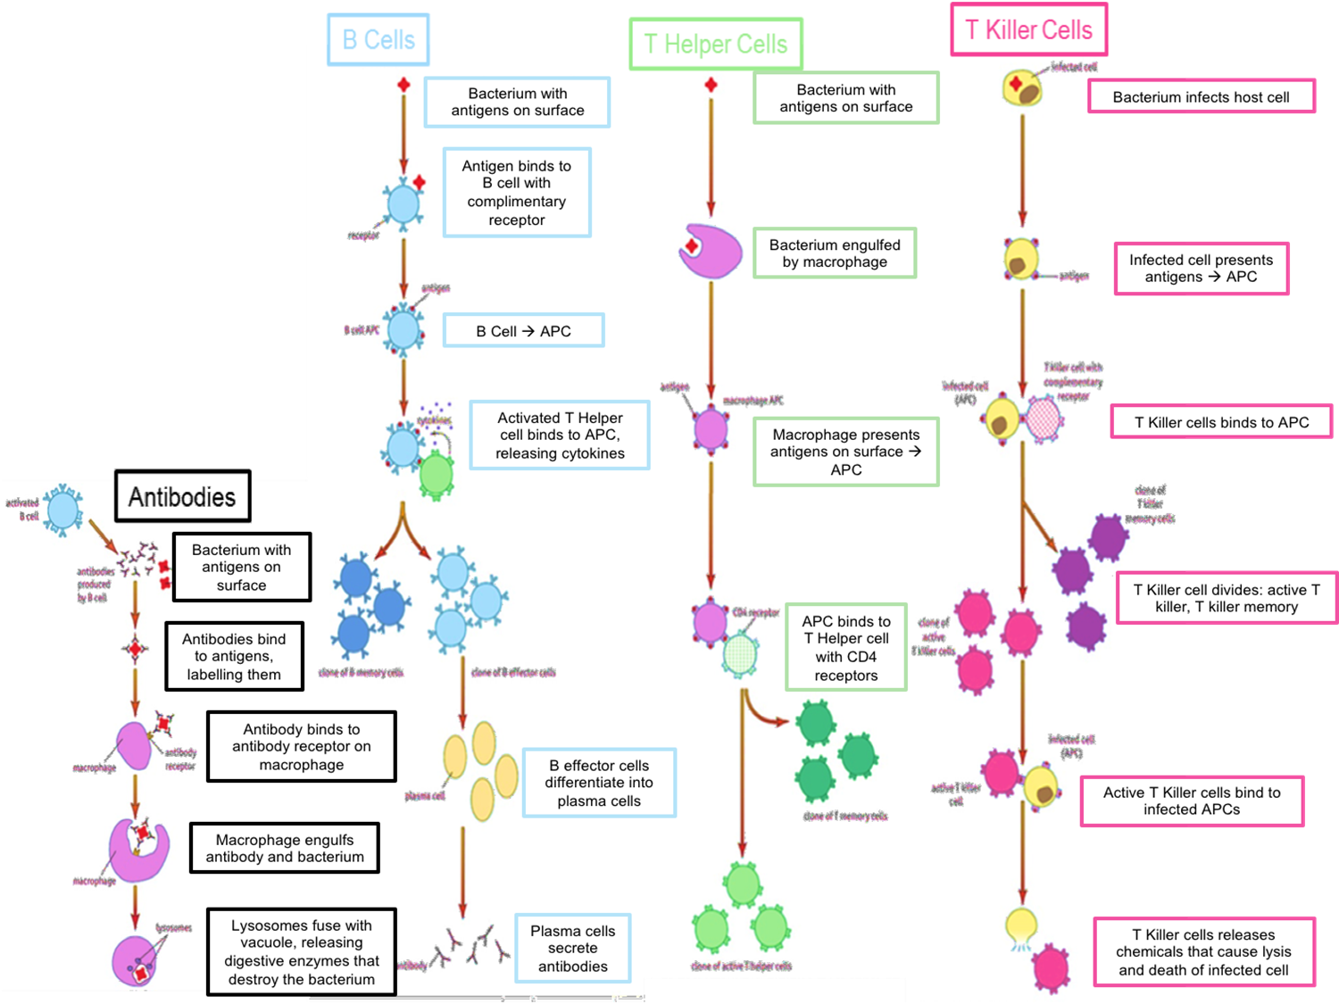

Slide 7
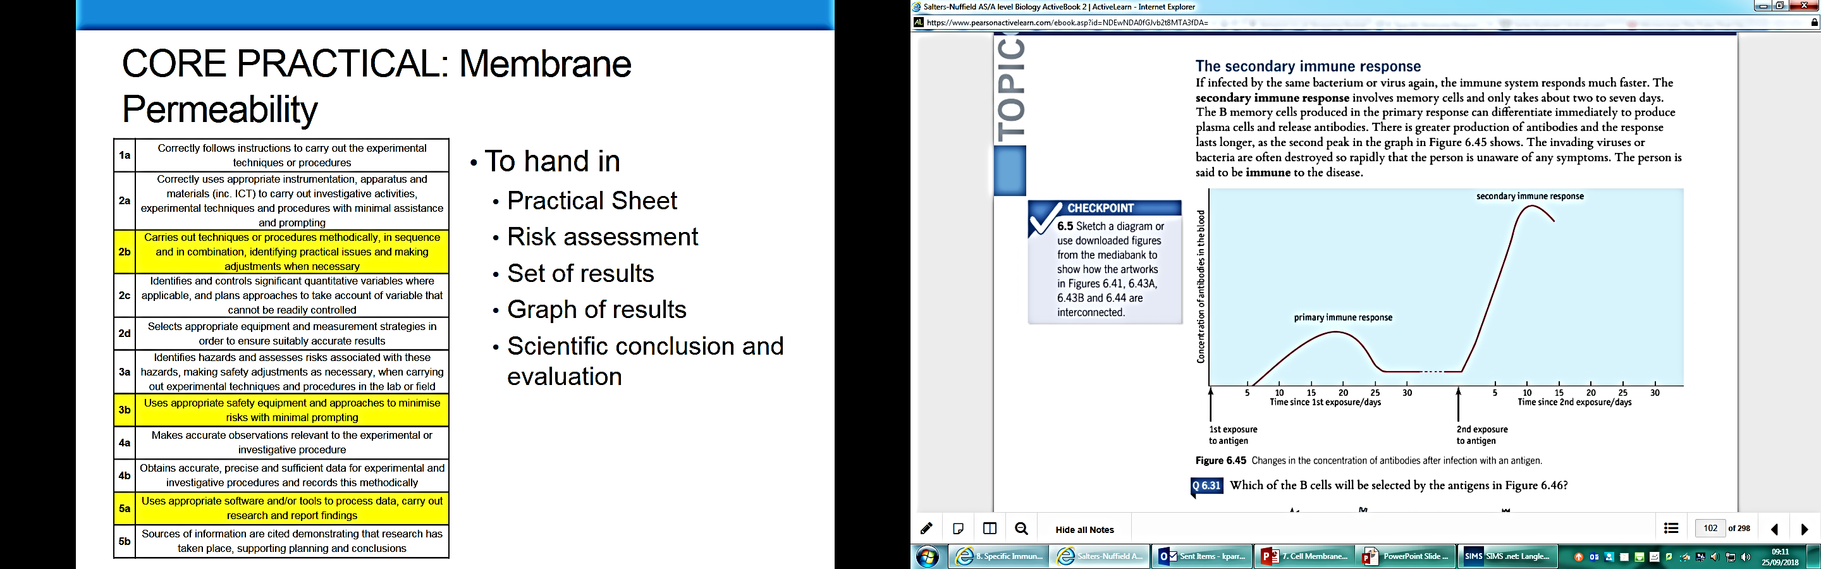
Topic 6 – Secondary Immune Response and Immunity
Describe the production of antibodies during the secondary immune response
What are the four different types of immunity?
Passive Natural | Active Natural
Passive Artificial | Active Artificial
What are autoimmune diseases?
How do they occur?
How does a vaccination work?
What is meant by the term “herd immmmunity”?
Why is “herd immunity” important?

Slide 8
Topic 6 – TB and HIV
What bacterium causes TB?
How can TB be diagnosed?
Skin and blood tests
X-Ray
How can HIV be transmitted?
How does the HIV virus infect T helper cells?
What happens during the stages of the disease?
Primary TB
Latent TB
Active TB
What happens during the stages of the disease?
Acute
Chronic
Disease
How can TB be treated?
How can HIV be treated?
List some symptoms of TB

Slide 9
Topic 6 – Proteins
What reaction joins amino acids together?
What bond holds two amino acids together?
What reaction breaks apart amino acids?
Structures of a Protein
Primary
Secondary
Tertiary
Quaternary
 | Transcription | Translation
Location
Molecules Involved
5 Step Summary
Draw and label the basic structure of an amino acid
What is meant by these terms about the genetic code:
Genetic Code Near-universal
Degenerate Non-overlapping

Slide 10
Topic 6 – Antibiotics
What is meant by the term ”antibiotic”
What is the difference between:
Broad Spectrum
Narrow Spectrum
Bacteriostatic
Bactericidal
What is a mutation?
What are the stages of natural selection?
Core Practical: Antibiotics
Independent variable
Dependent variable
Control variables
Method
Expected results
What can cause antibiotic resistance?
How can this be reduced?
How do antibiotics work?
What are abiotic techniques?
Why are they important?

