Slide 1



UCAS Parent and Carer Information Evening 2024

Slide 2
Agenda
Important information related to UCAS
Supporting your child academically

Slide 3
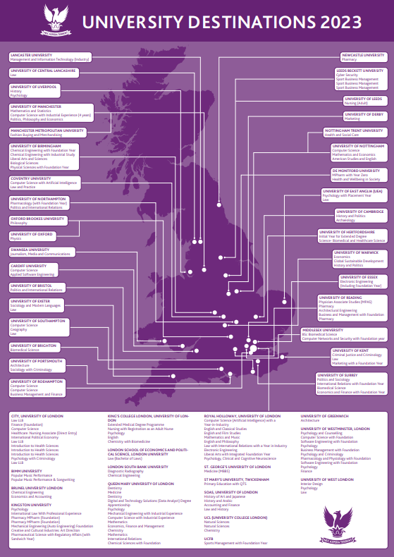
Outcomes: Our students are successful
Results 2023
Average grade B
29% A*-A
53% A*-B
3 Oxbridge
34% Russell Group
Degree Apprenticeships
Offers 2024
4 Medicine
52% Russell Group
32% World Top 100
61% UK Top 25
Degree Apprenticeships
Armed Forces Officer Training

Slide 4
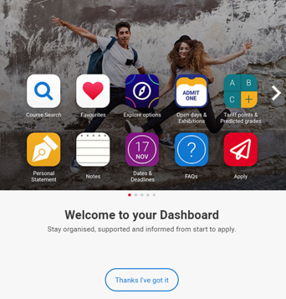
What is UCAS?
Central hub for managing university applications
If you want to go to university in the UK, you apply through UCAS
You send one application to UCAS which gets sent to various universities around the country
Security marking: PUBLIC
03 July 2024
| 4

Slide 5

Important Dates / Timeline
August Year 13:
RESULTS DAY
October to May Year 13:
Responses received from universities
29th January 2025 - 18:00:
Equal consideration application deadline
26th February 2025:
UCAS Extra opens
(5 choices made but no offers)
15th October - 18:00:
Deadline for Oxford, Cambridge, Medicine, Dentistry and Veterinary Science / Medicine
July Y12:
Student UCAS Day
Parent UCAS Evening
September Year 12:
Careers and university information
Opportunities to gain experience
January Year 12:
Internal preparation; application process starts

Slide 6

The Application Process
Six student sections completed
Application returned to student for correction
UCAS fee paid £28.50 (once)
*FSM fee waiver
Tutor checks
*UCAS will be waiving the undergraduate application fee
for any student who is/or has been in receipt of free school meals (FSM) at some point during the last six years, up until end of their final year at school.
Sixth form team checks
Application sent to UCAS

Slide 7
Key actions - what must be done?
Personal statement
Students must
Provide a high-quality draft for review
Meet tutor deadlines for submission of drafts
Make edits promptly
Ensure good grammar and punctuation

Slide 8
Key actions - what must be done?
UCAS Portal and choices
Students must
Make sure all sections of the form are completed
Thoroughly research university choices, including entry grades and modules
On completion, make payment and submit

Slide 9
Key actions - what must be done?
Admissions tests (if necessary)
Book via Pearsons from 1st August 2024
Students should prepare independently, but the school will offer support

Slide 10
Key actions - what must be done?
4) Enrichment and Opportunities
DMHS offers a wider range of opportunities for super-curricular and extra-curricular activities:
Super-curricular
Extra-curricular
Enrichment
Activities that take you beyond the curriculum of the subjects you are studying
Activities outside of your academic studies
e.g. Music, sport, Debating
Timetabled super-curricular and extra-curricular activities led or overseen by a teacher
(Wednesday afternoons)

Slide 11
Key actions - what must be done?
5) Further research into universities and courses
Visit universities
Attend open days (www.opendays.com)
Course specific requirements
Are they interested in the modules of the course?

Slide 12
UCAS Groupings
Students will be grouped to allow efficient management of the process and support for all students
Group 1: Early applicants - Medicine, Dentistry, Veterinary, Oxford and Cambridge
Group 2: Very well progressed with their planning - will be ready to apply early in the window
Group 3: Making good progress with planning - largely clear about choices and well organised
Group 4: Progressing with tasks but will require extra time and support
Group 5: Not engaging / progress unsatisfactory

Slide 13
Support in School
Form Tutors, Head of Year, and Head of Sixth Form
Careers Coordinator: UCAS and careers
Mental health support – two dedicated school counsellors
Pastoral Development Programme

