Slide 1

Writing an Artist Link
What is it and why do we do them?

Slide 2
What are artist links for?
In pairs, discuss what purpose you think looking a the work of other practitioners may have.

Slide 3
We look at the work of other artists in order to:
Diffract our observations and make material developments
Understand how our subject matter has been used artistically elsewhere
Broaden our knowledge of artists, culture/nature, processes and materials.
Help us decide how to make affective use of our primary recordings

Slide 4
What should an artist link include?
Biographical information – this is the CONTEXT in which the artists was/is producing work
Formal visual analysis of the artists work
Description and analysis of the artists main themes/concepts and ideas
Images of the artist’s work.
Images of YOUR work, with explanation of why your work is related to the artist.
Detailed description of at least three pieces of the artists work.
Paragraph(s) explaining what the artist does that you would like to explore e.g. materials they use, scale at which they work, concepts they explore etc.

Slide 5
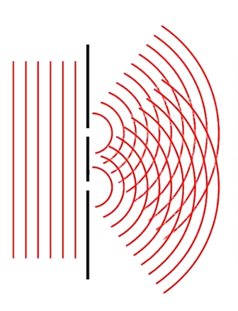
Visual Recordings
As with your visual recordings, the more thorough and extensive your artist research and analysis is, the stronger and more clear the diffractive pattern will be.
Diffraction pattern made of 1000s of potential material developments.
Artist link

Slide 6
Visual Elements
The elements of formal analysis are building blocks that can be combined to create a larger structure.
Line is the most basic building block of formal analysis. Line can be used to create more complex shapes or to lead your eye from one area in the composition to another.
Value is the degree of light and dark in a design. It is the contrast between black and white and all the tones in between. Value can be used with colour as well as black and white. Contrast is the extreme changes between values.
Shapes are created when lines are combined to form a square, triangle, or circle. Shapes can be organic (irregular shapes found in nature) or geometric (shapes with strong lines and angles such as circles, triangles, and squares).
Forms are three-dimensional shapes with length, width, and depth. Spheres, cylinders, boxes and pyramids are forms.
Space is the area between and around objects. Increasing or decreasing the amount of space around an object affects the way we view that object.
Colour differentiates and defines lines, shapes, forms, and space. Even black and white images have a huge number of different shades of grey.
Texture is the surface quality that can be seen and felt. Textures can be rough or smooth, soft or hard. Textures are often implied. For instance, a drawing of a rock might appear to have a rough and hard surface, but in reality is as smooth as the paper on which it is drawn.

Slide 7
Visual Principles
Balance is created in a work of art when textures, colours, forms, or shapes are combined harmoniously.
Contrast is the use of several elements of design to hold the viewer's attention and to guide the viewer's eye through the artwork.
Movement is the way a viewer's eye is directed to move through a composition, often to areas of emphasis. Movement can be directed by lines, contrasting shapes, or colours within the artwork.
Emphasis is created in a work of art when the artist contrasts colours, textures, or shapes to direct your viewing towards a particular part of the image.
Pattern is the repetition of a shape, form, or texture across a work of art. The light reflecting off of the waves in the water creates a pattern in the bottom half of the image.
Proportion is created when the sizes of elements in a work of art are combined harmoniously.
Unity is created when the principles of analysis are present in a composition and in harmony. Some images have a complete sense of unity, while some artists deliberately avoid formal unity to create feelings of tension and anxiety.

Slide 8
Task One
What: Write a paragraph that describes ONE of your artists piece’s of work. Use the visual elements and principals sheet to help you.
How: Independently and in silence
How long: 15 minutes
Tip: Imagine you are describing the artwork to someone on the phone. How would you make them see it in their mind’s eye?

Slide 9
Task two
What: Write a paragraph giving a personal response to the piece you have described.
How does it make you feel? Do you like it? If so, why, if so why not?
What elements of the artist’s work would you like to see within your own project?
How: independently and in silence
How long: 10 minutes

Slide 10
Homework
Complete your first double page artist link.
Details on Show My Homework along with examples of grade 9 artist links.

