Slide 1


Product Design Bridging Menu
You are about to start an exciting journey into the world of design, good luck!
Remember
Choose what modules you do and when, but work through them consistently. Different tasks will take you varying amounts of time, but on average you should aim to do one or two per week.
All green tasks are core modules, they are compulsory and must be completed and uploaded onto your application by 19 August
The red hot chili indicates that the task is more challenging than the others
Numbers eg (1) correspond to how you should evidence the module which can be found in the slides following the menu. They can be saved within this PowerPoint or as separate documents clearly labelled with the subject.

Slide 2






Product Design Bridging Menu (Green modules are core (compulsory) modules , indicates the most challenging modules )
 | Read | Watch | Listen | Visit | Do
 | The Eco-Design Handbook - Alastair Faud –Luke. The most comprehensive publication that catalogues and represents the vast array of ingenious green products available to the everyday consumer, scrutinizing every aspect of our designed world. (1) | Design Is One: The Vignellis Italian-born Massimo and Lella Vignelli are among the world's most influential designers. Throughout their long career, their motto has been, 'If you can't find it, design it‘ | Listen to the following podcasts based on Product/Digital Design. Design better podcast Design matters podcast The honest designers show This is product management Product podcast UI Breakfast 6 Essential Podcasts for Product Designers to Listen (1) | Visit the Design Museum (2) | MOOCs https://www.futurelearn.com/courses/ Search through the MOOCs on Unifrog using the filter ‘Design’ or ‘Engineering’ and chose one that particularly interests you (6)
 |  |  |  | Look at courses and view Open days/virtual tours Brunel Design School undergraduate courses | Brunel University of London
 | Design Museum: Contemporary Design Catherine McDermott A selection of nearly 400 of the best and most enduring examples of modern design, including the very latest examples from the twenty-first century. (1) | The Creative Brain Neuroscientist David Eagleman taps into the creative process of various innovators while exploring brain-bending, risk-taking ways to spark creativity. (1)
 |  |  |  | Visit these places for some design inspiration The Viktor Wynd Victoria and Albert Museum Museum of Curiosities, East London Twenty Twenty One, Islington Museum of Brands London Transport Museum Tate Modern Material Lab Sketch, London (3) | Research and create a research study on these 3 design movements: Arts and Crafts Bauhaus Memphis And these 3 designers: Marianne Brandt. James Dyson Margaret Calvert (4)
 | 50 Product Designs: Process - Jennifer Hudson. An in-depth study of the creative and manufacturing processes behind 50 contemporary domestic design objects. (1) | Print the Legend This award-winning, original documentary chronicles the race for market leadership in 3D printing, the next wave of technological evolution. (1)
 | How Designers Think: The Design Process Demystified - Bryan Lawson Depicts he belief that we all can, and do, design, and that we can learn to design better (1) | TED Talks (1) Sustainability by design Legends of the design world Human-centered design Organic design, inspired by nature My simple invention, designed to keep my grandfather safe Design is in the details The first secret of design is ... noticing |  |  | Design your own gaming controller. Annotate the following: Materials Manufacturing methods Inspiration Context – what is it for? Who would use it? What problem would it solve? (5)
 | Designed for Kids - Phyllis Richardson A guide to designing products for children from nursery age to pre-adolescence. (1)

Slide 3
Book/Journal/Podcast/Film Review
(1)
Review by: ___________________________________________
Title: _______________________________________________________
Author: ____________________________________________________
Review of (please circle)
Book Journal Podcast Film Documentary
Would you/would you not recommend it? Why?
Rating:
What was it about?
What did you find particularly interesting/inspiring/shocking? Has this changed your opinion?
What would you like to learn more about?
How does it link to this subject and why is it important?
Save your answers as part of this PowerPoint & copy the template as many times as you need

Slide 4
Museum/Gallery Visit: Design Museum:
(2)
What interesting products or designs did you see? Which were your favourites?
Include images here to document your visit:
Why did you like these particular exhibits?
What was something new that you discovered/saw/found out?
What could you take inspiration from in your future product design work?

Slide 5
Museum/Gallery Visit: Your Choice:
(3)
Where did you visit?
Include images here to document your visit:
What interesting products or designs did you see? Which were your favourites?
Why did you like these particular exhibits?
What was something new that you discovered/saw/found out?
What could you take inspiration from in your future product design work?

Slide 6
Design Research:
Marianne Brandt
(4)
Biography:
Images of their work
Picture of the designer
What are key features of this designer's work?
What inspired their work?
What are they most well-known for?

Slide 7
Design Research:
James Dyson
(4)
Biography:
Images of their work
Picture of the designer
What are key features of this designer's work?
What inspired their work?
What are they most well-known for?

Slide 8
Design Research:
Margaret Calvert
(4)
Biography:
Images of their work
Picture of the designer
What are key features of this designer's work?
What inspired their work?
What are they most well-known for?

Slide 9
Design Research:
Arts and Crafts Movement:
(4)
When was this design movement?
What historical context was there at this time?
Images of work from this design movement
What are key features of this design movement?
What inspired the work?
What designers and products is this movement best known for?

Slide 10
Design Research:
Bauhaus Movement
(4)
When was this design movement?
What historical context was there at this time?
Images of work from this design movement
What are key features of this design movement?
What inspired the work?
What designers and products is this movement best known for?

Slide 11
Design Research:
Memphis Movement
(4)
When was this design movement?
What historical context was there at this time?
Images of work from this design movement
What are key features of this design movement?
What inspired the work?
What designers and products is this movement best known for?

Slide 12
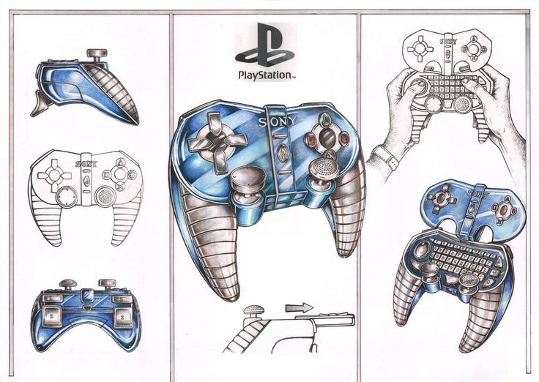
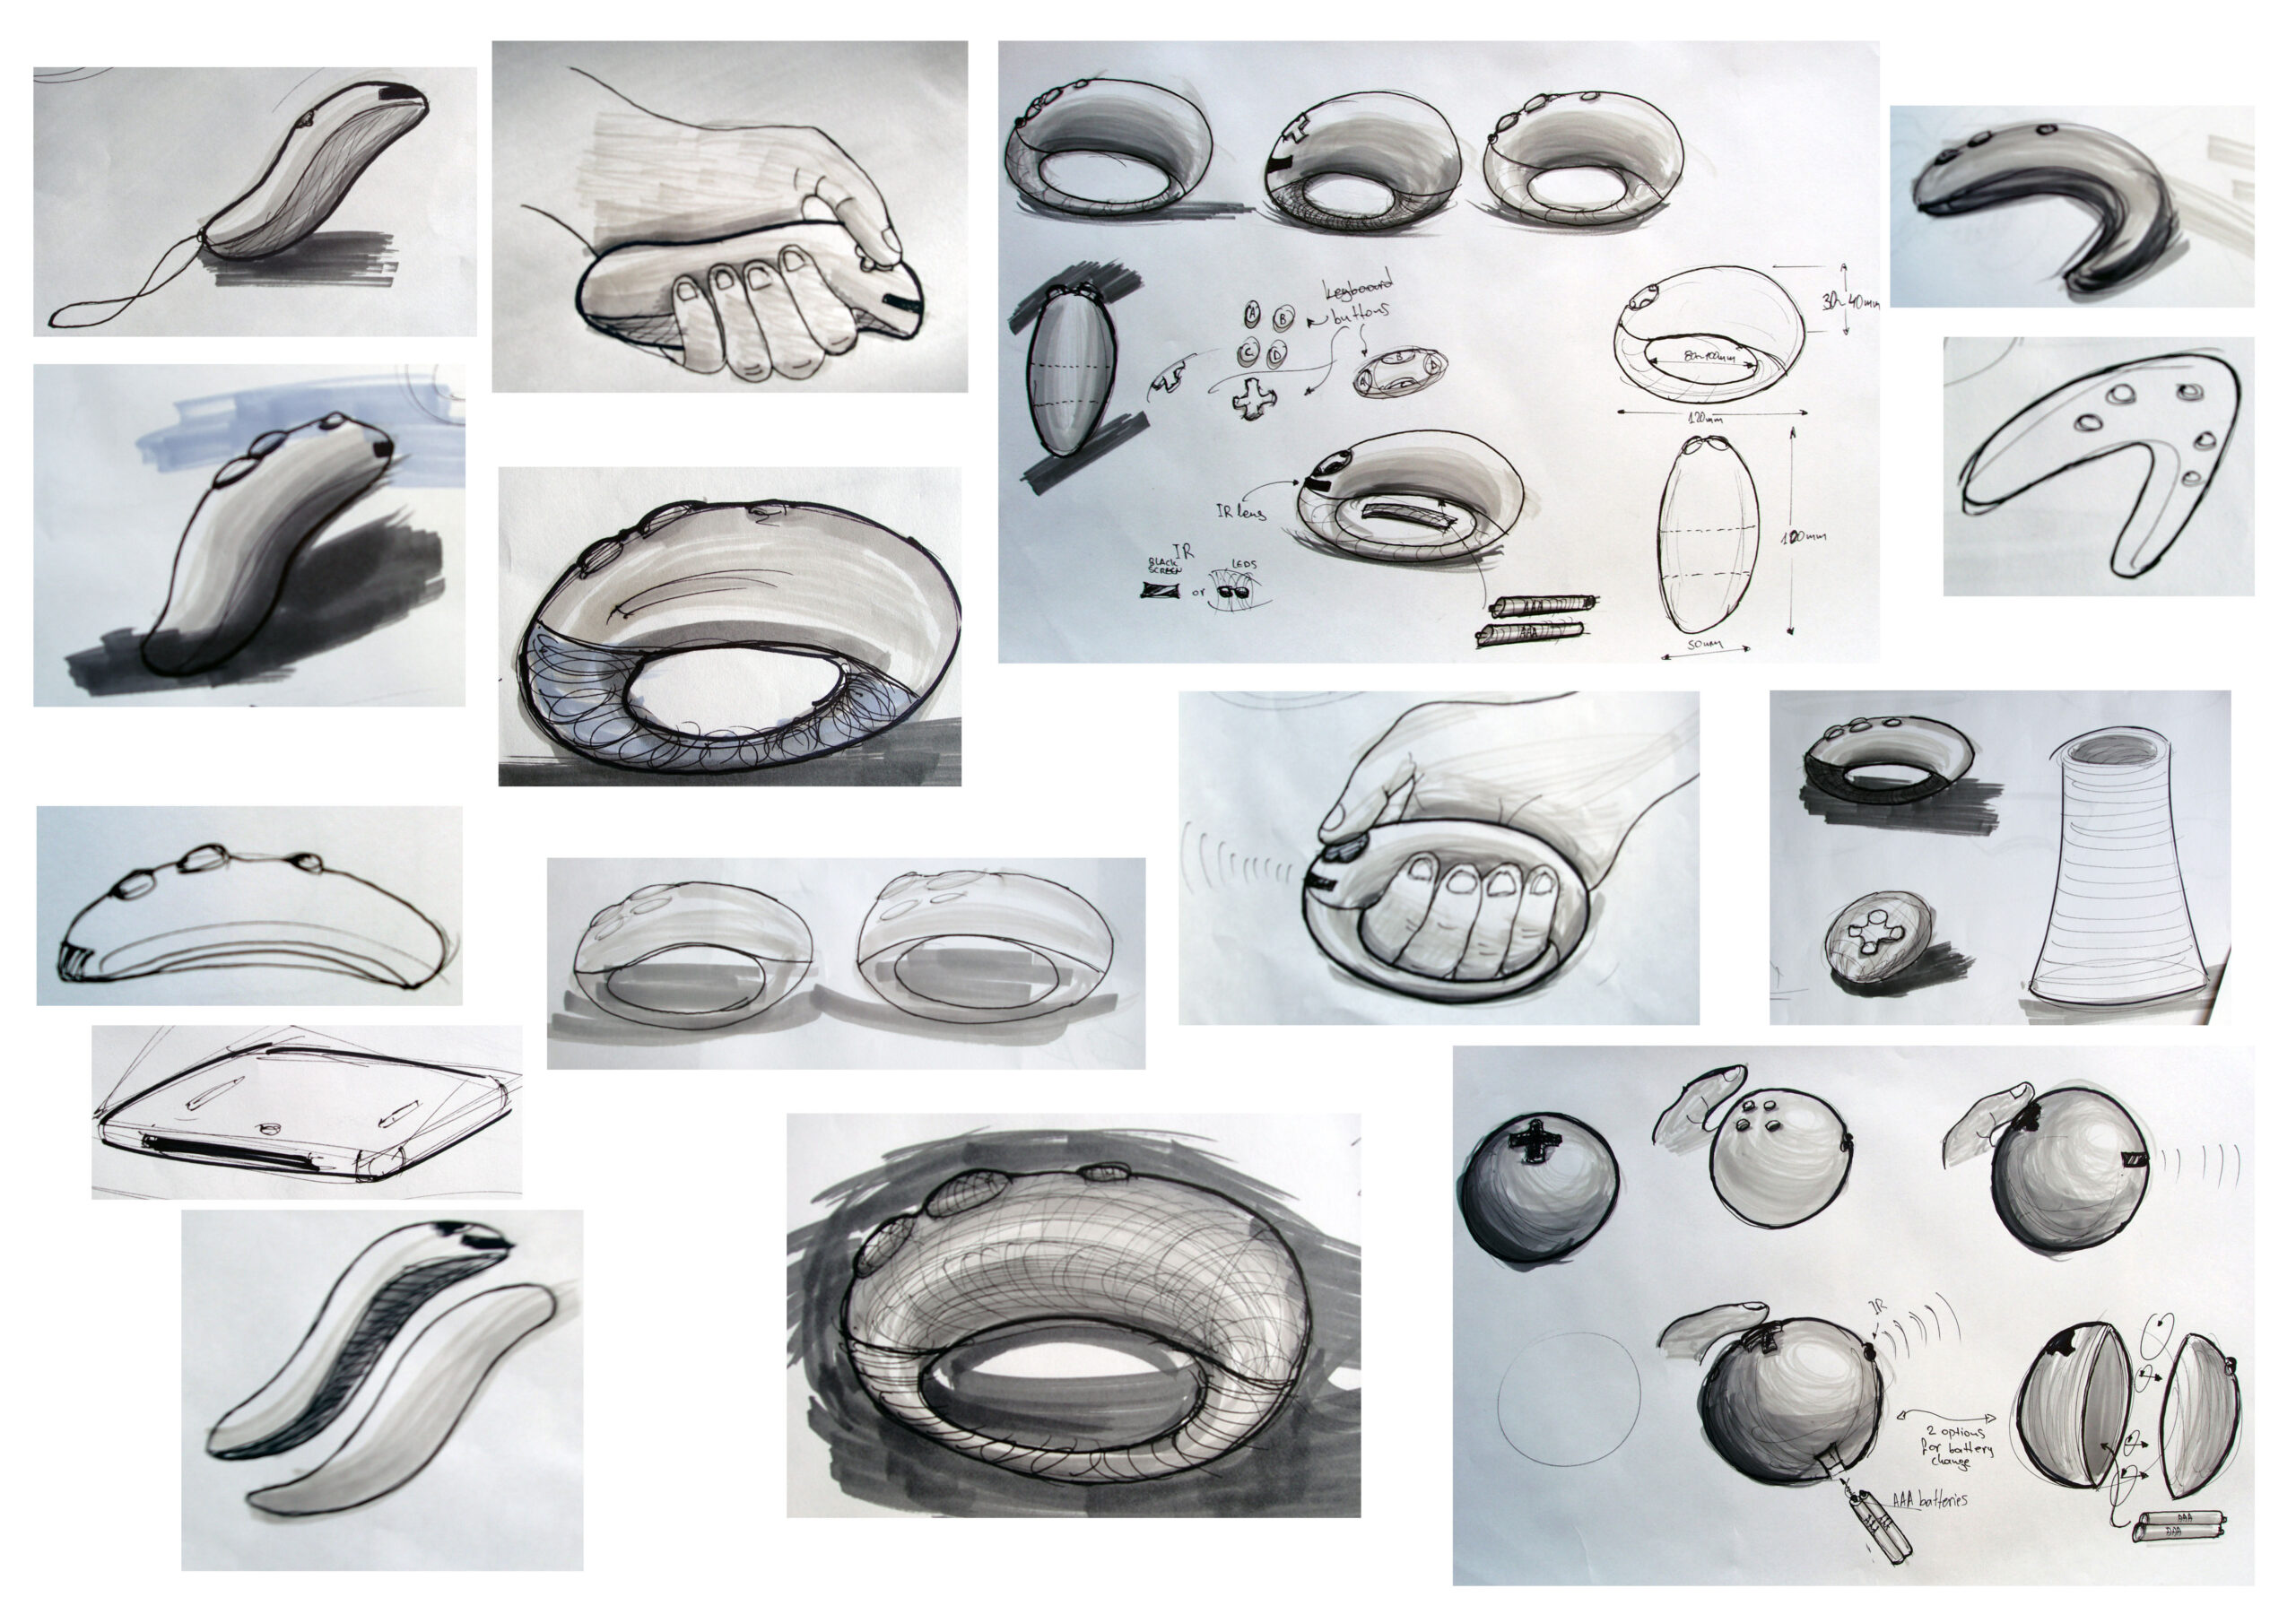
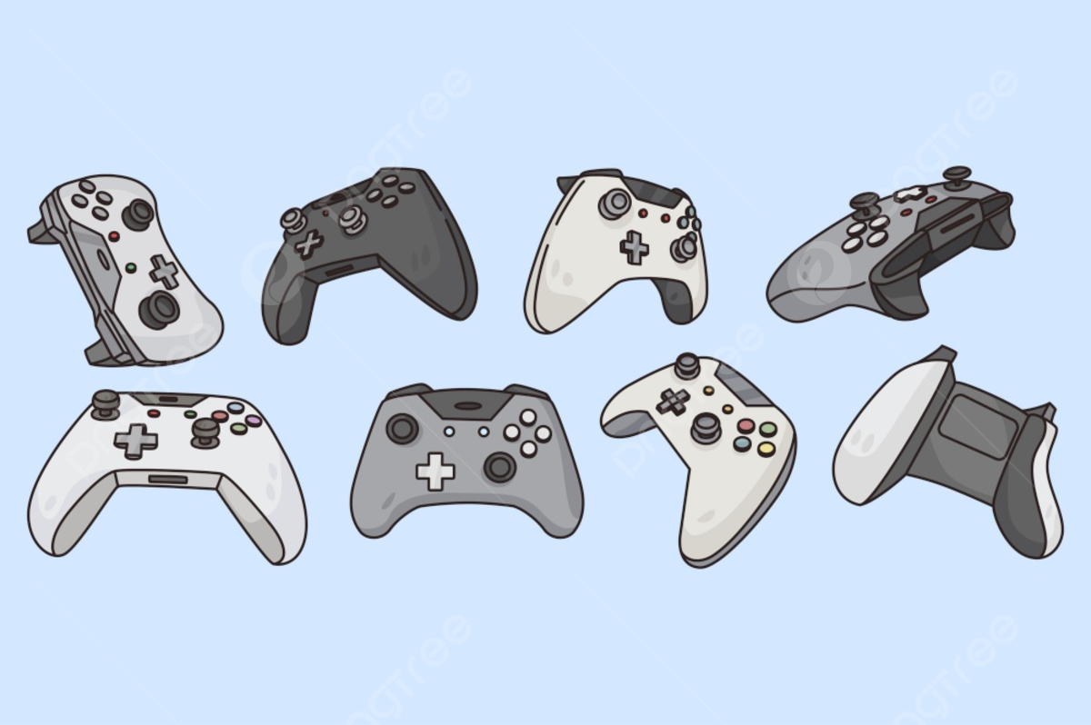
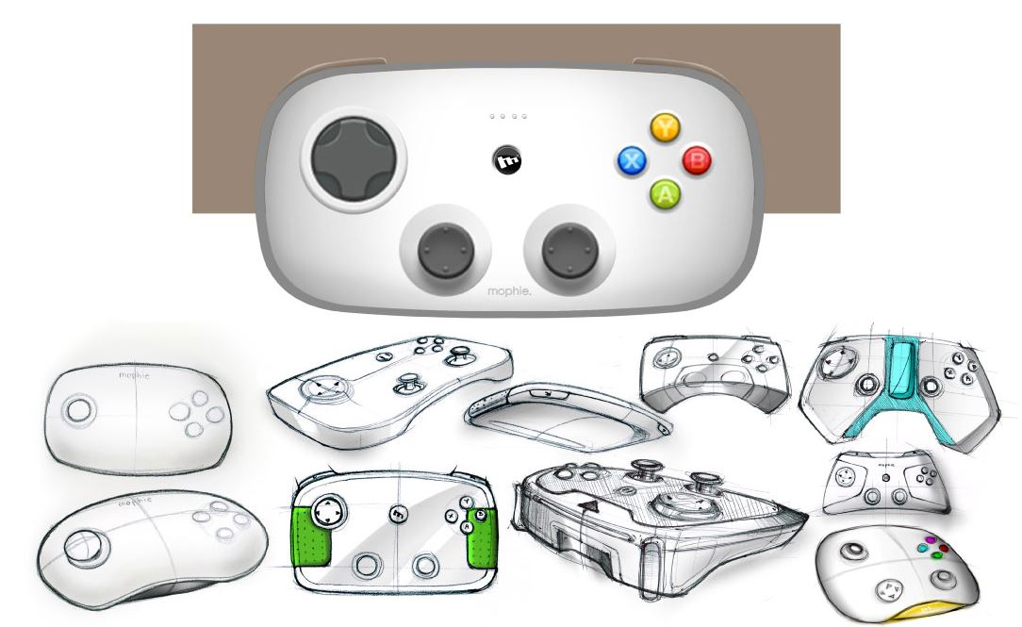
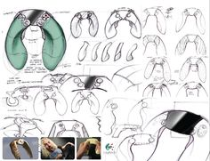
Design Task:
Gaming Controller
(5)
Exemplar work:

Slide 13
Design Task:
Gaming Controller
(5)
Your work:

Slide 14
MOOCs
Evidence
(6)
Evidence your progress: notes and/or screenshots

