Slide 1
Year 1 required practical revision
Starter
Define what the following practical key terms mean:
Independent variable
Dependent variable
Controlled variable
Control variable
Repeatable
Reproducible
Valid
Accurate
Precise
Systematic Error
Random Error

Slide 2
Accurate
Aspire: To be able to explain how to make experiments more valid using the correct keyword.
Challenge: To be able to recall the definitions of practical keywords.
A measurement result is considered accurate if it is judged to be close to the true value.

Slide 3
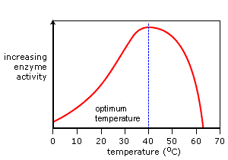
Accurate
Aspire: To be able to explain how to make experiments more valid using the correct keyword.
Challenge: To be able to recall the definitions of practical keywords.
How could you make these results more accurate?

Slide 4
Accurate
Aspire: To be able to explain how to make experiments more valid using the correct keyword.
Challenge: To be able to recall the definitions of practical keywords.
How could you make these results more accurate?
Repeat the experiment at smaller temperature intervals.

Slide 5
Precise
Aspire: To be able to explain how to make experiments more valid using the correct keyword.
Challenge: To be able to recall the definitions of practical keywords.
Precise measurements are ones in which there is a very little spread about the mean value. You can have precise measurements when all of your measurements are very close together, but that doesn’t mean that your readings are accurate.

Slide 6
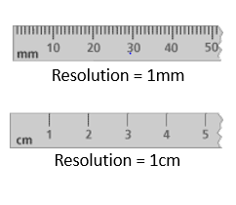
Precise
Aspire: To be able to explain how to make experiments more valid using the correct keyword.
Challenge: To be able to recall the definitions of practical keywords.
The top ruler is more precise not more accurate.
This is because it has a higher resolution.

Slide 7
Resolution
Aspire: To be able to explain how to make experiments more valid using the correct keyword.
Challenge: To be able to recall the definitions of practical keywords.
The smallest change in the quantity being measured of a measuring instrument that gives a perceptible change in the reading.

Slide 8
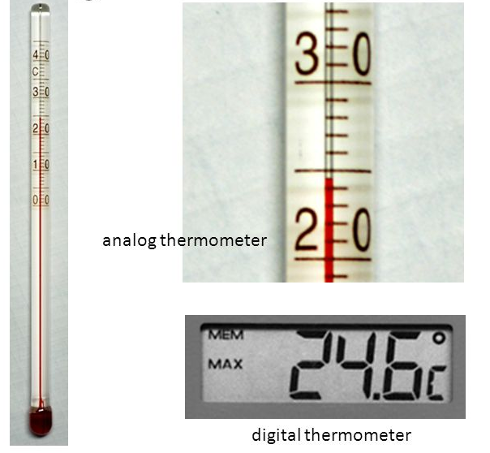
Precise
Aspire: To be able to explain how to make experiments more valid using the correct keyword.
Challenge: To be able to recall the definitions of practical keywords.
Which is the most precise piece of equipment?
Why?

Slide 9
Precise
Aspire: To be able to explain how to make experiments more valid using the correct keyword.
Challenge: To be able to recall the definitions of practical keywords.
Which is the most precise piece of equipment?
The digital thermometer because it has a higher resolution.

Slide 10
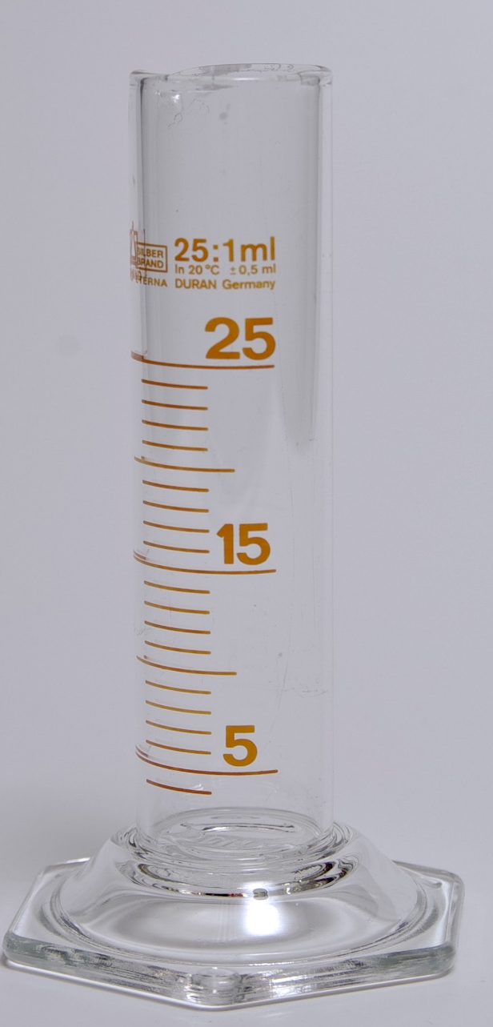
Resolution
Aspire: To be able to explain how to make experiments more valid using the correct keyword.
Challenge: To be able to recall the definitions of practical keywords.
What is the resolution of this measuring cylinder?

Slide 11
Resolution
Aspire: To be able to explain how to make experiments more valid using the correct keyword.
Challenge: To be able to recall the definitions of practical keywords.
What is the resolution of this measuring cylinder?
1 ml

Slide 12
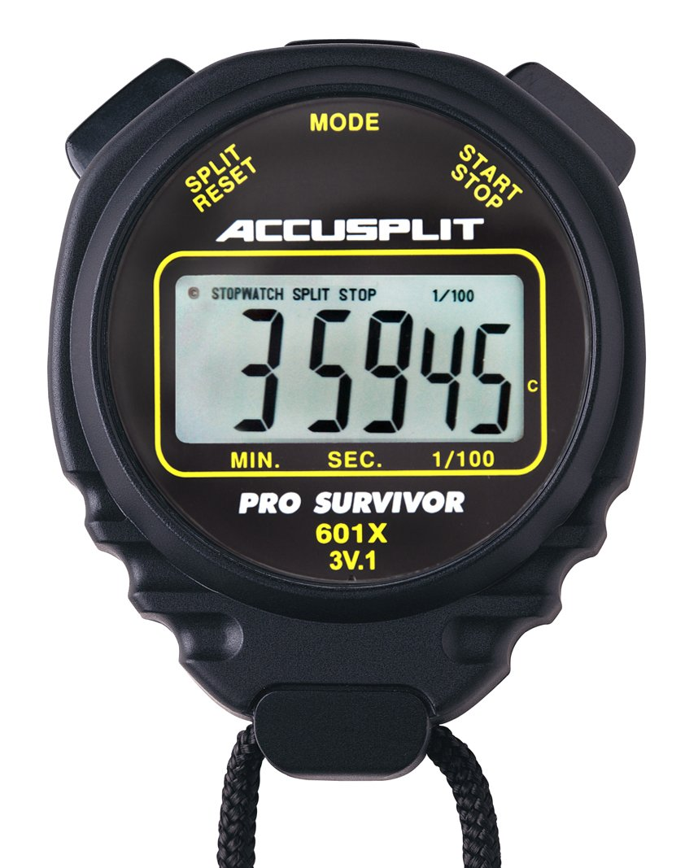
Resolution
Aspire: To be able to explain how to make experiments more valid using the correct keyword.
Challenge: To be able to recall the definitions of practical keywords.
What is the resolution of this stopwatch?

Slide 13
Resolution
Aspire: To be able to explain how to make experiments more valid using the correct keyword.
Challenge: To be able to recall the definitions of practical keywords.
What is the resolution of this stopwatch?
1/100th of a second

Slide 14
Validity
Aspire: To be able to explain how to make experiments more valid using the correct keyword.
Challenge: To be able to recall the definitions of practical keywords.
An experiment with valid results is one in which we trust their conclusions. Only the independent variable has been allowed to affect the dependent one. All other variables have been carefully controlled.

Slide 15
Control Variables
Aspire: To be able to explain how to make experiments more valid using the correct keyword.
Challenge: To be able to recall the definitions of practical keywords.
Why do you need a control variable?

Slide 16
Control Variables
Aspire: To be able to explain how to make experiments more valid using the correct keyword.
Challenge: To be able to recall the definitions of practical keywords.
Why do you need a control variable?
To compare to the factor you are investigating.
To check no other factor is influencing the result.

Slide 17
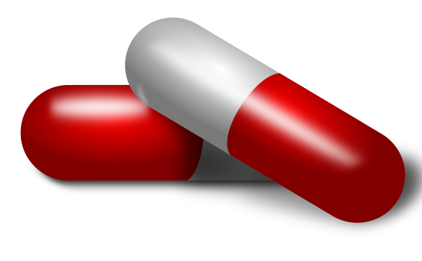
Validity
Aspire: To be able to explain how to make experiments more valid using the correct keyword.
Challenge: To be able to recall the definitions of practical keywords.
What should you control in this experiment?
Children who were ill with high body temperatures were identified at doctors’ surgeries.
These children were put into two groups.
Group 1: 50 children were given paracetamol.
Group 2: 50 children were given ibuprofen.

Slide 18
Validity
Aspire: To be able to explain how to make experiments more valid using the correct keyword.
Challenge: To be able to recall the definitions of practical keywords.
What should you control in this experiment?
Age of the children
Gender of the children
body mass of the children
number in each group / 50 children
high body temperature/starting temperature
dose / amount of drug given

Slide 19

Repeatable
Aspire: To be able to explain how to make experiments more valid using the correct keyword.
Challenge: To be able to recall the definitions of practical keywords.
YOU can do the experiment again (with the same equipment) and get the same results/conclusion.
(The same doesn’t have to mean identical results – it could mean the same pattern.)

Slide 20
Repeatable
Aspire: To be able to explain how to make experiments more valid using the correct keyword.
Challenge: To be able to recall the definitions of practical keywords.
How would you know if your experiment was repeatable?

Slide 21
Repeatable
Aspire: To be able to explain how to make experiments more valid using the correct keyword.
Challenge: To be able to recall the definitions of practical keywords.
How would you know if your experiment was repeatable?
Repeat it, using the same equipment, and see if you get the same conclusion.

Slide 22
If you did a field sample and you took 4 quadrats of results, is that repeatable?

Slide 23
Reproducible
Aspire: To be able to explain how to make experiments more valid using the correct keyword.
Challenge: To be able to recall the definitions of practical keywords.
SOMEONE ELSE can do the same experiment (possibly with different equipment) and get the same result/conclusion.
(The same doesn’t have to mean identical results – it could mean the same pattern.)

Slide 24
Reproducible
Aspire: To be able to explain how to make experiments more valid using the correct keyword.
Challenge: To be able to recall the definitions of practical keywords.
How would you know if your experiment was reproducible?

Slide 25
Reproducible
Aspire: To be able to explain how to make experiments more valid using the correct keyword.
Challenge: To be able to recall the definitions of practical keywords.
How would you know if your experiment was reproducible?
Compare your results to someone else’s results, investigating the same independent and dependent variables, and see if you get the same conclusion.

Slide 26
Errors
Aspire: To be able to explain how to make experiments more valid using the correct keyword.
Challenge: To be able to recall the definitions of practical keywords.
Random Errors affect just one or two results. They are usually caused by a measuring mistake or a brief change in a control variable.

Slide 27
Errors
Aspire: To be able to explain how to make experiments more valid using the correct keyword.
Challenge: To be able to recall the definitions of practical keywords.
Random Errors affect just one or two results. They are usually caused by a measuring mistake or a brief change in a control variable.
How could you reduce the effect of a random error?

Slide 28
Errors
Aspire: To be able to explain how to make experiments more valid using the correct keyword.
Challenge: To be able to recall the definitions of practical keywords.
How could you reduce the effect of a random error?
Repeat the readings. Calculate a mean, ignoring any anomalies.

Slide 29
Errors
Aspire: To be able to explain how to make experiments more valid using the correct keyword.
Challenge: To be able to recall the definitions of practical keywords.
Systematic Errors affect a whole set or all of the results. A systematic error is usually caused by either a zero error on a measuring device or a fault in the method.

Slide 30
Errors
Aspire: To be able to explain how to make experiments more valid using the correct keyword.
Challenge: To be able to recall the definitions of practical keywords.
Systematic Errors affect a whole set or all of the results. A systematic error is usually caused by either a zero error on a measuring device or a fault in the method.
How could you reduce the effect of a systematic error?

Slide 31
Errors
Aspire: To be able to explain how to make experiments more valid using the correct keyword.
Challenge: To be able to recall the definitions of practical keywords.
How could you reduce the effect of a systematic error?
Re-zero or recalibrate the equipment.

Slide 32
Year 1 practicals: topics 1 and 2
Investigate the effect of caffeine on heart rate of Daphnia
Investigating vitamin C content of food and drink
Investigate membrane structure, including the effect of alcohol concentration or temperature on membrane permeability
Investigate the effect of enzyme and substrate concentrations on the initial rates of reactions

Slide 33
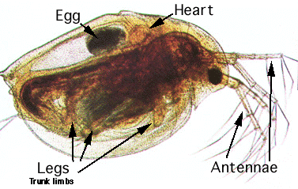
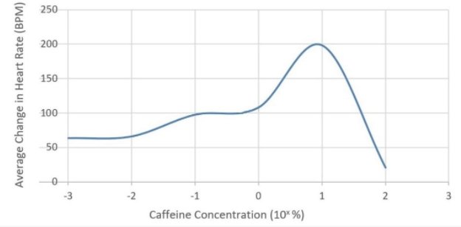
Investigate the effect of caffeine on heart rate of Daphnia
https://www.youtube.com/watch?v=FPX8hO8y6cQ&t=257s
Fill out your revision boxes in your lab book as you watch the video

Slide 34
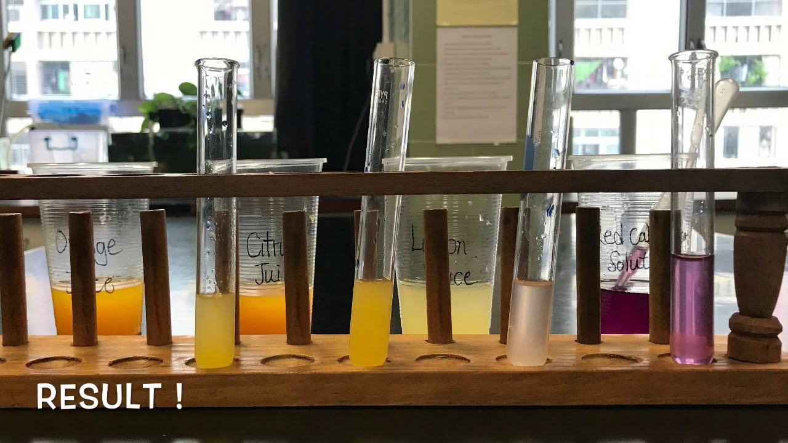
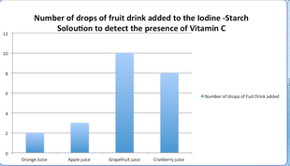
Investigating vitamin C content of food and drink
https://www.youtube.com/watch?v=oI33svVr82U
Fill out your revision boxes in your lab book as you watch the video

Slide 35
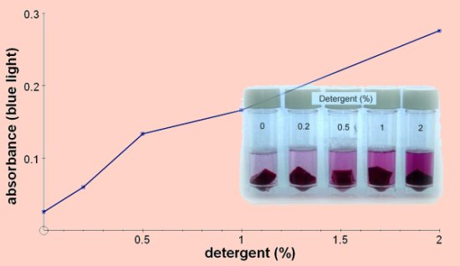
Investigate membrane structure, including the effect of alcohol concentration or temperature on membrane permeability
https://www.youtube.com/watch?v=UzwOfFvLtJ0
Fill out your revision boxes in your lab book as you watch the video

Slide 36
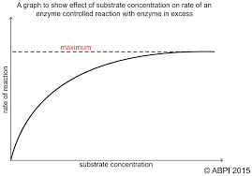
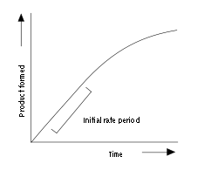
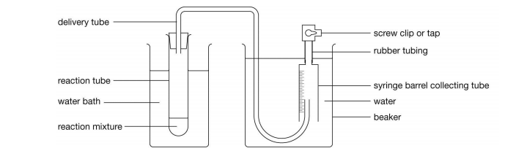
Investigate the effect of enzyme and substrate concentrations on the initial rates of reactions
https://www.youtube.com/watch?v=rABpkD42Ap4
Fill out your revision boxes in your lab book as you watch the video

Slide 37
Exam question circus on the core practicals from topics 1 and 2
5 mins per question station in pairs

Slide 38
What rules do we need to remember when answering core practical exam questions?

