Slide 1
Year 1 required practical revision – topics 3 and 4
Starter: Articulate
Independent variable
Dependent variable
Controlled variable
Control variable
Repeatable
Reproducible
Valid
Accurate
Precise
Systematic Error
Random Error

Slide 2
Year 1 practicals: topics 3 and 4
Prepare and stain a root tip squash to observe the stages of mitosis
Identify sclerenchyma fibres, phloem sieve tubes and xylem vessels and their location within stems through a light microscope
Investigating plant mineral deficiencies
The strength of plant fibres
Investigate the antimicrobial properties of plants, including the aseptic techniques for the safe handling of bacteria

Slide 3
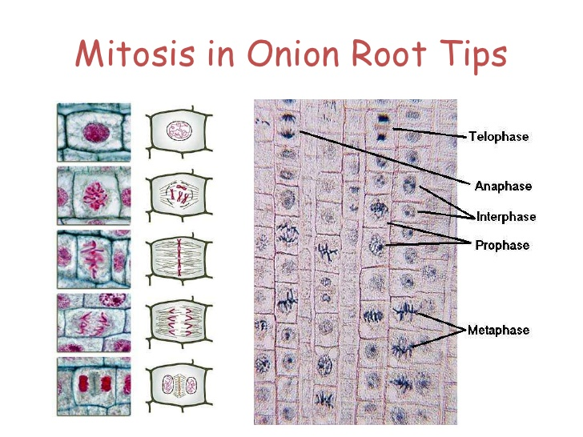
Core Practical 5: Prepare and stain a root tip squash to observe the stages of mitosis
https://www.youtube.com/watch?v=K2_FZRdjQH4
Fill out your revision boxes in your lab book as you watch the video

Slide 4
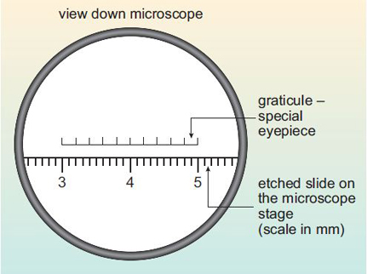
Core Practical 6: Identify sclerenchyma fibres, phloem sieve tubes and xylem vessels and their location within stems through a light microscope
https://www.youtube.com/watch?v=aWu0kbtymBY (graticules)
Fill out your revision boxes in your lab book as you watch the video
https://www.open.edu/openlearn/science-maths-technology/biology/introduction-microscopy/content-section-2.3
(includes an example)
Extra challenge = limitations and biological conclusions!

Slide 5
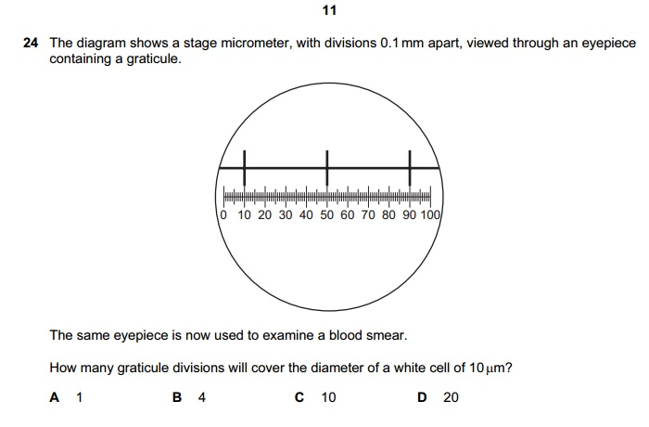

Slide 6
0.1 mm = 100um
10um goes into 100um x 10 times
40 graticule units covers 100um.
So 40/10 = 4 graticule units

Slide 7
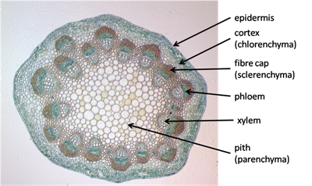
Core Practical 6: Identify sclerenchyma fibres, phloem sieve tubes and xylem vessels and their location within stems through a light microscope
https://www.youtube.com/watch?v=lVt_ACnSgOE (stem arrangement of vascular bundles – check)
Fill out your revision boxes in your lab book as you watch the video
Extra challenge = limitations and biological conclusions!

Slide 8
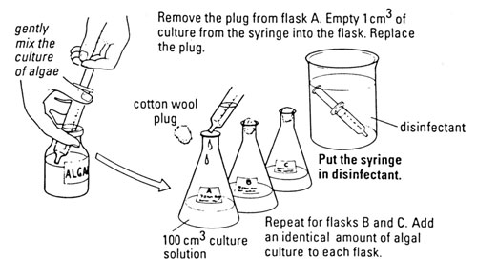
Core Practical 7: Investigating plant mineral deficiencies
https://www.youtube.com/watch?v=wepm47NXQUs&list=PLDM1f5SYgr96GbZM_PlRIvsVEvZxfU2_f&index=7
Fill out your revision boxes in your lab book as you watch the video
Extra challenge = limitations and biological conclusions!

Slide 9
Core practical 8: The strength of plant fibres
https://www.youtube.com/watch?v=bCc2WAsYSZ4&list=PLDM1f5SYgr96GbZM_PlRIvsVEvZxfU2_f&index=7&t=0s
Fill out your revision boxes in your lab book as you watch the video
Extra challenge = limitations and biological conclusions!

Slide 10
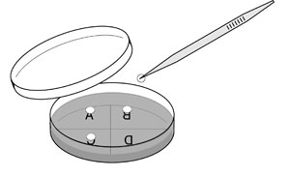
Core practical 9: Investigate the antimicrobial properties of plants, including the aseptic techniques for the safe handling of bacteria
https://www.youtube.com/watch?v=lGtWG28sKUg&list=PLDM1f5SYgr96GbZM_PlRIvsVEvZxfU2_f&index=13
Fill out your revision boxes in your lab book as you watch the video
Extra challenge = limitations and biological conclusions!

Slide 11
Exam question on the core practicals from topics 3 and 4
Warm: Use revision guides and textbooks to help you
Hot: Try the exam questions using your current knowledge to assess what you know
Scorching: Look at the student’s answers and guess the examiner’s comments

Slide 12
Before you start use CUBE to help you understand the questions:
C = circle the command words
U = underline the subject specific words
B = box the tricky words
E = eliminate any words that aren’t important
Look up the definitions of any words that you don’t understand.

Slide 13
What rules do we need to remember when answering core practical exam questions?

