Slide 1
Do Now:
Who is the prime minister?
Who is the leader of the opposition?
Who is the leader of the Liberal Democrats?
Who is the leader of Reform?
Who is the leader of the Greens
Challenge:
Give one argument in favour and one against giving 16-18 year olds the right to vote

Slide 2
Answers
Keir Starmer.
Kemi Badenoch
Ed Davey
Nigel Farage
5. Zak Polanski
Challenge:
Give one argument in favour and one against giving 16-18 year olds the right to vote
Politics affects young people – tuition fees, they can join the military at 17, age of consent is 16
They do not pay tax, polls indicate most young people have little interests in politics

Slide 3
What will I be studying and how will I be assessed?
Paper 1: UK Politics ad Core Ideologies
Democracy and Participation
Political Parties
Electoral Systems
Voting Behaviour and the Media
Liberalism Conservatism, Socialism
Paper 2: UK Government and Non Core Ideology
The Constitution
Parliament
The PM and Executive
Relations between branches including the UK Supreme Court
Feminism
Paper 3: Comparative Politics: The USA
The Constitution
Congress
The Presidency
The Supreme Court and Race relations
Democracy and Participation
Comparative Politics
Paper 1: 2hr examination
Paper 2: 2hr examination
Paper 3: 2hr examination
No coursework

Slide 4
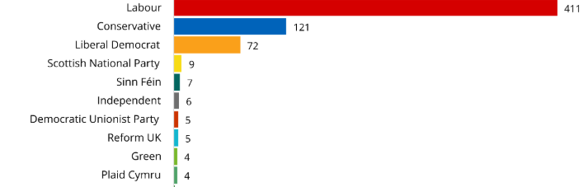
What are the strengths and weaknesses of First Past the Post?
Learning Objectives:
Understand how FPTP works
Identify some of its strengths and weaknesses as an electoral system
Be developing your own view on whether it should be retained
How does it work?
The country is divided into 650 geographical areas called a constituency
Each constituency has an election to decide who will be the Member of Parliament ( MP)
The party that wins the most MPs nationally wins the election and the leader of the party becomes Prime Minister
If a party wins more than 325 out of the 650 seats they have a majority in the House of Commons
TASK 1: Calculate the size of the Labour majority at the 2024 election
What is the size of the Labour majority?
411 – (121+72+9+7+6+5+5+4+4+4+)
174 ( This means they would normally win every vote in the House of Commons)
Green Pen Challenge
What might the size of this majority mean to the power of the Labour government?

Slide 5
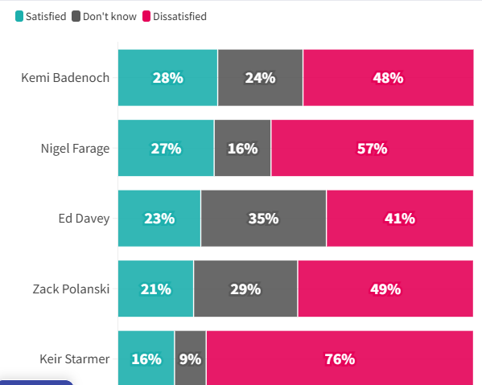
What are the latest leader opinion polls?
What: How can you explain how in May 2024 Starmer won a 174 seat majority and in May 2026 only 16% are satisfied with his performance and 76% are dissatisfied?
How Long One minute
How In Pairs

Slide 6
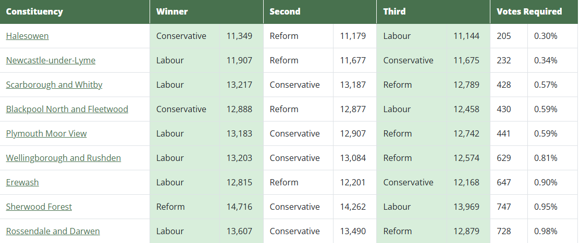
What are the advantages and disadvantages of FPTP
Learning Objectives:
To comprehend the features of FPTP.
To successfully analyse the strengths and weaknesses of FPTP – is it fit for purpose?

Slide 7
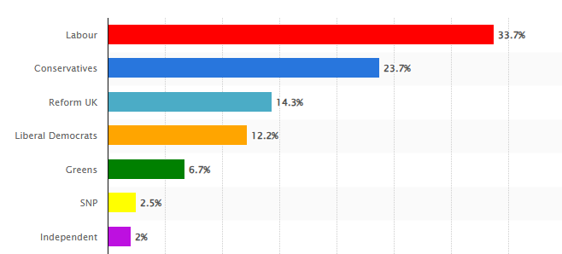
What are the strengths and weaknesses of First Past the Post?
Learning Objectives:
Understand how FPTP works
Identify some of its strengths and weaknesses as an electoral system
Be developing your own view on whether it should be retained
TASK 2: What do you notice about the relationship between the percentage vote share and the percentage of seats in the House of Commons gained by the Labour Party, Lib Dems and Reform? Does it seem fair? Does this help to explain the opinion polls on the previous slide?
Labour get 33.7% vote but 63% of the seats
Lib Dems 12.2 % of the vote but 11% of the seats
Reform get 14.3 % of the vote but 0.7 % of the seats
Green pen Challenge:
How does the SNP get 4.2% less votes than the Green Party but gets over 200% more seats in the House of Commons?

Slide 8

What are the strengths and weaknesses of First Past the Post?
Learning Objectives:
Understand how FPTP works
TASK 3: How does this happen under FPTP?
Imagine a country with five constituencies not 650. In this fictional example there are 5 constituencies and ten voters in each constituency so 50 votes in total. In order to win the election a party needs to win 3 out of the 5 constituencies. Which party wins this election, which comes second, which comes third?
Green Pen Challenge: What do you notice about the overall vote share of each party ? Why could this be seen as unfair?

Slide 9
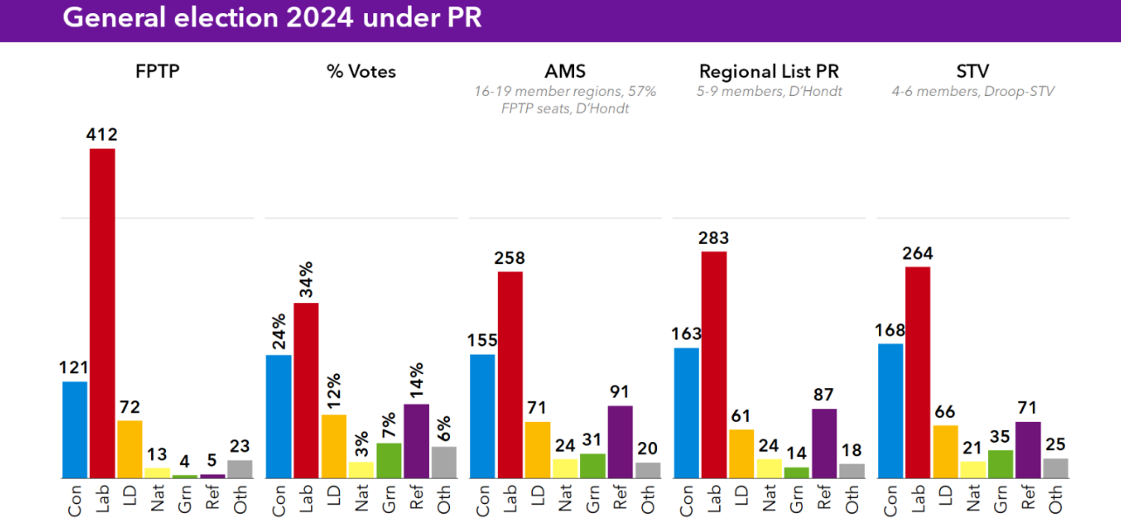
What are the strengths and weaknesses of First Past the Post?
Learning Objectives:
Identify some of its strengths and weaknesses as an electoral system
TASK 4: Below are the 2024 results using more proportional electoral systems – the d’Hondt formula used in many European countries. How are the results different?
Green Pen Challenge?
Why is a coalition government arguably more undemocratic than one elected under FPTPs?

Slide 10
What are the strengths and weaknesses of First Past the Post?
Learning Objective
3. Be developing your own view on whether it should be retained
TASK 4: Based on the information you have would you keep FPTP
Strength: Stable government. FPTP usually produces a clear winner , not a coalition meaning there is a clear line of accountability
But
Weakness: Smaller parties are disadvantaged and the House of Commons does not reflect the way the nation voted
Strength Parties that come third or fourth do not get a share of government that is disproportionate to their vote. There is never a mandate for a coalition government
But
Weakness: Some safe seats have been held by one party for over 50 years. What is the point of voting in these constituencies?
Green Pen Challenge?
Why is a coalition government arguably more undemocratic than one elected under FPTPs?

