Slide 1


ACHIEVING SUCCESS IN THE
SIXTH FORM
Thursday 5 October 2023

Slide 2
Agenda
Sixth form news and results
Key events and priorities in Year 13
Important information related to UCAS
Supporting your child academically
Supporting your child's well-being

Slide 3
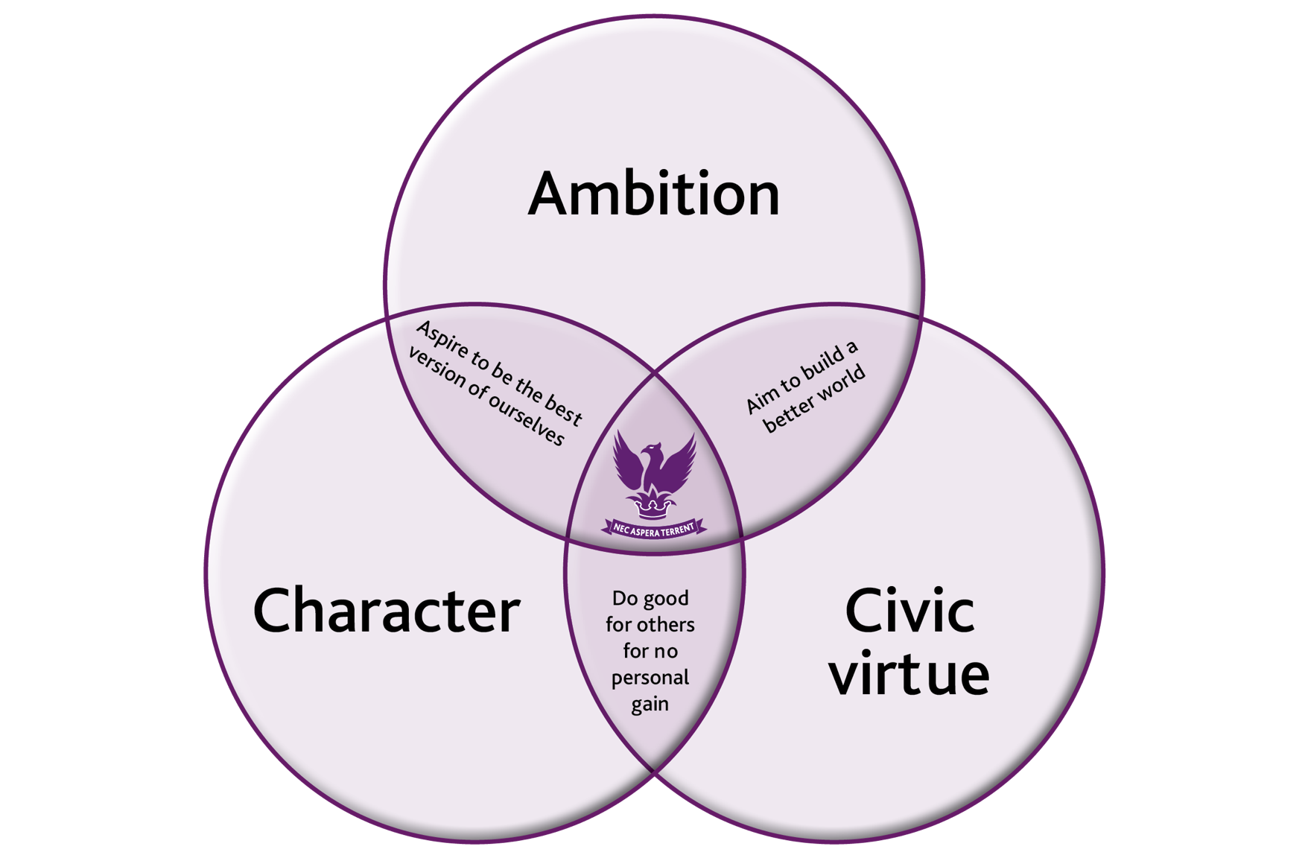

Slide 4
The Sixth Form Intent Statement
To provide a well-rounded, inclusive education where students develop their wider interests and are suitably prepared to succeed in the outside world. Good character, civic virtue and ambition is at the heart, which are proudly modelled to the lower school.

Slide 5
ROLES IN THE SIXTH FORM
Head of Year 13
Ms Venning
Head of Sixth Form
Mr Boniface
Enrichment and Community Service Co-ordinator
Ms H Dhillon
Sixth Form Pastoral Support
Ms J Dhillon
Careers Advisor
Ms Young

Slide 6
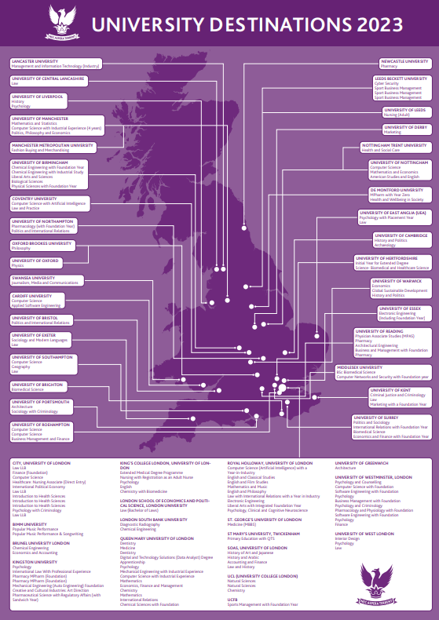
2023 Results
Average grade B
29% A*-A
53% A*-B
3 Oxbridge
34% Russell Group
Degree Apprenticeships

Slide 7
Exciting News…

Slide 8
State of the art Sixth Form Centre being built ready for April 2024

Slide 9
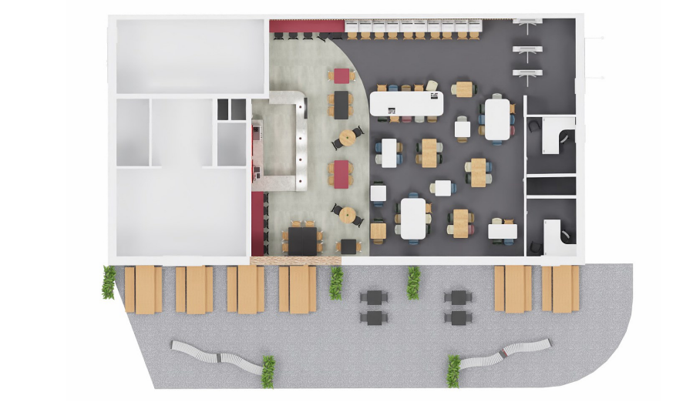
Ground floor –floor plan

Slide 10
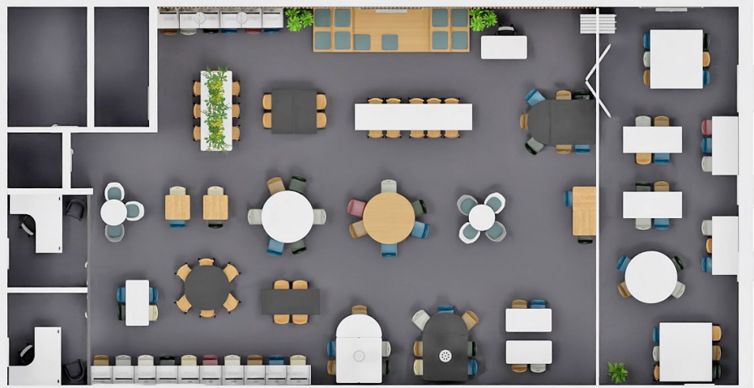
Upper floor – silent study area and flexible meeting space

Slide 11
The Importance of Year 13
Ambition: Achieving academic results to maximise opportunities
Character: Embedding behaviours and habits that determine future success
Civic virtue: Developing young citizens who will make a positive contribution to society; future leaders

Slide 12
Reminder: Important Dates
Event | Dates
January Mock Exams | 09/01/2024 – 19/01/2024
March Mock Exams | 20/03/2024 - 28/03/2024
Summer A Level Exams | Begin on 13/05/2024
A Level Results Day | 15 August 2024
UCAS Early Entry | 15/10/2023
UCAS Standard Entry | First Draft: 15/09/2023 Final Draft: 31/10/2023
Student Finance Applications | Open from February 2024

Slide 13
UCAS Timings
Students have been grouped to allow efficient management of the process and support for all students
Group 1 (early entry) – Friday 13 October
Group 2 - Friday 3 November​
Group 3 - Friday 17 November​
Group 4 - Friday 1 December​
Group 5 - Friday 15 December

Slide 14
Key actions
Personal statement
Students must
Provide a high-quality draft for review
Meet tutor deadlines for submission of drafts
Make edits promptly
Ensure good grammar and punctuation

Slide 15
What Must be Done?
UCAS Portal and choices
Students must
Make sure all sections of the form are completed
Thoroughly research university choices, including entry grades and modules
On completion, make payment and submit

Slide 16
What Must be Done?
Admissions tests (if necessary)
Booked for all students who requested them
Students should prepare independently, but the school will offer support

Slide 17
Predicted Grades
These are UCAS Mock exam results plus one grade
This ensures a level playing field and allows staff to focus on teaching and support

Slide 18
Support in School
Form Tutors, Head of Year, and Head of Sixth Form
Careers Coordinator: UCAS and careers
Mental health support – two dedicated school counsellors
Pastoral Development Programme

Slide 19
Progress
1
2
Ambition
Aspire
Effort
4
3
Action
Accelerate

Slide 20
What is needed for success?
Attendance & punctuality
Exam practice
Organisation
Wider reading
Low stakes testing
Contributions
Enrichment

Slide 21
Academic Support
How you can support your children

Slide 22
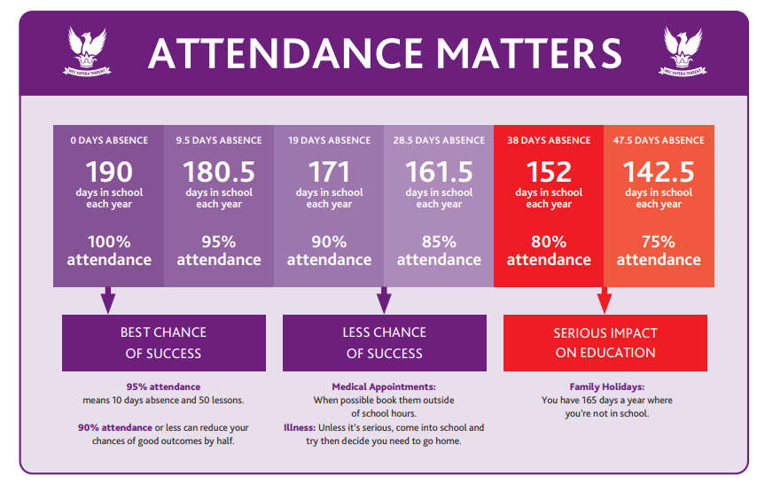
● Students are expected to attend every lesson and Registration on time
● Students should be on site by 8.45am ready for tutor at 8.53am
● Students must use sixth form processes to apply for and report absences

Slide 23

Organisation
Becoming more independent in Sixth Form
Free periods are study periods
Managing workload by being organised – little and often approach
Packing their bag (to include subject ring binders, pencil case & lanyard) & planning what they will wear the night before
Keeping folders organised
Making the right choices

Slide 24
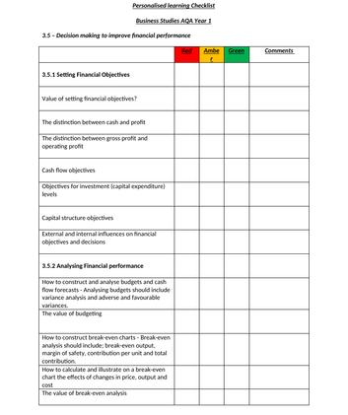
Personalised Learning Checklists (PLCs)

Slide 25
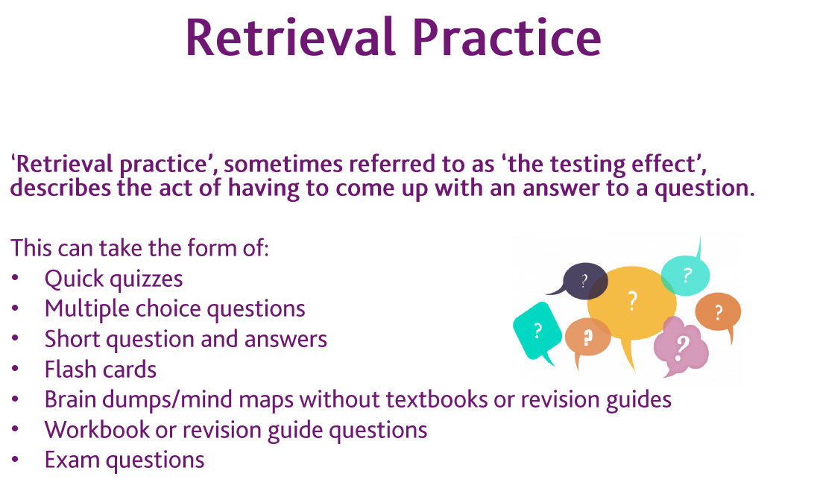

Slide 26
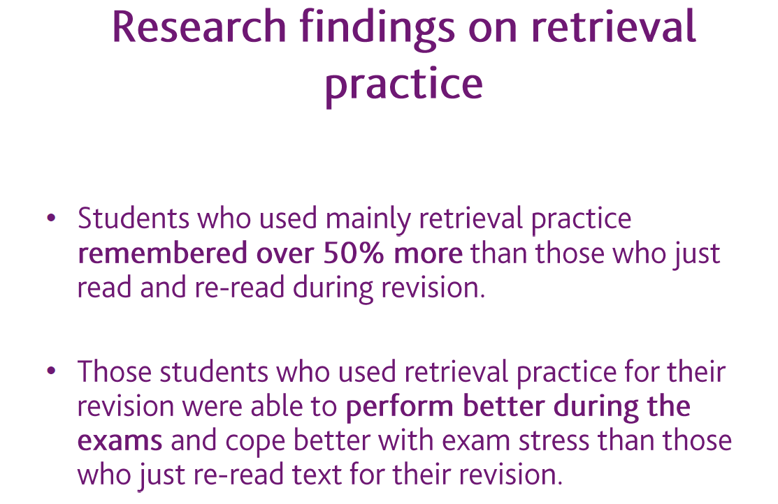

Slide 27
Cornell Note Books
In addition to set homework students should be consolidating their learning by summarising each topic they have learned in their Cornell notebook
This should include key words and concepts, definitions and an overall summary

Slide 28
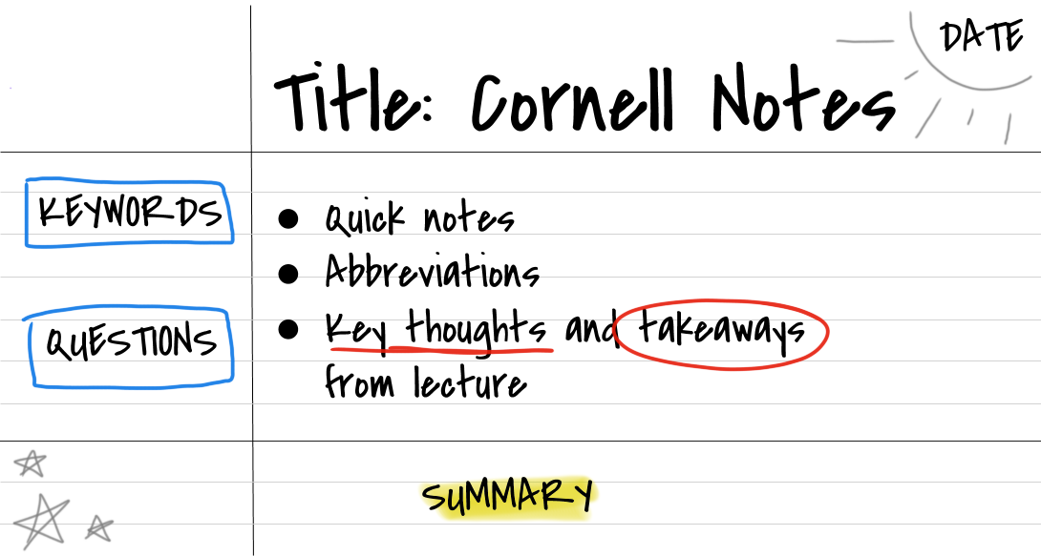

Slide 29
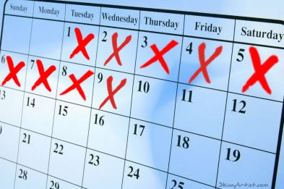
Strategy: Don’t break the chain
‘Don’t Break the Chain’ is a method of success
Research shows that habits can transform any part of our lives
Little & often
Notes:
‘Don’t Break the Chain’ is a method of success originally created by Jerry Seinfield. Jerry placed an X on a calendar for every day he completed writing new material. After a few days a chain of X’s form and the goal is to NOT break the chain by carrying out work for every day of the year.
Research shows that habits can transform any part of our lives. Getting the right habits in place prior to exams can make a huge difference to pupils’ success. The ‘Don’t Break the Chain’ strategy is a constant reminder which can help pupils stay disciplined, be determined and keep motivated.

Slide 30
How can parents support?
Have a calendar displayed for your child to use
Ask them about their progress and plans
Positive daily routines
Be familiar with upcoming deadlines
Notes:
Print off and have a calendar displayed for your child to use. Work with your child to set realistic goals and milestones. Offer them some mini-rewards when they achieve them to help keep them focused and motivated to carry on and succeed.
Encourage and work with your child to get into positive daily routines to keep the chain connected for a few weeks at least. Consistency is the key so encourage your child to keep it simple and manageable. Eventually, routines will become a habit and your child could add in new goals.
Try the ‘Don’t Break the Chain’ habit yourself so you are involved in the challenge as well and can support your child to stay on track. Encourage your child to stay on track using positive reinforcement. Make sure your child reflects on their progress every week or so to see where they are and if they need to change some of the habits they have decided to work on.

Slide 31
How can parents support?
Help your child to get everything ready in preparation for their exam
Students should create a revision timetable and share this with you
Late night revision will not be effective
Encourage your child to have a relaxing evening routine the night before an exam
Notes:
Encourage your child to review their revision and notes, covering topics one by one. Late night revision will not be effective so help your child to refresh themselves with what they need to and then to take a break so they get a good night’s sleep.
Encourage your child to have a relaxing evening routine the night before an exam, which could include eating a good meal (but not to try anything new), reading a book, going for a walk together, doing some exercise or having a bath. Be mindful that your child will be feeling stressed: provide them with comfort and reassurance and support them to be as calm and relaxed as possible.
Help your child to get everything ready in preparation for their exam, such as clothes they need to wear, bag, pens, equipment, revision notes, water bottle, snacks etc. This will eliminate any unwanted stress on the exam day. Make sure your child has a breakfast ready to eat the next day as well.

Slide 32
The Power of Interruptions
Distractions cause a problem at the time of the interruption but then continue to impact your concentration for up to half an hour afterwards
It takes on average around 25 minutes to return concentration to an original task after an interruption
Notes:
You may find that your child is often attempting to multi-task when they are doing their work, whether this is home learning, revision or attending a live lesson or online course. Did you know that it takes on average around 25 minutes to return concentration to an original task after an interruption, according to Gloria Mark who teaches on digital distraction in the USA.
You may find that your child is often attempting to multi-task when they are doing their work, whether this is home learning, revision or attending a live lesson or online course. Did you know that it takes on average around 25 minutes to return concentration to an original task after an interruption, according to Gloria Mark who teaches on digital distraction in the USA.
Distraction also has other downsides – higher stress, lower productivity and a bad mood are some of them according to research. None of this makes you feel good. Your child may be sitting ‘doing work’ for a long period of time but is it ‘deep work’, where they are fully present?

Slide 33
How can parents support?
Encourage your child to put their phone away and not switch between open tabs on the computer.
Ask them to concentrate in short bursts of 30 minutes - where they can get absorbed in their work.
Get them to identify one thing at a time they are working on, not several things at the same time.
Ask them to prioritise what it is they need to do first.
If they want to check social media, make the time to do that separately, perhaps suggest they set a timer so they are aware of the time they are spending.

Slide 34
Strategy: The Power of Sleep
Getting your child into a regular pattern of sleep is very important. Here is what the research says about sleep
It is better than any other performance-enhancing method
It makes us live longer
It improves our creativity
It enhances our memory
It can protect us from illnesses
It makes us considerably happier
It reduces reliance on sugary foods and caffeine
Scientists have found that people who go to bed earlier and sleep for a regular number of hours have less negative thoughts
It is free!
Notes:
Teenagers are often known for sleeping for a long time but perhaps at the ‘wrong’ times. Getting your child into a regular pattern of sleep is very important. Here is what the research says about sleep:

Slide 35
How can parents support?
Screens turned off and out of the bedroom an hour before bed
A routine that helps wind down before sleeping
A regular bedtime and ‘getting up’ time routine so that their body has a pattern
No caffeine late at night (including energy drinks)
A way of recording distracting thoughts - perhaps get them to write down what they are concerned about in a book next to their bed, so they are not dwelling on it all night.

Slide 36
How can parents support?
Listen to your child about subjects they are interested in or may struggle with.
Give your child the best advice you can and teach them that failure is a stepping stone to success.
Positively encourage your child and take an interest in their learning.
Notes:
Listen to your child about subjects they are interested in or may struggle with. Share thoughts with each other about how they may succeed and what they enjoy about different subjects. Try not to be openly negative about subjects which you didn’t enjoy or struggled with yourself.
Give your child the best advice you can and teach them that failure is a stepping stone to success. Give your children examples of things you have failed at but have overcome in your life. Explain your experiences and highlight that some subjects are challenging but are also fun to learn.
Positively encourage your child and take an interest in their learning. The key is to support them to develop a positive mind-set and passion for learning. Even if you found a subject difficult at school, it doesn’t mean that they will.

Slide 37

Strategy: The Night Before Exams
The night before an exam is a stressful time
By the time it is the night before the exam, all revision should have been done.
This is the perfect time for pupils to calm their nerves and make sure that they are ready to enter into their exam, well-rested and confident in their ability.
Notes:
Research shows that the night before an exam is a stressful time and that cramming the night before an exam only leaves pupils feeling frustrated and anxious. Studies show that getting enough rest is vital to consolidate new information, so it is best that pupils get a good night’s sleep and wake up feeling refreshed.
By the time it is the night before the exam, all revision should have been done. This is the perfect time for pupils to calm their nerves and make sure that they are ready to enter into their exam well-rested and confident in their ability.

Slide 38
Important Dates in Year 13
Event | Dates
January Mock Exams | 09/01/2024 – 19/01/2024
March Mock Exams | 20/03/2024 - 28/03/2024
Summer A Level Exams | Begin on 13/05/2024
A Level Results Day | 15 August 2024
UCAS Early Entry | 16/10/2023
UCAS Standard Entry | Group specific deadlines Completed by: 15/12/2023
Student Finance Applications | Open from February 2024

