Slide 1
Year 2 required practical revision – topics 5 and 6
Starter:
If an exam question asked you to describe a method of a required practical what things must your remember to include?

Slide 2
Year 2 required practical revision – topics 5 and 6
Starter:
If an exam question asked you to describe a method of a required practical what things must your remember to include?
Independent variable, its range and how you will change it
Dependent and how you will measure it
Named controls and how you will monitor or keep them the same
Number of repeats to get a reliable average (not always just 3!)
Named equipment
How you will use your results to make a conclusion, e.g. how will you plot it on a graph and what stats test will you use?

Slide 3
Year 2 practicals: topics 5 and 6
10. Carry out a study on the ecology of a habitat, including using quadrats and transects to determine distribution and abundance of organisms and measuring abiotic factors appropriate to the habitat.
11. Investigate photosynthesis using isolated chloroplasts (the hill reaction).
12. Investigate the effect of temperature on the initial rate of an enzyme-catalysed reaction, to include Q10.
13. Investigate the effects of temperature on the development of organisms (brine shrimp hatch rate or seedlings growth rate).
14. Use gel electrophoresis to separate DNA fragments of different length.
15. Investigate the effect of different antibiotics on bacteria

Slide 4
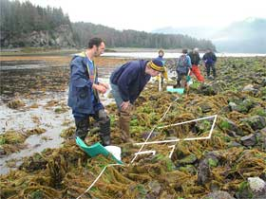
Core practical 10: Carry out a study on the ecology of a habitat, including using quadrats and transects to determine distribution and abundance of organisms and measuring abiotic factors appropriate to the habitat
https://www.youtube.com/watch?v=UDp3I07Wcrg
Fill out your revision boxes in your lab book as you watch the video
Extra challenge = limitations and biological conclusions!

Slide 5
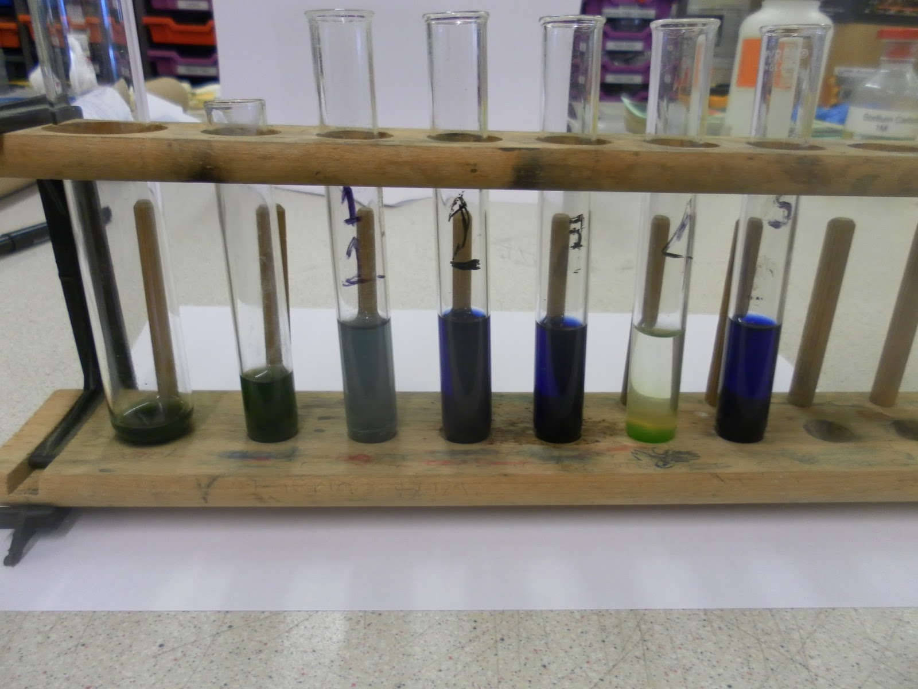
Core practical 11: Investigate photosynthesis using isolated chloroplasts (the hill reaction).
https://www.youtube.com/watch?v=i9_h3TSIJzM
Fill out your revision boxes in your lab book as you watch the video
Extra challenge = limitations and biological conclusions!

Slide 6
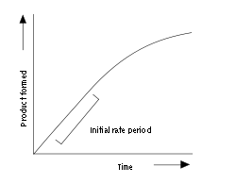
Core practical 12: Investigate the effect of temperature on the initial rate of an enzyme-catalysed reaction, to include Q10.
https://www.youtube.com/watch?v=JIN6CM6FQQY
Fill out your revision boxes in your lab book as you watch the video
Extra challenge = limitations and biological conclusions!

Slide 7
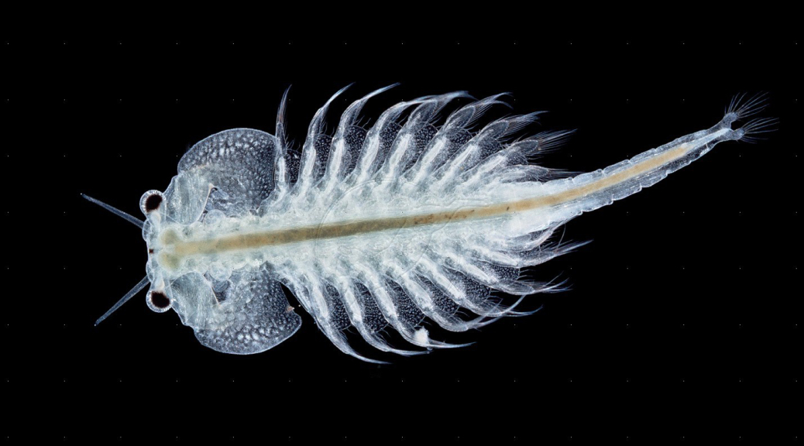
Core practical 13: Investigate the effects of temperature on the development of organisms (brine shrimp hatch rate or seedlings growth rate).
https://www.youtube.com/watch?v=l7hj6vAaojM
Fill out your revision boxes in your lab book as you watch the video
Extra challenge = limitations and biological conclusions!

Slide 8
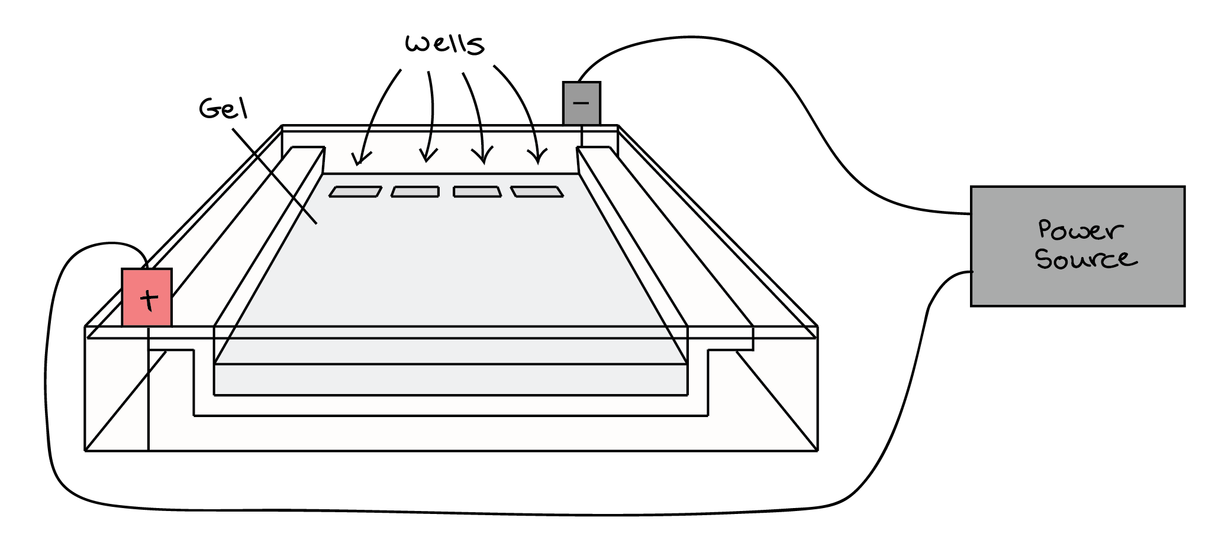
Core practical 14: Use gel electrophoresis to separate DNA fragments of different length.
https://www.youtube.com/watch?v=kjJ56z1HeAc
Fill out your revision boxes in your lab book as you watch the video
Extra challenge = limitations and biological conclusions!

Slide 9
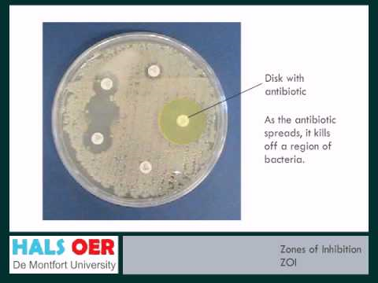
Core practical 15: Investigate the effect of different antibiotics on bacteria
https://www.youtube.com/watch?v=hcjbm_iHcgo
Fill out your revision boxes in your lab book as you watch the video
Extra challenge = limitations and biological conclusions!

Slide 10
Exam question on the core practicals from topics 5 and 6
Warm: Use revision guides and textbooks to help you
Hot: Try the exam questions using your current knowledge to assess what you know
Scorching: Look at the student’s answers and guess the examiner’s comments

Slide 11
Before you start use CUBE to help you understand the questions:
C = circle the command words
U = underline the subject specific words
B = box the tricky words
E = eliminate any words that aren’t important
Look up the definitions of any words that you don’t understand.

Slide 12
What rules do we need to remember when answering core practical exam questions?

