Slide 1
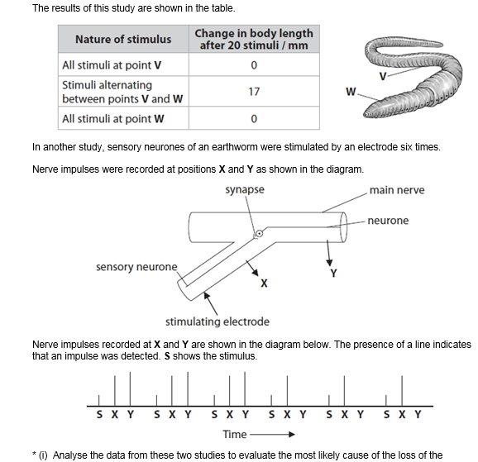
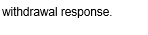
Year 2 required practical revision – topics 7 and 8
What does analyse mean?
What information do you need to include in your answer?
What does * mean?
Look at the student answers from the examiner’s report and guess which is the best answer and why

Slide 2
Definitions of analyse
Take apart an idea, concept or statement and examine and
criticise its sub-parts in detail. You have to be methodical and
logical.
Separate information into components and identify their characteristics

Slide 3
Year 2 practicals: topics 7 and 8
16. Investigate rate of respiration
17. Investigate the effects of exercise on tidal volume, breathing rate, respiratory minute ventilation and oxygen consumption using data from spirometer traces.
18. Investigate the habituation to a stimulus

Slide 4
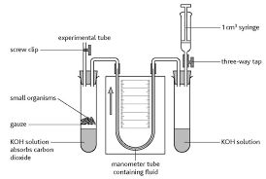
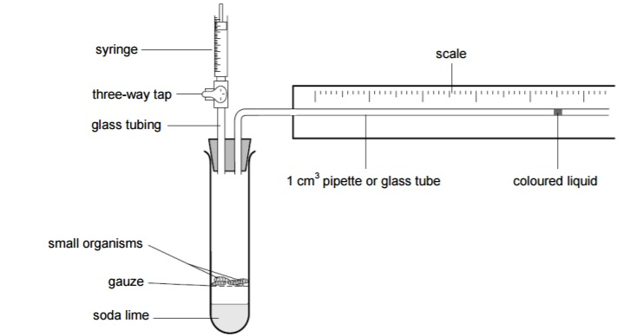
Core practical 16: Investigate rate of respiration
https://www.youtube.com/watch?v=Q7i4BgRdRnc
Fill out your revision boxes in your lab book as you watch the video

Slide 5
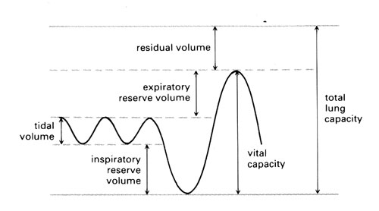
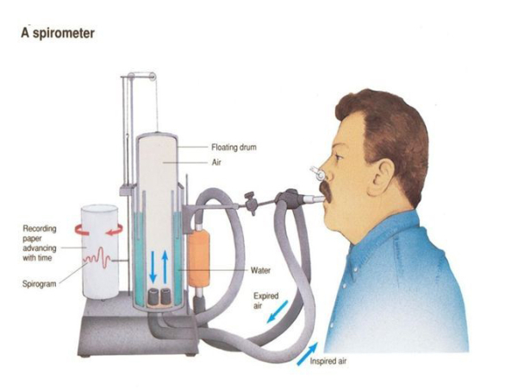
Core practical 17: Investigate the effects of exercise on tidal volume, breathing rate, respiratory minute ventilation and oxygen consumption using data from spirometer traces.
https://www.youtube.com/watch?v=UNvDwYdTFDs
Fill out your revision boxes in your lab book as you watch the video

Slide 6
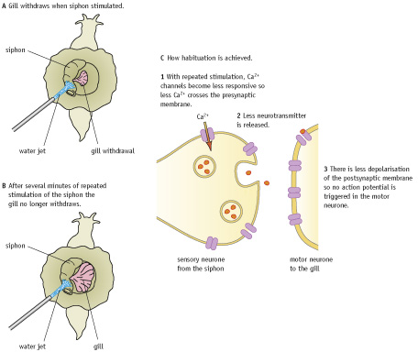
Core practical 18: Investigate the habituation to a stimulus
https://www.youtube.com/watch?v=caAnMK4kxqU
Fill out your revision boxes in your lab book as you watch the video

Slide 7
Exam question circus on the core practicals from topics 7 and 8
5 mins per question station in pairs

Slide 8
What rules do we need to remember when answering core practical exam questions?

